Slide 1




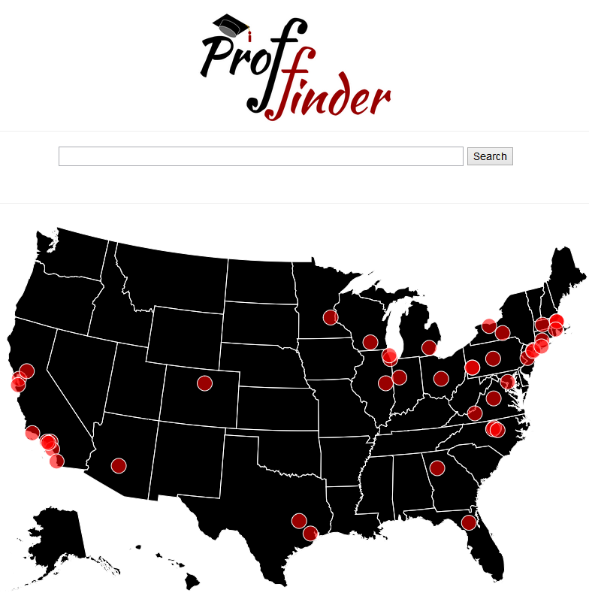
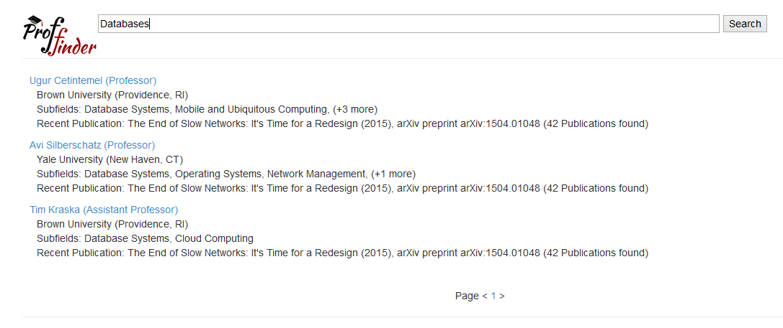
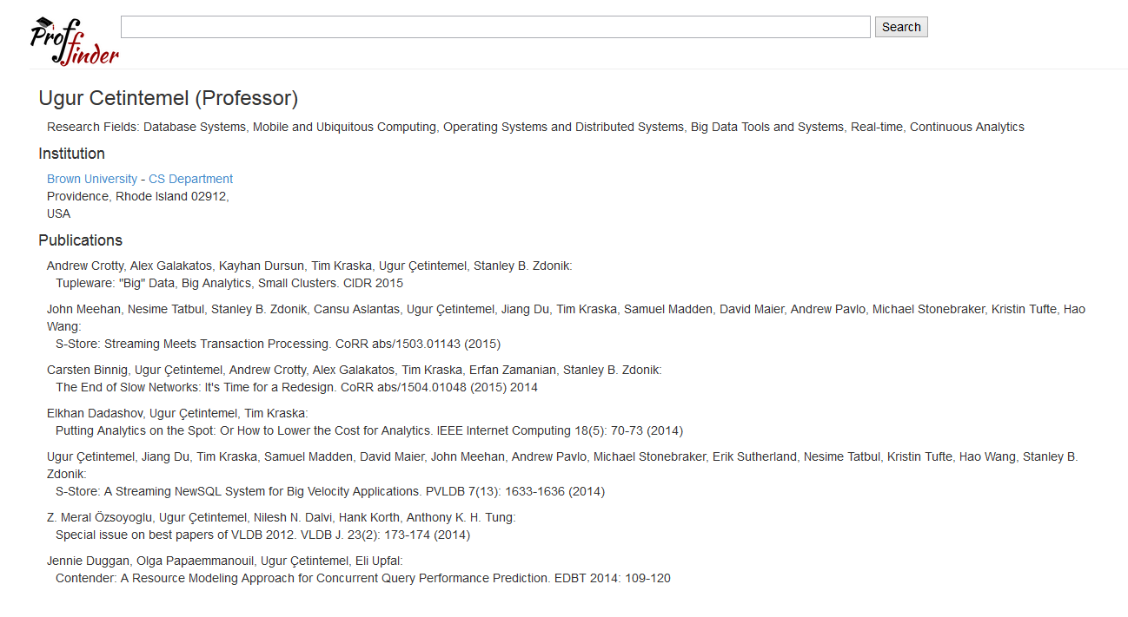

“Find the right professor for you”
Yeounoh Chung | Scott Houde | Johannes Novotny | Erfan Zamanian
yeounoh_chung@brown.edu | scott_houde@brown.edu | johannes_novotny@brown.edu | erfanz@cs.brown.edu
Goal: To provide an intuitive web site merging three main data sets together that allows potential applicants to find the right Computer Science doctoral program for them.
Citation Network Dataset¹
Faculty Professor Dataset
Integrated Postsecondary Education Data System (IPEDS)⁴
Extracted from DBLP, ACM and other citation sources, contains more than 4,354,534 citations. We reduced this down by faculty and transformed paper abstracts into a TF/IDF format.
Generated as part of a class assignment contains 2,195 faculty from 55 different universities.² We enhanced this by adding a generated faculty ID and existing Institution ID.³
Every US Institution is required to submit this data every year to the government. Highly accurate but required filtering and interpretation. We used Python scripts to reduce the data down to institution ID’s and award levels we are interested in.
Unique Faculty ID’s
Entity resolution was tricky and not all professors were in the dataset!
IPEDS Institution ID’s
TF/IDF Data
Final Dataset
All Tables by Institution ID
For every unigram and bigram in every abstract for our faculty we store the term, the faculty ID and the frequency, sorted from most frequent to least.
General Institution fields
Faculty Name, Institution, Sub-Field, Join Year, PhD earned Inst, etc…
Current Enrollment by student level, gender and race
Computer Science doctoral completions, for multiple years
Visualization and Interactive Search
Main Page
Search Results
Faculty Detail
1) Jie Tang, Jing Zhang, Limin Yao, Juanzi Li, Li Zhang, and Zhong Su. ArnetMiner: Extraction and Mining of Academic Social Networks. In Proceedings of the Fourteenth ACM SIGKDD International Conference on Knowledge Discovery and Data Mining (SIGKDD'2008). pp.990-998. | 2) Analysis of Over 2,000 Computer Science Professors at Top Universities , http://jeffhuang.com/computer_science_professors.html
3) Postsecondary Institutional Codes crosswalk table http://www.pesc.org/interior.php?page_id=145 | 4) National Center of Education Statistics, http://nces.ed.gov/ipeds/datacenter/DataFiles.aspx

