Slide 1








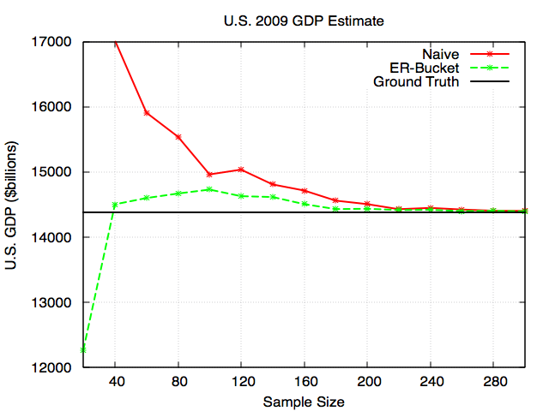
“Find the right professor for you”
Yeounoh Chung | Scott Houde | Johannes Novotny | Erfan Zamanian
yeounoh_chung@brown.edu | Scott_houde@brown.edu | Johannes_novotny@brown.edu | Erfan_zamanian@brown.edu
Goal: To create an easy to use web based search tool that combines three major data sets that allows prospective doctoral applicants to find the right computer science professor and university for them.
Can You Trust Your Query Results?
Techniques From Biological Species Estimation
Source A
Query
Observed
Sample
Unobserved
Population
Sampling with replacement
Sampling w/o replacement
Source B
Integrated Data Set
Unknown biological species estimation
Unknown data item estimation
Source C
{ A, A, Z, H, G, B, A, C, F, F, J, C, A, B, … }
{ A, A, Z, H, G, B, A, C, F, F, J, C, A, B, … }
Source D
Answer
{ A, H, Z,
B, F }
{ M, C, B,
D, F, J }
•••
{ A, F, Z, B,
H, L, E }
Fig. Typical Analytics Process Pipeline
“What is the total revenue of the restaurants on the east coast serve clam chowder?”
Chao92 Species Estimator:
N
N
K
H
A
K
H
A
E
We want to build a complete data set for your queries
by integrating multiple data sources, but …
E
L
L
G
R
C
* Requires sampling with replacement
I
G
R
C
I
B
F
M
B
F
M
Z
J
Z
J
O
D
O
D
How complete is the integrated data set?
What impact does the unknown data have on the result?
Fig. sampling model for species estimation / unknown data items estimation
The key idea is that the overlap between different data sources enable us to estimate the number of unknown data items.
Our goal is to estimate the number of unknown data items and their values.
1
2
Impact of The Unknown on Aggregation Query
3
4
Simulation Result and Future Work
Table. Known
SELECT SUM(Revenue) FROM Restaurant WHERE Region = ‘East Coast’ AND Clam_Chowder = ‘Yes’;
Restaurant | Region | Revenue | Clam_Chowder
Pirate | Mid West | 10,000 | Yes
King Crab | West Coast | 20,000 | Yes
Red Lobster | East Coast | 30,000 | Yes
Antonio’s Pizza | East Coast | 40,000 | No
We can adjust the aggregation query result using the average over known items and the unknown item count (i.e. Naïve).
But, we can do better by estimating the impact of the unknown items on different value ranges (i.e. ER-Bucket).
Φ: Aggregation Sum Query
Table. Unknown
Restaurant | Region | Revenue | Clam_Chowder
? | ? | ? | ?
Fig. simulation result for U.S. states GDP sum
Account for the impact of the unknown using the average value of the known data items and the number of the unknown data items.
How can we estimate the values of the unknown data items more precisely?

