Slide 1
Lock Management with RDMA
Yeounoh Chung, Erfan Zamanian
Instructor: Prof. Stan Zdonik

Slide 2
What it is about
Lock Management
Concurrent access control
Different types of locks (e.g., SHARED, EXCLUSIVE)
Client
Client
LM
Server
Client
Client
Notes:
This project is about lock management, so lets start by reminding ourselves what lock management is. Lock is a mechanism for concurrency control, and by enforcing every client to acquire a lock before touching the associated data item, we can maintain the consistency of the states of the system or the data items.

Slide 3
What it is NOT about
Not about : how to handle failures
Not about : transactions
A simple lock on shared resources
Not about : other essential components of DS
PAXOS
Designing “Lock Management” with RDMA.

Slide 4
A simple lock on shared resources
Two steps: request, release (with ACKs).
Client
LM
Server
Request(type )
Server CPU cycles for …
Message processing
Lock handling
ACK (granted)
Release(type)
Multiple clients per LM server …
ACK (released)

Slide 5
RDMA
“Direct memory access from the memory of one computer into that of another” wiki
without involving either one's operating system.
Minimum (or no) involvement of CPU
Low-latency, high-throughput
Communication types:
Send/Receive (similar to socket read() and write())
Direct Read/Write
Atomic operations (similar to CPU compare-and-swap() and fetch-and-add())

Slide 6
RDMA Meets Lock Management
Client
Server
lock(file_x)
wait
wait
wait
wait
wait
do_something(file_x)
.
.
release_lock()
request lock
.
receive_lock_request(client1, file_x)
Wait_(client1, file_x)
.
grant_lock(client1, file_x)
.
.
.
receive_release_request(client1, file_x)
Waiting time
grant lock
Holding time
release
With RDMA
Lower latency lower contention rate
If Waiting time >> holding time
Raises the likelihood of contention
Server becomes the bottleneck
More busy with message handling than the actual job
With RDMA
Less overhead on server
Overhead distributed over clients

Slide 7
Server Centric LM
Client
LM
Server
Item 1
C5, Sh
Client
Client
Client N
Thread N
. . .
 | Granted to | Waiting
Item 1 | C5 (SH)
…
Item M | C7 (EX)
Item M
C7, Ex

Slide 8
Server Centric LM
Client
LM
Server
Item 1
C5, Sh
C1, Sh
Client
Client
Client N
Thread N
. . .
 | Granted to | Waiting
Item 1 | C5 (SH), C1 (SH)
…
Item M | C7 (EX) | C9 (SH), C11 (SH)
Item M
C7, Ex
C9, Sh
C11, Sh

Slide 9
Server Centric LM
Client
LM
Server
Item 1
C5, Sh
C1, Sh
Client
Client
Client N
Thread N
. . .
 | Granted to | Waiting
Item 1 | C5 (SH), C1 (SH)
…
Item M | C7 (EX) | C9 (SH), C11 (SH)
Item M
C7, Ex
C9, Sh
C11, Sh
Release reqeust fromt C7

Slide 10
Server Centric LM
Client
LM
Server
Item 1
C5, Sh
C1, Sh
Client
Client
Client N
Thread N
. . .
 | Granted to | Waiting
Item 1 | C5 (SH), C1 (SH)
…
Item M | C9 (SH), C11 (SH)
Item M
C9, Sh
C11, Sh

Slide 11
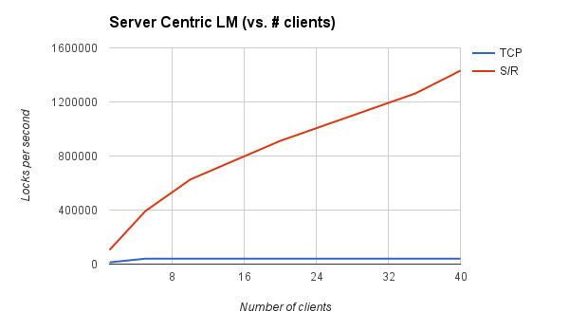
Server Centric LM
LPS upper bound =
(3*10^9 cycles / (sec * core)) * 40 cores / server
( 10^4 cycles / msg * 4 msg )
= 3,000,000 LPS / server
Notes:
100 items, 50-50 shared - exclusive

Slide 12
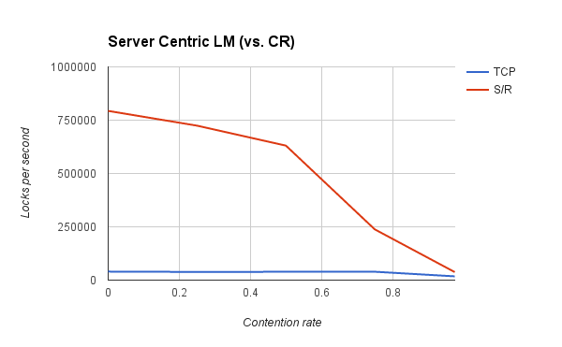
Server Centric LM
Contention Rate = (1-#items/#clients)
Notes:
40 clients, 50-50 shard – exclusive locks

Slide 13
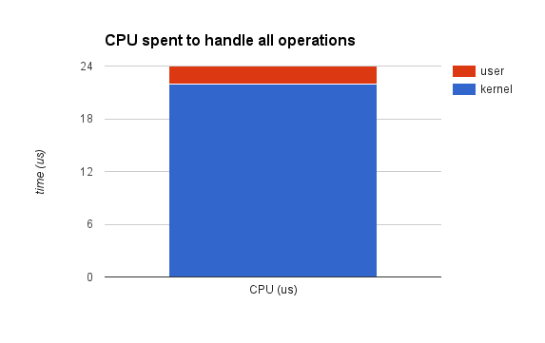
Server Centric LM
TCP: CPU utilization ~ 91%
Notes:
40 clients, 50-50 shard – exclusive locks

Slide 14
Simple RDMA Design
Extreme design ➔ use RDMA as much as possible
Basic Idea:
Server is oblivious
Each lock “i” has a corresponding memory buffer buff_{i}
Clients compete to get the lock ownership
By “register”-ing themselves as the owner
Use atomic operations
to deal with concurrent requests

Slide 15
Atomic Operations
64-bit memory buffer
CS(12, 19)
12
Compare and Swap (CS)
* expected value
* swap value
- Return the old value
12
CS(167, 19)
19
Fetch and Add (FA)
* add value
- Returns the old value
12
FA(2)
2

Slide 16
Server’s memory organization
Server
32-bit
32-bit
Lock items
X
S
Item 1
0
0
Item 2
0
0
.
.
Exclusive lock holder ID
# Shared lock requests
Item n
0
0
All lock items are initialized to (0|0)

Slide 17
Exclusive Lock Algorithm
Succeeded
0
0
C_id
0
Lock(X, client_id)
CS(0, client_id | 0)
Failed
X
S
X
S
Succeeded
0
0
C_id
0
Retry(X, client_id)
CS(0, client_id | 0)
Failed
X
S
X
S
Release(X, client_id)
WRITE(0, buffer_{X})
X
S
0
S

Slide 18
Shared Lock Algorithm
Lock(S, client_id)
FA(1)
Succeeded
X
S
X
S+1
Retry(X, client_id)
READ(buffer_{X})
Release(S, client_id)
FA(-1)
X
S
X
S-1

Slide 19
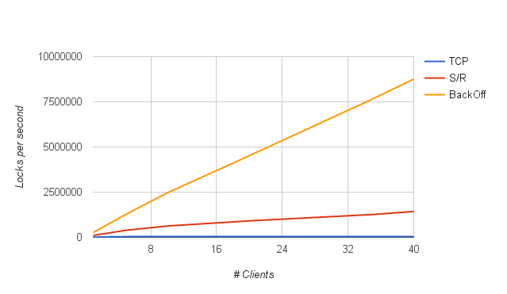
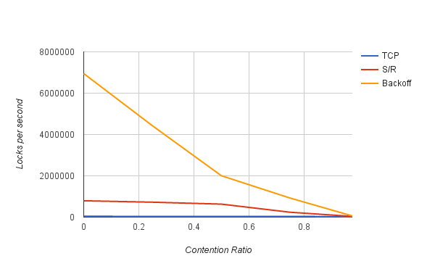
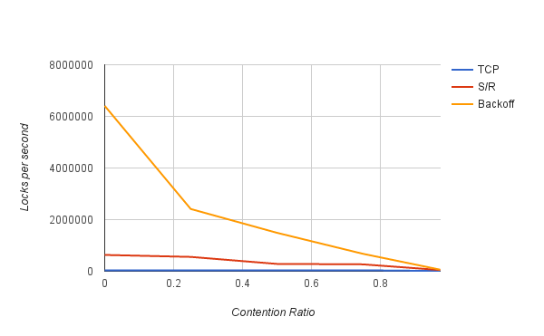
Putting everything together
Mix workload(50-50)
Mix workload(50-50)
All Exclusive

Slide 20
Conclusion
RDMA helps…
Server centric LM can scale up!
But, re-designing LM is much better!
Future work
Hybrid design
Distributed lock item queues

