Slide 1
NEURALFIELDMANIFOLD
From torus geometry to behavior
What the rebuttal experiments tell us - and what they do not
Mouse EEG sleep staging | Macaque reach-direction decoding
NeurIPS rebuttal experiments - application section
NeuralFieldManifold | Applications
1
Notes:
SLIDE 1: From torus geometry to behavior
SCRIPT
Kasra has shown the theoretical connection between sustained oscillatory modes and toroidal lag geometry. My part asks the next empirical question: once we recover that geometry, does it carry information about what the brain and animal are doing? The rebuttal gave us two tests: sleep staging across a full day of mouse EEG and six-way reach-direction decoding from macaque motor-cortex LFP.
TAKEAWAY
The application section asks whether the recovered geometry carries behaviorally useful information.
TRANSITION
I will start with the concrete questions raised during review.
IF CHALLENGED
If asked why decoding matters: it is a proof-of-concept behavioral readout, not the primary claim of the paper.
DELIVERY CUE
Pause after the title, then explicitly connect to Kasra's theory section.

Slide 2
MOTIVATION
Reviewers asked for evidence beyond a single decoding panel
01
02
03
BASELINES
GENERALIZATION
NEW TASK
Does the decoding gap survive explicit spectral baselines, cross-validation, and error bars?
Is the result stable across recording hours and separately in each animal?
Can the method decode repeated reaching movements from motor-cortex LFP?
The rebuttal became a stress test of behavioral utility, reproducibility, and claim precision.
NeuralFieldManifold | Motivation
2
Notes:
SLIDE 2: Reviewers asked for evidence beyond a single decoding panel
SCRIPT
The reviewers did not simply ask for a larger number. They asked whether the result survives a fully specified baseline, whether it is stable across independent recording units, and whether the same idea works in a repeated motor task. Those requests shaped every analysis I will show.
TAKEAWAY
The new experiments test rigor and scope, not just performance.
TRANSITION
First, here is the common evaluation framework used across both datasets.
IF CHALLENGED
If asked which reviewer prompted what, use the backup evidence matrix; the live story is organized by scientific question.
DELIVERY CUE
Keep the slide conversational and do not read every label.

Slide 3
METHODS
Both datasets use the same conservative decoding logic
WINDOW
FEATURES
DECODER
REPORT
Task-aligned or 2 s signal segment
>
Single band | Average PSD | All bands | Torus
>
Balanced, stratified 5-fold LDA
>
Macro F1; SD across sessions or LFPs
STATISTICAL UNIT
TEST
MULTIPLICITY
Matched session or LFP
Paired Wilcoxon
Holm correction
Chance: 0.33 for three sleep stages | 0.17 for six reach directions
NeuralFieldManifold | Methods
3
Notes:
SLIDE 3: Both datasets use the same conservative decoding logic
SCRIPT
For every comparison, we held the decoder fixed and only changed the representation. We balanced the labels, used stratified five-fold LDA, and report macro F1. Error bars are standard deviation across independent sessions for EEG or independent LFP traces for the macaque. Statistical comparisons are paired Wilcoxon tests with Holm correction.
TAKEAWAY
Differences in performance reflect representations, not different classifiers.
TRANSITION
With that framework fixed, the first test is the full-day mouse EEG recording.
IF CHALLENGED
Macro F1 is appropriate because it weights Wake, NREM, and REM equally after balancing and remains interpretable across six reach directions.
DELIVERY CUE
Keep the slide conversational and do not read every label.

Slide 4
MOUSE EEG
Mouse EEG provides a 24-hour repeated-session test
Question
24
Can compact geometry decode sleep stage consistently across recording hours?
one-hour sessions
21
Three classes: Wake, NREM, REM
-
sessions with enough Wake, NREM, and REM
-
Balanced sampling within each hour
-
Same feature definitions and classifier throughout
2-second windows
-
Session is the unit of replication
NeuralFieldManifold | Mouse EEG
4
Notes:
SLIDE 4: Mouse EEG provides a 24-hour repeated-session test
SCRIPT
We converted the full 24-hour cortical EEG recording into 24 one-hour sessions. Twenty-one hours contained at least five windows from each sleep class and entered balanced decoding. This gives us repeated temporal replicates rather than one pooled result.
TAKEAWAY
The EEG analysis tests repeatability across hours, not just average performance.
TRANSITION
The hour-by-hour heatmap shows how stable the representations are.
IF CHALLENGED
The three excluded hours lacked sufficient representation of all three classes; they were marked insufficient rather than forced into cross-validation.
DELIVERY CUE
Keep the slide conversational and do not read every label.

Slide 5
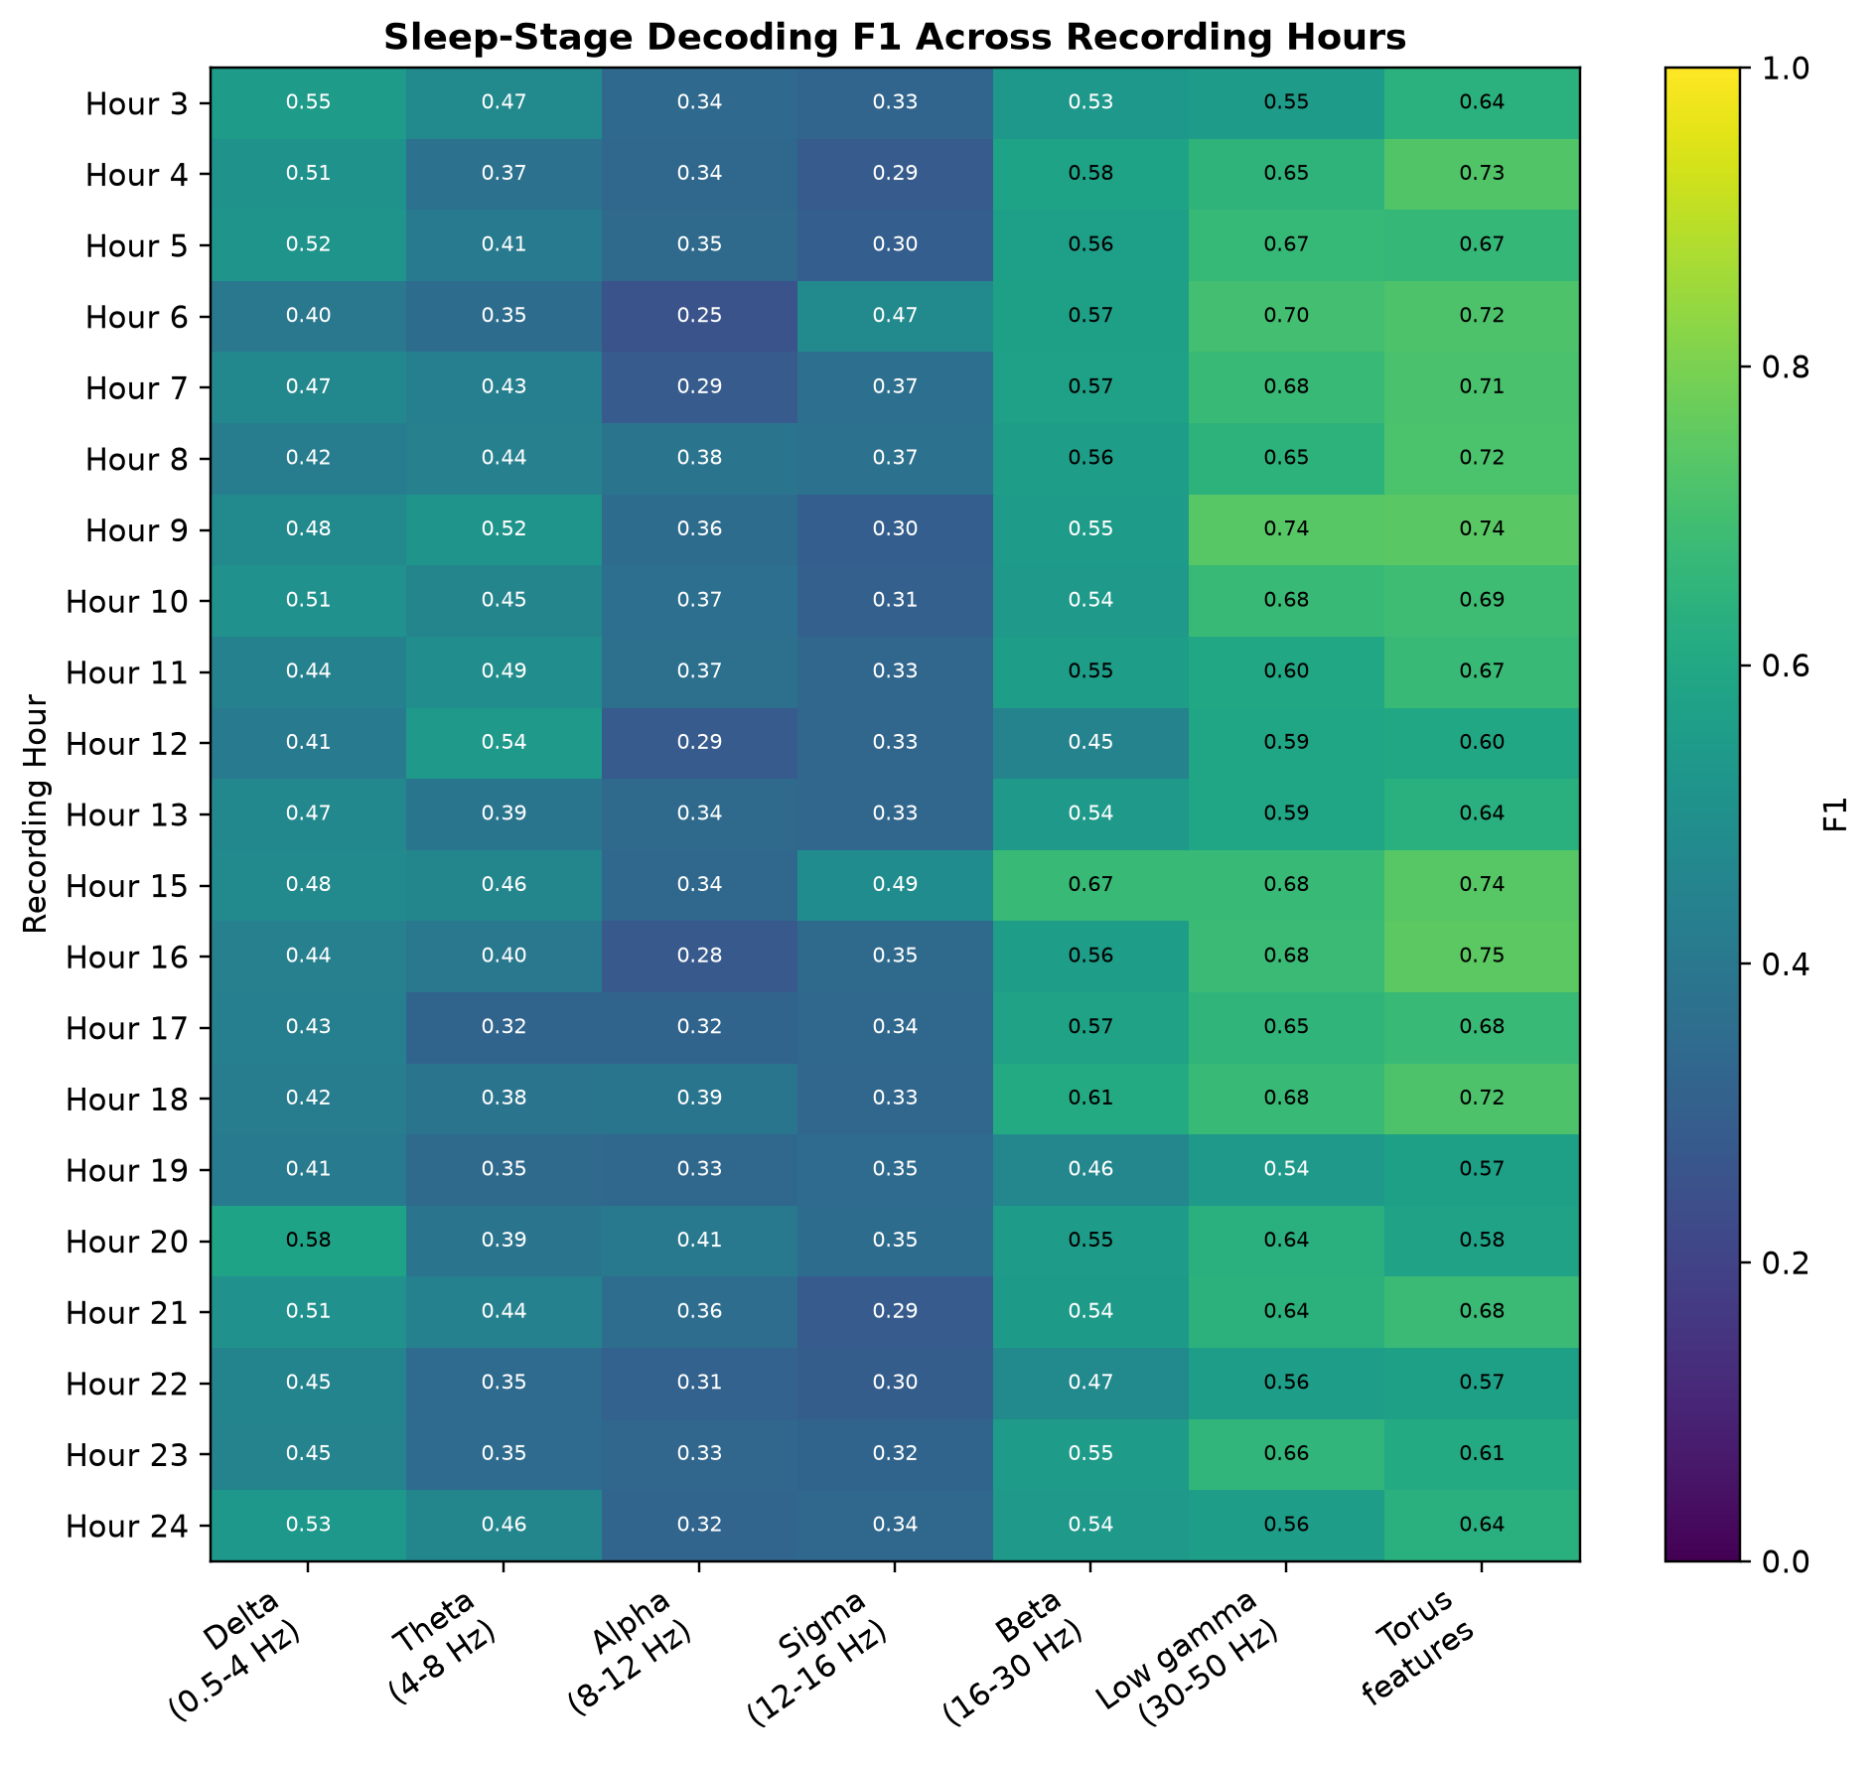
MOUSE EEG
Torus decoding remains stable across recording hours
READOUT
Torus F1 spans approximately 0.57-0.75
Torus exceeds every single band in 17 of 21 held-out hours and ties the strongest band in two more.
Variation is real, but the effect is not carried by one exceptional hour.
NeuralFieldManifold | Mouse EEG
5
Notes:
SLIDE 5: Torus decoding remains stable across recording hours
SCRIPT
Each row is one valid recording hour, and each column is a feature set. The important pattern is not a perfectly flat torus column; it is that torus decoding remains high across hours and is usually stronger than any single frequency band.
TAKEAWAY
The EEG result is distributed across time rather than driven by one session.
TRANSITION
Collapsing across hours lets us compare the compact baselines directly.
IF CHALLENGED
These are within-hour cross-validated F1 values summarized across hours; they should not be described as a train-on-one-hour, test-on-another transfer experiment.
DELIVERY CUE
Keep the slide conversational and do not read every label.

Slide 6
MOUSE EEG
EEG geometry outperforms compact spectral summaries
RELEVANT BAND: DELTA
AVERAGE PSD
TORUS FEATURES
0.470 +/- 0.050 SD
0.485 +/- 0.062 SD
0.670 +/- 0.060 SD
p = 5.72 x 10^-6
p = 5.72 x 10^-6
Geometry improves F1 by 0.200 over delta and 0.185 over Average PSD.
This is the defensible reviewer-facing claim: torus geometry carries information beyond compact spectral summaries.
NeuralFieldManifold | Mouse EEG
6
Notes:
SLIDE 6: EEG geometry outperforms compact spectral summaries
SCRIPT
Across 21 sessions, torus features reach 0.670 +/- 0.060 SD. Delta, our physiologically relevant sleep band, reaches 0.470 +/- 0.050 SD, and a single scalar Average PSD reaches 0.485 +/- 0.062 SD. Both paired differences survive Holm correction at p = 5.72 x 10^-6.
TAKEAWAY
Torus geometry is substantially more informative than delta power or mean broadband PSD alone.
TRANSITION
The next slide is the qualification that keeps this claim honest.
IF CHALLENGED
Relevant band is fixed a priori as delta for sleep; it is not selected after seeing decoder performance.
DELIVERY CUE
Keep the slide conversational and do not read every label.

Slide 7
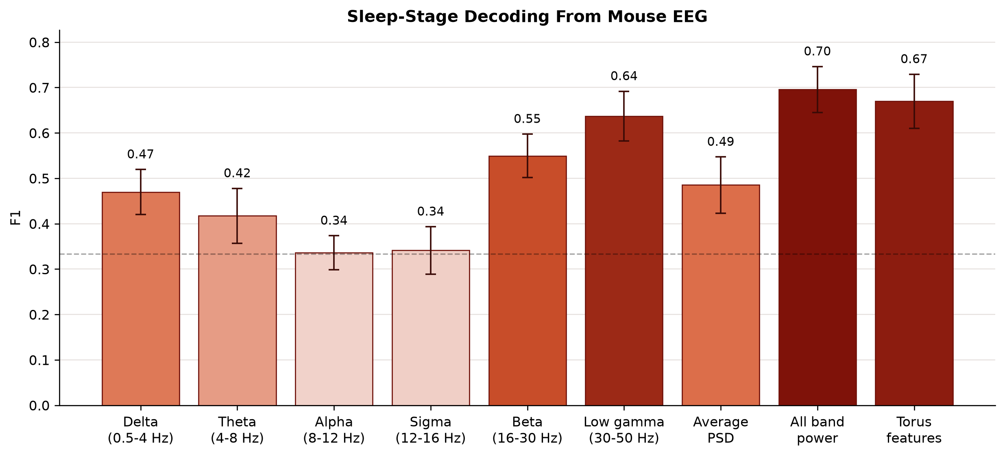
MOUSE EEG
The joint all-band vector is stronger than torus alone
IMPORTANT NUANCE
0.696 +/- 0.051 SD
All-band power combines six band powers in one feature vector.
Claim: geometry complements spectral summaries. Not: geometry universally beats spectral features.
NeuralFieldManifold | Mouse EEG
7
Notes:
SLIDE 7: The joint all-band vector is stronger than torus alone
SCRIPT
When we give the spectral decoder all six band-power values jointly, it reaches 0.696 +/- 0.051 SD, slightly above the torus result. That does not erase the geometry result; it sharpens it. The torus representation beats each single band and Average PSD, but a richer multiband spectral vector remains a strong baseline.
TAKEAWAY
The evidence supports complementary information, not universal spectral dominance.
TRANSITION
We also tested how much of the torus feature set is actually necessary.
IF CHALLENGED
All-band power is a multifeature vector, not the average of the band powers. Its dimensionality and information content are larger than the one-scalar baselines.
DELIVERY CUE
Keep the slide conversational and do not read every label.

Slide 8
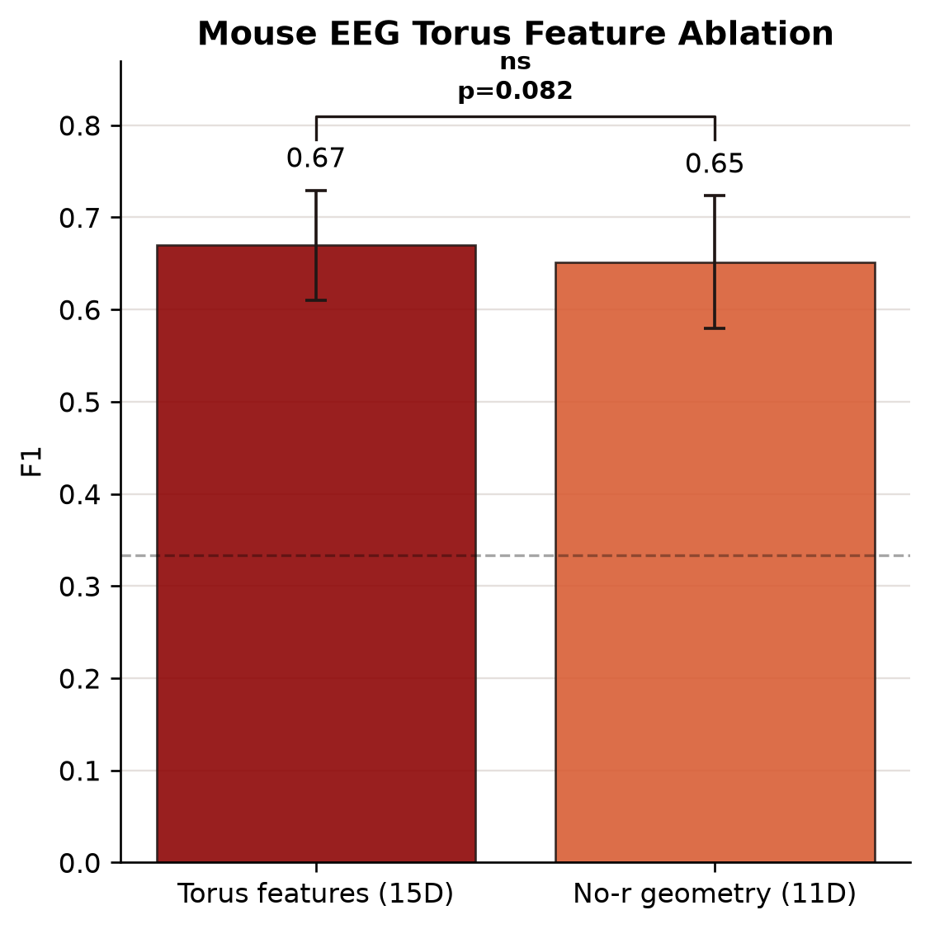
MOUSE EEG
Removing radius-related terms causes a modest, nonsignificant drop
WHAT WAS REMOVED
-
minor radius r
-
fit MSE
-
mean surface error
-
fraction inside
INTERPRETATION
A quick 15D-to-11D feature ablation, not a refitted lower-order model.
NeuralFieldManifold | Mouse EEG
8
Notes:
SLIDE 8: Removing radius-related terms causes a modest, nonsignificant drop
SCRIPT
The complete 15-feature vector reaches 0.670 +/- 0.060 SD; removing radius and tube-quality terms gives 0.651 +/- 0.072 SD. The paired p-value is 0.0822, so the decrease is not statistically reliable. This experiment is deliberately modest: it is a feature ablation, not direct measurement of wrong AR-order recovery.
TAKEAWAY
Radius-related geometry helps numerically, but this shortcut does not establish a significant order effect.
TRANSITION
The second application asks whether the framework extends beyond sleep to repeated reaching.
IF CHALLENGED
Do not label these bars correct-order and incorrect-order model accuracy; both are decoders built from cached geometric features.
DELIVERY CUE
Keep the slide conversational and do not read every label.

Slide 9
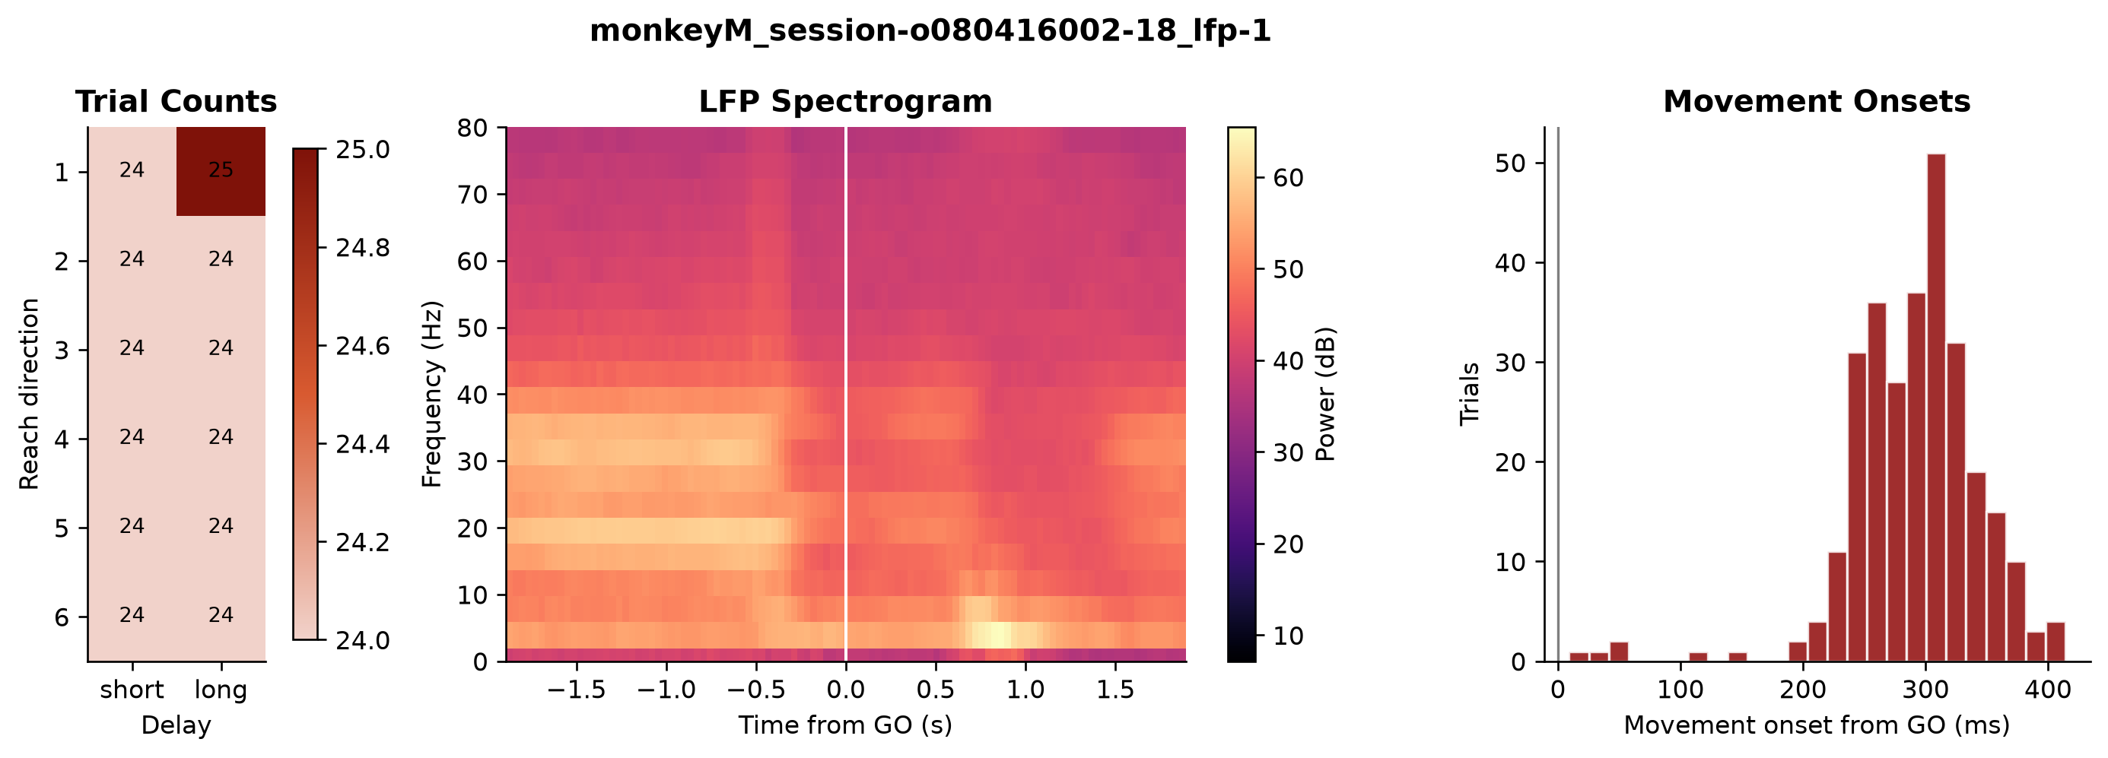
MACAQUE LFP
A reviewer-requested motor task extends the test across species and behavior
DATASET
2 macaques
CONVERTED
341 unique LFPs
MAIN ANALYSIS
237 six-direction LFPs
Decode reach direction from the movement-aligned LFP epoch.
NeuralFieldManifold | Macaque LFP
9
Notes:
SLIDE 9: A reviewer-requested motor task extends the test across species and behavior
SCRIPT
The reviewer specifically asked whether the approach could be applied to periodic trajectories associated with repeated reaching. We used a public motor-cortex LFP dataset from two macaques. The main analysis uses 237 LFP recordings containing all six reach directions and decodes direction from the movement-aligned epoch.
TAKEAWAY
The macaque analysis is a genuinely different task, species, and recording setting.
TRANSITION
Before fitting geometry, we made lag parameters trace-specific rather than imposing one global choice.
IF CHALLENGED
The documented task is six reach directions crossed with short and long delay; the primary decoder target here is six-way direction, not an invented eight-condition label.
DELIVERY CUE
Keep the slide conversational and do not read every label.

Slide 10
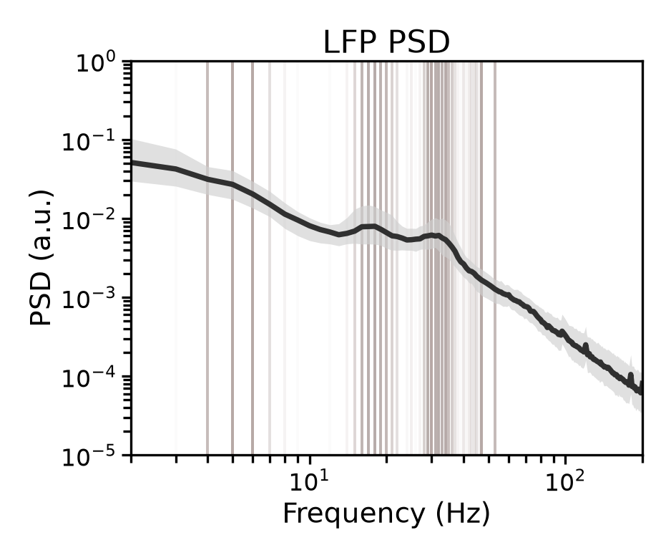
MACAQUE LFP
Lag parameters are estimated independently for each LFP trace
TAU: TEMPORAL SEPARATION
First local minimum of average mutual information, with autocorrelation fallbacks.
DIMENSION: MODE COUNT
Robust PSD peaks after 1/f correction; embedding dimension = 2K + 1, capped at 9D.
Median tau
17 ms
Dimensions
3D to 9D
3D: 34 | 5D: 103 | 7D: 123 | 9D: 81
NeuralFieldManifold | Macaque LFP
10
Notes:
SLIDE 10: Lag parameters are estimated independently for each LFP trace
SCRIPT
For each unique LFP trace, tau comes from the first local minimum of average mutual information, with autocorrelation fallbacks when necessary. The embedding dimension is derived from robust PSD peaks using two coordinates per oscillatory mode plus one, capped at nine dimensions. The median tau is 17 milliseconds, and selected dimensions range from three to nine.
TAKEAWAY
The torus fit is not based on a single arbitrary lag or one global dimension.
TRANSITION
With those unsupervised parameters fixed, we decode the six reach directions.
IF CHALLENGED
The PSD is used to choose the number of embedding coordinates, not to choose the decoder label or optimize F1.
DELIVERY CUE
Keep the slide conversational and do not read every label.

Slide 11
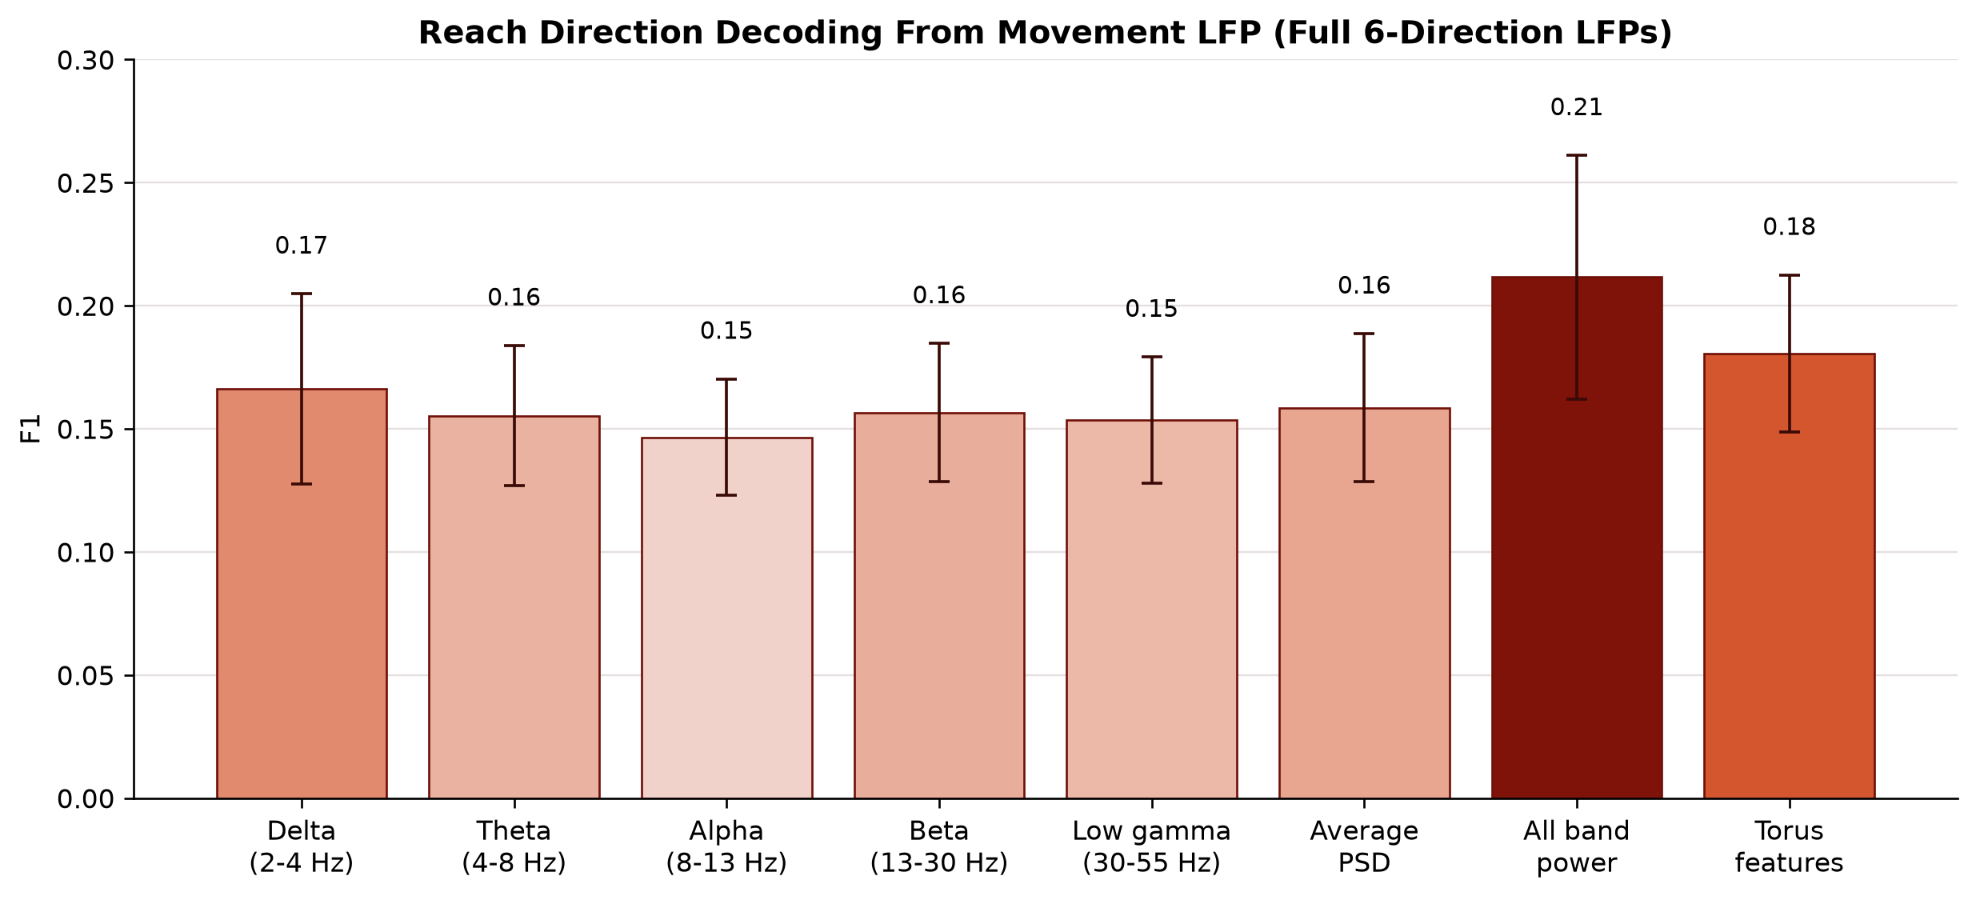
MACAQUE LFP
Torus features decode six reach directions above compact baselines
TORUS FEATURES
0.181 +/- 0.032 SD
RELEVANT BAND: BETA
0.157 +/- 0.028 SD
AVERAGE PSD
0.159 +/- 0.030 SD
Chance F1 approx. 0.17
NeuralFieldManifold | Macaque LFP
11
Notes:
SLIDE 11: Torus features decode six reach directions above compact baselines
SCRIPT
For the 237 full six-direction LFPs, torus features reach 0.181 +/- 0.032 SD. Beta power reaches 0.157 +/- 0.028 SD, and Average PSD reaches 0.159 +/- 0.030 SD. The effect size is modest in absolute terms, as expected for single-channel six-way decoding, but it is consistent across a large number of LFP recordings.
TAKEAWAY
Geometry carries reach-direction information beyond beta power and mean PSD.
TRANSITION
Matched tests quantify how consistently that advantage appears across LFPs.
IF CHALLENGED
Chance is approximately one-sixth, but macro F1 can sit slightly below nominal chance for noisy multiclass predictions; the paired comparisons are the more informative test.
DELIVERY CUE
Keep the slide conversational and do not read every label.

Slide 12
MACAQUE LFP
Small macaque geometry gains are highly consistent
TORUS MINUS BETA
TORUS MINUS AVERAGE PSD
MATCHED UNITS
+0.024 F1
+0.022 F1
237 LFPs
p = 2.32 x 10^-15
p = 2.97 x 10^-13
The small mean difference is highly consistent across independent LFP recordings.
Paired Wilcoxon signed-rank tests; Holm correction across the three planned comparisons.
NeuralFieldManifold | Macaque LFP
12
Notes:
SLIDE 12: Small macaque geometry gains are highly consistent
SCRIPT
The average improvements are about 0.024 F1 over beta and 0.022 over Average PSD. Because these are paired within the same 237 LFPs, we can ask whether the sign and magnitude of the difference are consistent. Both survive Holm correction: p = 2.32 x 10^-15 against beta and p = 2.97 x 10^-13 against Average PSD.
TAKEAWAY
The effect is modest but highly repeatable across LFP traces.
TRANSITION
The same qualitative pattern also appears separately in each macaque.
IF CHALLENGED
Statistical significance here reflects a large matched sample; pair the p-values with the effect sizes and SDs rather than presenting p-values alone.
DELIVERY CUE
Keep the slide conversational and do not read every label.

Slide 13
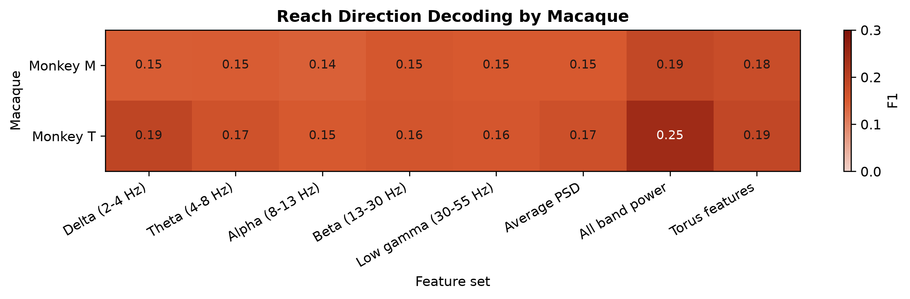
MACAQUE LFP
The qualitative result replicates separately in both macaques
MONKEY M
Torus F1
0.175 +/- 0.034
MONKEY T
Torus F1
0.188 +/- 0.028
Replication by animal - not train-on-one, test-on-the-other transfer.
NeuralFieldManifold | Macaque LFP
13
Notes:
SLIDE 13: The qualitative result replicates separately in both macaques
SCRIPT
When we summarize Monkey M and Monkey T separately, torus features exceed beta and Average PSD in both animals. Monkey T has higher overall decodability, especially for all-band power, but the compact-baseline geometry advantage is not restricted to one monkey.
TAKEAWAY
Both animals independently support the compact-baseline result.
TRANSITION
Finally, combining representations asks whether geometry and power are redundant or complementary.
IF CHALLENGED
Call this replication by animal. The decoder is fit and evaluated within each LFP; this is not a leave-one-animal-out transfer analysis.
DELIVERY CUE
Keep the slide conversational and do not read every label.

Slide 14
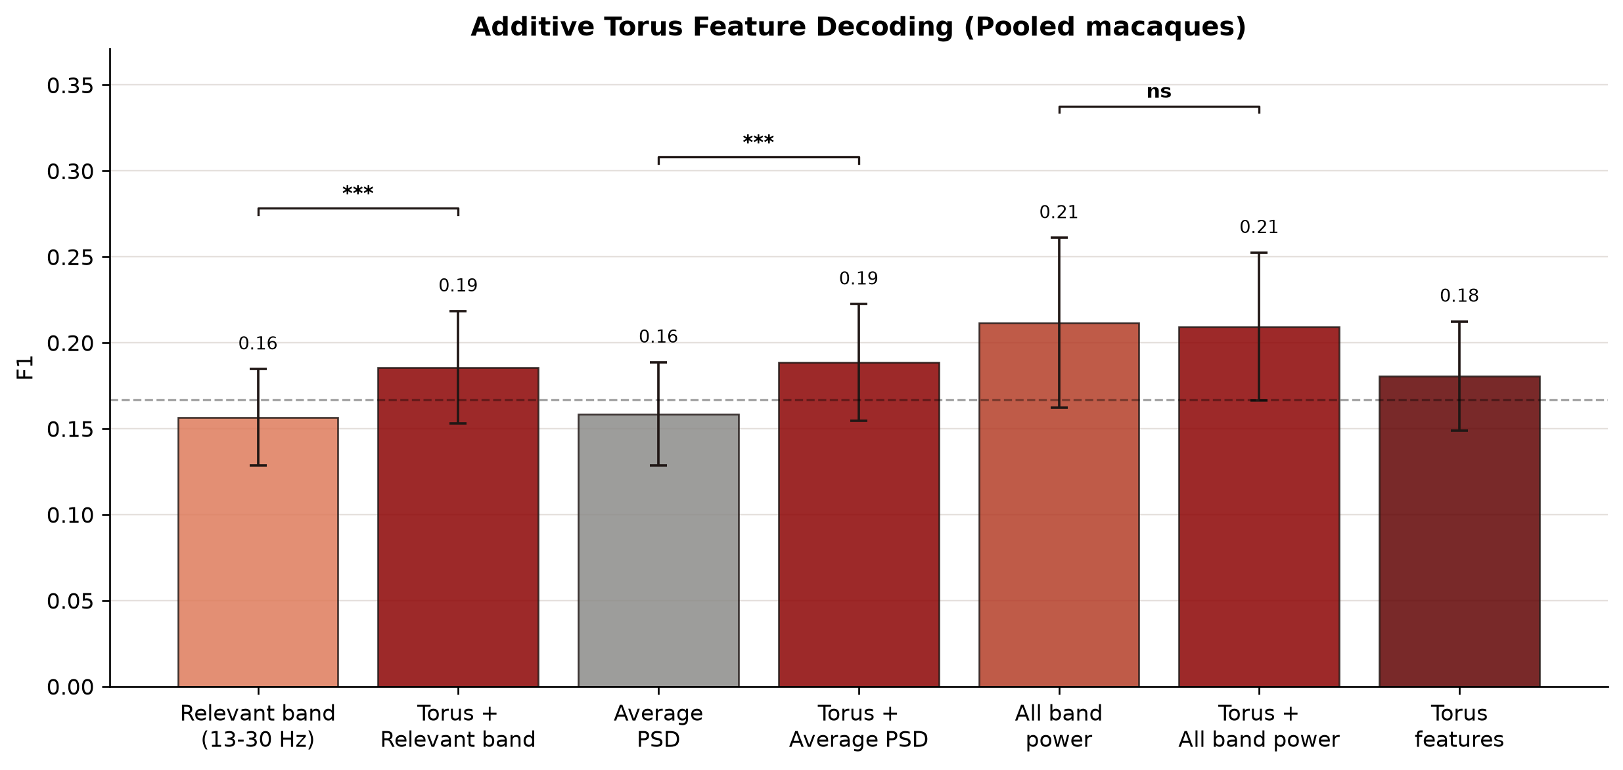
MACAQUE LFP
Geometry complements beta and Average PSD, not all-band power
ADDITIVE EFFECT
+0.029 F1
Torus + beta
+0.030 F1
Torus + Average PSD
-0.002 F1
Torus + all bands
Complementarity is strongest when the spectral baseline is compact.
NeuralFieldManifold | Macaque LFP
14
Notes:
SLIDE 14: Geometry complements beta and Average PSD, not all-band power
SCRIPT
Concatenating torus features with beta increases F1 by about 0.029, and concatenating them with Average PSD increases F1 by about 0.030. Both effects are strongly significant. But adding torus features to the full five-band vector does not improve the pooled result. The all-band vector already captures much of the task information available to this simple linear decoder.
TAKEAWAY
Geometry contributes nonredundant information to compact spectral summaries, not an unlimited independent signal.
TRANSITION
That leads to the balanced conclusion of the rebuttal experiments.
IF CHALLENGED
Concatenation increases dimensionality. The fair evidence is the paired out-of-fold F1, not the training score; no improvement over all-band power argues against a generic dimension-only benefit.
DELIVERY CUE
Keep the slide conversational and do not read every label.

Slide 15
CONCLUSIONS
The rebuttal turns the geometry into a testable application story
01
BEHAVIORAL UTILITY
Torus features decode sleep stage and reach direction across two species and recording modalities.
02
COMPLEMENTARITY
Geometry consistently beats a relevant single band and Average PSD, and improves them when concatenated.
03
CALIBRATED CLAIM
All-band power remains stronger than torus alone; the contribution is a principled geometric representation, not universal decoder supremacy.
Next: Rudra - reproducible package, GitHub tutorial, and future applications
NeuralFieldManifold | Conclusions
15
Notes:
SLIDE 15: The rebuttal turns the geometry into a testable application story
SCRIPT
The application takeaway has three parts. First, the recovered geometry is behaviorally informative in both sleep and reaching. Second, it contributes information beyond compact spectral summaries. Third, the strongest multiband spectral vector remains competitive or stronger, so our claim is complementarity and interpretability rather than universal decoding superiority. The rebuttal made the paper more precise and more useful.
TAKEAWAY
The geometry is useful, reproducible, and scientifically interpretable - with clearly stated limits.
TRANSITION
Rudra will now show how the full workflow is packaged and how a new user can apply it.
IF CHALLENGED
If challenged on why publish a representation that does not always win decoding: prediction accuracy and geometric fidelity are distinct objectives; the geometry links oscillatory structure to an interpretable state-space object.
DELIVERY CUE
Slow down here. This is the slide the audience should remember.

Slide 16
BACKUP
The torus decoder uses 15 geometric features
SIZE
FIT QUALITY
POSE: 9 COMPONENTS
-
Major radius R1
-
Mean-squared error
-
Direction x, y, z
-
Major radius R2
-
Mean surface error
-
u-axis x, y, z
-
Tube radius r
-
Fraction inside
-
v-axis x, y, z
3 size + 3 fit-quality + 9 orientation = 15 features per analysis window or trial epoch
The decoder sees fitted parameters, not the raw point cloud.
NeuralFieldManifold | Feature definitions
16
Notes:
SLIDE 16: The torus decoder uses 15 geometric features
SCRIPT
Use this slide when someone asks exactly what the 15 torus features are. The vector combines scale, fit quality, and pose. It is intentionally compact compared with feeding the entire delay cloud to a flexible model.
TAKEAWAY
The torus representation is a compact, interpretable parameter vector.
TRANSITION
Return to the relevant result slide.
IF CHALLENGED
Orientation terms are retained in the no-radius ablation because they describe the large fitted ellipse's pose, not local tube thickness.
DELIVERY CUE
Keep the slide conversational and do not read every label.

Slide 17
BACKUP
The reviewer-facing torus fit uses nonlinear surface optimization
1. Delay-embed
the LFP epoch
2. PCA initialize
center and axes
3. Nonlinear
elliptical-torus fit
4. Export
15 parameters
OBJECTIVE
CONSTRAINTS
COMPUTE
Minimize mean squared distance from embedded points to the fitted torus surface.
Positive tube radius and bounded major radius prevent degenerate fits.
Up to 1,200 objective evaluations per trial; cached after fitting.
The final macaque results use this slower nonlinear fit, not the earlier PCA/SVD screening proxy.
NeuralFieldManifold | Torus fitting
17
Notes:
SLIDE 17: The reviewer-facing torus fit uses nonlinear surface optimization
SCRIPT
The final macaque pipeline initializes from PCA, then refines the full elliptical torus by nonlinear least squares. Max nfev equals 1200, meaning the optimizer can evaluate the residual objective up to 1200 times. The result is cached because this is the expensive stage.
TAKEAWAY
The reported macaque features come from nonlinear fitted geometry.
TRANSITION
Return to the feature comparison.
IF CHALLENGED
PCA is only an initialization and a projection for embeddings above three dimensions; it is not the final torus parameter estimate.
DELIVERY CUE
Keep the slide conversational and do not read every label.

Slide 18
BACKUP
Spectral baselines range from one scalar to a multiband vector
SINGLE-BAND POWER
AVERAGE PSD
ALL-BAND POWER
One log-power scalar per epoch. Each band is decoded separately.
Welch PSD averaged over the analysis range, then log10 transformed: one scalar.
All band-power values entered jointly as a multifeature vector; they are not averaged.
EEG bands: delta, theta, alpha, sigma, beta, low gamma | Macaque bands: delta, theta, alpha, beta, low gamma
Relevant band is fixed as delta for sleep and beta for motor LFP. It is not chosen by maximizing F1.
NeuralFieldManifold | Spectral definitions
18
Notes:
SLIDE 18: Spectral baselines range from one scalar to a multiband vector
SCRIPT
This slide clarifies the baseline hierarchy. Average PSD is one scalar; a relevant band is one scalar; all-band power is a vector containing every band power jointly. The richer all-band representation is therefore a substantially stronger baseline.
TAKEAWAY
Baseline complexity increases from one scalar to a multiband vector.
TRANSITION
Return to the spectral nuance slide.
IF CHALLENGED
Average PSD is log10 of mean Welch PSD after detrending and z-scoring; it is not the average of the decoder scores across bands.
DELIVERY CUE
Keep the slide conversational and do not read every label.

Slide 19
BACKUP
Cross-validation uses matched labels and independent units
MOUSE EEG
MACAQUE LFP
COMPARISON
-
Balance Wake/NREM/REM within hour
-
Balance six direction labels within LFP
-
Same folds for matched features
-
Five stratified folds
-
Five stratified folds
-
Macro F1 from out-of-fold predictions
-
21 hours summarized independently
-
237 LFPs summarized independently
-
Paired Wilcoxon + Holm correction
No session or LFP is duplicated as an independent observation in the reported summary statistics.
NeuralFieldManifold | Decoding protocol
19
Notes:
SLIDE 19: Cross-validation uses matched labels and independent units
SCRIPT
Each decoding result is cross-validated within its independent reporting unit: hour for EEG and unique LFP for macaque. Features are compared on matched units, then paired statistics are run across those units.
TAKEAWAY
The statistics operate on independent session- or LFP-level F1 values.
TRANSITION
Return to the relevant p-value slide.
IF CHALLENGED
The existing analysis is not a session-disjoint train/test transfer decoder; describe it as repeated within-unit cross-validation summarized across independent units.
DELIVERY CUE
Keep the slide conversational and do not read every label.

Slide 20
BACKUP
Full EEG heatmap: 21 valid recording hours
NeuralFieldManifold | EEG detail
20
Notes:
SLIDE 20: Full EEG heatmap: 21 valid recording hours
SCRIPT
Use this full-size heatmap when the audience wants the individual hourly values. It exposes both the stability and the real session-to-session variability.
TAKEAWAY
The full session matrix is available rather than only a collapsed mean.
TRANSITION
Return to the EEG summary.
IF CHALLENGED
Hours 1, 2, and 14 are absent because they lacked enough examples from all three classes.
DELIVERY CUE
Keep the slide conversational and do not read every label.

Slide 21
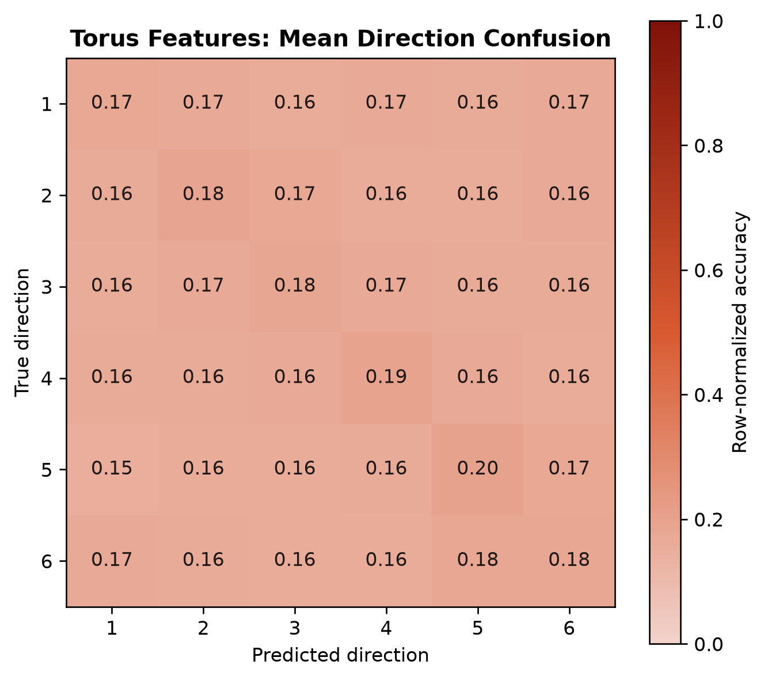
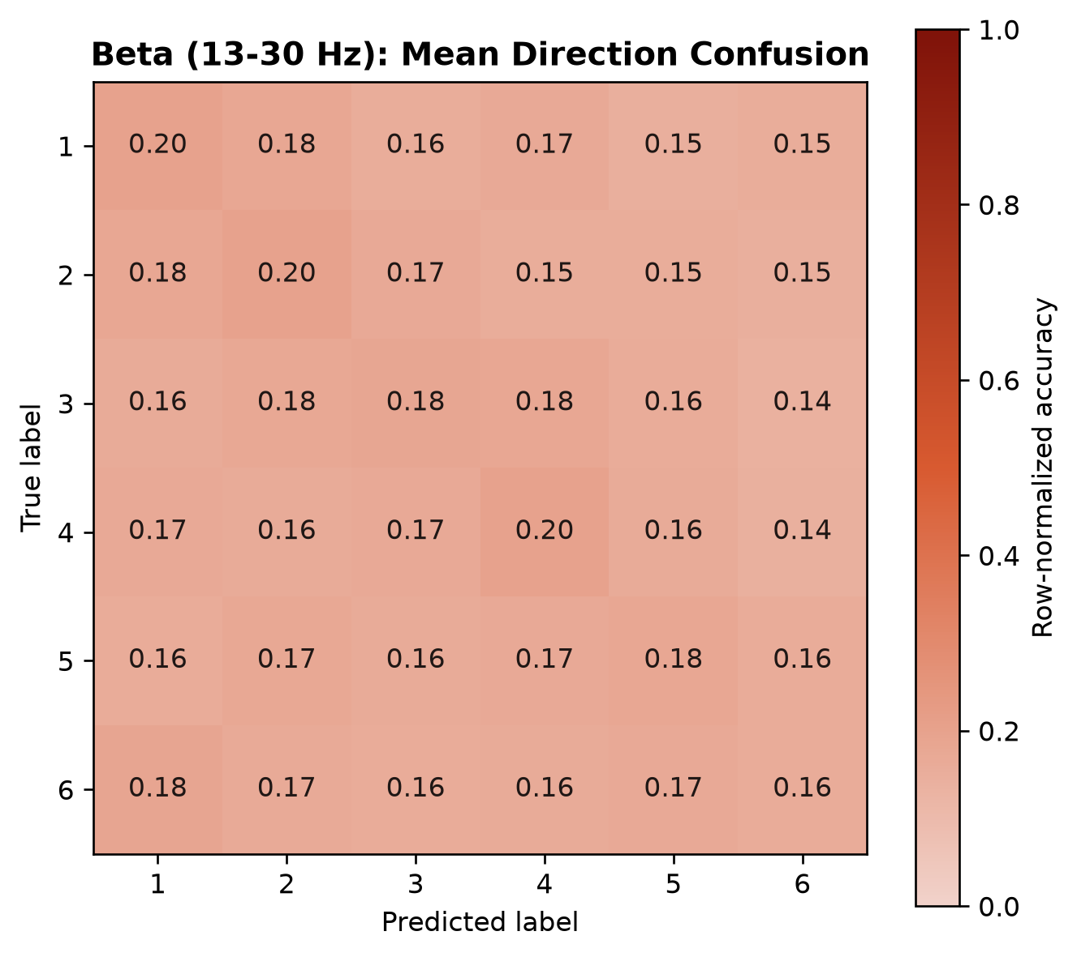
BACKUP
Macaque confusion matrices show structured direction signals
Torus features
Relevant band: beta
NeuralFieldManifold | Macaque detail
21
Notes:
SLIDE 21: Macaque confusion matrices show structured direction signals
SCRIPT
These averaged confusion matrices show that six-way decoding is challenging but not structureless. The torus decoder yields a slightly stronger diagonal than the beta-only decoder across the same LFPs.
TAKEAWAY
The macaque F1 difference corresponds to distributed direction information, not one isolated class.
TRANSITION
Return to the main macaque comparison.
IF CHALLENGED
A mean confusion matrix averages normalized out-of-fold confusion matrices across LFPs; it is not one pooled classifier.
DELIVERY CUE
Keep the slide conversational and do not read every label.

Slide 22
BACKUP
Additive tests isolate complementary geometric information
PAIRED COMPARISON
DELTA F1
HOLM p
CALL
Torus + Relevant band vs Relevant band
+0.029
1.12 x 10^-20
***
Torus + Average PSD vs Average PSD
+0.030
7.68 x 10^-22
***
Torus + All-band power vs All-band power
-0.002
0.372
ns
The additive result is specific: geometry supplements compact baselines but does not improve the complete multiband vector.
NeuralFieldManifold | Additive statistics
22
Notes:
SLIDE 22: Additive tests isolate complementary geometric information
SCRIPT
This table gives the exact primary additive comparisons. Torus features significantly improve beta and Average PSD. They do not improve all-band power in the pooled analysis.
TAKEAWAY
Complementarity depends on what the spectral baseline already contains.
TRANSITION
Return to the additive bar plot.
IF CHALLENGED
Holm correction is applied within the pooled additive comparison family shown here.
DELIVERY CUE
Keep the slide conversational and do not read every label.

Slide 23
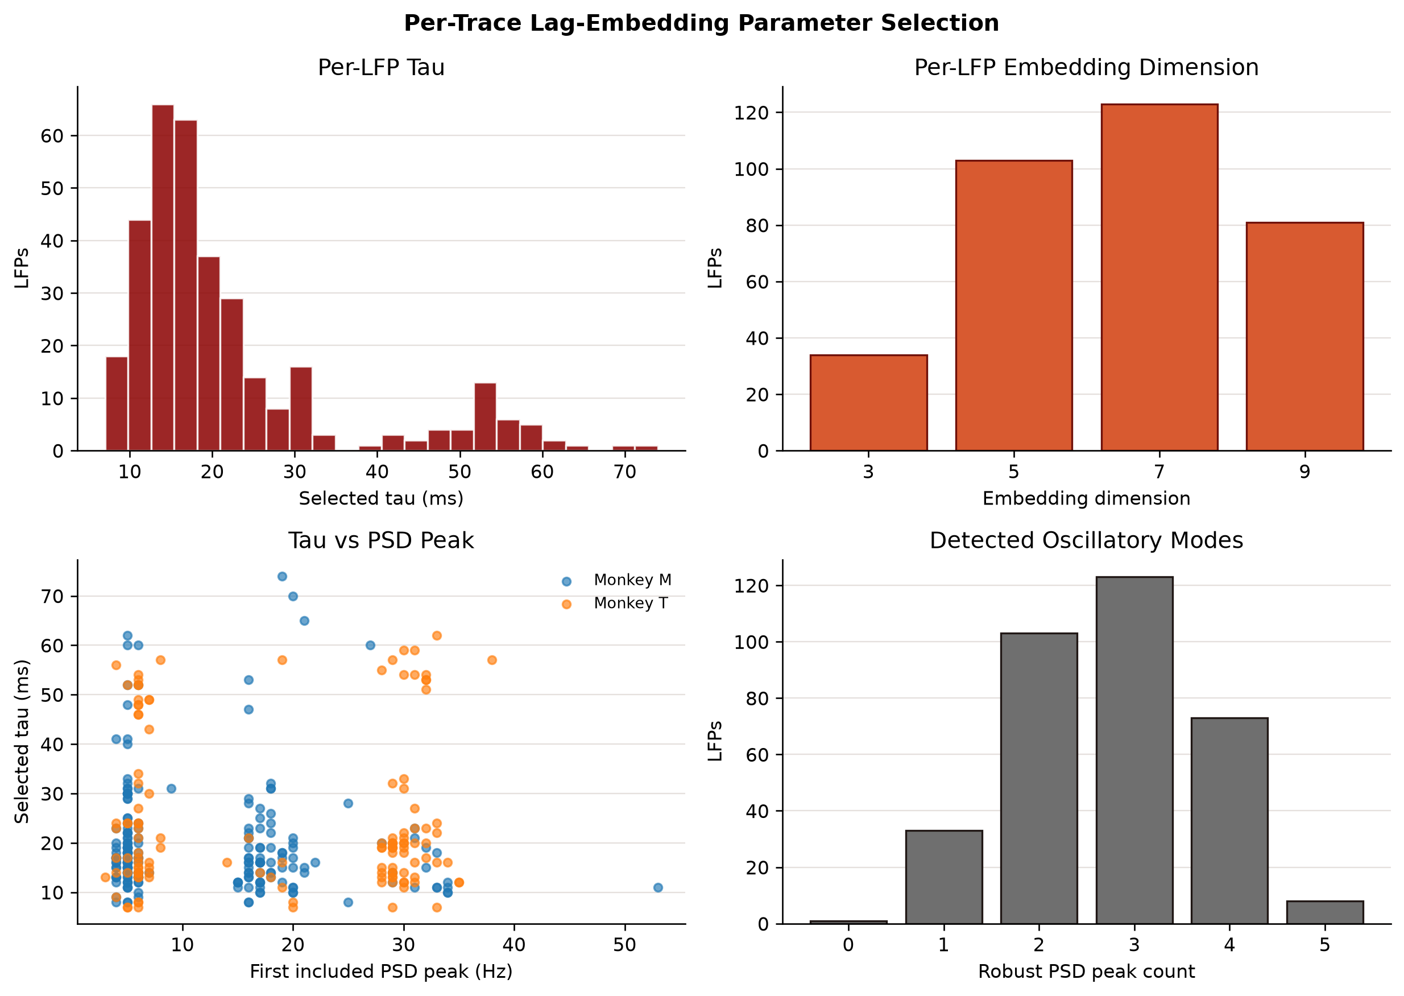
BACKUP
Per-trace lag selection yields heterogeneous dimensions
MEDIAN TAU
17 ms
TAU IQR
14-23 ms
DIMENSION COUNTS
3D: 34 traces
5D: 103 traces
7D: 123 traces
9D: 81 traces
NeuralFieldManifold | Embedding detail
23
Notes:
SLIDE 23: Per-trace lag selection yields heterogeneous dimensions
SCRIPT
This diagnostic shows why we abandoned a single dataset-wide tau and dimension. The signal structure varies across electrodes and sessions, so each trace receives unsupervised parameters before decoding.
TAKEAWAY
Heterogeneity in oscillatory content is modeled rather than averaged away.
TRANSITION
Return to the per-trace embedding slide.
IF CHALLENGED
Although embeddings may be higher than three dimensions, the current 15-feature torus fit projects each cloud to its leading three principal coordinates for a comparable elliptical-torus parameterization.
DELIVERY CUE
Keep the slide conversational and do not read every label.

Slide 24
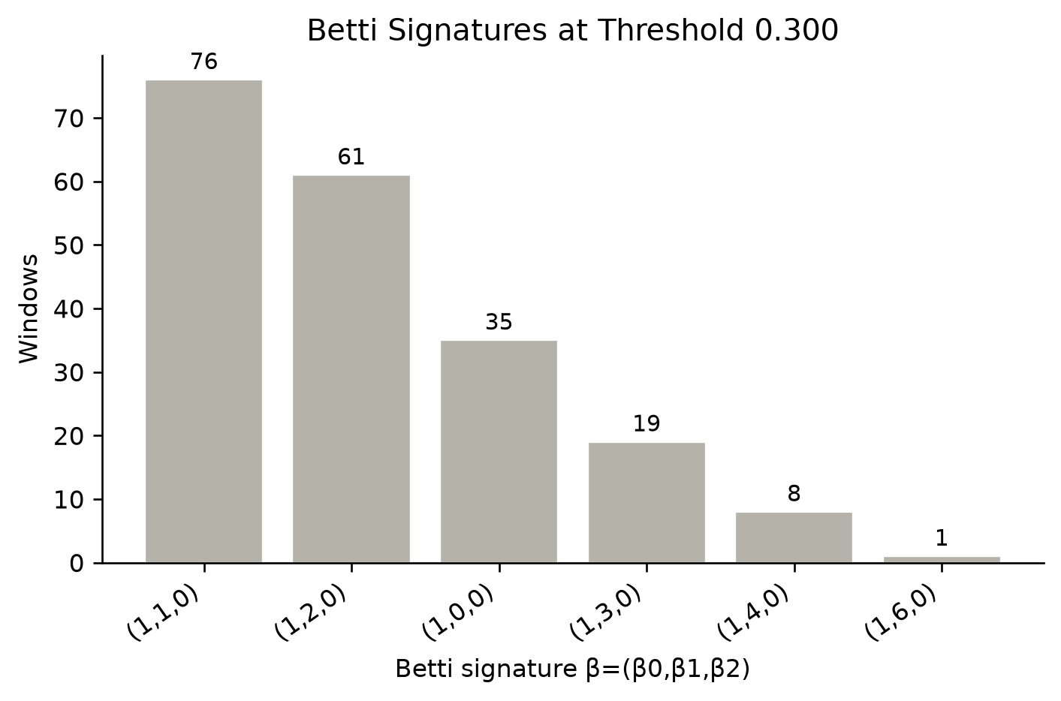
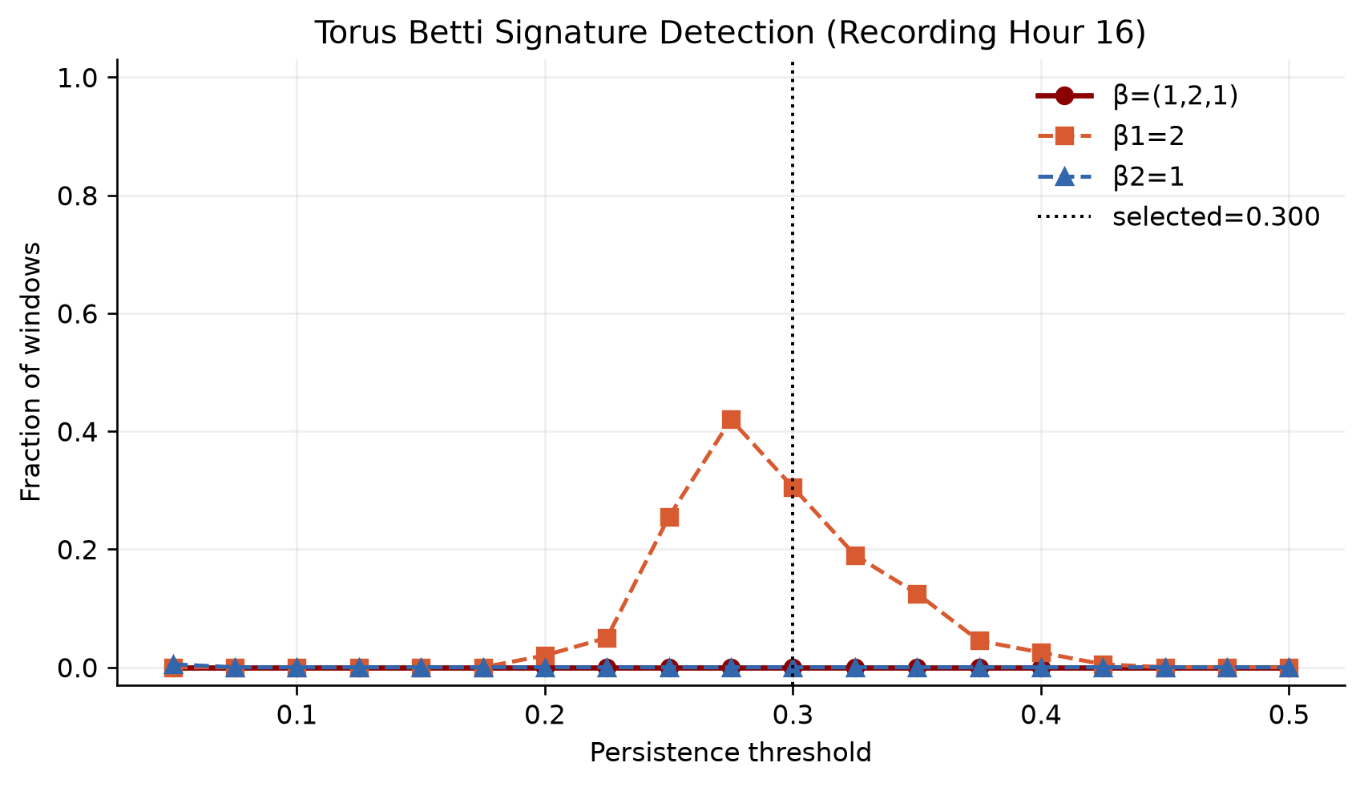
BACKUP
Persistent homology tests the torus hypothesis rather than forcing it
Observed dominant EEG signature in this probe: (1, 1, 0), not the hypothesized (1, 2, 1).
NeuralFieldManifold | Topology
24
Notes:
SLIDE 24: Persistent homology tests the torus hypothesis rather than forcing it
SCRIPT
This exploratory EEG persistent-homology notebook swept delays, window lengths, and thresholds without hardcoding the answer. In the selected session, the expected two-torus signature was not dominant. That negative result is informative and should not be conflated with the separate fitted-feature decoding analysis.
TAKEAWAY
Topological validation and geometric-feature utility are related but distinct empirical questions.
TRANSITION
Return to the limitations or conclusions slide.
IF CHALLENGED
Do not use this slide as evidence that every EEG window is a clean topological torus; it demonstrates the diagnostic and its honesty.
DELIVERY CUE
Keep the slide conversational and do not read every label.

Slide 25
BACKUP
The rebuttal converts reviewer concerns into concrete evidence
REVIEW QUESTION
NEW EVIDENCE
STATUS
Specified baselines and error bars
EEG and macaque relevant-band, Average PSD, and all-band comparisons
Addressed
Stability across recordings
21 EEG hours; 237 macaque LFPs; separate M/T summaries
Addressed
Repeated motor behavior
Six-way reach-direction decoding from movement-aligned LFP
Addressed
How much data / lag choice
Per-trace AMI tau; PSD-informed dimension; parameter distributions
Quantified
Order versus downstream utility
15D-to-11D no-radius feature ablation
Partial
The remaining gaps are explicit, which strengthens rather than weakens the revised claim.
NeuralFieldManifold | Reviewer matrix
25
Notes:
SLIDE 25: The rebuttal converts reviewer concerns into concrete evidence
SCRIPT
Use this as a navigation slide during questions. It maps each major concern to a result and marks the order-ablation response as partial rather than overselling it.
TAKEAWAY
Most application concerns now have a direct table, figure, or diagnostic.
TRANSITION
Close by returning to the calibrated conclusion.
IF CHALLENGED
The remaining theoretical noise/window-placement bounds belong in Kasra's theory discussion rather than this application section.
DELIVERY CUE
Keep the slide conversational and do not read every label.

