Slide 1
The lifecycle status of files in GIT
https://git-scm.com/book/en/v2/Git-Basics-Recording-Changes-to-the-Repository
git add
git rm
git rm --cached
git add
git commit
git commit -a -m ’comment'

Slide 2
Working with Remotes ( https://git-scm.com/book/en/v2/Git-Basics-Working-with-Remotes )

Slide 3
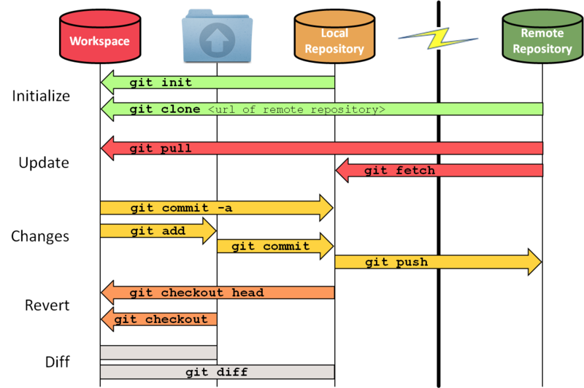
Complete workflow I

Slide 4
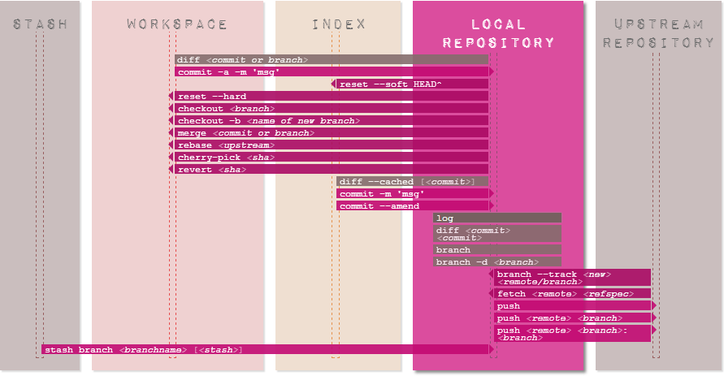
Complete workflow II

Slide 5
Eclipse & GIT workflow

Slide 6
Branching model(http://nvie.com/posts/a-successful-git-branching-model/ )

