Slide 2
Data Cleaning: Identifying and correcting mistakes or errors in the data. Feature Selection: Identifying those input variables that are most relevant to the task.
Data Transforms: Changing the scale or distribution of variables. Feature Engineering: Deriving new variables from available data. Dimensionality Reduction: Creating compact projections of the data.
Step 1: Define Problem.
Step 2: Prepare Data. Step 3: Evaluate Models.
Step 4: Finalize Model.

Slide 3
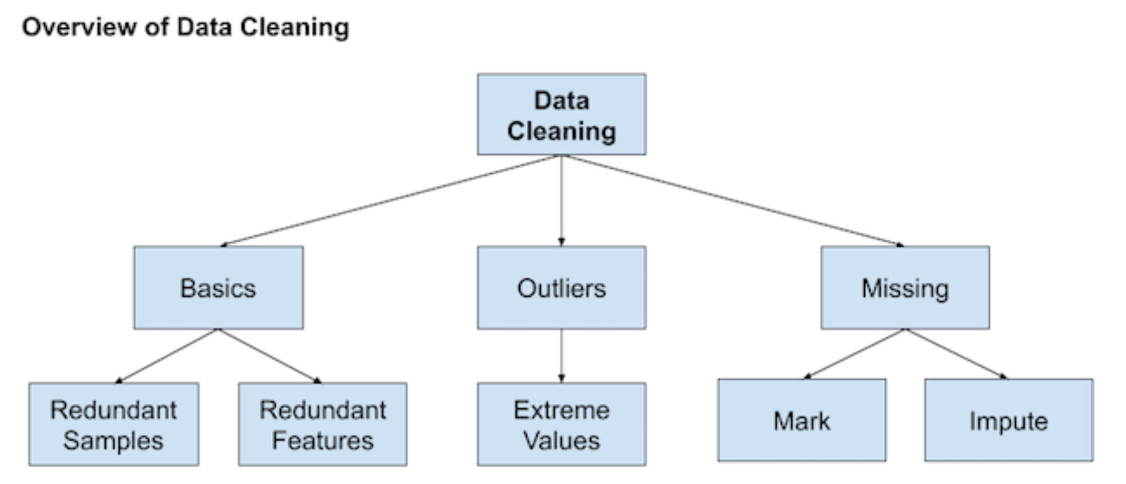
Data Cleaning
General data cleaning operations that can be performed:
Using statistics to define normal data and identify outliers.
Identifying columns that have the same value or no variance and removing them.
Identifying duplicate rows of data and removing them).
Marking empty values as missing.
Imputing missing values using statistics or a learned model.

Slide 4
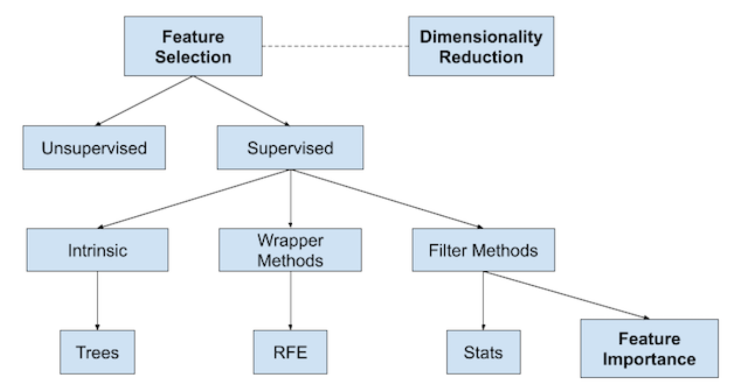
Feature Selection
Techniques for selecting a subset of input features that are most relevant to the target variable that is being predicted.
Is desirable to develop models only using the data that is required to make a prediction
Techniques that use the target variable (supervised)
can be further divided into models that
automatically select features as part of fitting the model (intrinsic)
explicitly choose features that result in the best performing model (wrapper)
score each input feature and allow a subset to be selected (filter)
Techniques that do not (unsupervised)

Slide 5
Feature Selection
regression target variable
Numerical inputs
Numerical inputs
classification target variable
Categorical inputs
Recursive Feature Elimination (RFE) method is agnostic to the input variable type.
Statistical methods, such as correlation, are popular for scoring input features. The features can then be ranked by their scores and a subset with the largest scores used as input to a model.
The choice of statistical measure depends on the data types of the input variables.
Broader field of scoring the relative importance of input features is referred to as feature importance

Slide 6
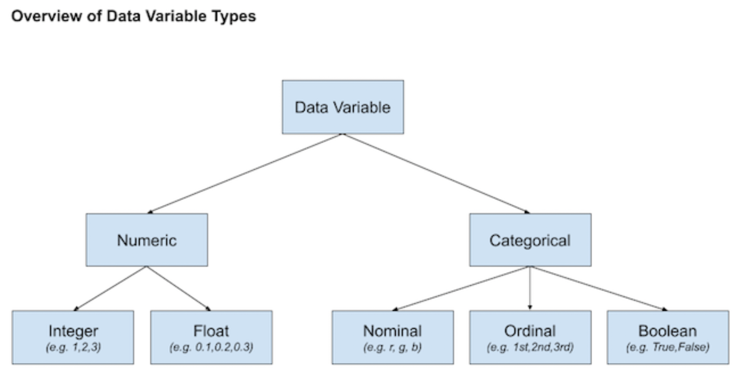
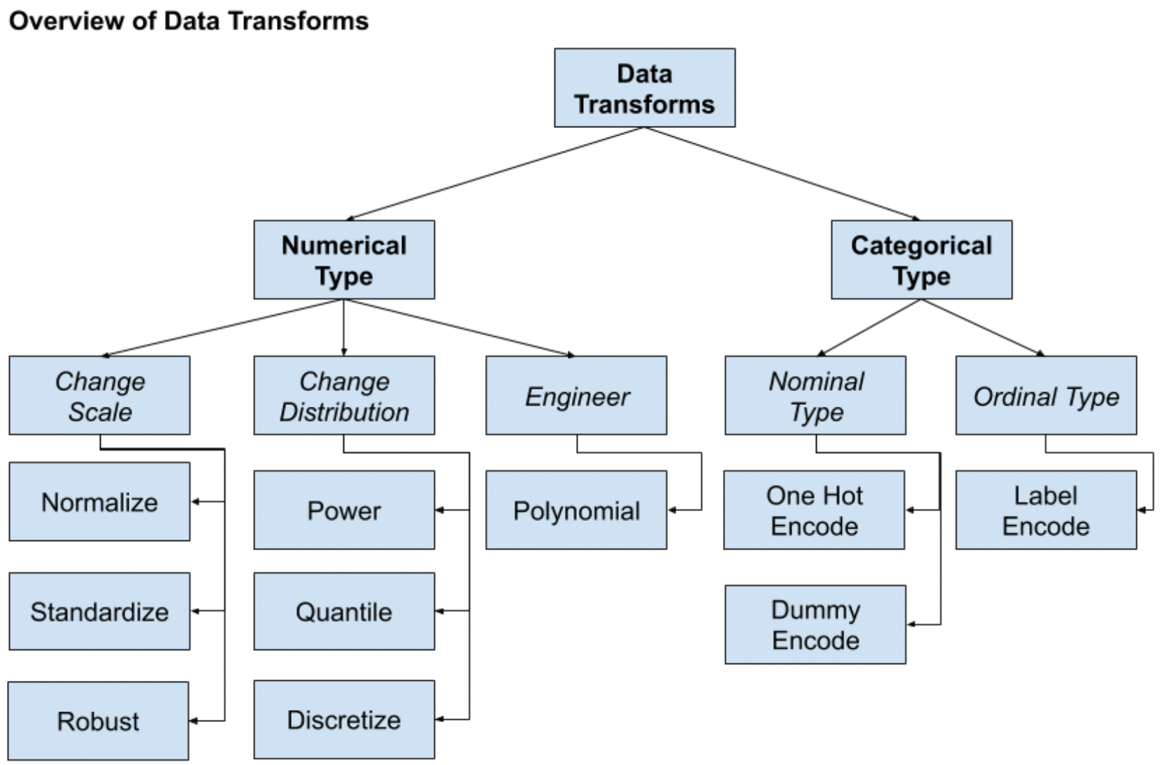
Data Transforms
Used to change the type or distribution of data variables.
Discretization Transform: Encode a numeric variable as an ordinal variable.
Ordinal Transform: Encode a categorical variable into an integer variable.
One Hot Transform: Encode a categorical variable into binary variables.
Normalization Transform: Scale a variable to the range 0 and 1
Standardization Transform: Scale a variable to a standard Gaussian.
Power Transform: Change the distribution of a variable to be more Gaussian.
Quantile Transform: Impose a probability distribution such as uniform or Gaussian.
Operations are generally performed separately for each variable.
To use the transform on new data in the future, save the transform objects to file along with the final model trained on all available data.

Slide 7
Feature Engineering
Process of creating new input variables from the available data. Often requires the collaboration of a subject matter expert to help identify new features
Adding a boolean flag variable for some state. Adding a group or global summary statistic, such as a mean. Adding new variables for each component of a compound variable, such as a date-time.
Polynomial Transform: Create copies of numerical input variables that are raised to a power

Slide 8
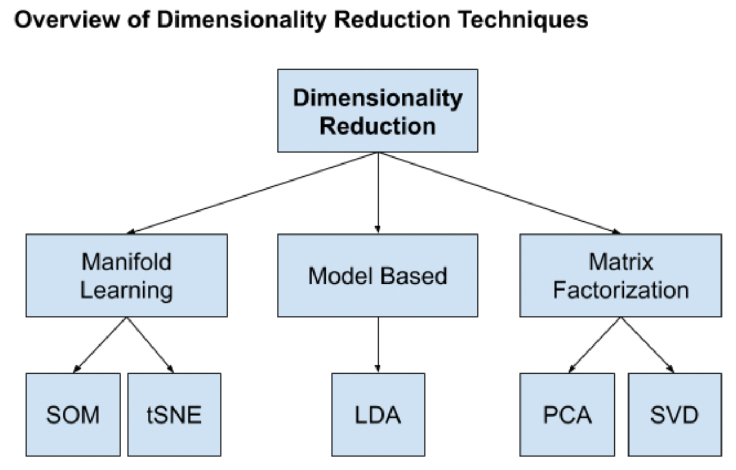
Dimensionality Reduction
Provides an alternative to feature selection.
The number of input features for a dataset may be considered the dimensionality of the data.
The problem is, the more dimensions, more sparsity and likely unrepresentative sampling of that space.
Dimensionality Reduction, creates a projection of the data into a lower-dimensional space that still preserves the most important properties of the original data.
The variables in the projected data are not directly related to the original input variables, making the projection difficult to be interpreted.
Most common approach
Principal Component Analysis
remove linear dependencies between input variables, e.g. correlated variables
Singular Value Decomposition
Linear Discriminant Analysis
model-based methods that discover a lower dimensionality reduction.

Slide 9
Data Preparation Without Data Leakage
Leakage means that information is revealed to the model that gives it an unrealistic advantage to make better predictions.
for train-test splits
Data preparation techniques varies depending on the model evaluation scheme used.
k-fold cross-validation in Python
Data preparation must be prepared on the training set only.
Solution
Prepare Dataset
2. Split Data 3. Evaluate Models
Naive Data Preparation
1. Split Data.
2. Fit Data Preparation on Training Dataset. 3. Apply Data Preparation to Train and Test Datasets.
4. Evaluate Models.
Dangerously incorrect in most cases!!!

Slide 10
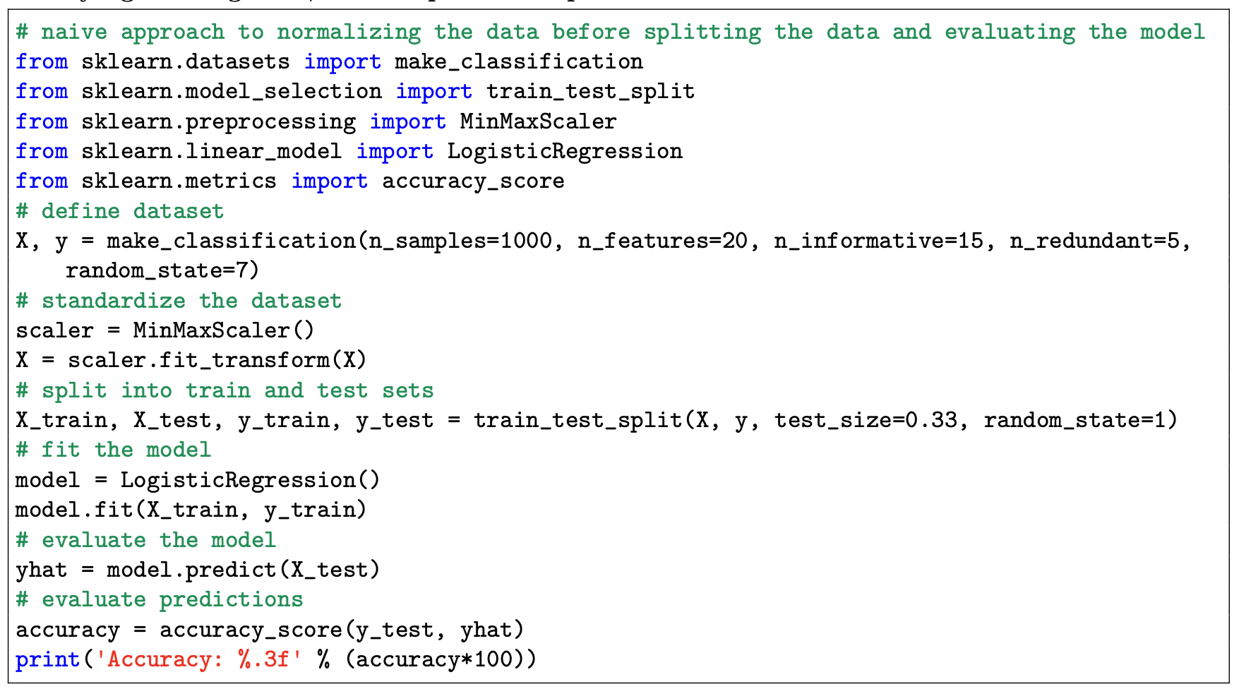
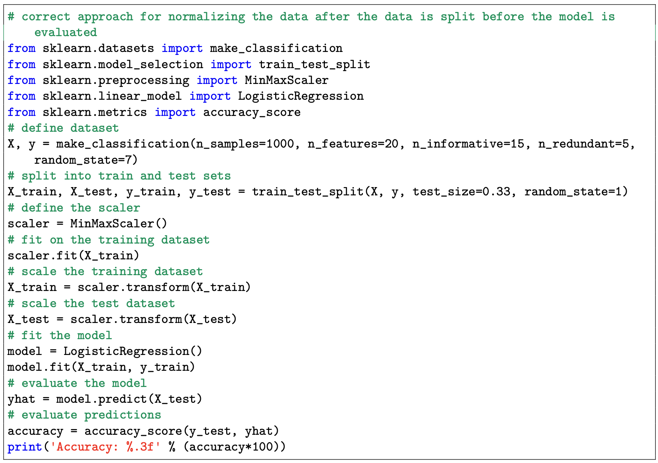
Data Preparation With Train and Test Sets

Slide 11
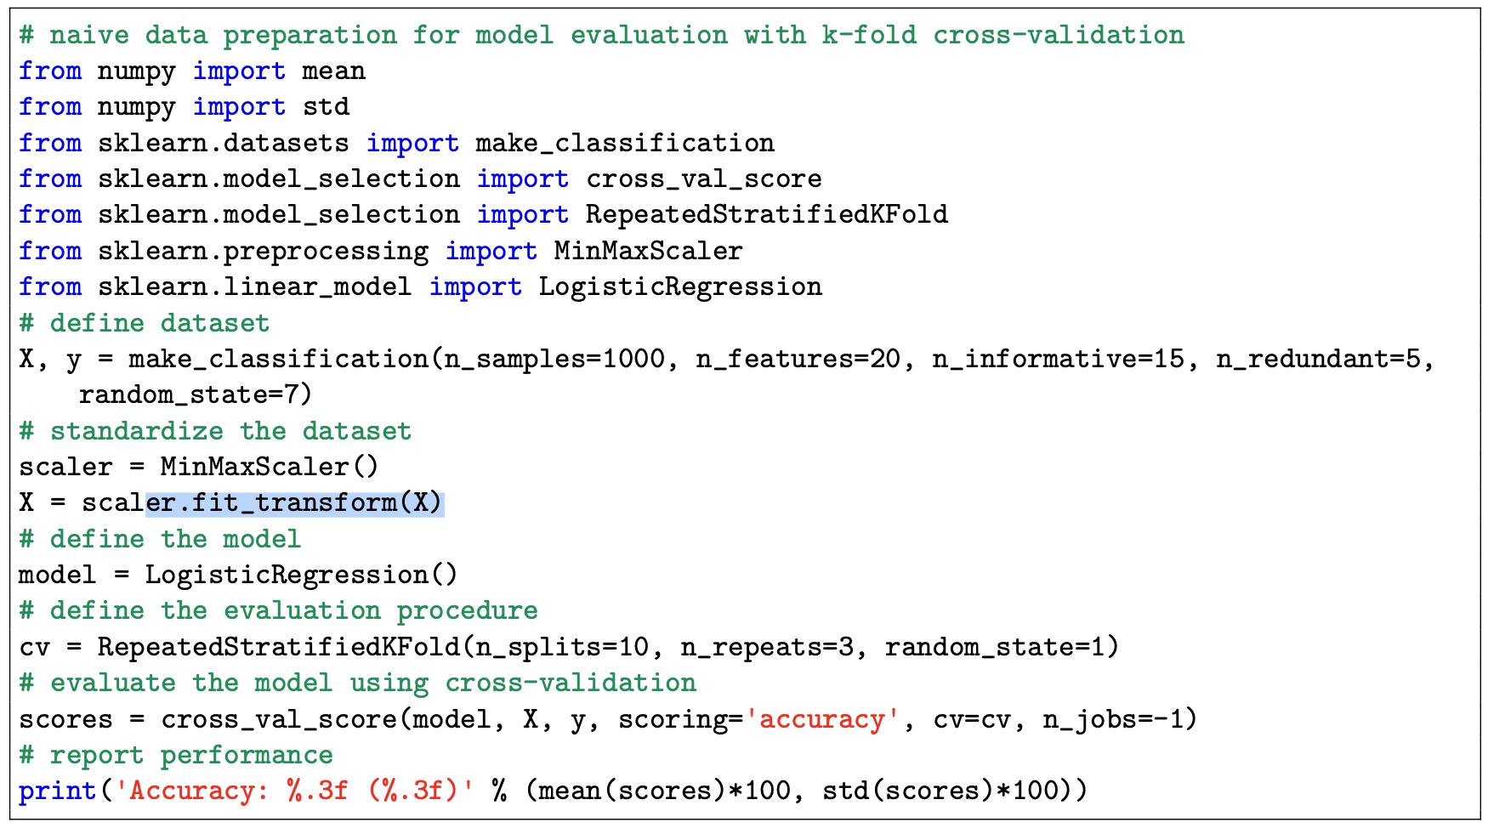
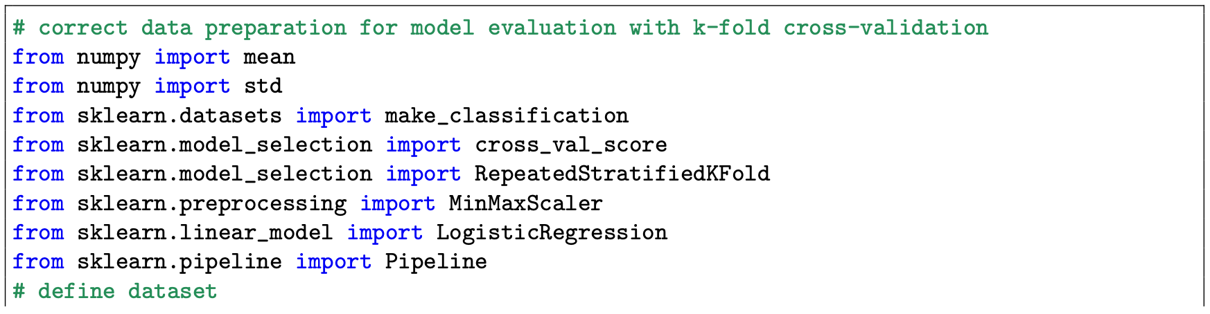
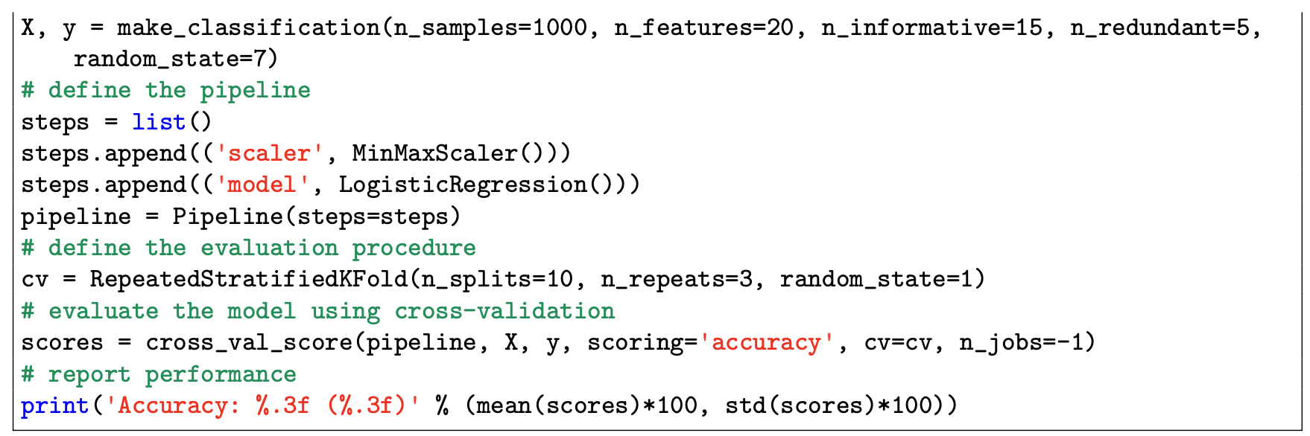
k-fold cross-validation in Python

