Slide 1
CS110 Discussion3
Weiming Hu, 胡洧铭

Slide 2
Agenda
C Memory Management
Common Memory Problems
strlen v.s. sizeof
Can We Do Better?
Manage Device Memory

Slide 3
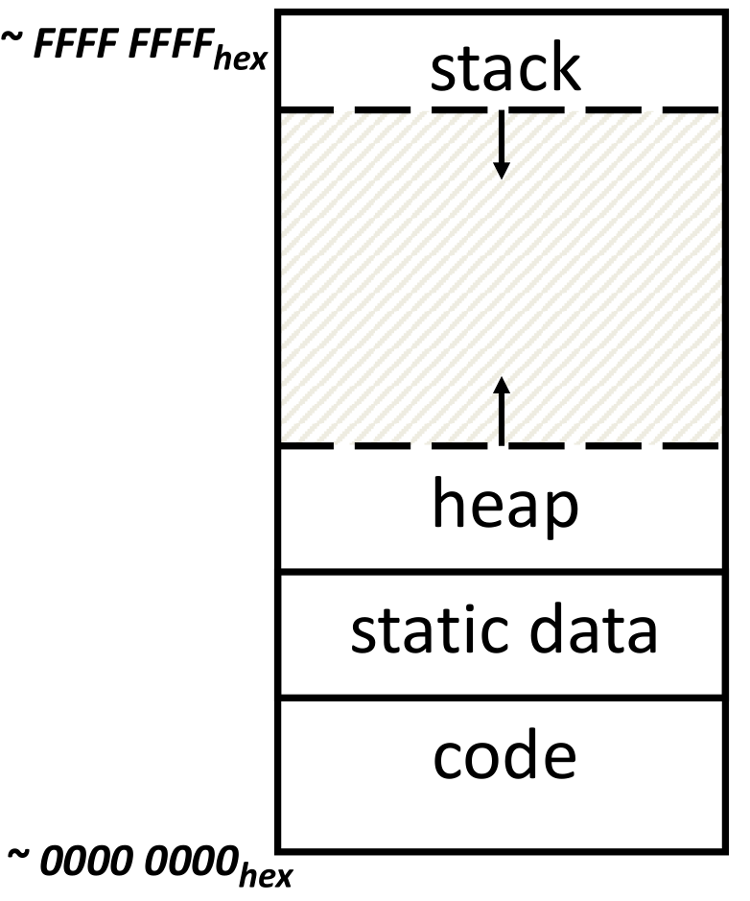
Memory Management in C
Memory Address
(32 bits assumed here)
Program’s address space contains 4 regions
Stack: local variables inside functions, grow downwards.
Heap: Space for dynamic data, requested via “malloc”, grows upwards.
Static data: Variables defined outside functions, does not grow or shrink. But can be modified.
Code: Loaded when program starts. Can not be modified.

Slide 4
Example
#include <stdio.h>
#include <stdlib.h>
static const int year = 2023;
int main(void){
char name[] = "Jose";
char *game = "The Elder Scrolls";
int *ver = malloc(sizeof(int));
*ver = 5;
/* Break! */
printf("Until %d, %s's favourite game is %s %d.\n", year, name, game, *ver);
return 0;
}
Expression:
&year _______
name _______
game _______
ver _______
&ver _______
static
stack
static
heap
stack

Slide 5
Observations
Code, Static storage are easy: they never grow or shrink
Stack space is relatively easy: stack frames are created and destroyed in last-in, first-out (LIFO) order
Managing the heap is tricky: memory can be allocated / deallocated at any time

Slide 6
Agenda
C Memory Management
Common Memory Problems
strlen v.s. sizeof
Can We Do Better?
Manage Device Memory

Slide 7
Common Memory Problems
Using uninitialized values
Using memory that you don’t own
Deallocated stack or heap variable
Out-of-bounds reference to stack or heap array
Using NULL or garbage data as a pointer
Improper use of free/realloc by messing with the pointer handle returned by malloc/calloc
Memory leaks (you allocated something you forgot to later free)
Or std::vector::push_back

Slide 8
Using Memory You Don’t Own
What is wrong with this code?
int *ipr, *ipw;
void ReadMem() {
int i, j;
ipr = (int*) malloc(4 * sizeof(int));
i = *(ipr - 1000);
j = *(ipr + 1000);
free(ipr);
}
void WriteMem() {
ipw = (int*) malloc(5 * sizeof(int));
*(ipw - 1000) = 0;
*(ipw + 1000) = 0;
free(ipw);
}
Using pointers beyond the range that had been malloc’d – May look obvious, but what if mem refs had been result of pointer arithmetic that erroneously took them out of the allocated range?

Slide 9
Using Memory You Don’t Own
What is wrong with this code?
int *ipr, *ipw;
int offset;
void ReadMem() {
int i, j;
ipr = (int*) malloc(4 * sizeof(int));
i = *(ipr - offset);
j = *(ipr + offset);
free(ipr);
}
void WriteMem() {
ipw = (int*) malloc(5 * sizeof(int));
*(ipw - offset) = 0;
*(ipw + offset) = 0;
free(ipw);
}
Using pointers beyond the range that had been malloc’d – May look obvious, but what if mem refs had been result of pointer arithmetic that erroneously took them out of the allocated range?
It may be non-obvious in the program.

Slide 10
Using Memory You Don’t Own
What is wrong with this code?
void StringManipulate() {
const char *name = "Safety Critical";
char *str = malloc(10);
strncpy(str, name, 10);
str[10] = '\0';
/* Write Beyond Array Bounds */
printf("%s\n", str); /* print Safety Cri*/
/* Read Beyond Array Bounds */
}
Reference beyond array bounds

Slide 11
Using Memory You Don’t Own
What is wrong with this code?
char *append(const char* s1, const char *s2) {
const int MAXSIZE = 128;
char result[128];
int i=0, j=0;
for (j=0; i<MAXSIZE-1 && j<strlen(s1); i++,j++) {
result[i] = s1[j];
}
for (j=0; i<MAXSIZE-1 && j<strlen(s2); i++,j++) {
result[i] = s2[j];
}
result[++i] = '\0’;
return result;
}
result is a local array name – stack memory allocated
Function returns pointer to stack memory – won’t be valid after function returns
Beyond stack read/write

Slide 12
Using Memory You Don’t Own
What is wrong with this code?
typedef struct node {
struct node* next;
int val;
} Node;
int findLastNodeValue(Node* head) {
while (head->next != NULL) {
head = head->next;
}
return head->val;
}
Following a NULL pointer to mem addr 0!

Slide 13
Faulty Heap Management
What is wrong with this code?
int *pi;
void foo() {
pi = malloc(8*sizeof(int));
/* Allocate memory for pi */
/* Oops, leaked the old memory pointed to by pi */
…
free(pi);
/* foo() is done with pi, so free it */
}
void main() {
pi = malloc(4*sizeof(int));
foo();
/* Memory leak: foo leaks it */
…
}
Memory leak: more mallocs than frees
Notes:
malloc for pi repeatly

Slide 14
Faulty Heap Management
What is wrong with this code?
int *plk = NULL;
void genPLK() {
plk = malloc(2 * sizeof(int));
… … …
plk++;
}
Potential memory leak – handle has been changed, do you still have copy of it that can correctly be used in a later free?
Notes:
malloc for pi repeatly

Slide 15
Misuse of free()
What is wrong with this code?
void FreeMemX() {
int fnh = 0;
free(&fnh);
}
void FreeMemY() {
int *fum = malloc(4 * sizeof(int));
free(fum+1);
free(fum);
free(fum);
}
Can’t free non-heap memory;
Can’t free memory that hasn’t been allocated
Notes:
malloc for pi repeatly

Slide 16
Managing the Heap
realloc(p,size)
Resize a previously allocated block at p to a new size
If p is NULL, then realloc behaves like malloc
If size is 0, then realloc behaves like free, deallocating the block from the heap
Returns new address of the memory block; NOTE: it is likely to have moved!
calloc(p,size)
Allocation with initialization: malloc() + memset()

Slide 17
Agenda
C Memory Management
Common Memory Problems
strlen v.s. sizeof
Can We Do Better?
Manage Device Memory

Slide 18
strlen v.s. sizeof
#include <stdio.h>
#include <string.h>
int main(){
/*I use a 64-bit system*/
char* ptrStr = "sist1";
char listStr1[] = "sist1";
char listStr2[10] = "sist1";
printf("%d\n", sizeof(ptrStr)); /* sizeof: 8, a ptr takes 8 bytes, 64 bits! */
printf("%d\n", strlen(ptrStr)); /* strlen: 5 */
printf("%d\n", sizeof(ptrStr + 2)); /* sizeof: 8, a ptr takes 8 bytes, 64 bits! */
printf("%d\n", sizeof(*(ptrStr + 2))); /* sizeof: 1 */
printf("%d\n", strlen(ptrStr + 2)); /* strlen: 3 */
printf("%d\n", sizeof(listStr1)); /* sizeof:6 */
printf("%d\n", strlen(listStr1)); /* strlen:5 */
printf("%d\n", sizeof(listStr2)); /* sizeof: 10 */
printf("%d\n", strlen(listStr2)); /* strlen: 5 */
return 0;
}

Slide 19
Agenda
C Memory Management
Common Memory Problems
strlen v.s. sizeof
Can We Do Better?
Manage Device Memory

Slide 20
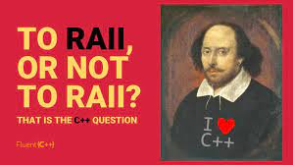

Can We Do Better?
Many language implements more advanced memory management
C++: Smart pointers, RAII, …
https://web.stanford.edu/class/archive/cs/cs106l/cs106l.1192/lectures/lecture15/15_RAII.pdf
Rust: Ownerships – References and Borrowing
https://doc.rust-lang.org/book/ch04-02-references-and-borrowing.html
Java, Python, …: Garbage Collection
https://www.oracle.com/webfolder/technetwork/tutorials/obe/java/gc01/index.html

Slide 21
Agenda
C Memory Management
Common Memory Problems
strlen v.s. sizeof
Can We Do Better?
Manage Device Memory

Slide 22
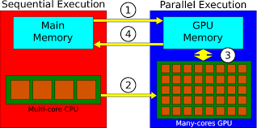
Manage Device Memory
Examples: Parallel Computing, Deep Learning, …
Use GPU / Device memory:
#include <stdio.h>
int main(){
int size_array = 1024;
int *h_a, *d_a;
h_a = (int*)malloc(size_array * sizeof(int));
cudaMalloc((void**)&d_a, size_array * sizeof(int));
for(int i = 0; i < size_array; i++)
h_a[i] = i;
cudaMemcpy(d_a, h_a, size_array * sizeof(int), cudaMemcpyHostToDevice);
…
/* Call CUDA Kernel Function*/
cudaMemcpy(h_a, d_a, size_array * sizeof(int), cudaMemcpyDeviceToHost);
free(h_a);
cudaFree(d_a);
return 0;
}

Slide 23
Conclusion
All data is in memory
Each memory location has an address to use to refer to it and a value stored in it
Pointer is a C version (abstraction) of a data address
* “follows” a pointer to its value
& gets the address of a value
Arrays and strings are implemented as variations on pointers
C is an efficient language, but leaves safety to the programmer
Variables not automatically initialized
Use pointers with care: they are a common source of bugs in programs

Slide 24
Conclusion Cont’d
C has three main memory segments in which to allocate data
Static Data: Variables outside functions
Stack: Variables local to function
Heap: Objects explicitly malloced/freed.
Heap data is biggest source of BUGs in C code

