Slide 1
Magic WAN and its interops
Erfi Anugrah

Slide 2
What is Magic WAN?
In short, using Cloudflare as an extension of your private network (even for public applications in the future) with the variety of on-ramps and off-ramps.
Think of connecting offices, remote-users, data-centers etc.

Slide 3
Why?
You get to leverage Cloudflare’s network
This means points of presence across the globe
Single pane view and interconnects (think secure web gateway, DNS rules, network rules etc.)
You can programmatically manage your infrastructure (even more so in the future when we talk about cloud connectivity)

Slide 4
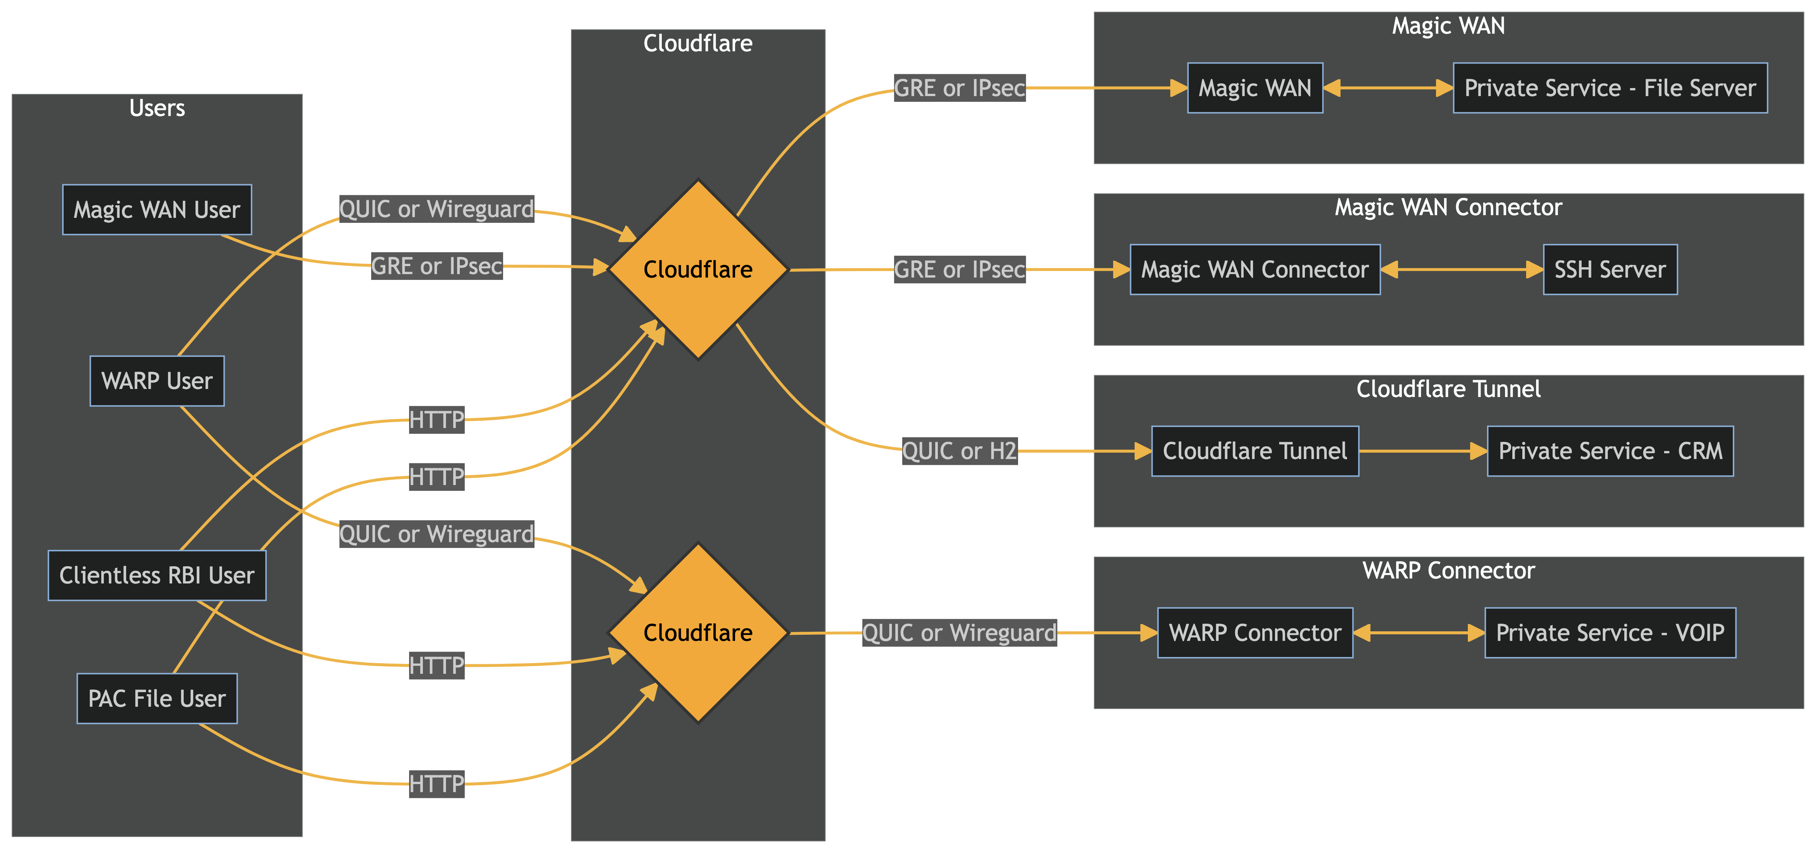
How does it work?

Slide 5
The double ended arrows indicate bi-directional flow

Slide 6
Demo

