Slide 1
Passive phase

Slide 2
This is your wealth

Slide 3
When the box lights up…
Press SPACEBAR

Slide 4

The wheel now spind to select a fractal at random

Slide 5
The fractal appears…

Slide 6
Your wealth has now changed because of the fractal

Slide 7
That was round 1, you will play many rounds
Try to remember how each fractal changes your wealth
You will need this information later

Slide 8
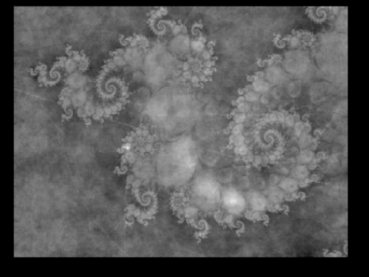
There are 6 different fractals in total
(Not these ones)

Slide 9
Three are positive …
… two are negative …
… And one does not change your wealth

Slide 10
Once you have seen these many times - you will get to the first active task - where you are to make choices…

Slide 11
Here you see two fractals that you will have seen many times.
You are to pick the one you think is best for your wealth by pressing LEFT/RIGHT.

Slide 12
This indicates how long you have left to choose

Slide 13
If you press RIGHT, this fractal will remain on screen indicating your choice
You can’t change your mind.

Slide 14
You will make a number of different choices

Slide 15
Active phase

Slide 16
This is your wealth again
We have reset it to 1000, but now your choices will affect it.
The wealth you earn in this game will affect your payout in real money.

Slide 17
You must now choose between LEFT and RIGHT by pressing the arrow keys
LEFT
RIGHT

Slide 18
Again, this indicates how long you have left to choose
If you don’t choose in time, we will give you the worst fractal

Slide 19
If you press RIGHT…
…your wealth will be changed by this fractal

Slide 20
If you had pressed LEFT you would get either the upper fractal or the lower fractal.
We flip a coin to decide

Slide 21
This time the coin landed HEADS…
…so you got the lower fractal

Slide 22
Your wealth will be changed by this fractal.

Slide 23
New pic needed where coin
Is on upper fractal
Had it been tails you would have gotten the upper fractal

Slide 24
New pic needed where coin
Is on upper fractal
… and your wealth would be changed by this fractal.

Slide 25
That was round one!
You will make many choices like this and your aim is to acquire as much wealth as possible.
Good luck!

