Slide 1
Physical product:
shovel
Members: 1.U2210150-Muborakov Muhammad Ali
2.U2210158-Mutalova Sarvinoz
3.U2210161-Nabiyeva Sevinch
4.U2210167-Nuridinnov Nurmuhammad.

Slide 2
Introduction
Modern shovels have come a long way from their humble beginnings as simple tools made of wood and metal. Today, shovels are available in a variety of shapes, sizes, and materials, each designed to meet specific needs and applications. From gardening to construction, shovels are an essential tool for any task that involves moving dirt, gravel, or other materials. In this article, we will explore the features and benefits of modern shovels and how they have evolved to become more efficient and ergonomic.

Slide 3
Our mission is to provide affordable and accessible increasing efficiency of labour,while promoting comfortable service of shovel.Simplifying the use of hand tools.

Slide 4
Costumers needs
Durability | Costumers want a shovel that is sturdy and can withstand heavy use without breaking or bending. | 2
Size and weight | The size and weight of the shovel should be appropriate for the user’s height and strength, as well as the type of they will be doing. | 4
Comfort | The handle of the shovel should be comfortable to grip and not cause blisters or hand fatigue during extended use. | 5
Functionality | Customers may need a shovel with a specific shape or design to suit their particular gardening or landscaping needs. | 3
Price | Customers want a shovel that is affordable and provides good value for money. | 2
Brand reputation | Customers may prefer to buy from a reputable brand with a proven track record of producing high-quality shovels. | 1
Material | The material used to make the shovel should be strong, durable, and resistant to rust and corrosion. | 3
Warranty | Customers may look for shovels with warranties that cover defects in materials or workmanship. | 5
Versatility | Customers may want a spade that can be used for multiple purposes such as digging, planting, and cutting roots. | 4

Slide 5
Objectives of shovel
A shovel is a tool used for: digging, lifting, moving , and bulk materials.
Efficiency: Modern shovels are designed to be more efficient than their traditional counterparts. They are lighter, easier to handle and require less effort to use.
Durability: Modern shovels are made with high-quality materials that make them durable and long-lasting. They are resistant to wear and tear, and can withstand heavy use.
Comfort: Modern shovels are designed to be more comfortable to use than traditional shovels. They have ergonomic handles that reduce strain on the hands and wrists, and some models even have padded grips.
Safety: Modern shovels are designed with safety in mind. They have non-slip handles and are made with materials that reduce the risk of injury.
Versatility: Modern shovels come in a variety of shapes and sizes, making them suitable for a wide range of tasks. Some models are designed specifically for digging, while others are better suited for moving materials like snow or gravel.
Environmental friendliness: Some modern shovels are made with eco-friendly materials, reducing their impact on the environment. Additionally, some models are designed to reduce the amount of effort required to complete a task, which can help conserve energy.

Slide 6
How our product behave: comfortable
For general digging/landscaping – ROUND-POINT
To transfer loose material – SQUARE-POINT
To dig a trench or get in a tight spot – TRENCHING SHOVEL
For clearing hard-to-reach spaces – DRAIN SPADE
To edge – EDGING SHOVEL/EDGER
To clear snow – SNOW SHOVEL/SNOW PUSHER
To dig post holes – POST HOLE DIGGER
For scooping mulch or snow – ONE-PIECE SCOOP/ SCOOP SHOVEL

Slide 7
Design variables
Material
Our shovel made from steel , aluminum and plastic. Each material has its own advantages in terms of weight,durability, cost.
The shape of the shovel is round in medium size which affect its ability to dig or move materials efficiently.
Shape
Handle
It has straight the handle.The handle affect the comfort and ease of use shovel.
It is lighter in weight which allow to easily handle and potentially durable .
Weight
While not necessarily affecting the functionality of the shovel, our shovel come in red for aesthetic purpose.
Weight
Color

Slide 8
QFD
IMPORTANCE
METALL
PLASTIC
LESS MATERIAL
SAFETY COVERS
SEPARATABLE
LENGTH CONTROL
BENDABLE
COST
VOLUME
THICKNESS
WIDTH(diameter)
LIGHT(green)
WATER REPELLANT
FIRE RETARDAT
CHEMICAL DUR.
SHARPENER
LIGHT WEIGHT
3
1
9
5
1
SAFE
5
5
9
9
1
5
SIZE
3
5
9
5
5
1
COLOUR
2
5
5
5
1
1
1
1
COMFORTABLE
4
1
1
1
5
5
5
1
1
COST AFFECTIVE
4
1
5
9
9
9
EASY TO PUT ON
2
5
9
1
9
9
9
1
LASTS LONG TIME
3
1
9
5
5
5
1
9
SHARPNESS
4
5
9
GRABBING PROB.
4
5
5
9
EASY TO FIND
3
9
9
DURABLE
5
9
5
5
5
9
9
9
96
168
73
92
99
67
84
36
68
45
67
29
60
48
72
38

Slide 9




Competitor benchmarking
01
Razor - Back
Company produces shovel with materials predominantly sourced from United states.
Hisko
Hisko’s shovels are known
To have the most secure and comfortable handles.
Bully tools
This brands shovel made from 100% steel.
Others
Shovels in this brand are useful mainly for gardening project.

Slide 10
Product specification
Metric | Units | Marginal | Ideal
Weight | kg | 5 kg | 3kg
Density | Kg/m3 | 2.640 kg/m3 | 2.810 kg/m3
Separetable | unit | no | yes
Smoothness of the stick | N | 1.2 | 0.5
Strength | kg | 2 | 2-3
Durability | year | 1 | 2-3
Color | Red and black | yes | yes
Material | plastic,metal | no | yes
Chemical durability | - | no | no
Fire-retardant or fire-protective | - | no | no
Length | m | 0.8-1 | 0.5-0.8

Slide 11
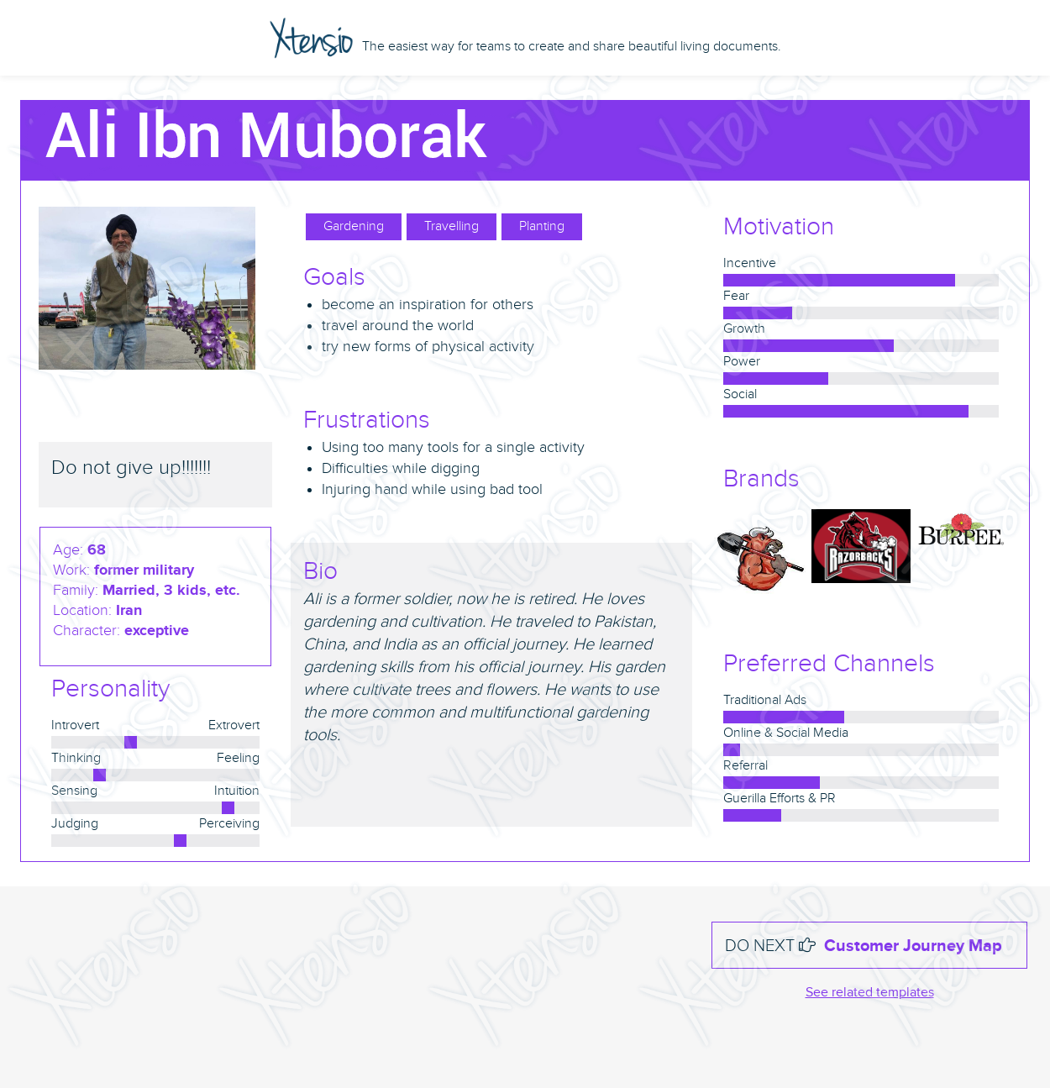
Persona

Slide 12
TRIZ Approach
Domain Specific Technical Contradictions:
A: Durability of moving object
B: Volume of moving object
A getting better | B getting worse
Durability of moving object getting better | volume getting worse
TRIZ Technical Parameter: 15. Durability of moving object | TRIZ Technical Parameter: 7.Volume of moving object

Slide 13
Parameter Resolution
10 - Preliminary action
2 - Separation
19 - Periodic action
30 - Flexible shells and thin films
According to TRIZ we have got Separatable, Bendable, sharp and durable object.

Slide 14
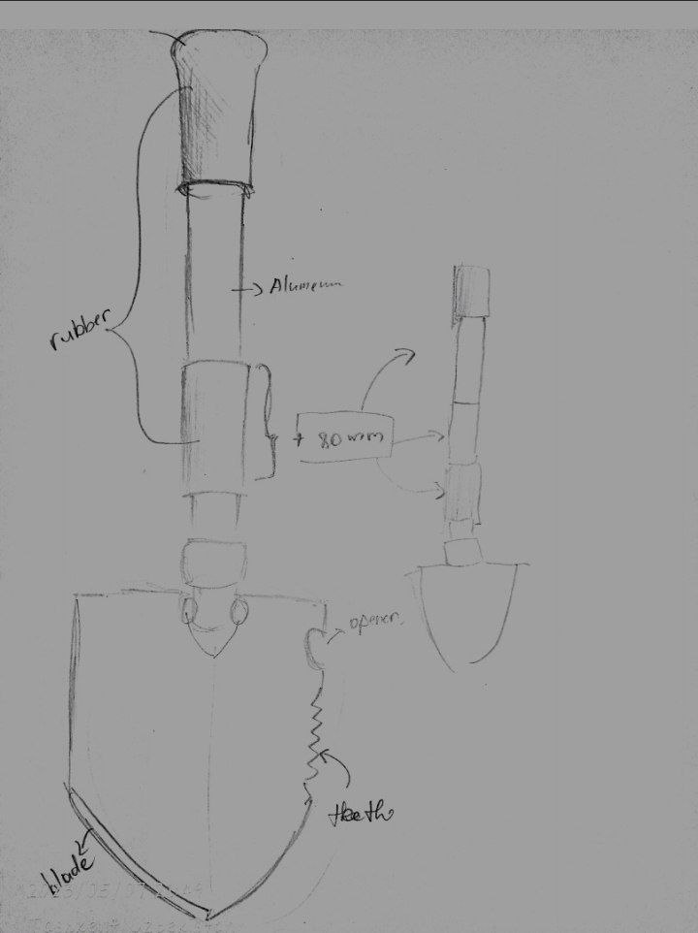
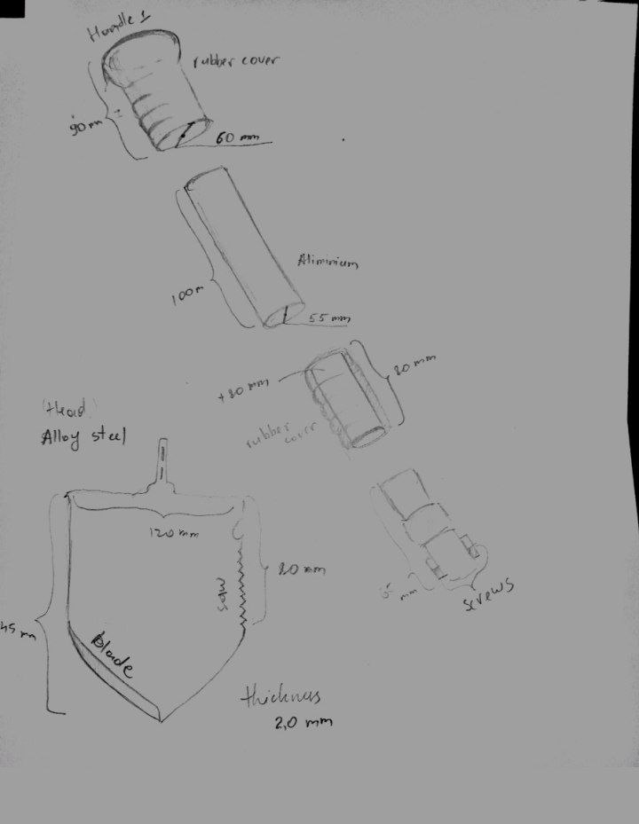
Technical drawings

Slide 15
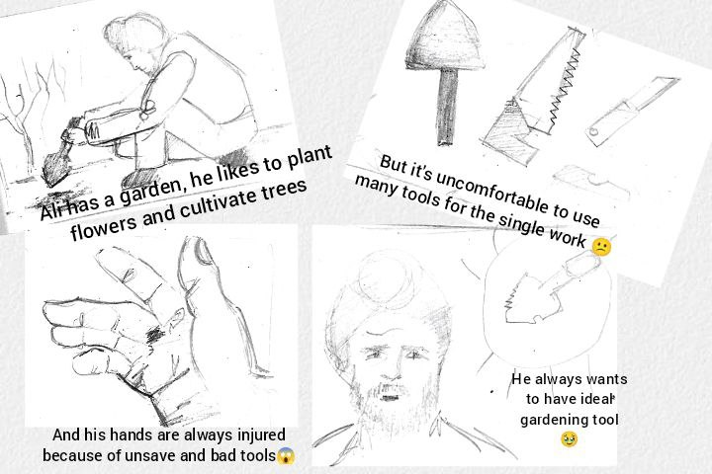
Storyboarding

Slide 16
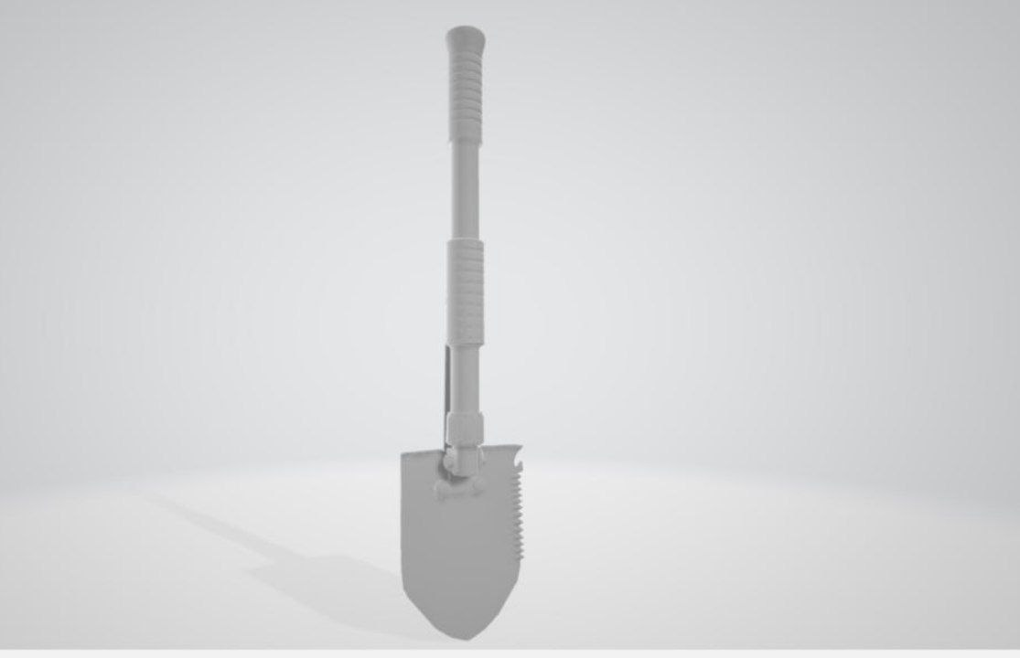
3D model

Slide 17
Conclusion
We discussed about challenges and weak parts of the concept. It also provides reflection on the entire process of our team's work as a product development.

Slide 18
Thank you
slides template: https://slidesgo.com/theme/technology-consulting#position-6&results-1268

