Slide 1


Bapuji Institute of Engineering and Technology, Davangere-577004
SIGNALS AND SYSTEMS [18EE54]
Credits - 03
Course objectives:
To discuss arising of signals in different systems
To classify the signals and define certain elementary signals.
To explain basic operations on signals and properties of systems
To explain the use of convolution integral and convolution summation in analysing the response of linear time invariant systems in continuous and discrete time domains.
To explain the properties of linear time invariant systems in terms of impulse response description
Dept. of Electrical and Electronics Engineering

Slide 2
Bapuji Institute of Engineering and Technology, Davangere-577004
To explain determination of response of a given linear time invariant system and to provide a block diagram representation to it
To explain Fourier transform representation of continuous time and discrete time non –periodic signals and the properties of Fourier Transforms.
To explain the applications of Fourier transform representation to study signals and linear time invariant systems. To explain the use of Z-transform in the complex exponential representation of discrete time signals and the analysis of systems
Dept. of Electrical and Electronics Engineering

Slide 3
Bapuji Institute of Engineering and Technology, Davangere-577004
Program Outcomes or Graduate Attributes
1. Engineering knowledge: Apply the knowledge of mathematics, science, engineering fundamentals, and an engineering specialization to the solution of complex engineering problems.
2. Problem analysis: Identify, formulate, review research literature, and analyze complex engineering problems reaching substantiated conclusions using first principles of mathematics, natural sciences, and engineering sciences.
3. Design/development of solutions: Design solutions for complex engineering problems and design system components or processes that meet the specified needs with appropriate consideration for the public health and safety, and the cultural, societal, and environmental considerations.
4. Conduct investigations of complex problems: Use research-based knowledge and research methods including design of experiments, analysis and interpretation of data, and synthesis of the information to provide valid conclusions.
5.Modern tool usage: Create, select, and apply appropriate techniques, resources, and modern engineering and IT tools including prediction and modeling to complex engineering activities with an understanding of the limitations.
6. The engineer and society: Apply reasoning informed by the contextual knowledge to assess societal, health, safety, legal and cultural issues and the consequent responsibilities relevant to the professional engineering practice.
Dept. of Electrical and Electronics Engineering

Slide 4
Bapuji Institute of Engineering and Technology, Davangere-577004
7. Environment and sustainability: Understand the impact of the professional engineering solutions in societal and environmental contexts, and demonstrate the knowledge of, and need for sustainable development.
8. Ethics: Apply ethical principles and commit to professional ethics and responsibilities and norms of the engineering practice.
9. Individual and team work: Function effectively as an individual, and as a member or leader in diverse teams, and in multidisciplinary settings.
10. Communication: Communicate effectively on complex engineering activities with the engineering community and with society at large, such as, being able to comprehend and write effective reports and design documentation, make effective presentations, and give and receive clear instructions.
11. Project management and finance: Demonstrate knowledge and understanding of the engineering and management principles and apply these to one’s own work, as a member and leader in a team, to manage projects and in multidisciplinary environments.
12. Life-long learning: Recognize the need for, and have the preparation and ability to engage in independent and life-long learning in the broadest context of technological change.
Dept. of Electrical and Electronics Engineering

Slide 5
Bapuji Institute of Engineering and Technology, Davangere-577004
Module:1
Introduction: Definitions of signals and a system, classification of signals, basic operations on signals.
Elementary signals viewed as interconnections of operations, properties of systems.
Module: 2
Time – Domain Representations for LTI Systems: Convolution, impulse response, properties, solution of differential and difference equations, block diagram representation.
Module: 3
The Continuous-Time Fourier Transform: Representation of a non -periodic signals: continuous-time
Fourier transform (FT), Properties of continuous-time Fourier transform, Applications. Frequency response of LTI systems, Solutions of differential equations
Dept. of Electrical and Electronics Engineering

Slide 6
Bapuji Institute of Engineering and Technology, Davangere-577004
Module: 4
The Discrete-Time Fourier Transform: Representations of non-periodic signals: The discrete-time
Fourier transform (DTFT), Properties of DTFT and applications. Frequency response of LTI system,
Solutions of difference equations.
Module: 5
Z- Transforms: Introduction, Z-transform, properties of ROC, properties of Z-transforms, inversion of
Z-transform methods - power series and partial expansion, Transforms analysis of LTI systems, transfer function, stability and causality, unilateral Z-transform and its application to solve difference equations.
Dept. of Electrical and Electronics Engineering

Slide 7
Bapuji Institute of Engineering and Technology, Davangere-577004
1 Signals and Systems Simon Haykin, Berry Van Veen, Wiley 2nd Edition, 2002
Reference Books
1 Fundamentals of Signals and Systems, Michael J. Roberts, Govind K Sharma McGraw Hill 2nd Edition 2010
Signals and Systems NagoorKani McGraw Hill 1st Edition 2010
Signals and Systems, A Primer with MATLAB, Matthew N.O. Sadiku Warsame H. Ali, CRC Press 1st Edition, 2016
Signals and Systems Anand Kumar PHI 3rd Edition, 2015
Dept. of Electrical and Electronics Engineering

Slide 8





Bapuji Institute of Engineering and Technology, Davangere-577004
Dept. of Electrical and Electronics Engineering

Slide 9
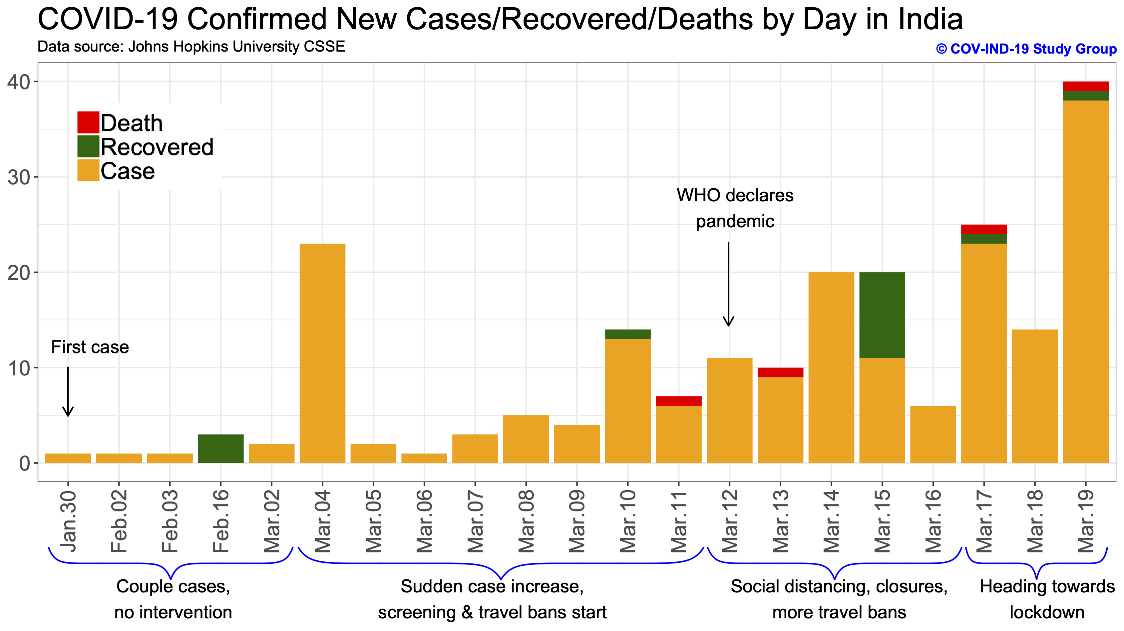
Bapuji Institute of Engineering and Technology, Davangere-577004
Dept. of Electrical and Electronics Engineering

Slide 10
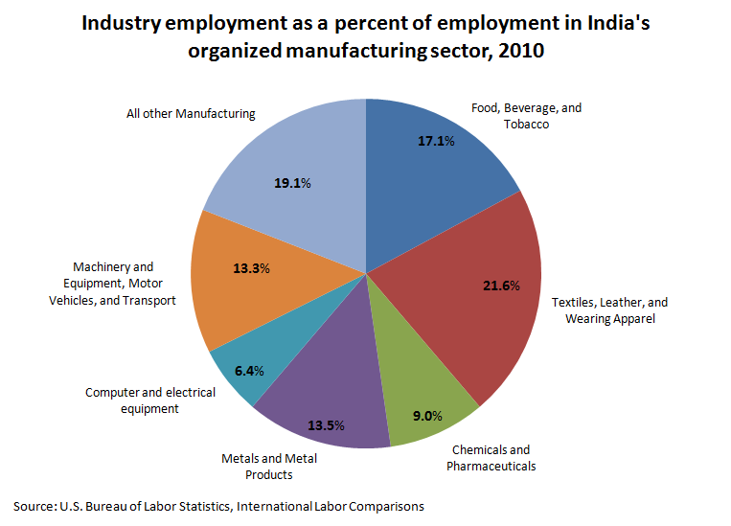
Bapuji Institute of Engineering and Technology, Davangere-577004
Dept. of Electrical and Electronics Engineering

Slide 11
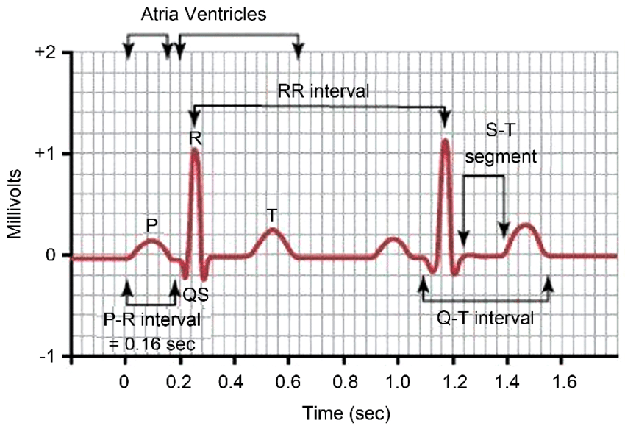
Bapuji Institute of Engineering and Technology, Davangere-577004
Dept. of Electrical and Electronics Engineering

Slide 12
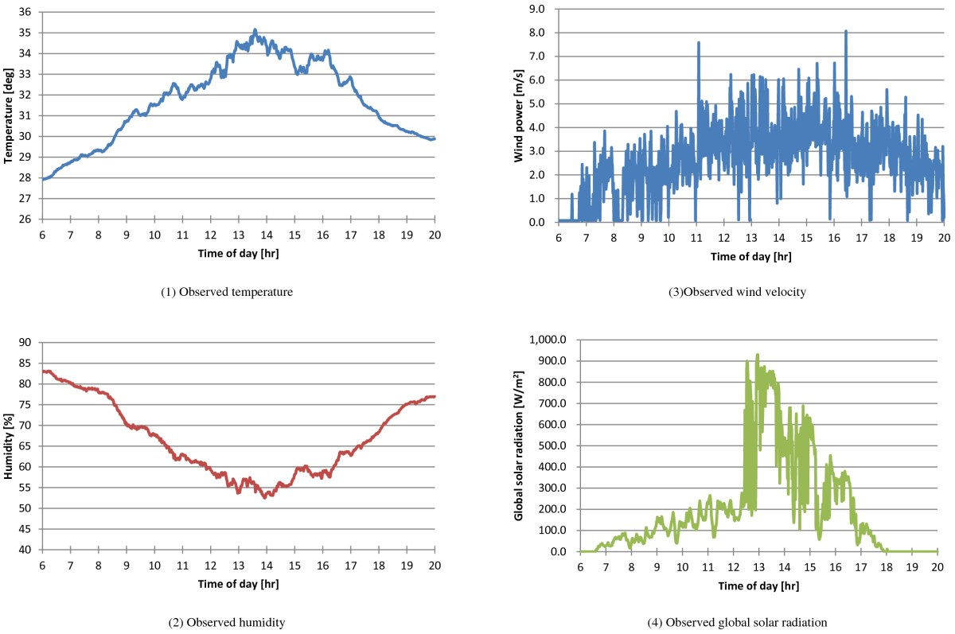
Bapuji Institute of Engineering and Technology, Davangere-577004
Dept. of Electrical and Electronics Engineering

Slide 13
Bapuji Institute of Engineering and Technology, Davangere-577004
Time Hrs | 8.00 am | 9.00 am | 10.00 am | 11.00 am | 12.00 pm | 1.00 pm | 2.00 am | 3.00 am | 4.00 am
Temp Deg. | 22 | 24 | 25 | 28 | 30 | 32 | 29 | 28 | 27
Month | Jan | Feb | Mar | Apr | May | June | July | Aug
Mess bill | 1500 | 1600 | 1700 | 1800 | 1900 | 2000 | 2100 | 2200
Year | first | second | Third | Fourth
College Fees | 90K | 90K | 90K | 90K
Dept. of Electrical and Electronics Engineering

Slide 14
Bapuji Institute of Engineering and Technology, Davangere-577004
Thank You
Dept. of Electrical and Electronics Engineering

