Slide 1

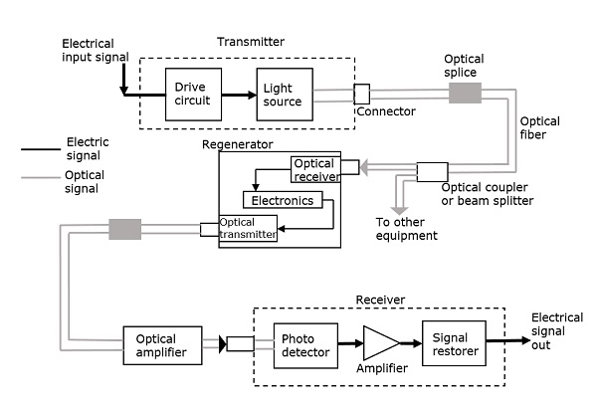

Slide 2

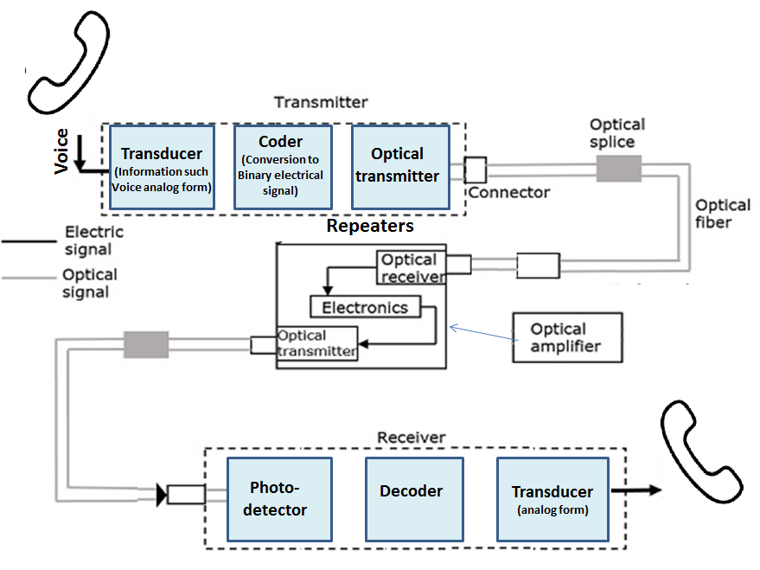
Block diagram of point to point fiber optic communication system:
The microphone in the telephone receiver converts voice in to equivalent analog electrical signals.
The analog signals are converted in to digital signals using a coder.
A transmitter consisting of a semiconductor diode laser which emits light according to the digital binary input. The light emitted from the laser source is launched on the optical fiber.

Slide 3
The information in the form of light can be transmitted over large distances. If necessary, repeaters can be used. A repeater, receives the signal and amplifies it and transmit again.
At the receiving end the photodiode convert the received light in to equivalent binary electrical signals.

Slide 4
The decoder converts binary electrical signal in to analog electrical signals.
The loud speaker in the handset produces sound waves to convey the voice information.

Slide 5
Advantages(Merits) of optical communication system:
Optical fibers can carry very large amount of information, whose frequencies are spread over a large bandwidth.
Material used for making the optical fibers are available in low cost.
Because of their compactness and lightweight, optical fibers much easier to transport.
Since the signal is optical, there is no short circuit happen as it could be in the case of electrical signal (wire).

Slide 6
Limitations(demerits) of optical communication system:
Splicing is a skilful task.
The escalation of maintenance cost.
The loss of signal is become considerable one when we bent the fibers into beyond critical bending.

Slide 7
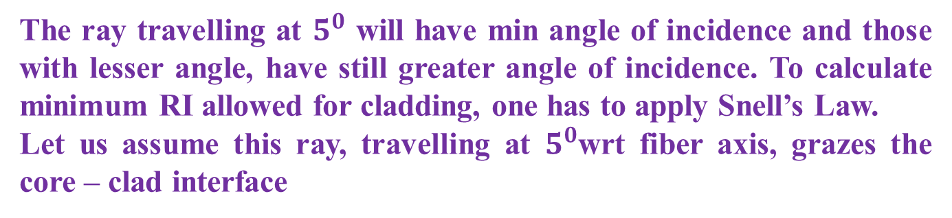
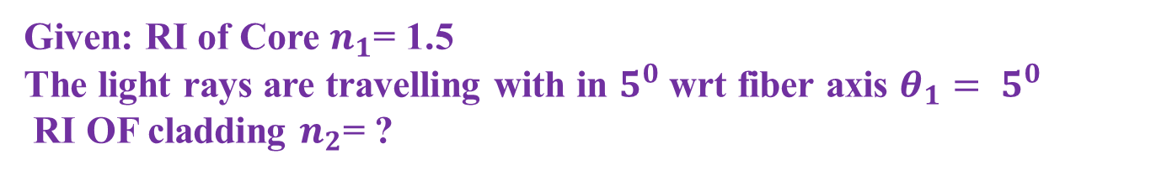





Numerical examples
1. An optic fiber of RI 1.50 is to be clad to ensure TIR that will contain light travelling with in $5^{0}$ of the fiber axis. What minimum RI is allowed for the cladding?
Given: RI of Core $n_{1}$= 1.5
The light rays are travelling with in $5^{0}$ wrt fiber axis $θ_{1}= 5^{0}$
RI OF cladding $n_{2}$= ?
B
C
Cladding
$$n_{2}$$
$$θ={85}^{0}$$
Core
$$n_{1}$$
Θ1 =$5^{0}$
O
The ray travelling at $5^{0}$ will have min angle of incidence and those with lesser angle, have still greater angle of incidence. To calculate minimum RI allowed for cladding, one has to apply Snell’s Law.
Let us assume this ray, travelling at $5^{0}$wrt fiber axis, grazes the core – clad interface

Slide 8

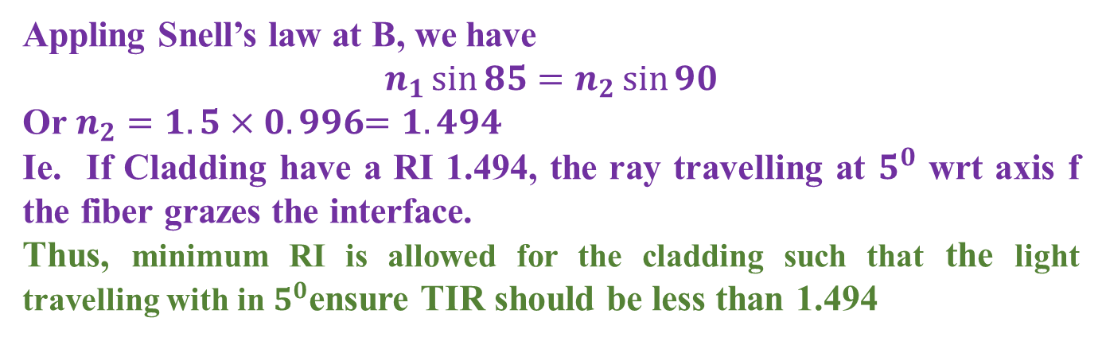


Numerical examples
1. An optic fiber of RI 1.50 is to be clad to ensure TIR that will contain light travelling with in $5^{0}$ of the fiber axis. What minimum RI is allowed for the cladding?
B
C
Cladding
$$n_{2}$$
$$θ={85}^{0}$$
Core
$$n_{1}$$
Θ1 =$5^{0}$
O
Appling Snell’s law at B, we have
$$n_{1}\sin{85=n_{2}\sin{90}}$$
Or $n_{2}=1.5×0.996﷮=1.494$
Ie. If Cladding have a RI 1.494, the ray travelling at $5^{0}$ wrt axis f the fiber grazes the interface.
Thus, minimum RI is allowed for the cladding such that the light travelling with in $5^{0}$ensure TIR should be less than 1.494

Slide 9


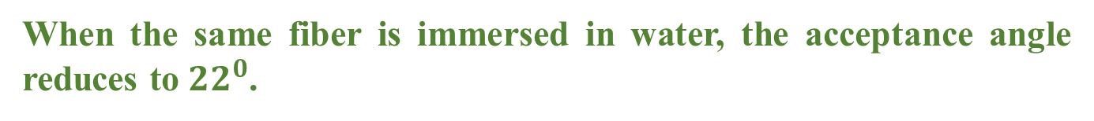
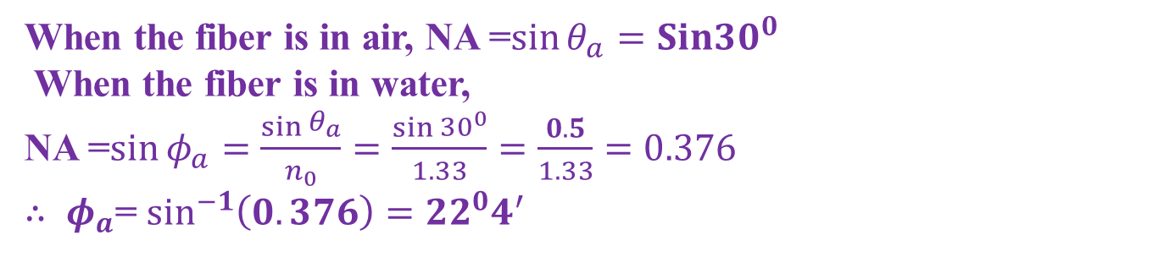
Numerical examples
2. The angle of acceptance of an optical fiber is ${30}^{0}$ when kept in air. Find the acceptance angle when the same fiber is immersed in water of RI 1.33
Given: RI of air $n_{0}=1$, Acceptance angle $θ_{a}$= ${30}^{0}$
RI of water $n_{0}=1.33$ Acceptance angle $φ_{a}$=?
When the fiber is in air, NA =$\sin{θ_{a}=Sin{30}^{0} }$
When the fiber is in water,
NA =$\sin{φ_{a}=\frac{\sin{\begin{aligned}θ_{a} \\ \end{aligned}}}{n_{0}}=\frac{\sin{\begin{aligned}{30}^{0} \\ \end{aligned}}}{1.33}}=\frac{0.5}{1.33}=0.376$
$∴ φ_{a}$= $\sin^{−1}\left(0.376\right)={22}^{0}4^{′}$
When the same fiber is immersed in water, the acceptance angle reduces to ${22}^{0}$.

Slide 10
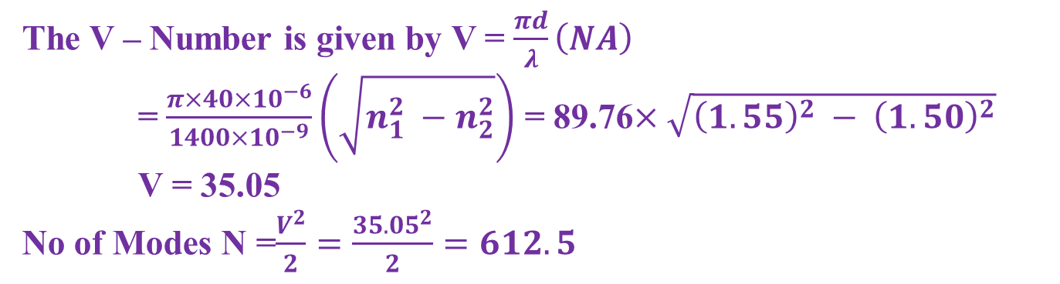
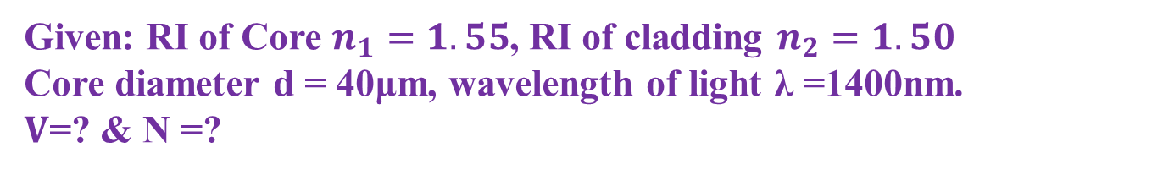
Numerical examples
3. Calculate the V- number for a fiber of core diameter 40μm & RI of 1.55 and 1.50 respectively for its core & cladding when a light of wavelength 1400nm is propagating. Also calculate the number of modes that the fiber can support for the propagation.
Given: RI of Core $n_{1}=1.55$, RI of cladding $n_{2}=1.50$
Core diameter d = 40μm, wavelength of light λ =1400nm.
$V$=? & N =?
The V – Number is given by V = $\frac{πd}{λ}\left(NA\right)$
= $\frac{π×40×{10}^{−6}}{1400×{10}^{−9}}\left(\sqrt{n_{1}^{2} −n_{2}^{2}}\right)$ = 89.76$×\sqrt{{\left(1.55\right)}^{2} − {\left(1.50\right)}^{2}}$
V = 35.05
No of Modes N =$\frac{V^{2}}{2}=\frac{{35.05}^{2}}{2}=612.5$
V parameter is 35 & the no of modes that fiber can support is 312

Slide 11
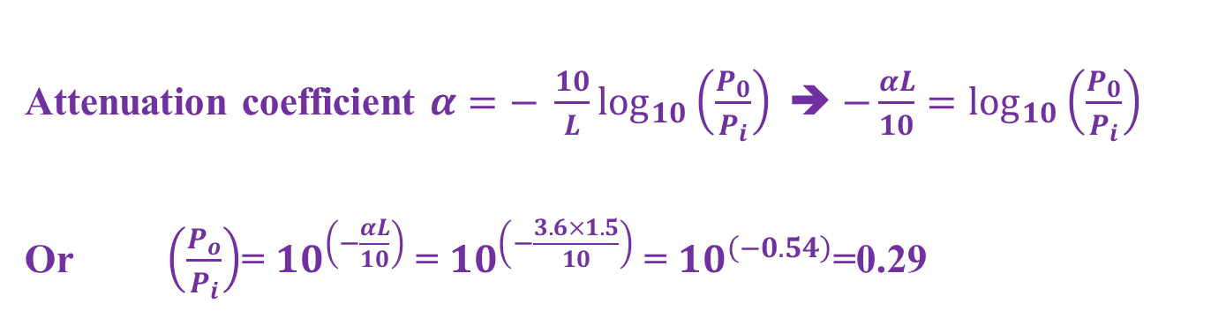
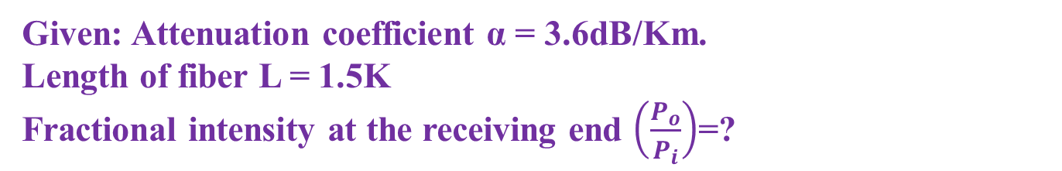
Numerical examples
4. The attenuation in optical fiber is 3.6dB/Km. What fraction of its initial intensity remain after 1.5Km
Given: Attenuation coefficient α = 3.6dB/Km.
Length of fiber L = 1.5K
Fractional intensity at the receiving end $\left(\frac{P_{o}}{P_{i}}\right)$=?
Attenuation coefficient $α=− \frac{10}{L}\log_{10}\left(\frac{P_{0}}{P_{i}}\right)$➔ $−\frac{αL}{10}=\log_{10}\left(\frac{P_{0}}{P_{i}}\right)$
Or $\left(\frac{P_{o}}{P_{i}}\right)$= ${10}^{\left(−\frac{αL}{10}\right)}$ = ${10}^{\left(−\frac{3.6×1.5}{10}\right)}$ = ${10}^{\left(−0.54\right)}$=0.29
At the receiving end 29% of its initial intensity is received.

