Slide 1
dwh-challenge
Ergem Peker

Slide 2
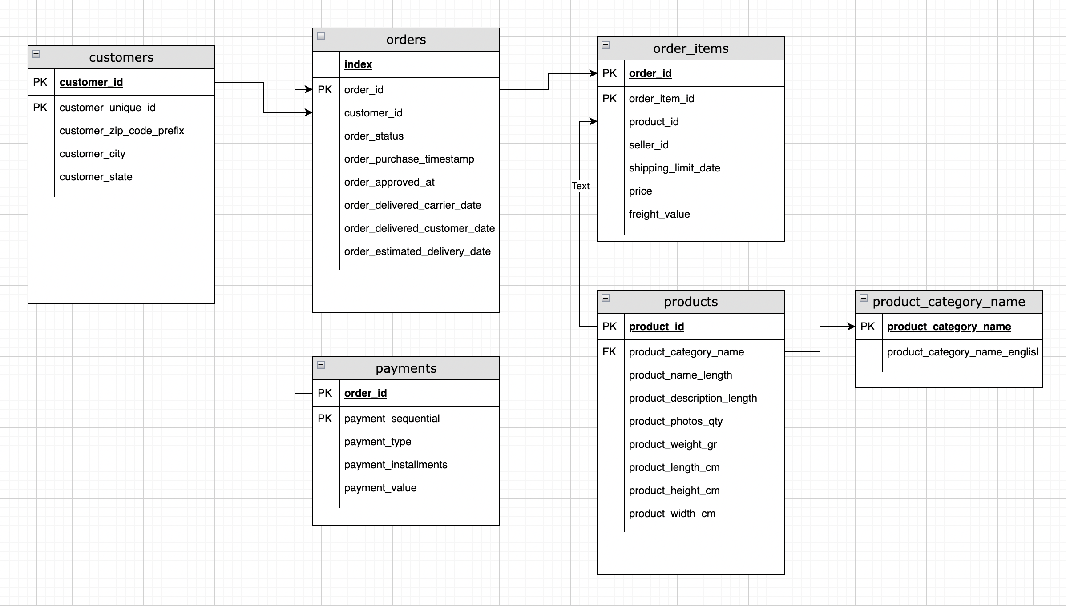
Transactional Model

Slide 3
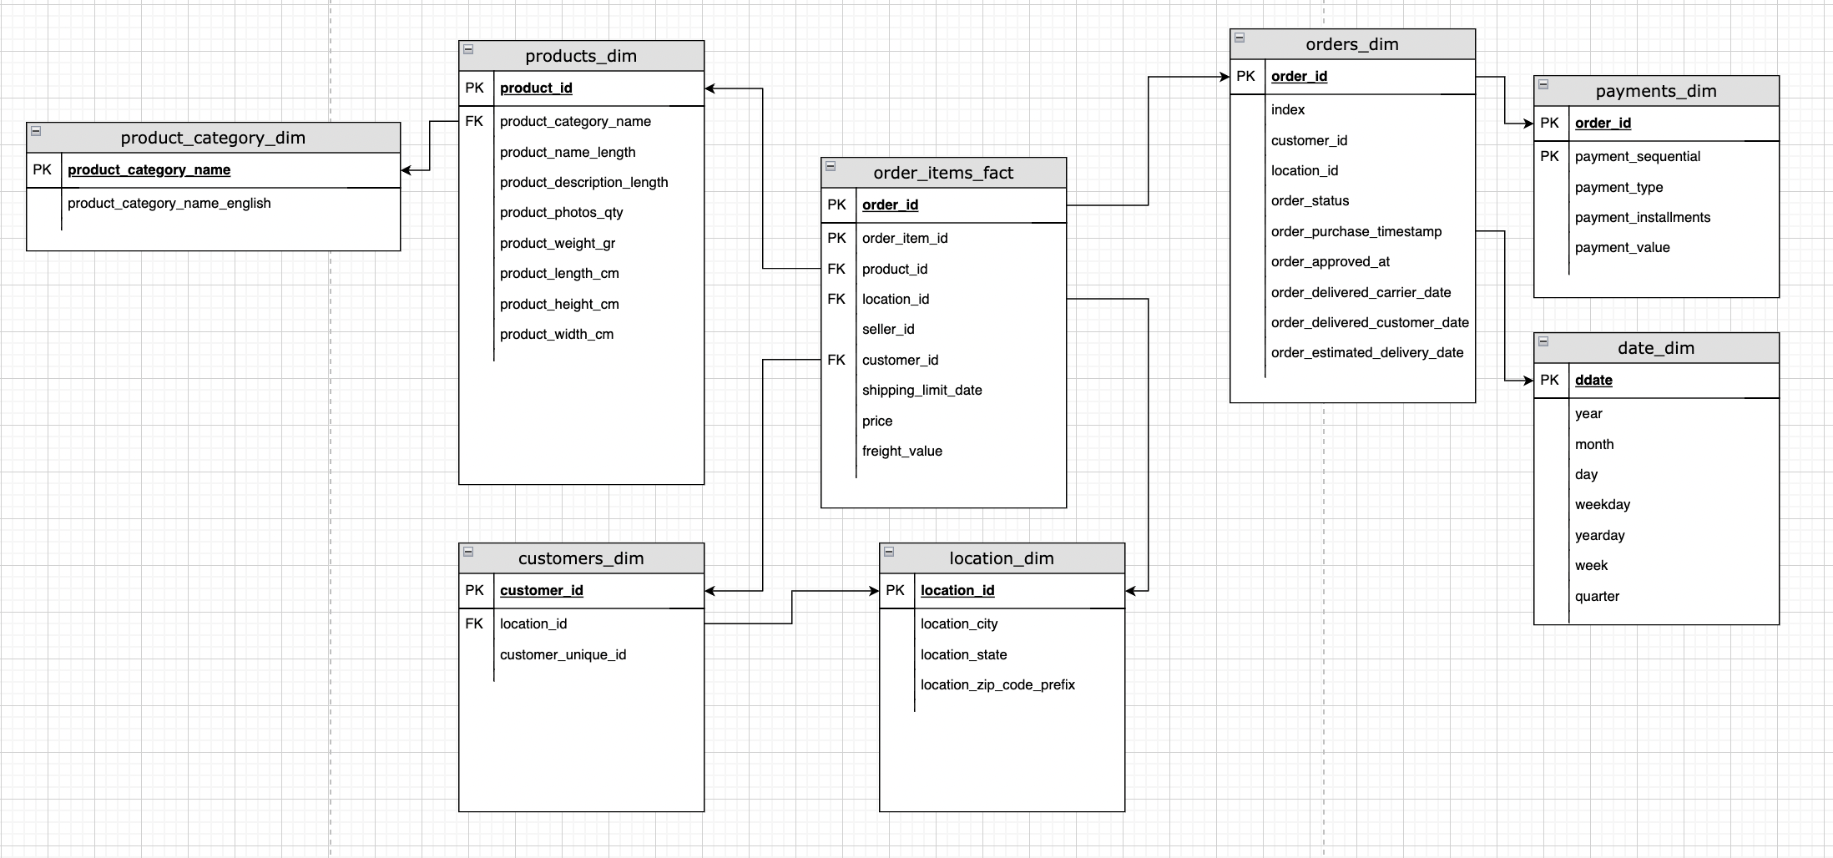
DWH Model

Slide 4
Dimension and Facts
Products_dim
Orders_dim
Customers_dim
Category_dim
Payments_dim
Order_items_fact

Slide 5
Two new dimensions created
Date_dim
Contains the vario types for the date
Year, month, day
Weekday
Yearday
Week
Quarter
Location_dim
Extracted from the customer table and left a location_id in the customers_dim
Location_id is also generated within the order_items_fact and orders_dim for easier filtering and reporting.

Slide 6
Techs used
challenge indicates to output the etl jobs to a S3 storage.
Since I don’t have any s3 access, I used minio (http://min.io) which is an S3 compatible server that can be installed on-prem (org.ergemp.EtlJobMinio.java)
I also have another job, which outputs the etl to a postgresql database (www.postgresql.com) (org.ergemp.EtlJobPostgres.java)
For the ETL jobs I preferred spark (with java) which reads raw data from csv files, transforms to a star schema and writes to a postgresql database (or minio object storage)
In case of postgresql based dwh, sql scripts for the reports can be found in the resources/reports.sql file.
In case of minio based dwh, sql scripts are actually the spark.sql sql’s within the java class (org.ergemp.ReportingJobMinio)

Slide 7
Considerations
Reading directly from the csv files with the header option=true brings the column naming but not the datatypes.
To deliver quickly I left the column types as text (without creating struct types for each table) and solve the typing with conversion functions within the sql
Solution could also be implemented in python, but for earlier access I skipped python and did the challenge in java.
Postgresql and minio access properties are hard coded in the code. There is only three classes, I guess finding and changing the access information would be easy to do.

Slide 8
How to Run
Project is developed in as maven project
All dependencies are in the pom.xml file
Java11 used as java version
IntelliJ idea is used as the project IDE.
For minio (S3) access some extra packages are directly included within the module settings. These jar files can found in the /lib directory of the project
Raw data, drawings, postgresql sql scripts and this peresentation can also be found underde /resources drectory

