Slide 1

Ergin Şen
Kuveyt Türk, 2017

Slide 2
OUTLINE
History
Kotlin
Sample Codes
Java vs Kotlin
Conclusion

Slide 3
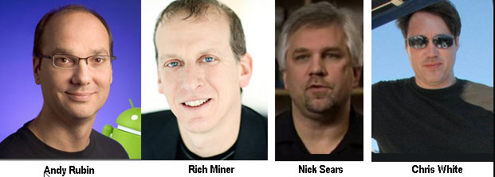
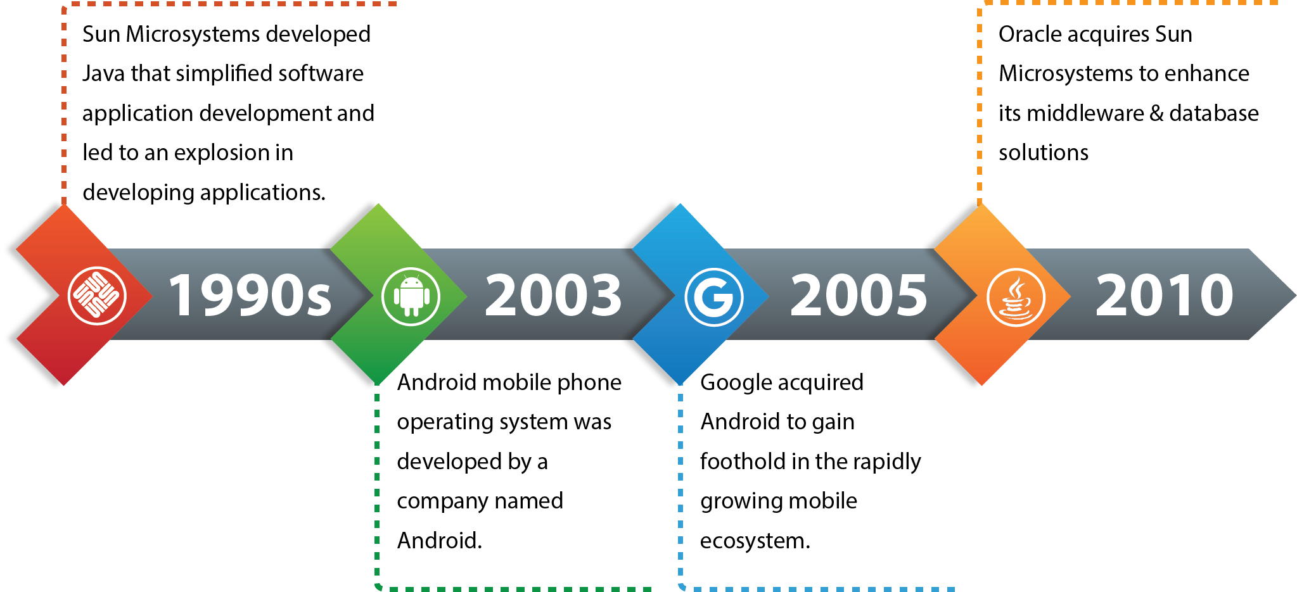
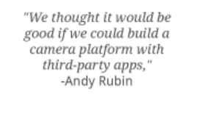
HISTORY

Slide 4
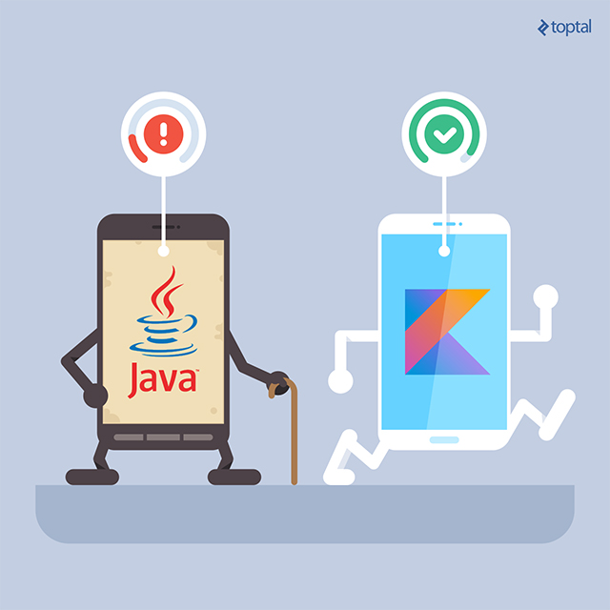

HISTORY

Slide 5
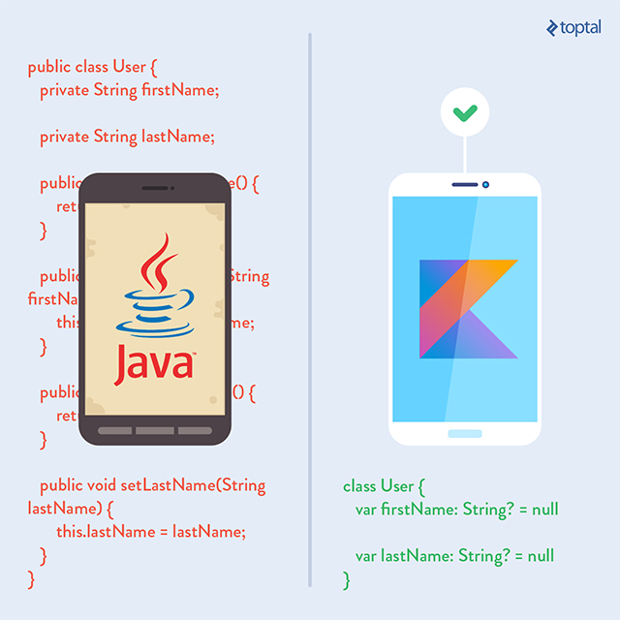
DISCUSSION
What to Do in This Situtation
Rewriting everything was a bad idea.
A new language needed to be Java compatible.
Scala was the only aviable option of existing languages but:
Slow compile speed.
Good IDE support not being possible due to the structure of the language.
It’s complex and inviting you to write unreadable code.

Slide 6




KOTLIN
Google made a deal with JetBrains which is founder of IntelliJ & Android Studio.
Full IDE support.
Many of Kotlins features are taken from other JVM languages (Groovy).

Slide 7
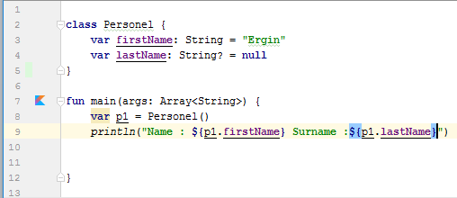
KOTLIN

Slide 8
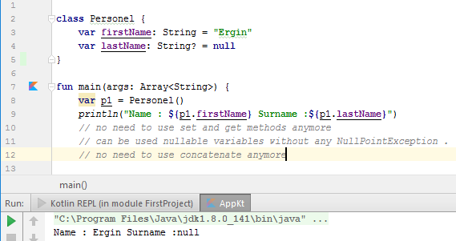
KOTLIN

Slide 9
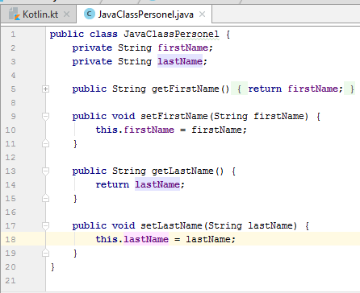
KOTLIN

Slide 10
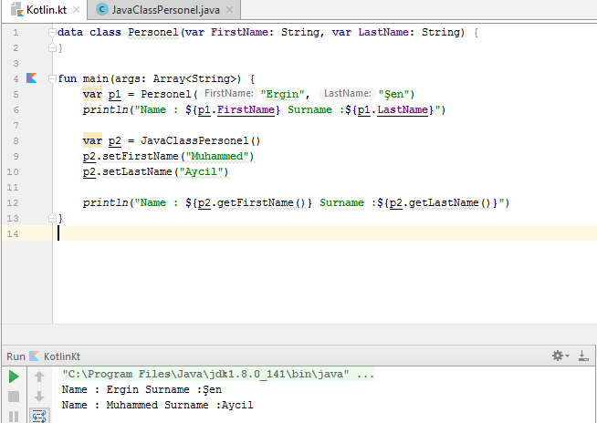
KOTLIN

Slide 11
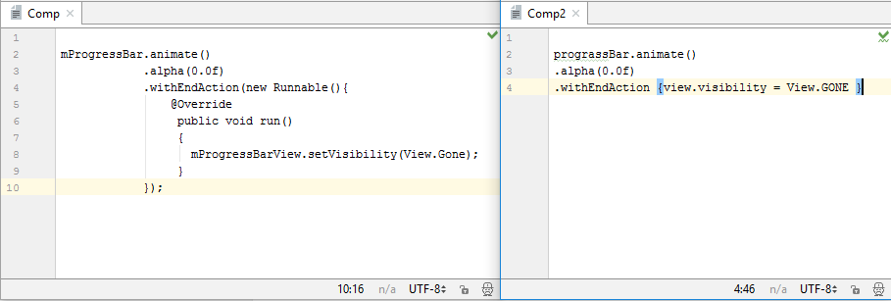
JAVA vs KOTLIN

Slide 12
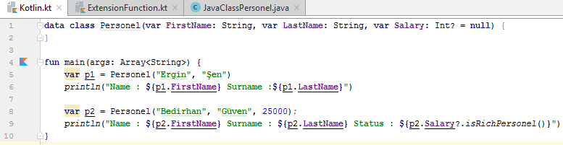
KOTLIN – EXTENSION FUNCTIONS

Slide 13
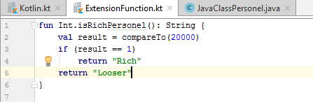
KOTLIN – EXTENSION FUNCTIONS

Slide 14

KOTLIN – EXTENSION FUNCTIONS

Slide 15
CONCLUSION
Clear syntax, modern features.
Write less code, Read less code.
No more NullPointerException.
%100 compatible with Java.

Slide 16

Thanks

