Slide 1
The Vector-Thread Architecture
By: Ronny Krashinsky, Christopher Batten, Mark Hampton, Steve Gerding, Brian Pharris, Jared Casper, and Krste Asanović
Presented by: Andrew P. Wilson

Slide 2
Agenda
Motivation
Vector-Thread Abstract Model
Vector-Thread Physical Model
SCALE Vector-Thread Architecture
  Overview
  Code Example
  Microarchitecture
  Prototype
Evaluation
Conclusion

Slide 3
Agenda
Motivation
Vector-Thread Abstract Model
Vector-Thread Physical Model
SCALE Vector-Thread Architecture
  Overview
  Code Example
  Microarchitecture
  Prototype
Evaluation
Conclusion

Slide 4
Motivation
Parallelism and Locality are key application characteristics
Conventional sequential ISAs provide minimal support for encoding parallelism and locality
  Result: high-performance implementations devote much area and power to on-chip structures to:
    extract parallelism
    support arbitrary global communication

Slide 5
Motivation
Large areas and power overheads are justified for even small performance improvements
Many applications have parallelism that can be statically determined
ISAs that can expose more parallelism
  require less area and power
  don’t have to devote resources to dynamically determine dependencies

Slide 6
Motivation
ISAs that allow locality to be expressed
  reduce need for long range communication and complex interconnections
Challenge: develop an efficient encoding of parallel dependency graphs for the microarchitecture that’ll execute the dependency graph

Slide 7
Motivation
SCALE
  Vector-Thread Architecture
  Designed for low-power and high-performance embedded applications
  Benchmarks show embedded domains can be mapped efficiently to SCALE
    Multiple types of parallelism are exploited simultaneously

Slide 8
Agenda
Motivation
Vector-Thread Abstract Model
Vector-Thread Physical Model
SCALE Vector-Thread Architecture
  Overview
  Code Example
  Microarchitecture
  Prototype
Evaluation
Conclusion

Slide 9
VT Abstract Model
Vector-Thread Architecture:
  Unified vector and multithreaded execution models
  Consists of a conventional scalar control processor and an array of slave virtual processors (VPs)
Benefits
  Large amounts of structural parallelism can be compactly encoded
  Simple microarchitecture
  High performance at low power by avoiding complex control and datapath structures and by reducing activity on long wires

Slide 10
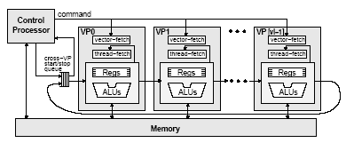
VT Abstract Model
Control Processor
Virtual Processor Vector
Virtual
Processor
Virtual
Processor
Virtual
Processor

Slide 11
VT Abstract Model
Control processor
  Gives work out to the Virtual Processors
Virtual Processor Vector
  Array of Virtual Processors
Two separate instruction sets
Well suited to loops, each VP executes a single iteration of the loop while the control processor manages the execution

Slide 12
VT Abstract Model
Virtual Processor
  Has set of registers and executes strings of Risc-like instructions packaged into atomic instruction blocks (AIBs)
  AIBs can be obtained in two ways:
    The control processor can broadcast AIBs to all VPs (data-parallel code) using a vector-fetch command or to a specific VP using a VP-fetch command
    The VPs can fetch their own AIBs (thread-parallel code) using a thread-fetch command
  No automatic program counter or implicit instruction fetch mechanism; all AIBs must be explicitly requested by the control processor or the VP itself

Slide 13
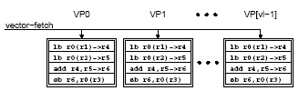
VT Abstract Model
Vector-Fetch example: vector-vector add loop
  AIB consists of two loads, an add, and a store
  AIB is sent to all VPs via vector-fetch command
  All VPs execute the same instructions but on different data elements depending on VP index number
  vl iterations of the loop executed at once
r0 = VP index
r1, r2 = input vector base addresses
r3 = output vector base address

Slide 14

VT Abstract Model
VP thread
Thread-fetch example: pointer-chasing
  Thread-fetches can be predicated
  VP thread persists until all no more fetches occur and the current AIB is complete
  Next command from control processor is ignored until the VP thread is finished
thread-fetch
thread-fetch

Slide 15
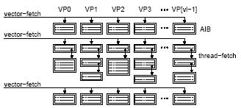
VT Abstract Model
Vector-fetching and thread-fetching combined

Slide 16
VT Abstract Model
VPs are connected in a unidirectional ring
  Data can be transferred from VP(n) to VP(n+1)
  Cross-VP data transfers
  Dynamically scheduled
  Resolve when data becomes available

Slide 17
VT Abstract Model
Cross-VP start/stop queue

Slide 18
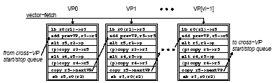
VT Abstract Model
Cross-VP Data Transfer example: saturating parallel prefix sum
  Initial value pushed into cross-VP start/stop queue
  Result either popped from cross-VP start/stop queue or consumed during next execution of the AIB
r0 = VP index
r1, r2 = input vector base addresses
r3, r4 = min and max saturation values
Cross-VP Data Transers
Vector-Fetch AIB
Vector-Fetch AIB
Vector-Fetch AIB

Slide 19
VT Abstract Model
VPs can be used as free-running threads as well, operating independently from the control processor and retrieving data from a shared work queue

Slide 20
VT Abstract Model
Benefits
  Parallelism and locality maintained at a high granularity
  Common code can be executed by the Control Processor
  AIBs reduce instruction fetching overhead
  Vector-fetch commands explicitly encode parallelism and instruction locality, high-performance, amortized control overhead
  Vector-memory commands avoid separate load and store requests for each element and can be used to exploit memory data-parallelism
  Cross-vp data transfers explicitly encode fined grain communication and synchronization with little overhead

Slide 21
Agenda
Motivation
Vector-Thread Abstract Model
Vector-Thread Physical Model
SCALE Vector-Thread Architecture
  Overview
  Code Example
  Microarchitecture
  Prototype
Evaluation
Conclusion

Slide 22
VT Physical Model
Control processor
  Conventional scalar unit
Vector-thread unit (VTU)
  array of processing lanes
  VPs striped across the lanes
  Each lane contains:
    physical registers holding the VP states
    functional units

Slide 23
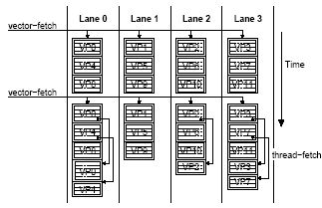
VT Physical Model
functional units are time-multiplexed across the VPs

Slide 24
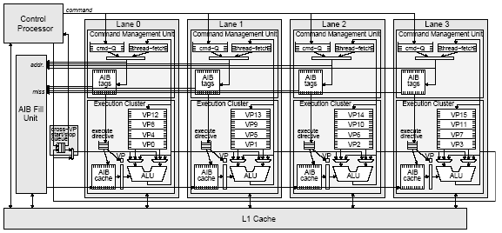
VT Physical Model
Each lane contains a command management unit and an execution cluster
Lane
Lane
Lane
Lane
CMU
CMU
CMU
CMU
Execution
Cluster
Execution
Cluster
Execution
Cluster
Execution
Cluster

Slide 25
VT Physical Model
Command Management Unit
  Buffers commands from control processor
  Holds pending thread-fetch addresses for VPs
  Holds tags for lane’s AIB cache
  Chooses a vector-fetch, VP-fetch, or thread-fetch command to process
    Fetch contains address/AIB tag
    If AIB is not in cache, request is sent to AIB fill unit
    When AIB is in cache, an execute directive is generated and sent to a queue in the Execution Cluster
    repeat

Slide 26
VT Physical Model
AIB Fill Unit
  Retrieves requested AIBs from the primary cache
  One lane’s request is handled at a time unless lanes are using vector-fetch commands when the AIB will broadcast the AIB to all lanes simultaneously

Slide 27
VT Physical Model
Execution Cluster
  To process execution directive cluster reads VP instructions one by one from the AIB cache and executes them for the appropriate VP
    All instructions in the AIB are executed for one VP before moving on to the next
    Virtual register indices in the AIB instructions are combined with active VP number to create an index into the physical register file
    Thread-fetch instructions are sent to the CMU with the requested AIB address and the VP’s pending thread-fetch register is updated
  Lanes are interconnected with a unidirectional ring network for cross-VP data transfers

Slide 28
Agenda
Motivation
Vector-Thread Abstract Model
Vector-Thread Physical Model
SCALE Vector-Thread Architecture
  Overview
  Code Example
  Microarchitecture
  Prototype
Evaluation
Conclusion

Slide 29
SCALE VT Architecture
Control Processor
  MIPS-based
Vector-thread unit
  Each lane has a single CMU but multiple execution clusters with independent register sets
  AIB instructions target specific clusters
    Source operands must be local to cluster
    Results can be written to any cluster

Slide 30
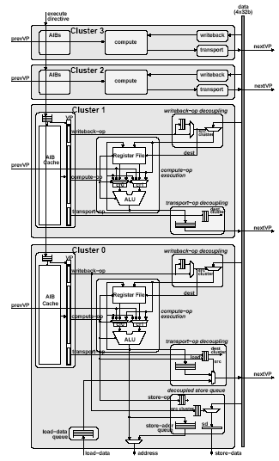
SCALE VT Architecture
Execution Clusters
  All support basic integer operations
  Cluster 0 supports memory accesses
  Cluster 1 supports fetch instructions
  Cluster 3 supports integer multiply and divides
  Clusters can be enhanced and more can be added
  Each cluster within has its own predicate register

Slide 31
SCALE VT Architecture
Registers
  Registers in each cluster are either shared or private
    Private registers preserve their values between AIBs
    Shared registers may be overwritten by a different VP, may be used as temporary state within an AIB
  Two additional chain registers
    Associated with the two ALU operands, can be used to avoid reading and writing the register file
    Cluster 0 has an additional chain register through which all data for VP stores must pass (store-data register)
  The Control processor configures each VP by indicating how many shared and private registers it requires in each cluster
    Determines maximum number of VPs that can be supported
    Typically done once outside each loop

Slide 32
Agenda
Motivation
Vector-Thread Abstract Model
Vector-Thread Physical Model
SCALE Vector-Thread Architecture
  Overview
  Code Example
  Microarchitecture
  Prototype
Evaluation
Conclusion

Slide 33
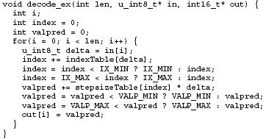
SCALE Code Example
Decoder example: C code
  Non-vectorizable
Table Look-ups
loop carried
dependencies

Slide 34
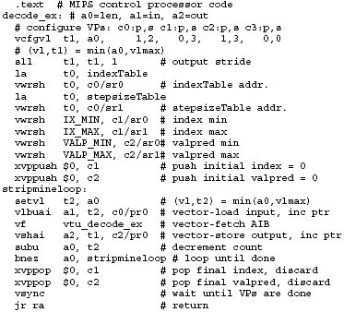
SCALE Code Example
Decoder example: control processor code
Configure VPs
Vector-Writes
Push onto cross-VP
start/stop queue
Pop off of cross-VP
start/stop queue

Slide 35
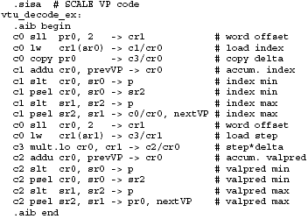
SCALE Code Example
Decoder example: AIB code executed by each VP

Slide 36
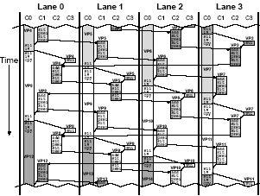
SCALE Code Example
Decoder example: cluster usage

Slide 37
Agenda
Motivation
Vector-Thread Abstract Model
Vector-Thread Physical Model
SCALE Vector-Thread Architecture
  Overview
  Code Example
  Microarchitecture
  Prototype
Evaluation
Conclusion

Slide 38
SCALE Microarchitecture
Clusters support three types of hardware micro-ops
  Compute-op: performs RISC-like operations
  Transport-op: sends data to another cluster
  Writeback-op: receives data sent from another cluster
  Transport and writeback ops are used for inter-cluster data transfers
  Data dependencies are synchronized with handshake signals
  Transport and writebacks are queued so execution can continue while waiting for external clusters to receive or send data

Slide 39
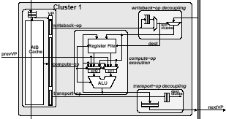
SCALE Microarchitecture
Transport and Writeback ops

Slide 40
SCALE Microarchitecture
Memory Access Decoupling
  Memory is only accessed through cluster 0
  Load data queue used to buffer the data and preserve correct ordering
  Decoupled store queue used to buffer stores
    Can be targeted by transport-ops directly
  Queues allow cluster to continue working without waiting for a store or load to resolve

Slide 41
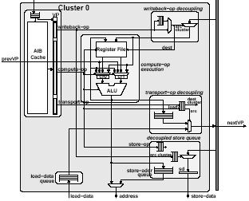
SCALE Microarchitecture
Decoupled store queue
Load data queue

Slide 42
Agenda
Motivation
Vector-Thread Abstract Model
Vector-Thread Physical Model
SCALE Vector-Thread Architecture
  Overview
  Code Example
  Microarchitecture
  Prototype
Evaluation
Conclusion

Slide 43
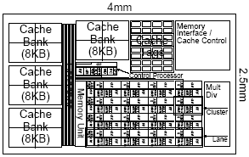
SCALE Prototype
Single-issue MIPS processor
Four 32-bit lanes with four execution clusters each
32KB shared primary cache
32 registers per cluster
Supports up to 128 VPs
L1 Cache is 32-way set associative
Area ~10mm²
400 MHz target

Slide 44
Agenda
Motivation
Vector-Thread Abstract Model
Vector-Thread Physical Model
SCALE Vector-Thread Architecture
  Overview
  Code Example
  Microarchitecture
  Prototype
Evaluation
Conclusion

Slide 45
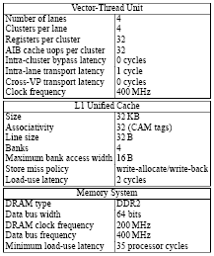
Evaluation
Detailed cycle-level, execution-driven microarchitectural simulator
Default parameters

Slide 46
Evaluation
EEMBC benchmarks
  Can be run “out-of-the-box” or optimized
  Drawbacks
    Performance can depend greatly on programmer effort
    Optimizations used for reported results are often unpublished

Slide 47
Evaluation
Results
  SCALE competitive with larger more complex processors
  SCALE performance scales well as lanes are added
  Large speed-ups possible when algorithms are extensively tuned for highly-parallel processors

Slide 48
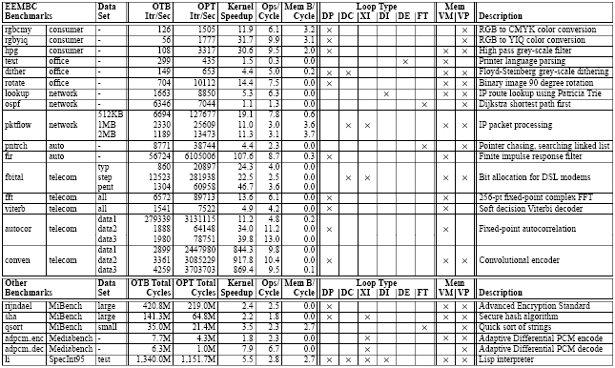
Evaluation
dasds

Slide 49
Evaluation
Register usage
Resulting vector lengths

Slide 50
Evaluation
Compared Processors
  AMD Au1100
    Similar to SCALE
  Philips TriMedia TM 1300
    Five-issue VLIW
    32-bit datapath
    166 MHz, 32kB L1 IC, 16kB L1 DC
    125 MHz 32-bit memory port
  Motorola PowerPC (MPC7447)
    Four-issue out-of-order superscalar
    1.3 GHz, 32kB L1 IC and DC, 512kB L2
    133 MHz 64-bit memory port
    Altivec SIMD unit
      128-bit datapath
      Four execution units

Slide 51
Evaluation
Compared Processors (cont’d)
  VIRAM
    Four 64-bit lanes
    200 MHz, 13MB embedded DRAM with 256bits each of load and store data, 4 independent addresses per cycle
  BOPS Manta
    Clustered VLIW DSP with four clusters
    Each cluster can execute up to five ipcs, 64-bit datapaths
    136 MHz, 128kB on-chip memory
    138 MHz 32-bit memory port
  TI TMS TMS320C6416
    Clustered VLIW DSP with two clusters
    Each cluster can execute up to four ipcs
    720 MHz, 16kB IC, 16kB DC, 1MB on-chip SRAM
    720MHz 64-bit memory interface

Slide 52
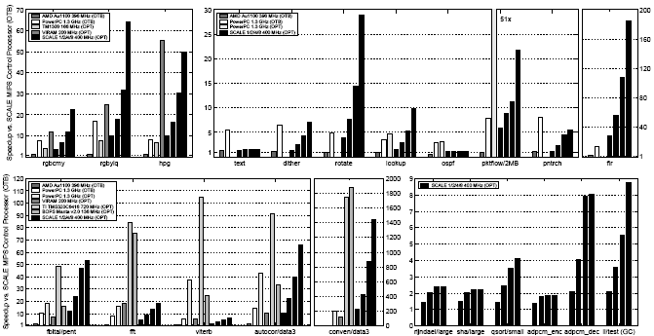
Evaluation

Slide 53

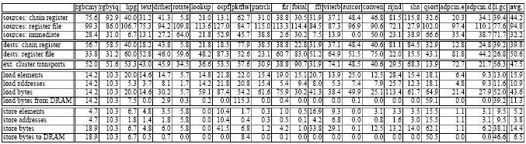
Evaluation

Slide 54
Agenda
Motivation
Vector-Thread Abstract Model
Vector-Thread Physical Model
SCALE Vector-Thread Architecture
  Overview
  Code Example
  Microarchitecture
  Prototype
Evaluation
Conclusion

Slide 55
Conclusion
Vector-Thread Architecture
  Allows software to more efficiently encode parallelism and locality
  Enables high-performance implementations that are efficient in area and power
  Supports all types of parallelism
  SCALE shows well suited to embedded applications
    Relatively small design provides competitive performance
  Widely applicable in other application domains

