Slide 1
ChatBot & Log Parser
Thesis 2026
By Ergi Toshkezi

Slide 2
Context
In the Opcenter environment, the Portal communicates with the Application Server.
This communication happens through XML messages.
Every request and response between these components is recorded in log files.
These logs keep a trace of system activity and interactions.
The log files record the communication between system components.
They contain structured text based on the Opcenter model-driven architecture.
This text includes references to system elements such as CDOs and CLFs.
Because the logs are raw text, the information can be difficult to analyze directly.
CDOs represent the business objects of the system.
Examples include Product, Workflow, Equipment, and Material.
Data CDOs store persistent information about these entities.
Service CDOs perform actions on them, such as Move, CollectData, or ProductMaintenance.
CLFs define the business logic of the system.
They control how operations are executed and in which order.
CLFs can validate inputs, determine workflow steps, or perform calculations.
They are often attached to CDOs or their fields.

Slide 3
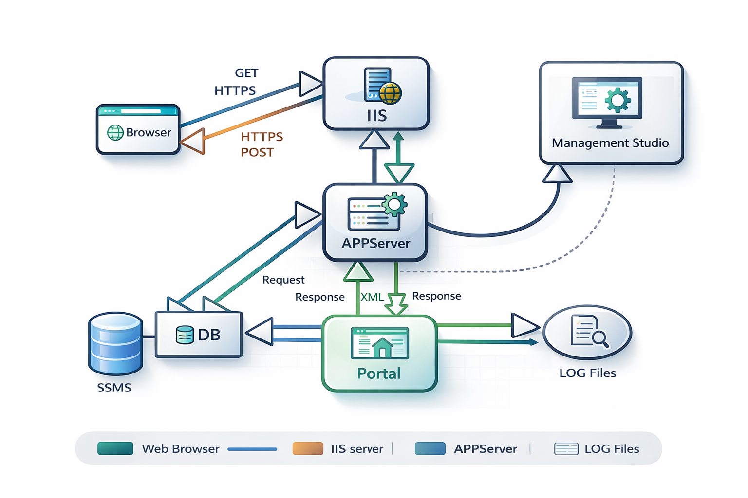
Architecture

Slide 4
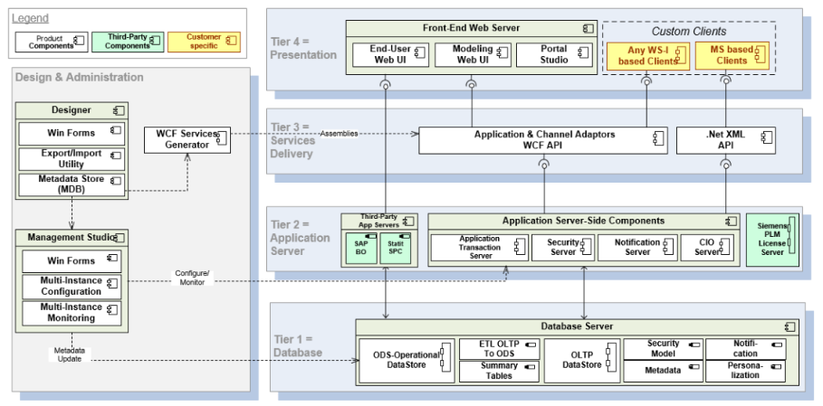
This diagram represents the high-level components in OpcenterEX MDD and OpcenterEX CR.

Slide 5
AI ChatBot
The ChatBot is a Python application that allows you to chat with multiple PDF documents. You can ask questions about the PDFs using natural language, and the application will provide relevant responses based on the content of the documents. This app utilizes a language model to generate accurate answers to your queries. Please note that the app will only respond to questions related to the loaded PDFs. This is a Fine Tunning based application

Slide 6
How It Works
The application follows these steps to provide responses to your questions:
PDF Loading: The app reads multiple PDF documents and extracts their text content (Limit 200 Mb per File)
Text Chunking: The extracted text is divided into smaller chunks that can be processed effectively.
Language Model: The application utilizes a language model to generate vector representations (embeddings) of the text chunks.
Embeddings can be stored in a database (DB)
You can select in which DB to store your data
Can Select the Manuals you wish to retrieve from the already analyzed PDFs
Similarity Matching: When you ask a question, the app compares it with the text chunks and identifies the most semantically similar ones.
Response Generation: The selected chunks are passed to the language model, which generates a response based on the relevant content of the PDFs.

Slide 7
Chunking with Unstructured
The extracted text is divided into smaller chunks that can be processed effectively.
Chunking has 2 processes : Document Elements Structure Detection, Strategy of Splitting the Chunks
Document Elements Structure Detection
The chunks are done taking in consideration the Manuals structure Document Elements are detected in base of the PDF Manual page Structure
Unstructured uses specific knowledge about each document format to partition the document into semantic units (Document Elements), we only need to resort to text-splitting when a single element exceeds the desired maximum chunk size. Except in that case, all chunks contain one or more whole elements, preserving the coherence of semantic units established during partitioning.
In general, chunking combines consecutive elements to form chunks as large as possible without exceeding the maximum chunk size.
A single element that by itself exceeds the maximum chunk size is divided into two or more chunks using text-splitting.
Elements Detection produces a sequence of : CompositeElement {Image, NarrativeText, Title, …..}, Table, TableChunk elements. Each “chunk” is an instance of one of these 3 types.

Slide 8
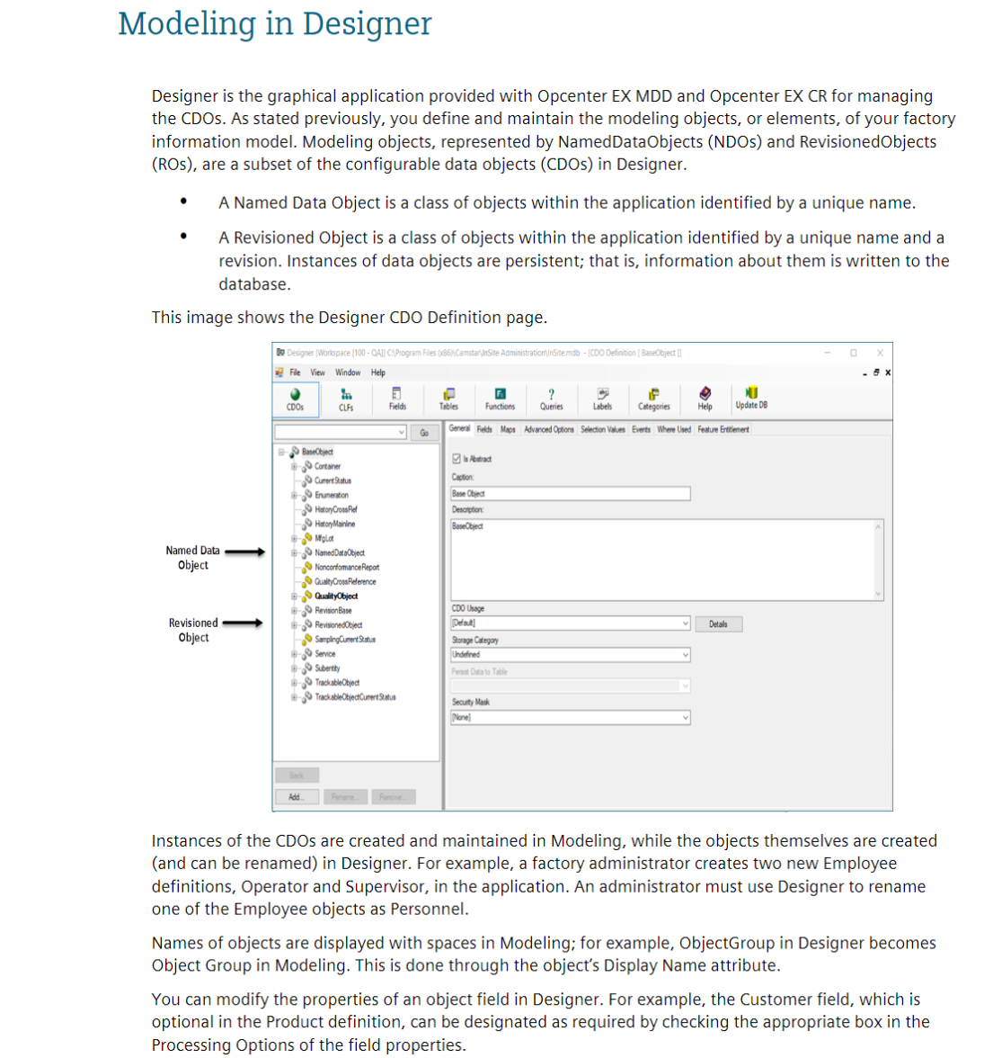
PDF Example
CompositeElement: Title
This are the Elements types that will be Detected by: Elements Structure Detection
CompositeElement: Narrative Text
CompositeElement: Image

Slide 9
Strategy: «By Title»
Once we have detected the structure (Document Elements) of the text, we now group them, in order to create the Chunks The strategy used to create the chunks is "by title" By Title Chunking Strategy:
- Preserves section boundaries and optionally page boundaries.
- Detects section headings and starts a new chunk when a Title element is encountered.
- Can respect page boundaries to keep elements on different pages in separate chunks.
- Combines small sections to fill chunks, adjustable with combine_text_under_n_chars

Slide 10
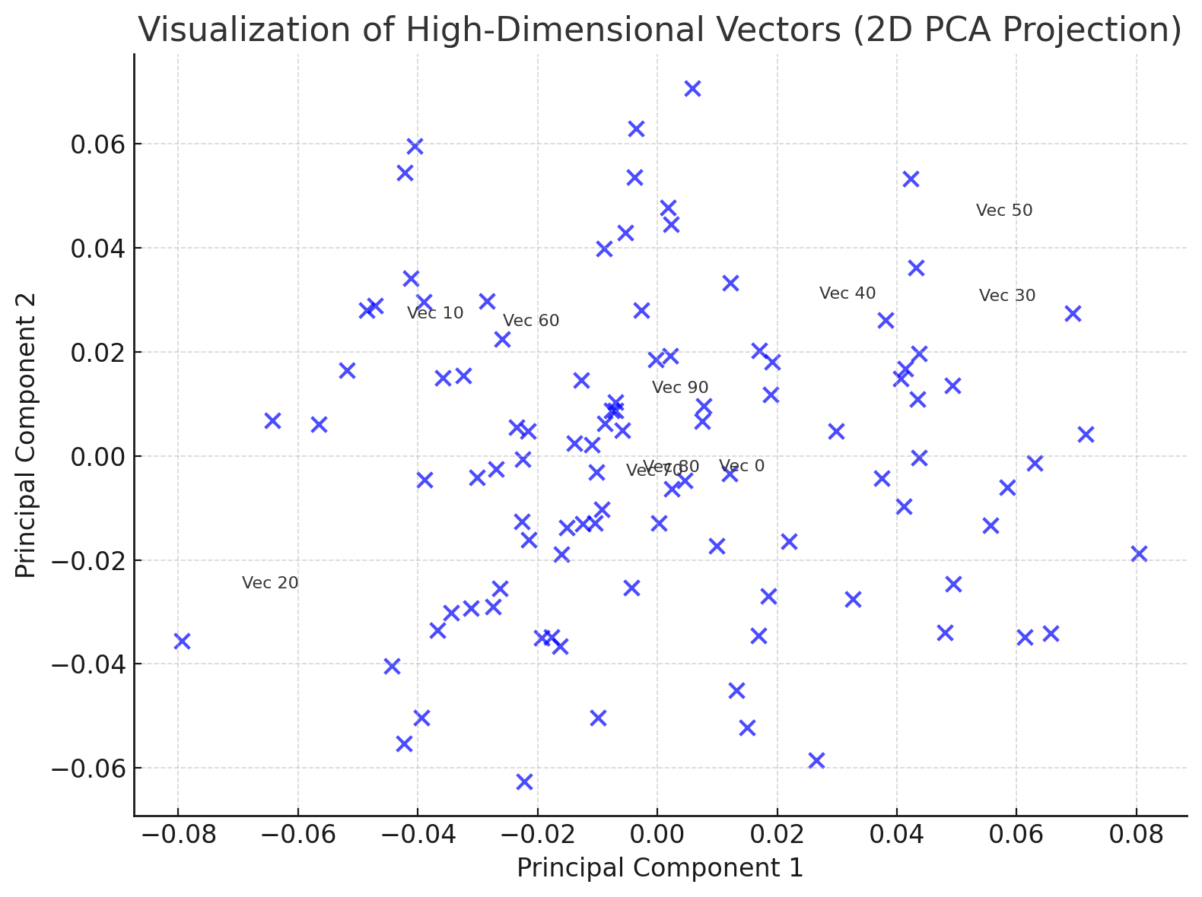
Embedding
An embedding is a learned representation of objects (e.g., words, images, or entities) as vectors in a continuous vector space.
It captures the semantic relationships between objects by placing similar objects closer together in the vector space.
To each chunk we have, we associate it to a high dimensional vector
Key Features
High-dimensional numerical vectors represent objects.
Similarity is measured using metrics like cosine similarity or Euclidean distance.
On this application Siemens Rest Apis are used to create embeddings, Provided by :

Slide 11
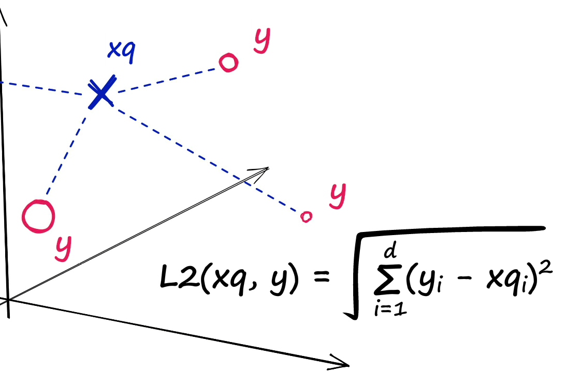
Faiss
Finding Closest Vectors with Faiss:
Process:
Faiss is used to perform similarity searches on vector embeddings derived from a knowledge base.
Output: The top k most relevant vectors are identified and ordered by their distance to the query (from smallest to largest distance)
IndexFlatL2 method is used:
IndexFlatL2 measures the L2 (or Euclidean) distance between all given points between our query vector, and the vectors loaded into the index. It’s simple, very accurate, but not too fast.
L2 distance calculation between a query vector xq and our indexed vectors (shown as y)

Slide 12
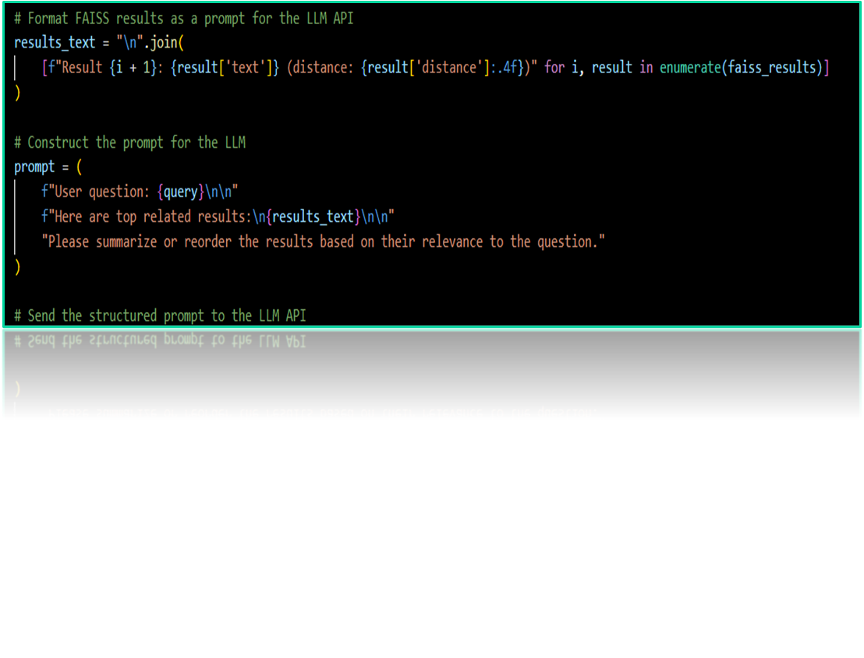
LLM
- Preparing the Payload for Siemens REST API:
The top k closest vectors, along with their associated text and distance values, are formatted into a payload.
The payload is passed to the Siemens REST API to enable contextual processing.
- Role of the LLM in Summarization:
The Siemens REST API LLM processes the relevant information from the payload.
It summarizes the text data while:
Prioritizing content based on relevance to the user query.
Taking the distance value into account to weigh importance.

Slide 13
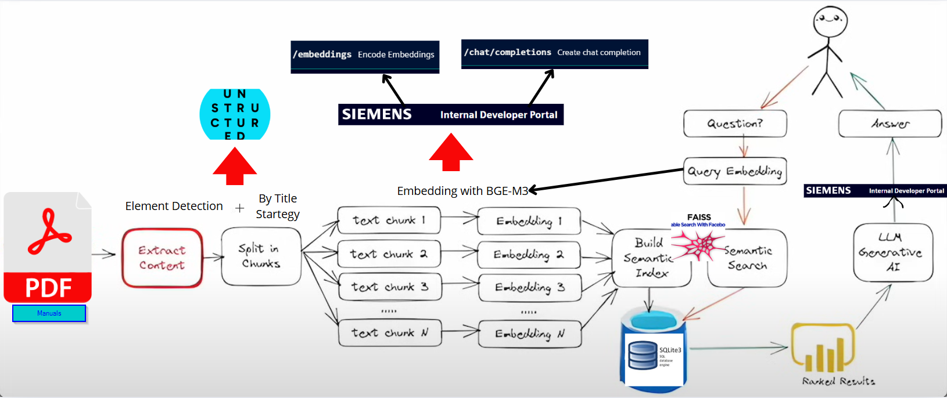
How It Works
mistral-7b-instruct

Slide 14
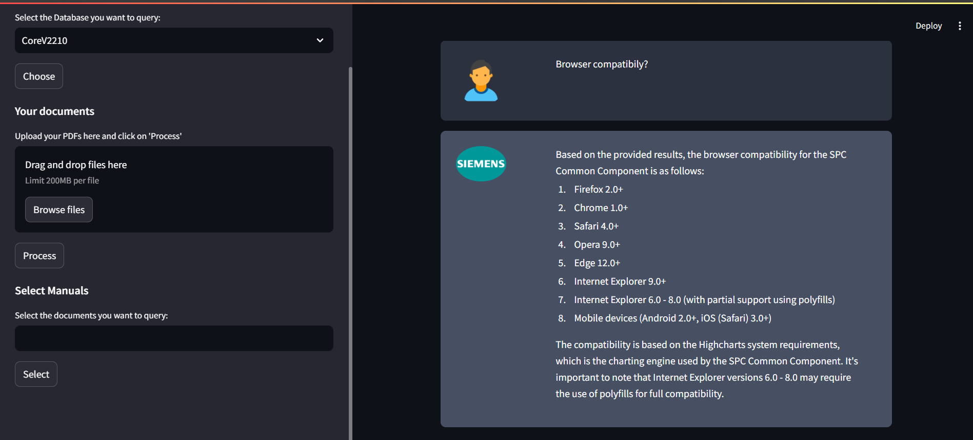
Test

Slide 15
Python
THESIS PRESENTATION
tkinter
Log Parser
Ultimate
LLM / AI
XML
AI-Assisted Transaction Log Analysis & Visualization Platform
Excel
Built with Python · tkinter · Siemens LLM API · Matplotlib · pandas

Slide 16
Project Overview
6+
AI
MT
XML
Core
Features
LLM
Integration
Multi-Thread
Parsing
Performance
Analysis
What is Log Parser Ultimate?
A desktop application built in Python (tkinter) designed to help engineers visualize, navigate, and analyze large transaction log files from Siemens server systems.
Addresses the core pain point that raw logs are thousands of lines long and human-unreadable — the tool structures them into hierarchical trees, charts, and AI-powered explanations.
Integrates directly with the Siemens LLM API (Mistral-7B) for natural-language Q&A on any selected log segment.
Supports .log, .txt, and .xml file formats with automatic encoding detection via chardet.
Uses multi-threaded processing to keep the GUI responsive even with files containing millions of lines.

Slide 17
Architecture & Technology Stack
UI Layer
Python tkinter · ttk TreeView · tk.Toplevel
Key
Design
Goals
Parsing Engine
Multi-threaded workers · chardet · regex
Speed
Data Layer
JSON tree structure · pandas · openpyxl
Readability
Visualization
Matplotlib (TkAgg) · L(t) / L'(t) charts
AI assist
Low memory
AI Integration
Siemens LLM API · Mistral-7B · chunked input
Cross-format
XML Analysis
xml.etree · lxml · execution-time diff

Slide 18
Core Features · Part 1 of 2
File Loading (Open / Open Excel)
Standard OS file dialog for .log / .txt / .xml files
Excel import via openpyxl + pandas — maps Timestamp, ThreadID, CDO Name columns into internal log objects
Automatic encoding detection (chardet) ensures UTF-8 and ANSI logs are read correctly
Parses timestamps, thread IDs, execution depth, CDO operations, CLF calls, parameters
Smart Search (in-file & cross-file)
In-file: highlights occurrences in green; shows total count + current position; starts from the cursor line
Navigate with ← → arrow keys or the Next button
Search in All Files: scans every file in the same directory simultaneously
1 MB binary chunk reading prevents memory overflow on huge directories
State-machine filtering ignores noise between transaction boundaries
Results shown in a TreeView: parent = filename, children = matching lines with original line numbers
Tree Navigation (Expand / Collapse)
Expand All, Expand Node (level by level), Close Nodes buttons
Double-click Expand closes all and resets to starting point
Mirrors the server execution depth for step-by-step transaction walkthrough

Slide 19
Core Features · Part 2 of 2
Time Chart — L(t) Performance Visualization
Timestamp format: 20260128143510.10028348 — parser extracts per-step durations
Aggregation function L(t) = Σ Lᵢ(t) gives total accumulated execution time
Toggle switch computes the derivative L'(t) to expose rate-of-change and critical spikes
Right-click on any data point opens the log content for that step AND jumps to the exact line
Built with Matplotlib TkAgg backend; path chunksize tuned for 100 000+ point plots
File Comparison
Compares current log vs. any second file row-by-row with token-level diffing
FOUND (orange) — row exists in both files but at a different position
NOT FOUND (blue) — row is completely missing in the other file
Helps diagnose why the same transaction behaves differently across customer environments
XML Time Analysis + Query Analyzer
Parses XML response document; calculates Start→End duration per node
Hierarchical TreeView: Index, Node Type, Execution Time (ms/s), Attributes
Top-3 slowest nodes at each level highlighted in red automatically
Right-click on any node reveals the full SQL query in a popup
Analyze Queries button sorts all DB queries by execution time for bottleneck focus

Slide 20
AI Integration — SiemensGPT
1
Select log rows
Model Details
User pastes or selects the log segment to analyze (timestamps, thread IDs, CDO operations, CLF calls).
Model
Mistral-7B-Instruct
2
Type a question
Endpoint
api.siemens.com/llm
Natural language input: e.g. Why does this fail? or What is this CDO operation?
Chunks
≤ 7 500 tokens each
3
Chunked pre-processing
Log text is tokenized and split into ≤7500-token chunks to stay within API limits while covering large logs.
Temp.
0.1 (deterministic)
4
API call per chunk
Auth
Bearer token (saved)
Each chunk + question is sent to https://api.siemens.com/llm/v1/chat/completions with structural context.
Fallback
Default shared key
5
Answer displayed
Mistral-7B response is assembled and shown in the popup; the user can iterate with follow-up questions.

Slide 21
Performance Engine — Multi-Threaded Log Parsing
Load File
+ Detect Encoding
Divide into
Line Chunks
Worker
Threads ×N
Build JSON
Tree Nodes
Merge &
Visualize
Incremental Line-by-Line Loading
Depth-Aware JSON Tree Construction
File is never loaded fully into RAM — parsed line by line as it streams
Each line immediately yields: Timestamp · ThreadID · Depth · CDO · CLF · Parameters
Dramatically reduces memory footprint for million-line logs
GUI remains responsive because the main thread never blocks
Depth value in each log line drives child/parent node creation automatically
Depth increases → new child node attached; decreases → parser climbs back to parent
Multiple threads each build subtrees; synchronized merge prevents race conditions
Final JSON structure is nearly complete when the last thread finishes

Slide 22
Key Algorithms
L(t) Time Aggregation
L'(t) Derivative — Critical Point Detection
L(t) = Σ Lᵢ(t)
L'(t) = ΔL / Δt
Sums all per-step durations into an accumulated execution curve. Engineers can immediately see where overall time balloons across a transaction sequence.
Computes rate-of-change between consecutive steps. Spikes in L'(t) pinpoint exactly which individual operation caused a sudden slowdown — no manual scanning needed.
Token-Level File Diff
Chunk-Based Cross-File Search
FOUND | NOT FOUND
1 MB binary chunks + chardet
Each line is tokenized; tokens compared row-by-row between two files. Lines shifted in position are marked orange (FOUND); lines entirely absent are marked blue (NOT FOUND).
Files in the directory are read in 1 MB chunks rather than fully buffered. A state machine skips non-transaction noise, reducing false positives and keeping memory flat.

Slide 23
Challenges & Solutions
Challenge
Solution
Impact
Millions of log lines freeze the UI
Multi-threaded background workers; main thread never blocks; incremental file streaming
High
Mixed file encodings from different server sources
chardet library auto-detects UTF-8, ANSI, Latin-1 etc. before any line is read
High
LLM context window limits on large logs
nltk.word_tokenize + chunking at ≤7 500 tokens; results merged per chunk
High
Locating a rare event across 50+ log files
Search-in-all-files with state-machine filtering + chunk-based reading for low memory
Med
Identifying slowest XML operations manually
Automatic red highlighting of top-3 slowest nodes per hierarchy level
Med
Matplotlib perf on 100 000+ data points
agg.path.chunksize = 100 000; TkAgg backend; derivative computed lazily on toggle
Med

Slide 24
Results & Impact
~10×
∞
7
AI
Faster debug
vs manual scan
Log size
(streamed)
Core modules
integrated
Natural language
log Q&A
✗ Before (Manual Process)
✓ After (Log Parser Ultimate)
Scroll through thousands of raw log lines
Manually timestamp-diff adjacent entries
Open multiple files separately to trace events
No quick way to spot performance outliers
Paste log into ChatGPT manually per session
Diff two customer logs by eye
Hierarchical TreeView with expand/collapse
L(t) + L'(t) chart shows time distribution instantly
Cross-file search in one click across entire directory
Red auto-highlight on slowest XML nodes per level
SiemensGPT answers questions in natural language
Structured diff with FOUND/NOT FOUND color coding

Slide 25
Future Work & Roadmap
v2.0
Web-based UI
Migrate from tkinter to a browser frontend (React/Electron) for cross-platform deployment without a local Python install.
v2.1
Real-time Log Streaming
WebSocket or file-watch integration to tail live logs and update the tree and time chart in real time as lines arrive.
v2.2
Anomaly Detection Model
Train a lightweight classification model on historical logs to automatically flag unusual patterns before the engineer even runs a search.
v2.3
Plugin Architecture
Allow teams to add custom log parsers for non-standard formats without modifying the core application.
v3.0
Collaborative Annotations
Enable multiple engineers to annotate log lines and share findings via a shared backend — turning the tool into a team debugging platform.

Slide 26
Thank You!

