Slide 1
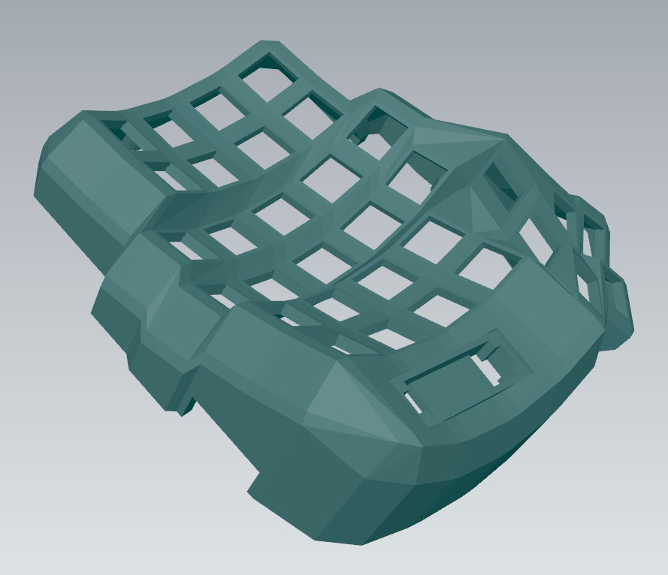
Controller Tray Interface
OLED Mounting

Slide 2
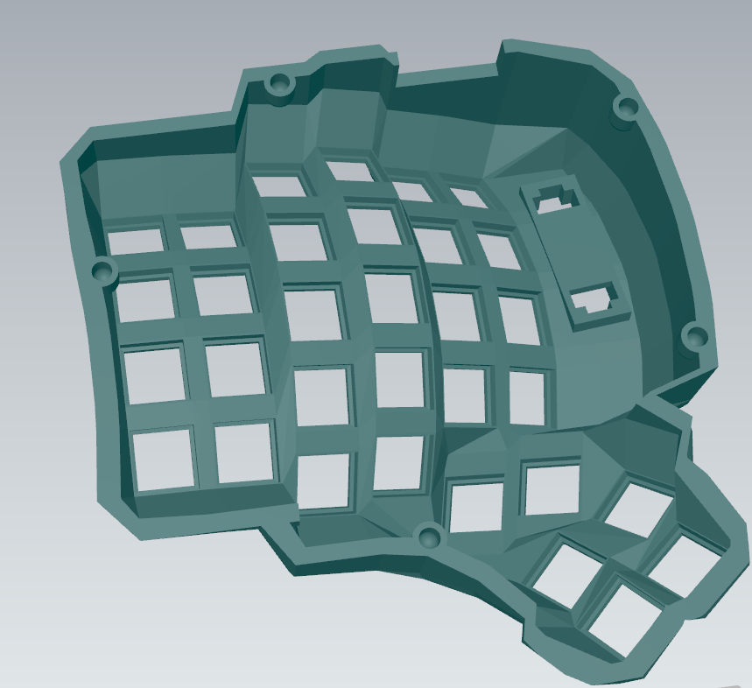
Controller Tray Interface
OLED Mounting
Internal Mount Screws

