Slide 1
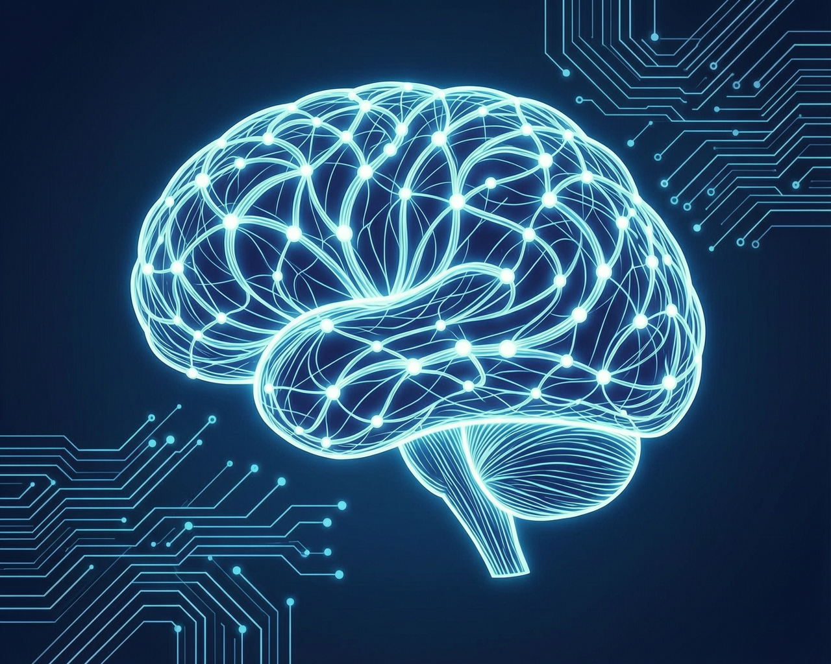
AI Image Generation
Automated Visual Content for Presentations

Slide 2
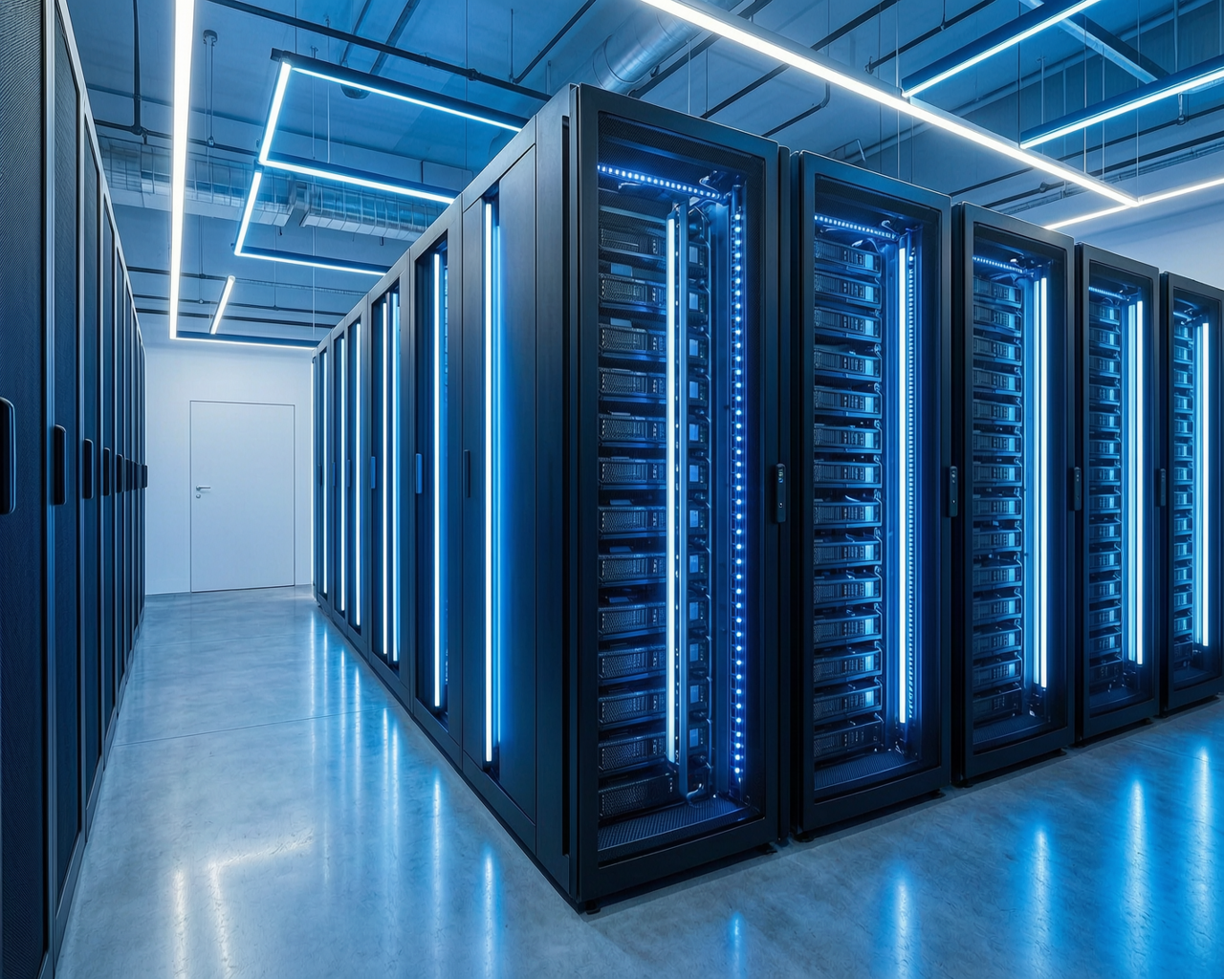
What We Built
Image Generation Module
Python script calling DashScope WAN 2.7 API
Supports Chinese & English prompts
Outputs PNG + base64 for PPT embedding

Slide 3
The Pipeline
01
02
03
Generate
Process
Embed
AI generates image from text prompt
Saves to local file + base64 encoding
Insert into slide via pptxgenjs

Slide 4
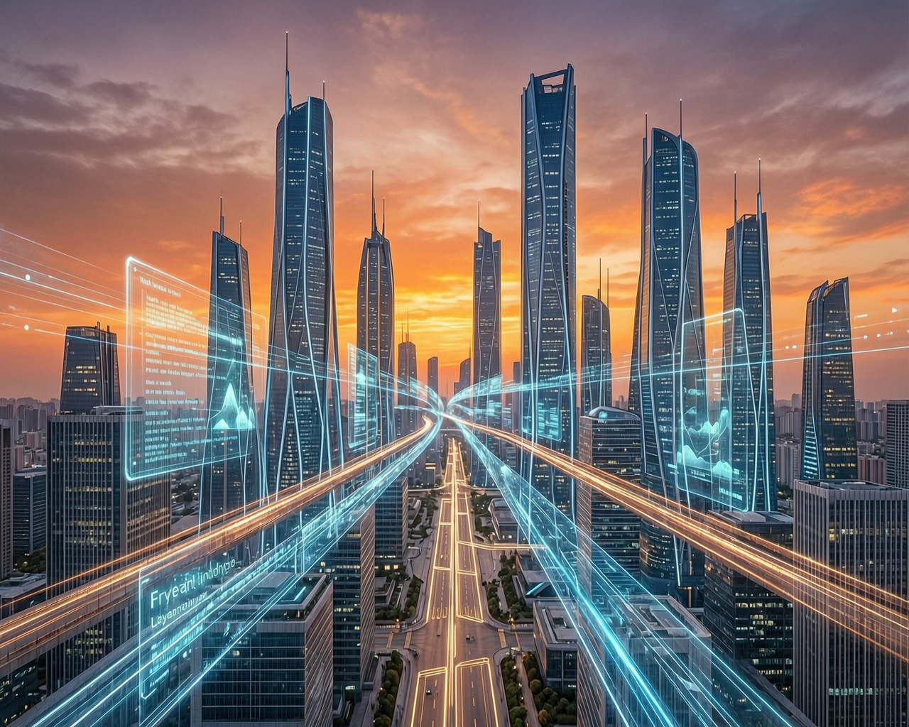
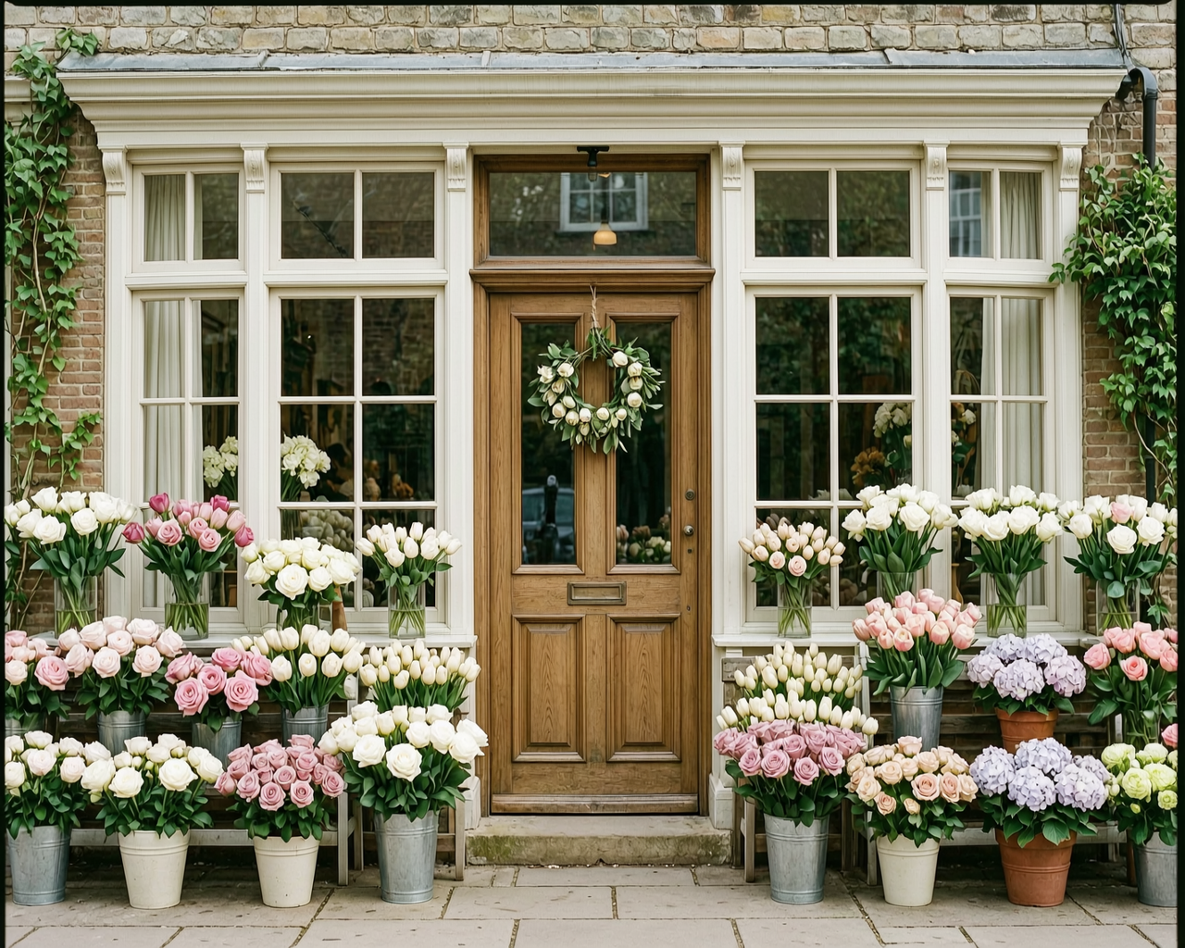
Example: AI-Generated Image
Prompt: "一间有着精致窗户的花店， 漂亮的木质门，摆放着花朵"
AI Generated

Slide 5
AI + PPT
Every slide can have unique AI-generated visuals

