Slide 1
20486B
Developing ASP.NET MVC 4 Web Applications

Slide 2

Welcome!
Thank you for joining us today.
We’ve worked together with Microsoft Learning Partners and Microsoft IT Academies to bring you a world-class learning experience, including:
Microsoft Certified Trainers + Instructors. Your instructor is a premier technical and instructional expert who meets ongoing certification requirements.
Customer Satisfaction Guarantee. Our Partners offer a satisfaction guarantee and we hold them accountable for it. At the end of class, please complete an evaluation of
today’s experience. We value your feedback!
Certification Benefits. After training, consider pursuing a Microsoft Certification, to help distinguish your technical expertise and experience. Ask your instructor about available exam promotions and discounts.
We wish you a great learning experience and ongoing career success!

Slide 3
Hello
Instructor: <Instructor Name>
<Title or other credentials, e.g. Microsoft Certified Trainer>
<Affiliation/Company>
<A few words about my technical and professional experience>

Slide 4
Facilities
Class hours
Building hours
Parking
Restrooms
Meals
Phones
Messages
Smoking
Recycling

Slide 5
About This Course
Audience
Professional web developers who use Microsoft Visual Studio in an individual-based or team-based, small-sized to large development environment.
Professional web developers seeking certification in the 70-486: Developing ASP.NET 4.5 MVC Web Applications exam.
Course Prerequisites
A minimum of two to three years of experience in developing web-based applications by using Microsoft Visual Studio and Microsoft ASP.NET.
Proficiency in using the .NET Framework and some familiarity with the C# language.
Equivalent knowledge of courses - 20483A: Programming in C# and 10958A: Programming Fundamentals of Web Applications.

Slide 6
About This Course (Continued)
Course Objectives
After completing this course, students will be able to:
Describe the Microsoft Web Technologies stack and select an appropriate technology to use to develop any given application.
Design the architecture and implementation of a web application that will meet a set of functional requirements, user interface requirements, and address business models.
Create MVC Models and write code that implements business logic within Model methods, properties, and events.
Add Controllers to an MVC Application to manage user interaction, update models, and select and return Views.
Create Views in an MVC application that display and edit data and interact with Models and Controllers.
Run unit tests and debugging tools against a web application in Visual Studio 2012.
Develop a web application that uses the ASP.NET routing engine to present friendly URLs and a logical navigation hierarchy to users.

Slide 7
About This Course (Continued)
Course Objectives (Continued)
Implement a consistent look and feel, including corporate branding, across an entire MVC web application.
Use partial page updates and caching to reduce the network bandwidth used by an application and accelerate responses to user requests.
Write JavaScript code that runs on the client-side and utilizes the jQuery script library to optimize the responsiveness of an MVC web application.
Implement a complete membership system in an MVC 4 web application.
Build an MVC application that resists malicious attacks and persists information about users and preferences.
Describe how to write a Windows Azure web service and call it from and MVC application.
Describe what a Web API is and why developers might add a Web API to an application.
Modify the way browser requests are handled by an MVC application.
Describe how to package and deploy an ASP.NET MVC 4 web application from a development computer to a web server for staging or production.

Slide 8
About This Course (Continued)
What You Can Expect
Plan the overall architecture, controllers, views, and models of the MVC 4 web application.
Create Models, Controllers, and Views in MVC 4 web application.
Unit test the components of the application and implement exception handling strategy.
Implement a consistent look and feel to the web application.
Build responsive pages by using partial page updates and caching.
Increase the responsiveness of the web application by using JavaScript and jQuery.
Implement authentication and authorization for accessing the web application.
Design and write a Windows Azure service.
Implement Web APIs in the web application.
Create HTTP Modules and HTTP Handlers to handle requests.
Deploy a completed MVC application to a web server or Windows Azure.

Slide 9
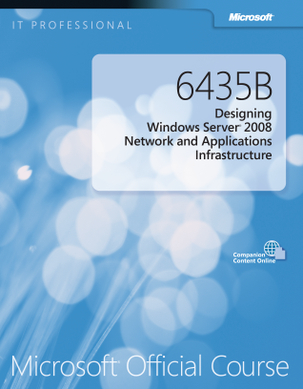

Your Course Materials
Designed to optimize your classroom learning experience.
And support you back on the job.
Microsoft Official Course Handbook
Organized by Modules
Includes Labs + Lab Answer Keys
Module Reviews + Takeaways—great for on-the-job reference
Digital Companion Content
Supplemental content + helpful links
Download at: http://www.microsoft.com/learning/companionmoc

Slide 10
Course Outline
Module 1: Exploring ASP.NET MVC 4
Module 2: Designing ASP.NET MVC 4 Web Applications
Module 3: Developing ASP.NET MVC 4 Models
Module 4: Developing ASP.NET MVC 4 Controllers
Module 5: Developing ASP.NET MVC 4 Views
Module 6: Testing and Debugging ASP.NET MVC 4 Web Applications
Module 7: Structuring ASP.NET MVC 4 Web Applications
Module 8: Applying Styles to ASP.NET MVC 4 Web Applications

Slide 11
Course Outline (continued)
Module 9: Building Responsive Pages in ASP.NET MVC 4 Web Applications
Module 10: Using JavaScript and jQuery for Responsive MVC 4 Web Applications
Module 11: Controlling Access to ASP.NET MVC 4 Web Applications
Module 12: Building a Resilient ASP.NET MVC 4 Web Application
Module 13: Using Windows Azure Web Services in ASP.NET MVC 4 Web Applications

Slide 12
Course Outline (continued)
Module 14: Implementing Web APIs in ASP.NET MVC 4 Web Applications
Module 15: Handling Requests in ASP.NET MVC 4 Web Applications
Module 16: Deploying ASP.NET MVC 4 Web Applications

Slide 13
Related Courses
20480A : Programming HTML with JavaScript
20483A : Programming in C#
20485A : Advanced Metro-Style App Development
Using C#
20487A : Developing Windows Azure and Web Services
See the full line of Microsoft Training and Certification resources at: http://www.microsoft.com/learning/

Slide 14
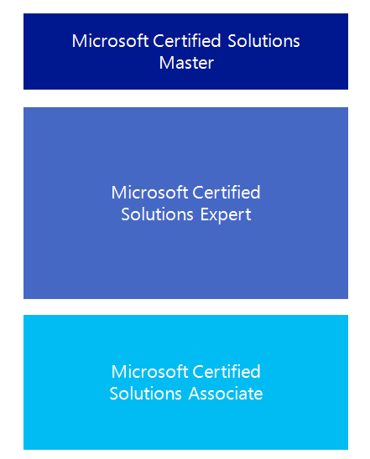

Microsoft Certification Program
Get trained. Get certified.
Get ahead.
Microsoft Certifications demonstrate you have the skills to design, deploy, and optimize the latest technology solutions.
Ask your Microsoft Learning Partner how you can prepare for certification.
Also see:
http://www.microsoft.com/learning/
certification

Slide 15

Preparing for the Labs
Your lab activities will be centered around a fictitious company that we’ll call Adventure Works.
By working through the labs, you will learn how to develop ASP.NET MVC 4 web application that will help Adventure Works achieve its business goals.
To complete the labs, you will work in a virtual machine (VM) environment.

Slide 16

Virtual Machine Environment
Virtual Machine Name: | Use as:
20486B-SEA-DEV11 | Windows 8 client computer
MSL-TMG1 | Microsoft Forefront® Threat Management Gateway (TMG) virtual machine

Slide 17
Demonstration: Using Hyper-V Manager
In this demonstration, you will learn how to:
Open Hyper-V Manager
Navigate the various sections/panes within Hyper-V Manager
Virtual Machines (VMs), Snapshots, and Actions: Server-specific and VM-specific
Identify the VMs used in the labs for this course
Take a Snapshot and Apply a Snapshot
Connect to a VM
Start and log on to a VM
Switch between full screen and window modes
Revert to the previous Snapshot
Shut down a VM
When to use Shut Down or Turn off
Close Hyper-V Manager

