Slide 1
Module02
Designing ASP.NET MVC 4 Web Applications
Notes:
20486B
02: Designing ASP.NET MVC 4 Web Applications

Slide 2
Module Overview
Planning in the Project Design Phase Designing Models, Controllers, and Views
Notes:
20486B
02: Designing ASP.NET MVC 4 Web Applications

Slide 3
Lesson 1: Planning in the Project Design Phase
Project Development Methodologies Gathering Requirements Planning the Database Design Planning for Distributed Applications Planning State Management Planning Globalization and Localization
Notes:
20486B
02: Designing ASP.NET MVC 4 Web Applications

Slide 4
Project Development Methodologies
Development Model | Description
Waterfall Model | Activities for building an application are performed sequentially in distinct phases with clear deliverables.
Iterative Development Model | An application is built iteratively in parts, by using working versions that are thoroughly tested, until it is finalized.
Prototype Model | Based on a few business requirements, a prototype is made. Feedback on the prototype is used as input to develop the final application.
Agile Development Model | An application is built in rapid cycles, integrating changing circumstances and requirements in the development process.
Extreme Programming | Begins with solving a few critical tasks. Developers test the simplified solution and obtain feedback from stakeholders to derive the detailed requirements, which evolve over the project life cycle.
Test-Driven Development | A test project is created and you can test changes to the code singly or as a group, throughout the project.
Unified Modeling Language | UML diagrams are used for planning and documenting purposes, across all project development models.
Notes:
Waterfall, iterative, and prototype development are older models and now less popular. You should devote most time to agile development, extreme programming, and test-driven development, and mention these as the most up-to-date models.
If you have worked on projects that used agile development, extreme programming, or TDD, use your real-world experience to illustrate the concepts in this topic. For example, describe a real-world component that you built and the unit tests that applied to it.
Mention that UML is not a project development methodology but is introduced here because it is common to all methodologies. Mention to students that UML diagrams will be shown later in the module.
Question: What aspects of agile software development and extreme programming might be of concern to customers? What aspects might reassure them?
Answer: Customers may be concerned that a complete specification is not in place when they place a purchase order for developing the application.
Customers will be reassured when developers continue to communicate with them throughout project development. They will also be reassured when they see functional applications early in the project, on which they can provide feedback.
20486B
02: Designing ASP.NET MVC 4 Web Applications

Slide 5
Gathering Requirements
Functional requirements describe how the application responds to users
Technical requirements describe the technical features of an application, such as availability, security, or performance
You can build functional requirements by using:
Usage scenarios
Use cases
Requirements modeling in agile
User stories in extreme programming
Sample UML Use Case Diagram
Notes:
The graphic on the slide is a simple UML use case diagram.
Before you teach this topic, you must read more details of requirement analysis methods, particularly with regard to how they apply to development methodologies such as Agile and Extreme Programming. The following links provide a starting point:
http://go.microsoft.com/fwlink/?LinkID=288946&clcid=0x409
http://go.microsoft.com/fwlink/?LinkID=288947&clcid=0x409
http://go.microsoft.com/fwlink/?LinkID=288948&clcid=0x409
Question: If a customer asks you to ensure 95% availability, is this a functional requirement or a technical requirement?
Answer: If a customer asks you to ensure 95% availability, it is a technical requirement.
20486B
02: Designing ASP.NET MVC 4 Web Applications

Slide 6
Planning the Database Design
Logical Modeling
Physical Database Structure
Working with DBAs
Database Design in Agile and Extreme Programming
Notes:
The audience of this course has experience in creating databases for simple web applications. The database objects that you describe should refresh their memory or fill in gaps in their knowledge. However, a complete description of all the objects in Microsoft SQL Server 2012 or other database engines is beyond the scope of this ASP.NET course, and you cannot train the students to be DBAs. The intention is to provide a simple introduction to database structures.
Question: You want to implement a shopping cart in your web application. How many logical data models are required? How many database tables are required?
Answer: Answers may vary. Logical models may include a Shopping Cart, a Customer, a Product, and a Shipping Method. Students might suggest others. Database tables may include ShoppingCarts, ShoppingCartEntries, Products, ShippingMethods, Customers, and others.
20486B
02: Designing ASP.NET MVC 4 Web Applications

Slide 7

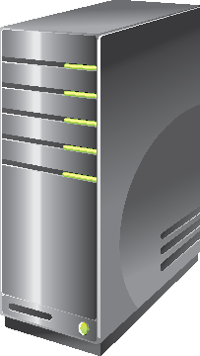

Planning for Distributed Applications
Layers
Presentation
Business Logic
Data Access
Database
Communication
Security
Browser
Web
Server
Presentation
Middle
Tier
Server
Business Logic
Data Access
Database
Server
Notes:
The subject of distributed applications, their architecture, and the protocols and technologies underlying them is huge and cannot be treated in full here. Your aim should be to introduce the concepts and technologies like WCF. If students demonstrate an interest in building distributed architectures for their web application, refer them to Course 20487A: Developing Windows Azure and Web Services.
Question: What are the advantages of writing middle-tier components as WCF services and not web services?
Answer: You can host WCF services on either Internet Information Server (IIS) or WAS. Web services can only be hosted on IIS.
20486B
02: Designing ASP.NET MVC 4 Web Applications

Slide 8
Planning State Management
Client-side locations to store state data:
Cookies
Query Strings
Server-side locations to store state data:
TempData
Application State
Session State
Profile Properties
Database Tables
Notes:
In Module 4, you will describe to the students the ViewBag and ViewData objects. Do not introduce them here because the ViewBag object and ViewData object cannot be used to store state information. They are destroyed for a new page request. Those objects are used to store information between the controller, view, and partial views that render a single HTML page.
You might like to present some state management scenarios from your own experience of building real-world MVC web applications, and discuss with the students the most appropriate location to use.
If you have any ASP.NET Web Forms developers in the class, emphasize that View State, Control State, and Hidden Fields are not available. You should discourage them from developing similar solutions for MVC pages because of the extra resources such approaches use to store data in HTML pages.
Question: You show the visitors of your website a choice of countries. When they pick a state, you want to redirect them to a page that shows a map of that state. You will not use the name of the chosen country that the user selected after this. Which location should you use to store the name of the chosen country?
Answer: The TempData store is ideal for storing the country because you only use it on the next page. Alternatively, you can use a query string value or a form field with the POST method to pass the country value.
20486B
02: Designing ASP.NET MVC 4 Web Applications

Slide 9
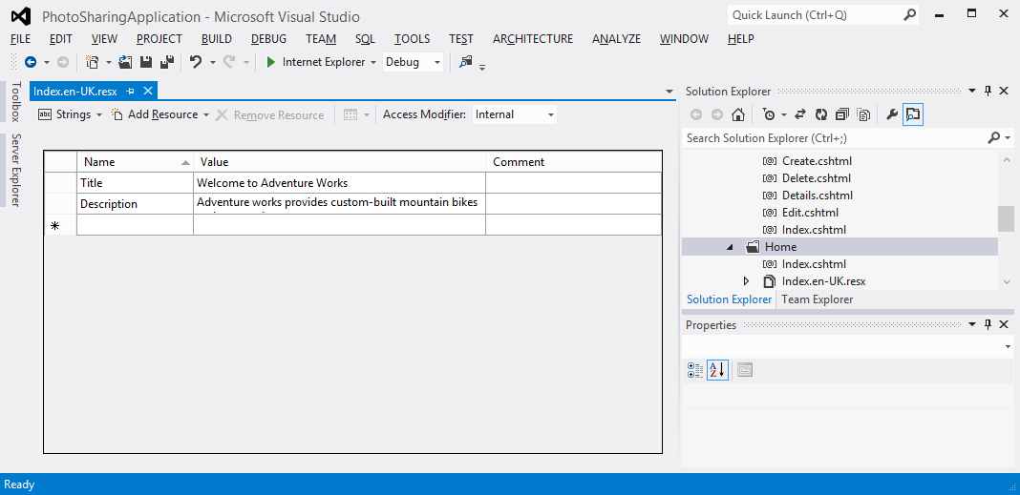
Planning Globalization and Localization
You can use the internationally-recognized set of language codes available in browsers to present content customized to suit a user’s language or region
You can use resource files to provide a localized response suitable to a user’s culture
You can use separate views to suit each language code
Notes:
Question: Which language do you consider would be appropriate to specify in the default resource file?
Answer: The language that you choose for the default resource file should be the one that is spoken by the largest proportion of your visitors. Because Internet is a global system, the language is usually English because it is the language spoken by the largest number of people, worldwide.
20486B
02: Designing ASP.NET MVC 4 Web Applications

Slide 10
Lesson 2: Designing Models, Controllers, and Views
Designing Models Designing Controllers Designing Views
Notes:
20486B
02: Designing ASP.NET MVC 4 Web Applications

Slide 11
Designing Models
Model Classes and Properties
Domain Model and Logical Data Model Diagrams
Relationships and Aggregates
Entity Framework
Design in Agile and Extreme Programming
Notes:
Tell the students that they will use Entity Framework in the code-first mode in the lab.
20486B
02: Designing ASP.NET MVC 4 Web Applications

Slide 12
Designing Controllers
Controller | Action
Photo | AddPhoto (GET)
 | AddPhoto (POST)
 | DisplayGallery (GET)
User | Logon (GET)
 | Logon (POST)
Identify Controllers and Actions
Design in Agile and Extreme Programming
Notes:
Because the students have little experience of coding controllers and actions for themselves, they may find this topic difficult. Reassure them that this task becomes easier when they perform some hands-on exercises, which they will do in Module 4. They will architect a few controllers in Module 4.
20486B
02: Designing ASP.NET MVC 4 Web Applications

Slide 13
Designing Views
Views, Templates, and Partial Views
Wire-Framing
Design in Agile and Extreme-Programming
Notes:
The graphic on the slide is a simple wireframe diagram that resembles the photo details view in the photo sharing application that the students will build in the labs.
20486B
02: Designing ASP.NET MVC 4 Web Applications

Slide 14
Lab: Designing ASP.NET MVC 4 Web Applications
Exercise 1: Planning Model Classes Exercise 2: Planning Controllers Exercise 3: Planning Views Exercise 4: Architecting an MVC Web Application
Logon Information
Virtual Machine: 20486B-SEA-DEV11
User name: Admin
Password: Pa$$w0rd
Note: In Hyper-V Manager, start the MSL-TMG1 virtual machine if it is not already running.
Estimated Time: 40 minutes
Notes:
This is a planning lab in which students add information to a document and create diagrams to plan a web application, based on their reading of an investigation document. Students do not write any code in this lab.
Encourage the students to work in pairs or groups of three in this lab. This ensures that students discuss and think carefully about their solution and engage with the lab. You must also lead a discussion of students' suggestions at the end of the lab.
Exercise 1: Planning Model Classes
You need to recommend an MVC model that is required to implement a photo sharing application. You will propose model classes based on the results of an initial investigation into the requirements.
Exercise 2: Planning Controllers
You need to recommend a set of MVC controllers that are required to implement a photo sharing application. You will propose controllers based on the results of an initial investigation into the requirements.
Exercise 3: Planning Views
You need to recommend a set of MVC views that are required to implement a photo sharing application. You will propose views based on the results of an initial investigation into the requirement.
Exercise 4: Architecting an MVC Web Application
You need to recommend a web server and database server configuration that is required to implement a photo sharing application. You will propose details based on the results of an initial investigation into the requirements.
20486B
02: Designing ASP.NET MVC 4 Web Applications

Slide 15
Lab Scenario
Your team has chosen ASP.NET MVC 4 as the most appropriate ASP.NET programming model to create the photo sharing application for the Adventure Works web application. You need to create a detailed project design for the application, and have been given a set of functional and technical requirements with other information. You have to plan:
An MVC model that you can use to implement the desired functionality.
One or more controllers and controller actions that respond to users actions.
A set of views to implement the user interface.
The locations for hosting and data storage.
Notes:
20486B
02: Designing ASP.NET MVC 4 Web Applications

Slide 16
Lab Review
What model classes should be created for the photo sharing application based on the initial investigation? What controllers should be created for the photo sharing application based on the initial investigation? What views should be created for the photo sharing application?
Notes:
Question
What model classes should be created for the photo sharing application based on the initial investigation?
Answer
Answers may vary. The initial investigation implies that the following model classes, or a similar set, should be created:
Photo
Comment
User
Question
What controllers should be created for the photo sharing application based on the initial investigation?
Answer
Answers may vary. Students may design different controllers for the application. However, there is usually one controller for each model class. Bearing in mind that the controller name is conventionally the model class name with “Controller” appended, the following controllers may be appropriate.
The initial investigation implies that the following controllers, or a similar set, should be created:
PhotoController
CommentController
UserController
Question
What views should be created for the photo sharing application?
Answer
Answers may vary.
20486B
02: Designing ASP.NET MVC 4 Web Applications
(More notes on the next slide)

Slide 17
Module Review and Takeaways
Review Question(s) Real-world Issues and Scenarios Tools Best Practice
Common Issues and Troubleshooting Tips
Notes:
Review Question(s)
Question
You want to support both English and Spanish in your web application. You have both Spanish-speaking and English-speaking developers and want to ensure that views remain readable as easily as possible. Should you use multiple view files or multiple resource files to globalize your site?
Answer
Multiple view files.
Real-world Issues and Scenarios
You should bear in mind that when you select a project methodology, few projects follow a neat plan in real situations. Of the methodologies described in this module, agile development and extreme programming are the most flexible and respond when plans change in the middle of development. However, even with these methodologies, changing circumstances result in wasted development time and your project budget should include a contingency to cope with such changes.
Furthermore, when working with agile development and extreme programming projects, project managers must take care to avoid project creep or scope-creep. This occurs when people add new requirements when development takes place. Project creep results in projects that are over-budget and late.
Tools
Microsoft Office Visio: You can use Visio to create all types of UML software design diagrams, including Domain Model diagrams and LDMs. You can also use it to create wireframes.
Visual Studio 2012: You can create class diagrams such as LDMs in Visual Studio 2012.
Best Practice: In Agile Development and Extreme Programming projects, developers discuss with users and stakeholders throughout development to ensure that their code will meet changing requirements. Even if you are not formally using these methodologies, it is good practice to regularly communicate with users.
Best Practice: When you design an ASP.NET MVC web application, start with the model, and then plan controllers, actions, and views. The controllers, actions, and views that you create each depend on the model.
20486B
02: Designing ASP.NET MVC 4 Web Applications
(More notes on the next slide)

Slide 18
Notes:
Common Issues and Troubleshooting Tips
Common Issue: When you create a very detailed project plan, much of your work is wasted when requirements change late in the project.
Troubleshooting Tip: Use Agile Development and Extreme Programming methodologies. Such methodologies, which are based on the real-world assumption that requirements will change frequently, are proven to prevent the time wastage that often occurs when complete designs are altered during the development phase.

