Slide 1
Fuel Composition Transition Modeling
Ross Hays
Idaho National Laboratory
Technical Workshop on Fuel Cycle Simulation

Slide 2
The Dilemma
We need to model a two-stage recycling reactor scenario
Stage 1
High breeding ratio
Long fuel residency time
Lower burnup
Stage 2
Low breeding ratio
Shorter fuel residency
Higher burnup
The reactor transitions between cores gradually, without shutting down
Previous versions of VISION could not do this.

Slide 3
Background
VISION tracks fuel mass through various fuel cycle stages
Isotopics can be calculated
Implicitly (total mass at fixed composition)
Explicitly (individually tracked/decayed)
Buffers for different stages
Mining, Conversion, Enrichment
Reactor
Storage
Reprocessing, Fabrication
Disposal
Etc.
Flows move material from buffer to buffer

Slide 4
Modeling Fuel in Reactors
Within the reactor module, VISION now:
Uses recipe-based isotopics
Tracks fuel in integer bits per timestep (one per reactor)
Has an index for Fuel Vintage
Two values: New, Previous
Can change fuel recipe w/o reactor restart
Irradiation advancement only for fully fueled reactors
Improved discharge/advance prioritization
Previous recipe
Earliest pass
Improved discharge calculations
Surplus fuel (due to shortened irradiation time)
Shutdown discharge (can be made burnup dependent)
Refueling discharge
Notes:
During a transition from long-irradiating fuel to short, some short-burning fuel will reach discharge time while the reactor still has partially burned fuel from the previous recipe within the reactor. This fuel must be discharged early so that the reactor does not have more than a full load of fuel. (Interpolation between discharge times is not performed, as it is expected to be more complex than warranted for these scenarios).

Slide 5
Modeling Fuel in Reactors
New Recipe
Previous Recipe
Flow Diagram (Simplified)
Time in Reactor

Slide 6
Example
Transition through six sequential fuel recipes
Pass 0 is externally derived
Pass 1, 2 are recycled transition stage recipes
High breeding
5.5 year irradiation time
Pass 3, 4, 5 are recycled equilibrium stage recipes
Low breeding
4.5 year irradiation time
Lower pass material utilized preferentially when available
Prevents accumulation of low-pass material
Prolongs evolution to equilibrium in some systems
Pass 0 can be used anytime as a backstop supply

Slide 7
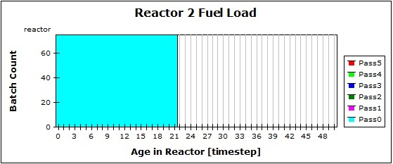
Example (Startup)
Feed
Discharge
Notes:
Reactors start fully fueled with Pass 0 fuel.

Slide 8
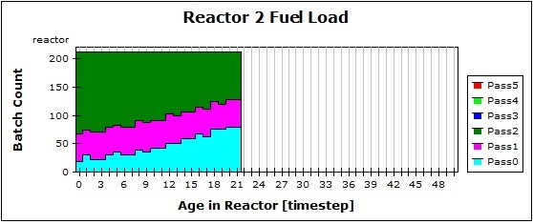
Example (Midway)
Notes:
As fuel is recycled, higher passes become available and are loaded

Slide 9
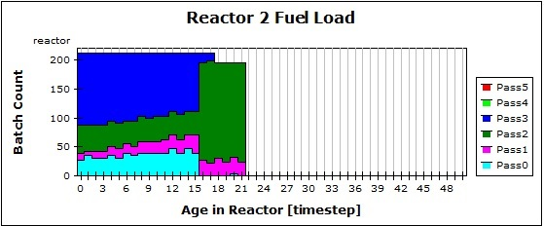
Example (Transition to Equilibrium)
Pass 3+ discharged at 4.5yr
Pass 2- discharged at 5.5yr
Notes:
Pass 3 and higher fuel has a shorter irradiation time than Pass 2 and lower.
Once a reactor has fully irradiated Pass 3 fuel, any remaining Pass 2 or below is discharged.
This is a modeling approximation of how a core might transition from one core loading to another.

Slide 10
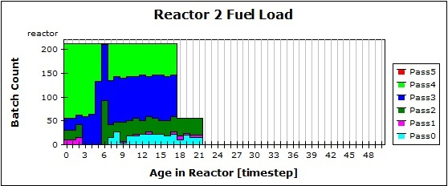
Example (More Transition)
Notes:
Transition continues

Slide 11
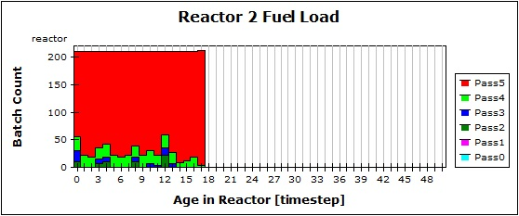
Example (Near Equilibrium)
Notes:
All reactors are now on Pass 3+ fuel.
Lower pass fuel continues to be fed as full recyclable batches become available.

Slide 12
Observations
Integers are easier to manage than floats
Book-keeping is straight-forward, until upset conditions must be included. What-if’s include:
Fuel supply shortage
Coincident shut-down or startup

Slide 13
Discussion
What issues have you encountered in extending a model?
What have you been surprised to find or learn?
How would you change things if starting from scratch?
Which assumptions are the most limiting to the results?
Which are the most easily generalized within a the model?
How should one handle the first core load, where batches are not fully irradiated at discharge, and do not require full equilibrium fissile loading?

Slide 14
Supplemental Material

Slide 15
Modeling Fuel in Reactors
Previous versions of VISION tracked total mass by
Reactor type
Recycling pass
Irradiation timesteps
There were several drawbacks
Floating point underflow errors
Poor handling of fuel supply shortfalls
Irradiation time, batch sized fixed for each reactor
An improved method was needed

