Slide 1

Scenario Analysis of PT-HWR Used Fuel Management for Once-Through Thorium Fuel Cycles
Daniel Wojtaszek
2nd Technical Workshop on Fuel Cycle Simulation
July 19, 2017
Notes:
For best results, please send the large top image to the back layer. Choose “Arrange” then select “Send to Back”.

Slide 2
Presentation Outline
Objective
Pressure Tube Heavy Water Reactor (PT-HWR)
Thorium-Uranium Fuel Concepts
Analysis Methodology
Results
Conclusions / Future Work
Discussion

Slide 3
Objective
To analyze some potential impacts on the management of used fuel associated with deploying thorium fuels in PT HWRs in a once through fuel cycle.
This analysis is focused on dry storage and the deep geological repository (DGR).

Slide 4
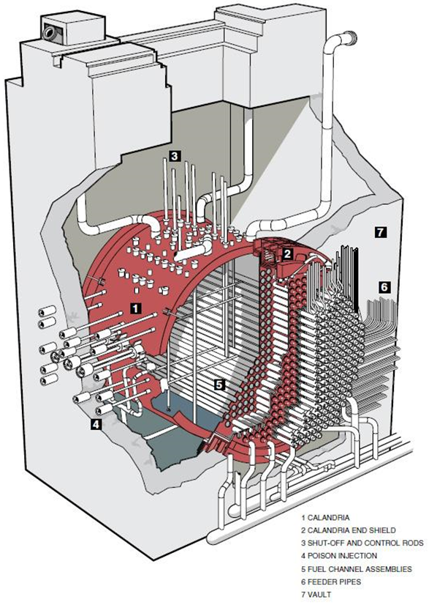
Pressure Tube Heavy Water Reactor
Heavy water moderated and cooled,
High neutron economy
Current PT-HWRs are fuelled with natural uranium (NU)
Online refuelling
Fuel is in the form of cylindrical fuel bundles
(~0.5 m long, ~0.1 m diameter)

Slide 5



Thorium-Uranium Fuel Concepts
Low-NU
100% NU
BU ~7.1 MWd/kg
Core Mass ~86 MTHE
Med-SEU+Th
Centre element (red): 100% Th
Ring elements (green): 98% SEU + 2% Th
BU~19.1 MWd/kg
Core Mass ~86 MTHE
Hi-LEU/Th
Graphite Centre Element (grey)
Ring elements (green): 50% LEU / 50% Th
BU~40.6 MWd/kg
Core Mass ~60 MTHE
SEU: Slightly Enriched Uranium (1.2 wt% ²³⁵U/U)
LEU: Low Enriched Uranium (5 wt% ²³⁵U/U)

Slide 6
Analysis Methodology (pt. 1)
Scenario Assumptions
Fuel Depletion and Decay Calculations
(WOBI)
PT-HWR Assumptions
Installed Capacity: ~13.5 GW_{e}
Fleet operation: 2025 - 2085
Reactor Power
Fuel Burnup
Decay power
Core Fuel Mass
Thermal efficiency: 33%
Capacity Factor: 85%
Reactor Lifetime: 30 years
Calculate Used Fuel Discharge
Annually discharged used fuel (kgHE/year)
Core fuel mass discharged at reactor end of life
Decay power of used fuel each year after discharge

Slide 7
Analysis Methodology (pt. 2)
Wet storage duration: 5 years
Minimum used fuel age for DGR: 30 years
Used Fuel Mass Flow
Reactor
↓
Wet storage
↓
Dry storage
↓
DGR
(Spreadsheet)
Scenario Assumptions
Dry Storage Assumptions
(MACSTOR)
Max number of Fuel bundles/basket: 60
Max decay power/basket: 0.36 kW
Max number of Fuel bundles/container: 360
Max decay power/container: 1.3 kW
Max number of containers loaded/year: 370
First year of operation: 2060
DGR Assumptions
(Canadian Concept)
Annually discharged used fuel (kgHE/year)
Core fuel mass discharged at reactor end of life
Decay power of used fuel
Used Fuel Discharge

Slide 8
Results: Wet Storage

Slide 9
Results: Dry Storage

Slide 10
Results: DGR

Slide 11
Conclusions
PT-HWRs are a viable existing technology for utilizing thorium-based fuels and uranium-based fuels augmented by small amounts of thorium.
Higher-burnup fuels can result in lower wet-storage requirements, but higher dry-storage requirements.
Ultimately, higher-burnup SEU+Th and LEU/Th fuels can have lower DGR requirements than NU.

Slide 12
Future Work: Multi-Stage Fuel Cycles
Stage 1
Stage 2
Stage 3
LWR LEU
Pu
PT-HWR Pu+Th
²³³U
PT-HWR ²³³U+Th
²³³U
PT-HWR LEU+Th
²³³U
PT-HWR ²³³U+Th
Pu
LWR LEU
Pu
FR Pu+²³⁵U+Th
²³³U
PT-HWR ²³³U+Th

Slide 13

Thank you
Questions?
Daniel Wojtaszek
daniel.wojtaszek@cnl.ca
Notes:
For best results, please send the large top image to the back layer. Choose “Arrange” then select “Send to Back”.
This slide is not available in the Master. To add slides to you deck, simply duplicate the slide itself.

