Slide 1
Simulation Tool Benchmarking and Verification
Brent Dixon
Idaho National Laboratory
Technical Workshop on Fuel Cycle Simulation

Slide 2
FCS Verification – What to test
Basic features or essential functionalities
These are the building blocks of the code
May also be considered “core capability” blocks
Integral features that bind the basic features together and produce useful results
Considering the core capabilities as an integrated whole
Produces a complete result
Limited to basic capabilities common to most codes
Exemplary features that enable study of particular sensitivities or other capabilities
May not be present in every tool
Provides “full features” of a code

Slide 3
FCS Verification – How to test
General Approaches
Manual verification of individual equations up to a highly simplified model
Spreadsheet verification of a simple model
Benchmarking of single or multiple scenarios with a set of codes
Auto-verification of code functions/methods
Scenario-Specific Approaches
Manual or spreadsheet verification of key results
Cross-comparison to results from other FCS codes

Slide 4
Unit Tests – Parts of Code or Full Code
Parts example
Enrichment module provides correct NU, LEU, DU masses and SWUs
Full Code Examples
Run one reactor at steady state
Startup and run (and retire) one reactor
Run a homogenous fleet at steady state
Run a homogenous fleet with simple growth
Items reviewed in full code tests are just the basics
Number of reactors, basic material flows
May omit mining, conversion, transportation, storage, reprocessing, waste disposal, etc.
Includes no exemplary features such as decay

Slide 5
Code to Code Testing
Purpose is to produce exactly the same results or be able to explain any differences
Reference result may be calculated with a different tool (e.g. spreadsheet)
Differences may result in:
Evolution of the specification to eliminate multiple interpretations
Changes to codes to correct any errors discovered
Detailed explanation of differences due to different code architectures, time steps sizes, reporting times (e.g. first of the year vs. end o the year), rounding, etc.

Slide 6
Benchmarking
Full code tests
May be based on one or a family of scenarios
Typically will assess more parameters that a code-to-code test
Often used to prove a new code is ready for production work
Purpose is typically to produce similar behavior, not exact matches
Only significant differences require explanation
Typically these trace back to unmodeled features in less mature codes, etc.
May involve disabling exemplary features to improve matches
May be blind or open
Blind tests do not allow for iteration of the specification if found to allow multiple interpretations

Slide 7
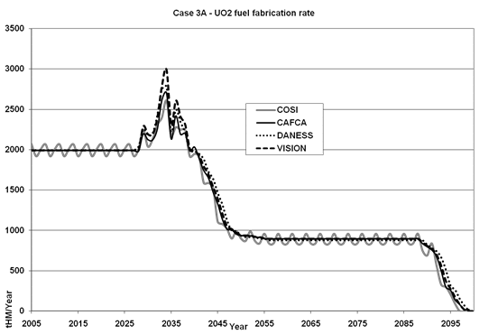
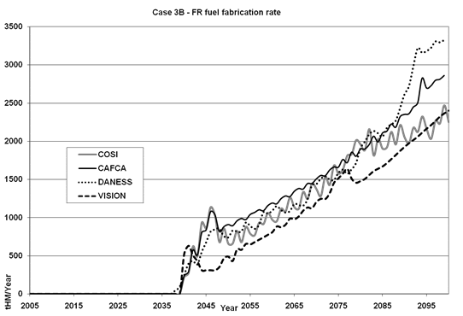
Benchmarking Examples
MIT Benchmark (2009)
Included multiple scenarios
One iterated for close matches with advanced features disabled
Others allowed for all features to operate, including automated decision-making
Four mature codes compared

Slide 8
Benchmarking Examples
NEA/OECD Benchmark (2012)
Involved a single scenario with three stages
Five mature codes were compared

Slide 9
Benchmarking Examples
IAEA/INPRO GAINS (2013)
Involved three simple scenarios
Six codes compared (several not previously benchmarked)

Slide 10
Benchmarking Observations
Results are more understandable with simple scenarios and tight specifications
Must design around the intersection of code capabilities, not the union
Expect differences in results
Just because results do not match, does not mean one code is “wrong”
However - Allow time for iterations
When running a new type of problem, a code may reveal a bug that needs fixing
Expect strong similarities in general trends
A transition may not occur in the same year, but should occur near the same time
A slope may not be equal, but should be close (e.g. all trending slightly up)
Use the experience to improve your code
Tune up your calculations or add a new capability you saw in another code

Slide 11
References
[1] Brown, N.R., B.W. Carlsen, B.W. Dixon, B. Feng, H.R. Greenberg, R.D. Hays, S. Passerini, M. Todosow, A. Worrall, “Identification of fuel cycle simulator functionalities for analysis of transition to a new fuel cycle”, Annals of Nuclear Energy 96 (2016) 88-95, 2016.
[2] Feng, B., B. Dixon, E. Sunny, A. Cuadra, J. Jacobson, N.R. Brown, J. Powers, A. Worrall, S. Passerini, R. Gregg, “Standardized verification of fuel cycle modeling”, Annals of Nuclear Energy 94 (2016) 300-312, 2016.
[3] Guerin, L., B. Feng, P. Hajzlar, B. Forget, M.S. Kazimi, L. Van Den Durpel, A. Yacout, T. Taiwo, B.W. Dixon, G. Matthern, L. Boucher, M Delpech, R. Girieud, M. Meyer, “A Benchmark Study of Computer Codes for System Analysis of the Nuclear Fuel Cycle”, Center for Advanced Nuclear Energy Systems, Massachusetts Institute of Technology, MIT-NRC-TR-105, April 2009.
[4] “Benchmark Study on Nuclear Fuel Cycle Transition Scenarios Analysis Codes”, Expert Group on Fuel Cycle Transition Scenario Studies, Nuclear Energy Agency, NEA/NSC/WPFC/DOC(2012)16, Paris, June 2012.
[5] “Framework for Assessing Dynamic Nuclear Energy Systems for Sustainability: Final Report of the INPRO Collaborative Project GAINS”, International Atomic Energy Agency, NP-T-1.14, Vienna, 2013.
[6] Gidden, M., Scopatz, A., Wilson, P., “Developing standardized, open benchmarks and a corresponding specification language for the simulation of dynamic fuel cycle”, Trans. Am. Nucl. Soc. 108, 127–130, 2013.

Slide 12
Discussion
What issues have you encountered in code verification?
What have you been surprised to find or learn?
What weaknesses in current approaches have you noted and what ideas do you have to address them?

