Slide 1
Visualization of Simulation Results
Brent Dixon
Idaho National Laboratory
Technical Workshop on Fuel Cycle Simulation

Slide 2
Purpose of Presentation
Stimulate a discussion on different ways to graphically present results of simulations
What works, what doesn’t
What people would like to see in the future
Uses of graphical representations include:
Debugging of simulation specifications
Examining a feature of a simulation to improve analyst understanding
Technical collaboration
Presenting results in technical papers and presentations
Communication with sponsors & presentations to management
All examples here are static, but dynamic displays are also used to monitor simulations, zoom in on timestep level behavior, etc.

Slide 3
Example of code in operation

Slide 4
On-board graphs

Slide 5
Parameters during transition

Slide 6
Metrics during transition

Slide 7
Use of a Standard Output Template

Slide 8
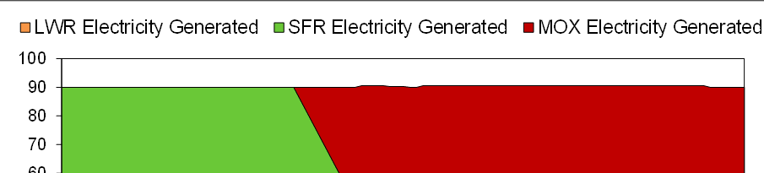
Zooming in on specific behavior

Slide 9
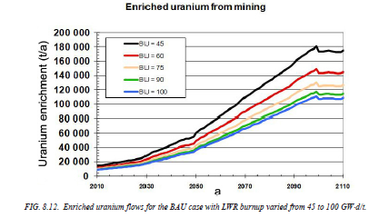
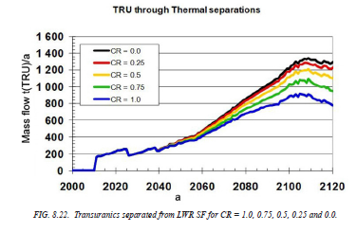
Sensitivity Studies
Figure 15. Fast reactors as a function of growth rate

Slide 10
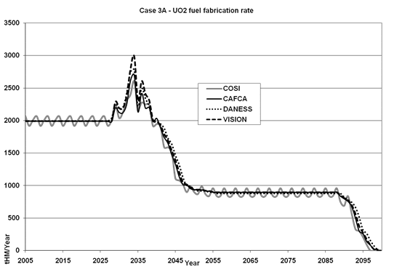
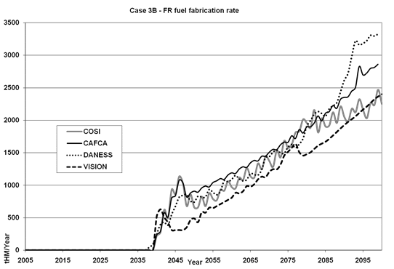
Benchmarking Examples

Slide 11
Explanation of Code Behavior

Slide 12
Discussion
How do you use graphical output?
What different types of graphical output do you use . . .
during problem analysis?
for presenting technical results?
for communication to sponsors?
Ideas beyond line and area graphs?
Other ways of dealing with time?
What did you always wish you could do with your output?

