Slide 1


Between heterogeneity and cooperation The (electronuclear) scenario as a ‘boundary object’ for decision-making?
2nd annual Technical Workshop on Fuel Cycle Simulation
Stéphanie TILLEMENT
Associate Professor, Sociologist
IMT Atlantique
Notes:
Good morning everyone! Thanks a lot for giving me the opportunity to present part of our work on electronuclear scenario.
My name is Stéphanie Tillement and I am associate professor in sociology at Institute Mines Telecom Atlantique in Nantes, France.
I am really sorry for not being able to participate physically to this workshop, yet, I’m very happy to present my good excuse, named Théo!

Slide 2
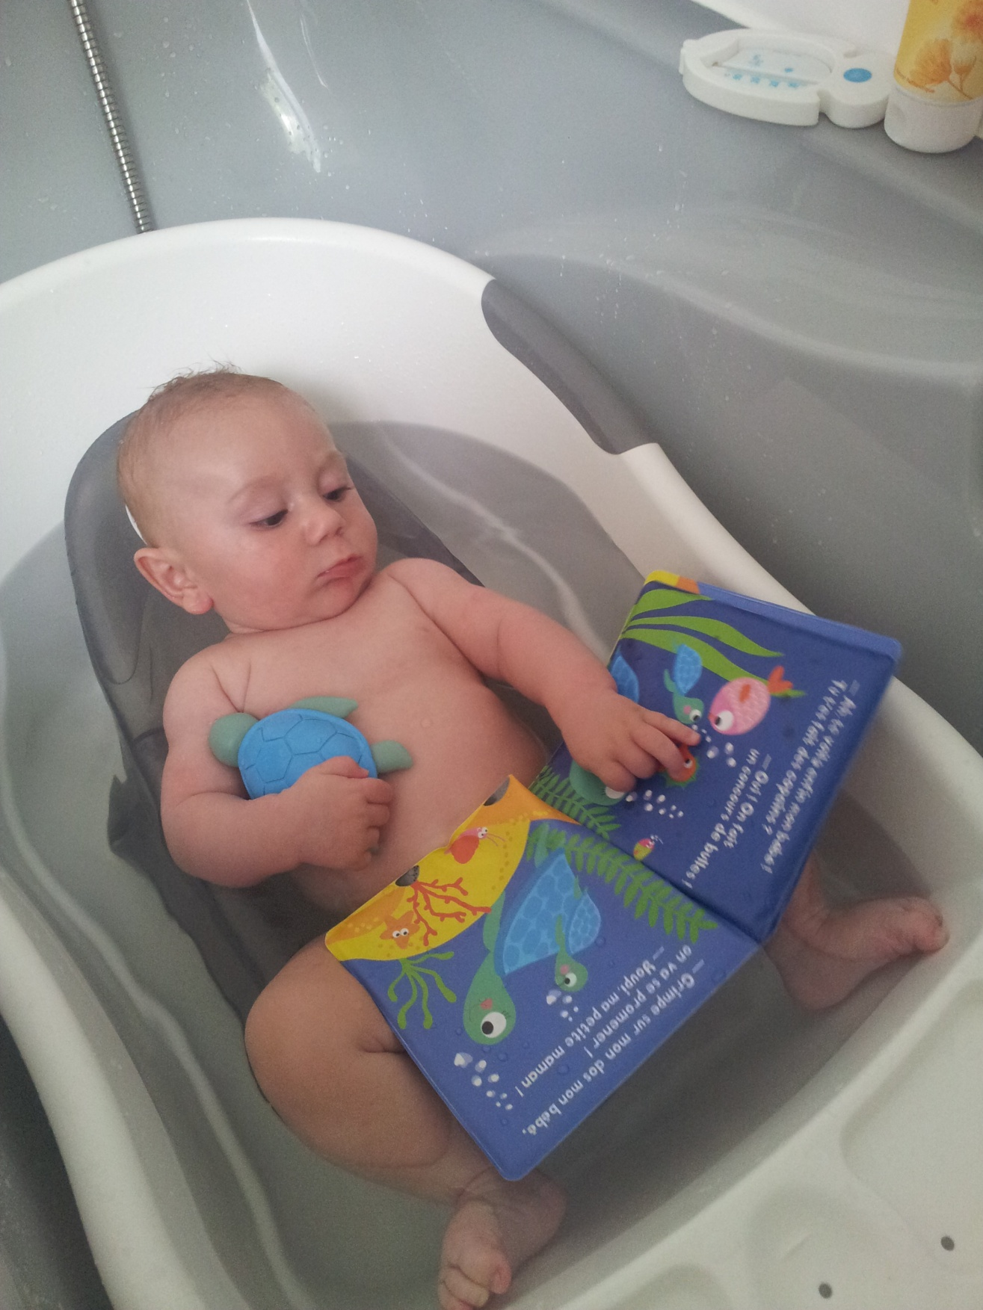
My “good” excuse for not being here
2nd annual Technical Workshop on Fuel Cycle Simulation
Notes:
I am really sorry for not being able to participate physically to this workshop, yet, I’m very happy to present my good excuse, named Théo!

Slide 3
Research framework
2nd annual Technical Workshop on Fuel Cycle Simulation
PRISE (Interdisciplinary Research Project on Electronuclear Scenario)
An interdisciplinary project team:
scholars in sociology (S. Tillement, S. Guyard), management (B. Journé) & physics (N. Thiolliere, X. Doligez, A. Bidaud)
A central research thematic
What about the link between scenario and decision-making processes?
In the continuity of collaborations initiated in 2014 :
A presentation last year at the “1st Technical workshop on Fuel Cycle Simulation” focused on studying role played by scenarios through the lens of long-term trajectories (sequenced by turning points) to qualify 3 different sociotechnical configurations, shaped by:
participation forms of the different actors involved (including evolution of hierarchy of credibility and legitimacy)
a specific form of scenario and specific practices of construction and uses of scenario
Notes:
This paper is based on an interdisciplinary research (social sciences & physics) conducted in the framework of PrISE (Interdisciplinary research project on Electronuclear Scenarios) funded by French NEEDS program. In the continuity of research collaborations initiated in 2014, this project questions the link between scenario (especially electronuclear scenario) and decision-making processes through the lens of the French case. This case is specific for several reasons: 1) France is currently engaged in an energy transition which implies technological innovation and political decisions 2) This country is characterized by the very important part of electricity of nuclear origin, produced thanks to 58 pressurized water reactors (PWR) operated by EDF; 3) a particular legal framework (with laws ‘Bataille’ in 1991 and ‘Birraux’ in 2006) that shaped participation in research & development in the nuclear field, by enabling the entry of new actors (mainly academics) in this field.
We had the opportunity to present our previous work last year during the 1st workshop in fuel cycle, and we focused at that time on 2 main questions:
How electronuclear scenario, as a sociotechnical device, intervenes in the structuring of a community of practice?
How professional interactions and institutional dynamics affect electronuclear scenario?
Our socio-historical approach enabled us to identify three different sociotechnical configurations, sequenced by turning points according to the participation forms of the different actors involved (including evolution of hierarchy of credibility and legitimacy), in link with the role played by sociotechnical devices, that is electronuclear scenario.

Slide 4
Research framework
2nd annual Technical Workshop on Fuel Cycle Simulation
PRISE (Interdisciplinary Research Project on Electronuclear Scenario)
From the analysis of the factory of the scenarios to the analysis of their use
A project centered on ‘blind spots’ of previous researches:
The implication of the political sphere in processes of decision making and scenarios’ development
Different visions of scenarios and scenario-based practices according to the different social worlds or communities of practices
The collective dynamics of scenarios’ evaluation
Main scientific goal:
Developing a critical analysis of the content, roles and uses of scenarios that takes into account the diversity of involved actors and long-term (past, present, future) temporal dynamics
Notes:
Our current research comes to complement the previous one and aims at understanding how scenario, as a tool and a collective process, shapes scientific, technological and more importantly political decisions regarding nuclear power and more broadly energy production. Indeed, the implication of the political sphere in the construction and evaluation of scenario and their relationships with communities of practices involved in scenario-making (industrials, academics…) were ‘blind spots’ of previous researches (Tillement et al., 2015, Tillement, 2016).

Slide 5
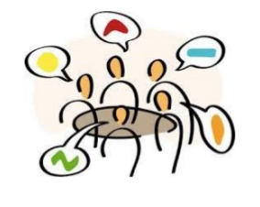
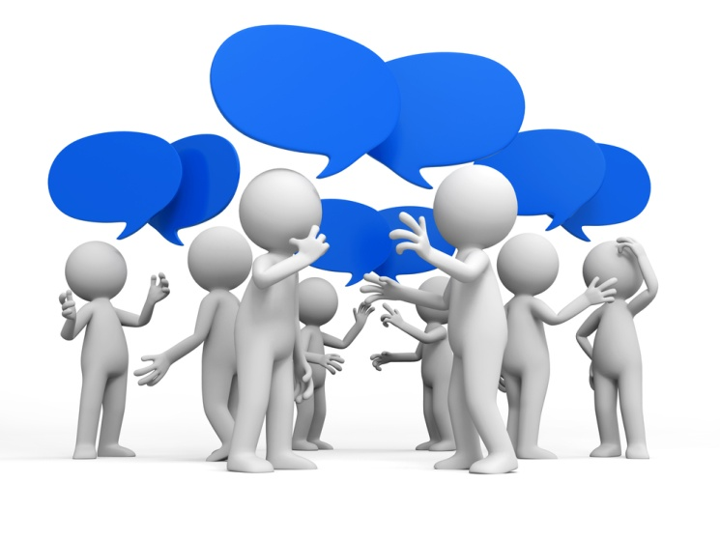
Research framework
2nd annual Technical Workshop on Fuel Cycle Simulation
PRISE (Interdisciplinary Research Project on Electronuclear Scenario)
An original methodology based on ‘Focus-groups’
A 2-steps research process
1st step (2016-2017): Focus-groups to structure collective discussions between representatives of the same community of practices, among 3:
“Politics” (P1, P2, P3, P4)
“Research, Engineering and Industry” (I1, I2, I3, I4, I5)
“Academics” (A1, A2, A3, A4, A5, A6, A7)
2nd step (2017): Final workshop gathering all previous participants to structure collective discussions between representatives of different social worlds around key thematics
On-going analysis of data
Notes:
To address this question, we adopt an original methodology based on the organization of focus-groups. In contrast to traditional methods in social sciences, focus-groups enable to structure collective discussions on a specific topic. For now, we organized three focus-groups gathering representatives of three different communities of practices, involved, more or less directly, in scenario- and decision-making processes: 1) “Politics”; 2) “Engineering and Industry”; 3) “Academics”. From the analysis of these focus-groups, we propose in this communication to consider the scenario as a “boundary object” (Star, 2010) that sometimes helps to cross inter-occcupational boundaries and sometimes reinforces those boundaries.

Slide 6
Thinking scenarios as “boundary objects”
2nd annual Technical Workshop on Fuel Cycle Simulation
The field of STS
(Science & Technology Studies)
Boundary objects
(Star & Griesemer, 1989; Star, 2010)
Scenario
Notes:
From a theoretical point of view, our work is embedded in the field of STS, science & technology studies. In particular, we draw on the concept of boundary object, as developed by the sociologist Susan Star, to think scenario as a BO.

Slide 7
Thinking scenarios as “boundary objects”
2nd annual Technical Workshop on Fuel Cycle Simulation
Boundary object
Distributed and embedded in action
Weakly structured in common use
Strongly structured in local use
Concrete or abstract
Temporal
All at once ambiguous and clear, at different moment, for different objectives
Interpretive flexibility
Notes:
À l’origine du concept, les questionnements suivants:
Qualifier les mécanismes d’articulation des perspectives d’acteurs appartenant à des mondes sociaux différents
Par quel processus des acteurs relevant de mondes sociaux différents mais appelés à coopérer réussissent-ils à se coordonner malgré leurs points de vue ou objectifs différents?
Comment créent-ils des compréhensions communes sans perdre la diversité des mondes sociaux?
OF : Arrangement qui permet à différents groupes de travailler ensemble sans consensus préalable
Interpretive flexibility: a road map may point the way to a campground for one group, a place for recreation. For another group, this ‘‘same’’ map may follow a series of geological sites of importance, or animal habitats, for scientists. Such maps may resemble each other, overlap, and even seem indistinguishable to an outsider’s eye. Their difference depends on the use and interpretation of the object.
Ce sont des objets qui s’étendent sur plus d’une communauté de pratiques – une discipline, une ligne de travail, ou une association volontaire.
Ils ont deux propriétés importantes :
Ils sont faiblement structurés dans l’usage commun et deviennent plus fortement liés dans des endroits particuliers ;
Ils sont à la fois ambigus et clairs, à différents moments, pour différents objectifs.
Les objets frontières sont partout, mais le concept est particulièrement important quand on regarde la coopération interdisciplinaire et les problèmes d’infrastructure. Un instrument d’infrastructure peut devenir un objet frontière.
Quand les échanges sont stabilisés autour d’un outil (ils s’y réfèrent de la même façon), les objets frontières se développent, facilitant la coopération hétérogène.
p. 19 : On a besoin de mieux comprendre comment se développent les OF, mais aussi comment ils échouent à se développer dans le travail interdisciplinaire.
Ce qui importe pour les OF: façon dont les pratiques se structurent et dont le vocabulaire émerge, pour faire des choses ensemble
Les OF sont :
temporels
encastrés dans l’action
sujet à la réflexion et à l’adaptation locale
distribués
Les OF sont à la fois concrets et abstraits

Slide 8
Scenarios as BO for ‘informed’ decisions
2nd annual Technical Workshop on Fuel Cycle Simulation
Scenarios as BO helps more “informed” decisions by supporting
inter-disciplinary work (e.g. physics & economy)
“My second experience with scenarios is a much more multidisciplinary work, with an energy approach voluntarily not an economic one. Because the economists [with who we collaborated] were saying that the costs associated with energy were nonsense. If economists themselves say ‘That’s nonsense', where are we going? And the economists in question have suggested to have a very physical approach. [...] With these economists, we tried to build a tool that allows, in a given framework, with the same hypotheses, to compare different scenarios from the physics’ point of view.” (A1)
Inter-occupational work (e.g. politicians & academics)
“What was quite interesting is that a kind of group phenomenon takes place between the scientists who are brought together, who attend all our hearings and who can intervene when they want… I think of one of the studies where when the auditions were finished, they were discussing again between them or sending emails and telling us: “there is still a question that must be deepened, it's not clear…”. When you work like that, there is relatively little chance of misleading, especially since I liked to put people completely outside the field. What I'm interested in is what they feel and can tell me”. (P2)
Notes:
On the one hand, scenarios support knowledge transfer and translation between communities of practices.
They support inter-disciplinary work, for example between physicists and economists
They appear flexible enough to enable different groups to work together without prior consensus or shared goals.
je me serais attendu à ce que l'implication du CNRS reste plus en amont de ce qu'elle a été c'est-à-dire que finalement ils se sont investis [Inaudible] sur le terrain d'une organisation comme le CEA et je me serais attendu à ce qu'ils soient en amont pour alimenter les aspects plus fondamentaux sur la science, la physique, or ils ont trouvé opportun, intéressant de, de venir sur ce terrain et donc d'avoir une voix au débat en particulier sur les scénarios alors ça serait intéressant d'analyser ça puisque effectivement pour être entendu, si on parle que de sciences très fondamentales on n'est pas très entendu. Par contre si on, si on rentre dans le débat sur les scénarios dans les forums de discussion de scénarios on est très entendu.
P5 : Ouais c'est une façon peut-être de rendre réel aussi les choses parce que... avec les scénarios on peut savoir par exemple le nombre de réacteurs qu'on peut faire. On a certains flux, certains stocks qui font que ben on est dans un ADS, et on peut mettre tant de plutonium, donc on ne peut pas en faire plus de cinq ou six.
Scenarios mediate the relationships between different organizations and occupational communities
symbolizing their knowledge,
inciting their rhetoric,
and defining task boundaries between them (Bechky, 2003)
ce qui était tout à fait intéressant c'est qu'il y a un, une sorte de phénomène de groupe qui se... qui se noue entre les scientifiques que l'on réunit, qui assistent à toutes nos auditions qui peuvent intervenir quand ils veulent, je pense à une des études où quand on avait fini les auditions ils rediscutaient entre eux ou bien ils s'envoyaient des mails et ils nous disaient le coup d'après « bah il y a encore telle question qu'il faut approfondir » ça ce n'est pas clair donc quand vous travaillez comme ça vous avez quand même relativement peu de chance de vous planter surtout que moi j'aimais bien mettre des gens complètement extérieurs, je vous ai dit cette prof de sociologie euh parce que c'était le rôle du naïf qui est extérieur à tout ce monde là. Et moi ce qui m'intéresse c'est ce que elle, elle ressent et elle peut me dire.

Slide 9
Scenarios as tools that reinforce boundaries
2nd annual Technical Workshop on Fuel Cycle Simulation
The interpretive flexibility of scenarios
“Yesterday we were talking about conviction, we get into the game of the conviction of one person who will say ‘yes that is realistic for me’ and another one will say ‘it's unrealistic’”. (I3)
Reinforce organizational and occupational boundaries
Limit the rationality of decisions
Keeping some part of scenario invisible to other communities
"We were several to consider that these scenarios were very obscure... We did not see what were the criteria, the hypotheses of these scenarios. So we had an extremely limited reading grid… We can not do anything with them because we do not understand with what hypotheses... As scientists, we can not be satisfied of that.” (A1)
Key issues:
How to control the “robustness”, “reliability”, “credibility”, “realism” of scenarios that are supposed to inform decisions?
Who is legitimate? Has sufficient knowledge? Can have authority? To do so…
Notes:
Scenarios may resemble each other, overlap, and even seem indistinguishable to an outsider’s eye. Their difference depends on the use and interpretation of the object. These differences often are in the invisible, opaque part of scenarios
On the other hand, scenarios can be ‘instrumentalised’ to serve one particular message or built in a way that makes them very ‘opaque’ or too complex to support any decisions. In these last cases, scenarios rather tend to reinforce boundaries.
P4 : Dans cette phase de délire là sur les scénarios, on a vu apparaître vraiment deux types de scénarios : ils sont tous selon les démarches « if then », ça on est bien d’accord, mais il y a quand même deux types, il y a les scénarios dits « réalistes », les hypothèses qu'on fait derrière essayent de configurer le futur ; et puis il y a les scénarios qui s'affichent comme normatifs c'est-à-dire on veut arriver à tel résultat et alors au prix de certains « game changers » [59:16] certaines hypothèses secondaires qui sont souvent complètement... complètement folles ! Et alors le grand danger c'est que si on savait mettre une étiquette sur chaque scénario en disant « celui-là c'est un réaliste et celui-là c'est un normatif » tout irait bien, mais on a tout un continuum entre ces scénarios là et souvent ils n'affichent pas leurs noms. Ça introduit un flou absolument magnifique dans les... dans l'analyse qu'on peut faire derrière. Il faut une police des scénarios voilà [Rires] !

Slide 10
Different scenarios for different decision-making processes
2nd annual Technical Workshop on Fuel Cycle Simulation
In this crazy phase around scenarios, we saw two types of scenarios appear: there are the so-called "realistic" scenarios, in which the hypotheses behind it try to configure the future. And then there are “normative” scenarios, that is, one wants to arrive at such a result… at the price of certain "game changers“, certain secondary hypotheses which are often completely, completely crazy! And then the big danger is… if we could put a label on each scenario saying "that one is a realistic and that one is a normative“, everything would be fine, but we have a continuum between these scenarios that often do not display their names. It introduces a fantastic blur in the analysis that can be done behind. We need a police of scenario [laughs]!
Normative scenario
Realistic scenario
Other oppositions in scenario’s qualification…
“Industrial” versus “exotic”
“complex” versus “simple”
… that deserve to be studied in link with the decision-making issue
Key issues:
How to control the “robustness”, “reliability”, “credibility”, “realism” of scenarios that are supposed to inform decisions?
Who is legitimate? Has sufficient knowledge? Can have authority? To do so…
Notes:
On the other hand, scenarios can be ‘instrumentalised’ to serve one particular message or built in a way that makes them very ‘opaque’ or too complex to support any decisions. In these last cases, scenarios rather tend to reinforce boundaries.

Slide 11
Scenarios as tools disconnected from the political world
2nd annual Technical Workshop on Fuel Cycle Simulation
Disconnection between decisions and scenarios?
“What is happening around the energy transition law, which is typically the kind of law that we vote without believing in it, but we vote it because we know it will not be enforced. All this makes us a little puzzled about how we prepare the future and I also feel that all this was done regardless of the reference to any scenario whatsoever.” (P3)
Incompatibility between political career and long-term scenarios
The last point I wanted to tell you is that we need a strong political backing. This is the most difficult! Because if you do not have people who agree to politically support these subjects, they will remain forever under the table. So it takes a strong commitment, but it is not fashionable at the moment. This is a matter of great concern to us: who will agree to devote tens of days, hundreds of hours to a subject that is not directly related to his constituency? and who will have the courage to carry it politically? And the scenarios that are built in this long-term, there's the scenario that threatens the one of "my turn", my election or my re-election. So that becomes extremely difficult! (P2)
When politicians instrumentalize the construction and use of scenarios
“EDF did not participate, I believe, in the construction of the scenario ... then I understood at one point that in fact the government did not want to ask the question to us but rather to associations deemed more neutral [laughs]”. (I5)
When scenarios justify decisions
“We were talking about independence, I think it is a fiction, independence! On the other hand, the plurality of opinions is a way for a government to come to [Inaudible] but we do not have the impression that it currently works so much like that! They get an idea a priori and then they look for scenarios, it's justification eh!” (I4)
Notes:
The political arena in particular appears very far from scenarios and political decisions do not seem motivated by scenarios, for cognitive as well as strategic reason. We conclude with some limitations and avenues for future research.
P1 : Les scénarios qui ont pris place dans le débat... on est dans l'usage des scénarios.
A1 : Oui.
P1 : Là c'est vrai que c'est décevant... moi je trouve que tout a été mis sur un pied d'égalité au final donc on a fait fi, on a même occulté la partie hypothèses/construction d'ailleurs c'est reconnu par rapport maintenant le rapport [02:44:48???] il disent bien « on n'a pas eu le temps » parce que tout ce dont on parle ça prend du temps. Et ils disent « bah on n'a pas eu le temps de faire un travail de construction sur commande » donc on a pris l'existant et voilà, on fait des paquets. Il y a cinq ou six typologies de scénarios ou quatre je ne sais plus donc voilà et c'est reconnu mais on passe allègrement sur les implications de, de cette façon de travailler. Et je crois qu'il est dit quand même quelque part dans le rapport, il faudrait reprendre ça sérieusement donc on s'attendait à ce que la suite de, du débat invite les alliances enfin... à s'emparer d'un deuxième travail pour la prochaine étape.
P4 : On parlait d'indépendance je crois que c'est une fiction, l'indépendance par contre la pluralité des avis est une façon pour un gouvernement de se [Inaudible] mais on n'a pas l'impression qu'actuellement il fonctionne tellement comme ça ! Ils se font une idée à priori et puis ensuite ils cherchent des scénarios, c'est de la justification hein ! C'est de la justification scientifique pour justifier ses idées à priori et si on leur pond des scénarios qui n'auront pas dans leur sens bah ils les mettent gentiment à la trappe jusqu'à ce qu'il y en ait un qui leur plaise, en l'occurrence c'était celui de l'Ademe si je résume voilà. On fonctionne tous à peu près comme ça hein pour se forger une opinion.
P2 : Il y a des lobbys hein, je veux dire il y a un lobby ENR, un lobby nucléaire entre guillemets mais ça existe chacun essaye de vendre, c'est normal le problème c'est que [Inaudible] et la seule critique que l'on fait c'est que les arguments de choix ne sont vraiment pas bons sur le plan technique, c'est ça qui est choquant !
P4 : Je ne suis pas certain que les scénarios jouent un rôle central dans le choix de, des technologies à développer pour le futur si on parle de filières de réacteurs, je ne suis pas certain, je pense qu'on a plutôt résonné en termes de choix multi-critères, multi-critères la sûreté est un de ces critères pour le moins essentiel hein, il y a également la technico-économie, il y a également le critère de durabilité en termes d'exploitation des ressources, il y a le critère de non-prolifération. Il y a le critère de maturité aussi, la technologie au stade actuel et je crois que c'est sur la base de ces critères là que finalement en France on a décidé de mettre la priorité sur, sur la filière sodium pour le futur. Je ne pense pas que des scénarios soient intervenus explicitement dans ce choix, c'est plutôt on met les critères sur la table, on pèse les avantages et les inconvénients de performance de chacune des actions possibles et puis on choisit. Ce n'est pas vraiment un scénario qu'il y a derrière.
P3 : C'est parce que quand vous avez montré le scénario des références, là derrière il y a déjà certaines hypothèses qui ne sont pas contestées entre les acteurs mais il y a quand même des hypothèses derrière donc par exemple ça veut dire qu'on va transmuter quand même une partie des actinides mineurs c'est un choix, c'est une valeur implicite qui est, si on regarde les autres pays, ils ne vont peut-être pas adhérer à cette valeur là hein ? Ils vont faire le cycle ouvert et basta hein ! Une autre hypothèse qui est derrière qu'on va disperser les actinides mineurs donc c'est une valeur implicite hein ? Une autre hypothèse c'est on regarde niveau national, on n'intègre pas les aspects régionaux européens tout ça c'est derrière !

Slide 12
Discussion & conclusion
2nd annual Technical Workshop on Fuel Cycle Simulation
Potential contributions:
The (electronuclear)scenario not seen as a purely ‘technical’ tool, but as an object that embeds cognitive, political and social dimensions
A better understanding of the link between scenarios’ construction and evaluation and decision-making processes
Limitations and avenues for future research:
Still an on-going research
Industrials still missing in the landscape
Going further on the ill-structured / well-structured aspects of the arrangements built thanks to scenarios
Are those results specific to the French case? Or generalizable to other countries?
Notes:
Finally, our research is still on-going. In particular, the final collective workshop has yet to take place
In terms of limitation, we can regret the relative « absence » of industrials that obviously have an important weight in the

