Slide 1
Valuable Lessons from Fuel Cycle Code Comparisons
TECHNICAL WORKSHOP ON FUEL CYCLE SIMULATION
drhgfdjhngngfmhgmghmghjmghfmf
Bo Feng
Principal Nuclear Engineer
Reactor and Fuel Cycle Analysis
The submitted manuscript has been created by UChicago Argonne, LLC as Operator of Argonne National Laboratory ("Argonne") under Contract No. DE-AC02-06CH11357 with the U.S. Department of Energy. The U.S. Government retains for itself, and others acting on its behalf, a paid-up, nonexclusive, irrevocable worldwide license in said article to reproduce, prepare derivative works, distribute copies to the public, and perform publicly and display publicly, by or on behalf of the Government. The Department of Energy will provide public access to these results of federally sponsored research in accordance with the DOE Public Access Plan.
Friday, July 21, 2017
University of South Carolina

Slide 2
key observations
Observations from various code-to-code comparisons and benchmarks:
U.S. DOE NE Fuel Cycle Options Campaign (2014 - present)
U.S. DOE NE/NNSA International Pu Management studies (2016 - present)
OECD NEA Advanced Fuel Cycle Scenarios Expert Group (2015 - present)
MIT Fuel Cycle Benchmark (2009)
Key Observations on the fuel cycle code comparison process:
Most differences were due to people’s different interpretations of the input specifications, not different code algorithms or calculation approaches
Do not plan on the first specifications to be the final version; will require iterative updating with preliminary results from codes
Different codes often report or account for mass inventories at different times within a given year or even time-step that lead to misleading differences
Guessing reasons for differences is easy (and they’re often wrong), finding the reasons is much more difficult and pain-staking

Slide 3
Keys to success
Suggestions for Benchmark Organizer
1.) Avoid Ambiguous Language – No such thing as too much instructions (as long as they are all consistent)
2.) Avoid Borderline Scenarios – Try to specify a large buffer/margin to avoid fuel shortage or other system failure; ensure all codes can run scenario
3.) Specify Timing and Sequence – Specify exactly when events happen (reprocessing, reactor startup, etc.), the duration, magnitude, etc.
4.) Specify Data Reporting – Specify when values are reported in terms of during the year, before or after other events, the value type (annual, instant, cumulative)
5.) Use Output Template – Provide the figure/table templates and describe in full detail (when they are reported, how they are reported) to standardize comparisons
6.) Set Schedule (time limit) – Set a schedule and agree on when the results are “close enough”; these comparisons can take years

Slide 4
Avoid Ambiguous language
Specifications: “1% annual growth rate in nuclear energy demand”
Clarifying text: “90 GWe-y demanded in 2015 with constant 90 GWe power, 90.9 GWe-y demanded in 2016 with constant 90.9 GWe power, etc.”

Slide 5
Avoid Borderline Scenarios
For example, specifying that all codes use the same reactor capacity profile – one that was calculated by one code to minimize the surplus fuel in the system
This creates a borderline scenario for which some codes may show system failure (e.g., insufficient fuel → idle reactor capacities, backup fuel, no simulation)
Advice: Specify a scenario with plenty of fuel margin (e.g., less aggressive SFR deployment schedule) to avoid any failures OR produce specifications based on code that produces most limiting condition
Specified reactor profile
Example of system failure (DYMOND)
Notes:
System failure

Slide 6
Specify timing and sequence
Instant (every time step) versus Annual Throughputs
DYMOND
Reprocessing every DT
Spreadsheet
Reprocessing once a year
Resulting Discrepancy
Notes:
Surplus TRU due to recovered TRU not getting to reactors in time, leading to idle capacities (less energy generated → more surplus TRU)

Slide 7
Specify timing and sequence
Illustrations/schematics may be required
Some processes assumed to occur instantly and one after the other
This results in step functions and delta functions
System dynamics codes were designed for more realistic continuous flows and often require a minimum of 1 time step for each process
An annual mass flow is divided by the number of time steps per year

Slide 8
Specify data reporting
Before or after accounting
Directions: “For each year, plot the surplus Pu fuel resource in storage”
Beginning/Middle/End of year? If inventory, Max/Min/Mean over the year?
Before or after accounting for Pu being allocated for fresh fuel?

Slide 9
Specify data reporting
Instantaneous (time-step) Reporting vs. Annual Averaged Reporting
Another example of ambiguous data reporting: annual reprocessing rates were reported based on the first time step’s instantaneous reprocessing rate
Since there is only 1 datum point per year in this figure, one must be careful in the data description (e.g., “plot the annual-averaged rates each year”).

Slide 10
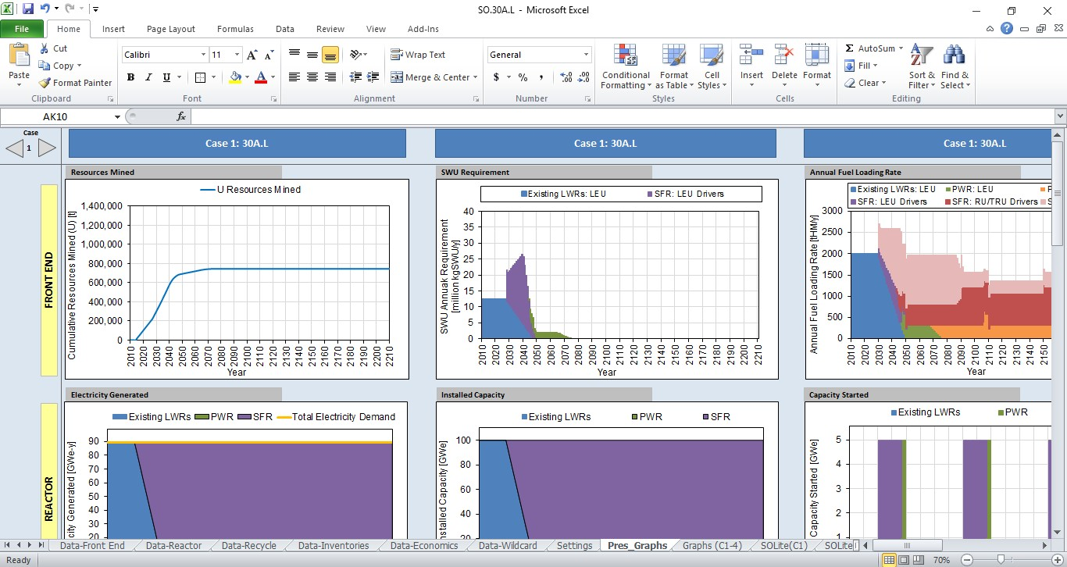
Use output template
Standardized display or tables for ease of comparison
Pre-determined format provokes thought and discussion on hardwired, familiarized outputs

Slide 11
Set schedule
With large groups and international participants, response times may be months; Most of these benchmarks are unfunded work
Try to have regular calls or set fixed schedules
Tracing the source of every difference can be excruciating; agree when results are “close enough” and move on (convergence criteria)

Slide 12
Additional Insights
There may be significant differences attributed to how the fuel movement is modeled: batch-wise vs “continuous” refueling (every DT)
The differences in results between elemental and isotopic definition of fuel can be significant
For more complex scenarios, all codes may need to make approximations at one level or another (in the input or modeling of mass flows), which is okay as long as it is stated up front and the impact is qualified

Slide 13
Thank you!

