Slide 1


Energize: An interactive evaluation tool for engaging the general public with energy decision making
PI: Lindsay Shuller-Nickles
co-PIs: D. Matthew Boyer, Michael Carbajales-Dale, Stephen Moysey, Frances Smith (PNNL)
Graduate students: Rob Bickhart, Kara Godsey, Alex Hanna, Megan Hoover, Emily Murawski
This work is supported by DOE NEUP award number DE-NE0008568.

Slide 2
Energize: An interactive evaluation tool for engaging the general public with energy decision making
High School Students
Electrical energy systems management GAME
Undergrad & Graduate Students
Manage electrical energy portfolio to achieve economic and environmental goals.
Educators, Sci. & Eng. Professionals
Interested members of the public

Slide 3
Goal of discussion today
Introduce the Energize game:
Narrative
Game progression
Win State
Dashboard features/key game mechanics
Two key questions:
Information overload
Developer bias

Slide 4
Energize Game Narrative
Players = CEO for an energy company
Goal
increase their company earnings
meet energy demand
maintain societal favorability
limit environmental effects
Starting point – generic energy portfolio
Contract renewal

Slide 5
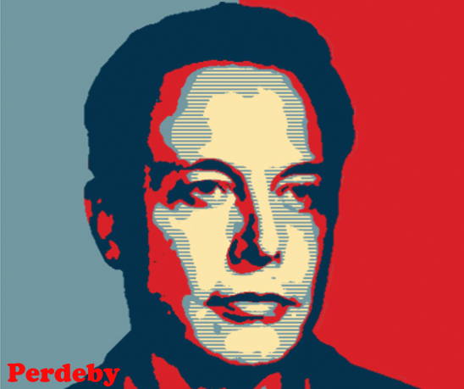
Congratulations on your new appointment as the CEO for [company]. In the face of challenges, your goal is to maintain balance to your key metrics – grow company profit, limit environmental impact, meet energy demand, and maintain social status. Use your advisor and stakeholder feedback to make operational and policy decisions about your company’s electrical energy portfolio. Best of luck!
Image: Brandon Dlamini

Slide 6
Game progresses through a series of Episodes/Missions/Quests
Category: Market
Category: Weather
Category: Policy
Category: Resource
Your marketing department wants you to distribute free low power lightbulbs to your customers. Do you implement their proposal?
Newly proposed state legislation in part of your service region would selectively tax electricity produced by coal as a new consumer tax, directly impacting many of your customers. Make a public statement - do you support the legislation or not?
No = Social -1; Supply -#
Yes = Social +2; Financial -$
Do not support = Environmental -1; Social +1*
Support = Environmental +1; Social -1*
*location dependent
A heatwave strains the grid. Lose reserve capacity.
Event consequence:
Supply -##
Event Consequence:
Financial -$$
Coal prices soar during a rail strike!

Slide 7
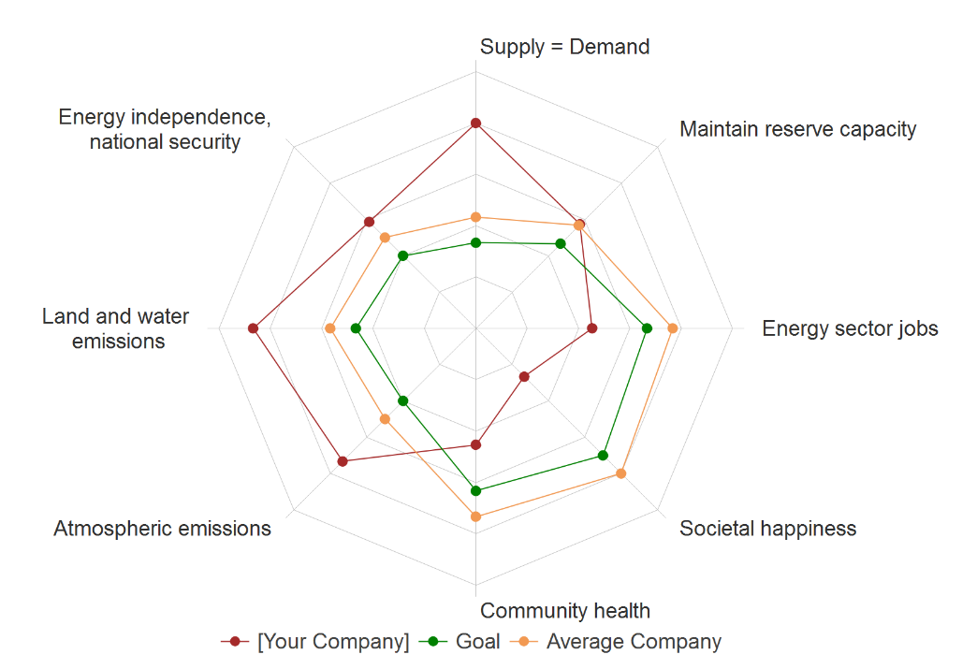
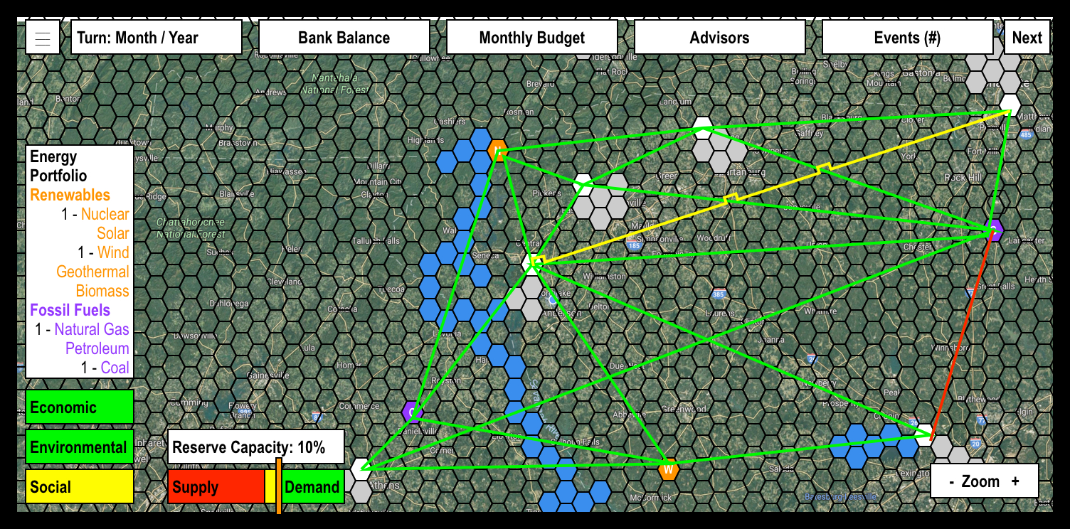
The Win State
Options:
No win state
Singular win state
Unique win state linked to a given goal (e.g., green tech)
Concerns/Challenges:
Imposition of bias
Level of transparency
Player engagement and satisfaction
Color Bars
Spider Diagram →

Slide 8
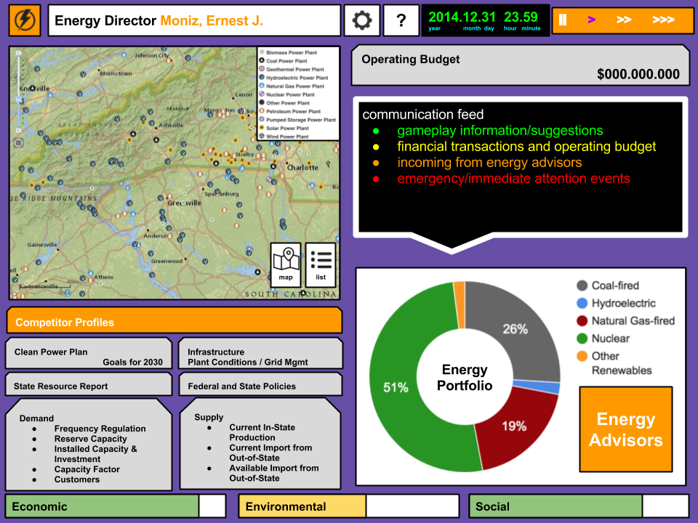
Home Screen Version 2.0

Slide 9
Main Screen Version 3.0

Slide 10
Topic(s) of discussion
How much is too much?
Can users experience information overload, leading to indifference with the game interface?
Can one tool be used by several audiences? (with different levels of game play)
In defining the game narrative, game objectives and specifying a win state, do we:
instill misconceptions about realities of electrical energy management?
impose developer biases on the win state?
Notes:
Can the users distinguish between game and reality when the game is linked in many ways to reality?
How transparent should we be with the back-end model?
What is the best way to define the win state?

Slide 11
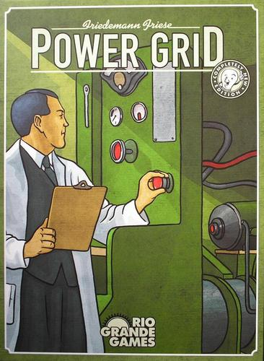
Game Night
Where: Courtyard Marriott Downtown Lobby
When: 6:30pm
What: Play Power Grid (and eat dinner)
Tutorial: https://youtu.be/G7SboSRAQcU

