Slide 1
From Cyclist to Cyclus.js Cyclus user interfaces
Yarden Livnat, University of Utah
Anthony Scopatz, University of South Carolina
Valerio Pascucci, University of Utah
Paul Wilson, University of Wisconsin-Madison

Slide 2
Cyclist
A Java-based desktop application (part of the Cyclus eco-system)
Computational steering
Scenario
input
Cyclus
Data
exec
vis
Cyclist
Scenario Authoring (Cycic)
Simple remote Cyclus executions
Visual analytics
authoring
Decouple the Simulation engine
from scenario Authoring and Visualization

Slide 3
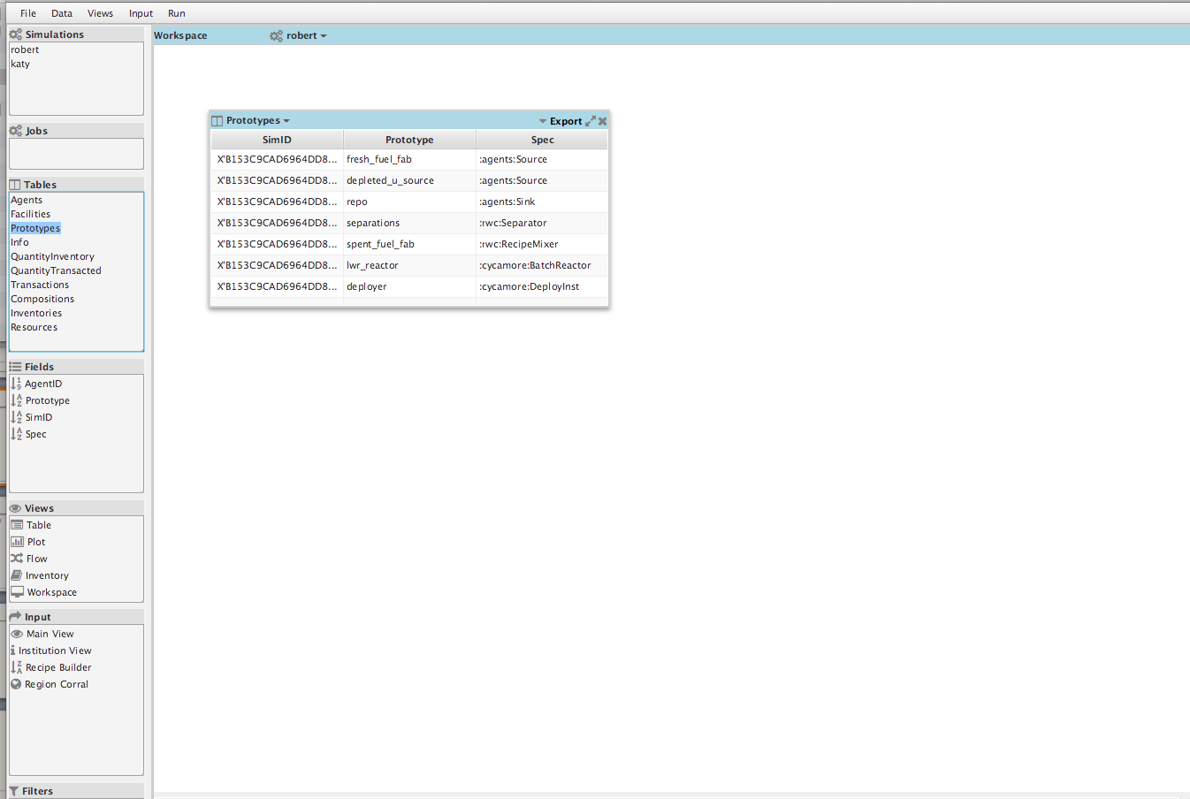
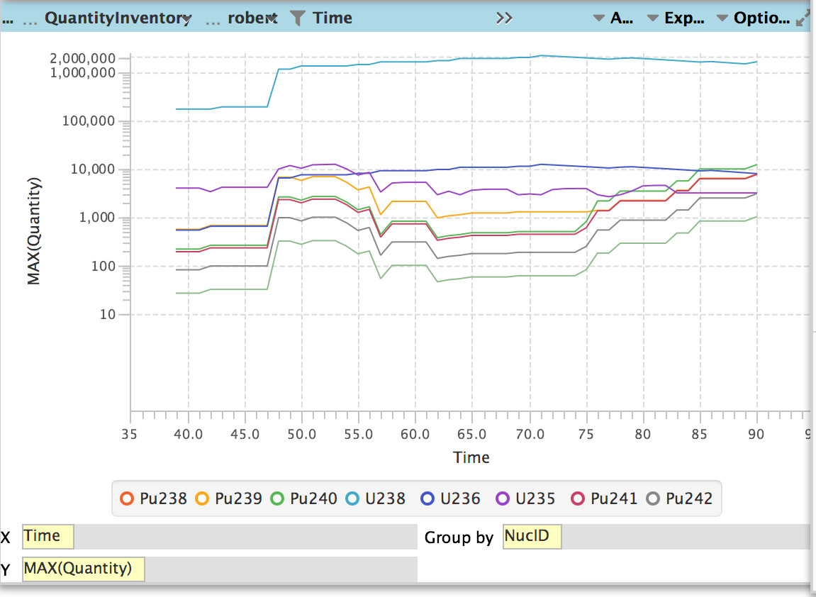
Cyclist visualization
Focus on Cyclus database tables
Drag ‘n drop interactions
simulations
jobs
tables
table fields
workspace
views
authoring

Slide 4
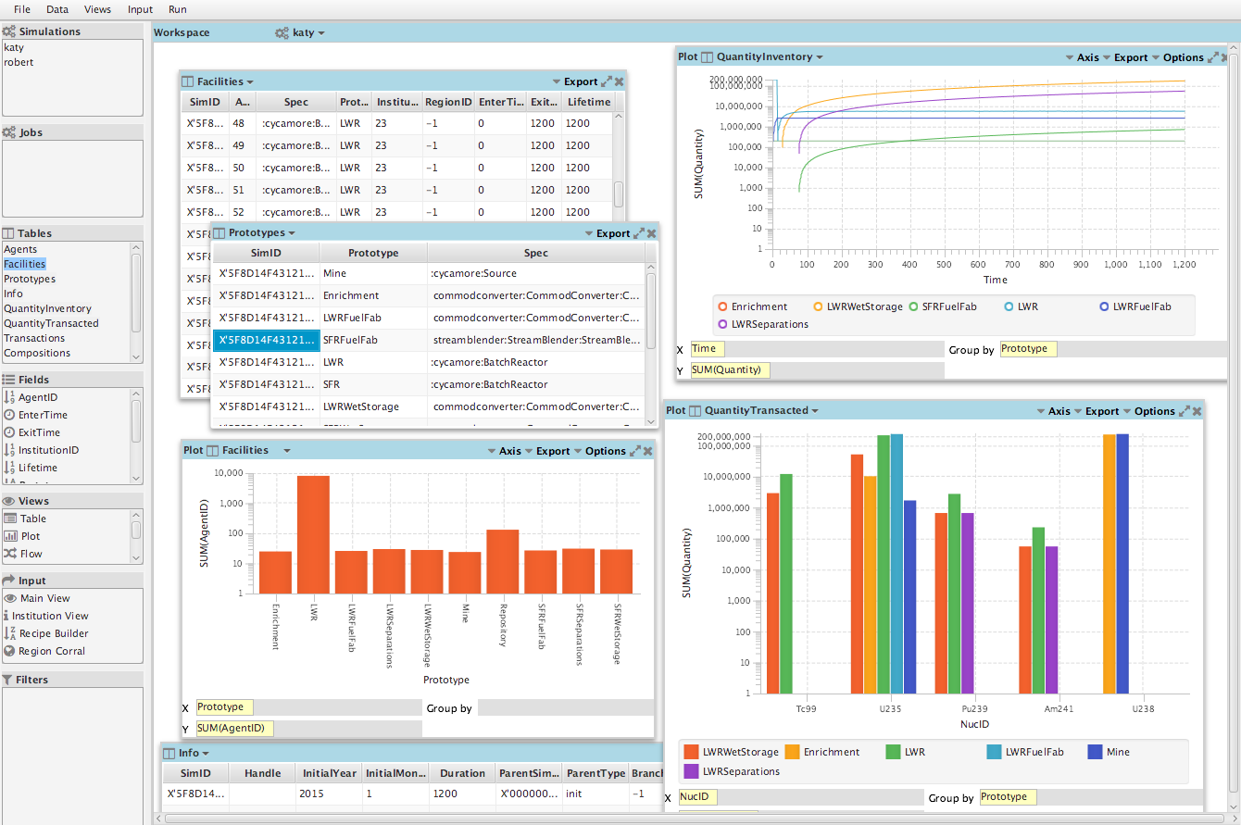
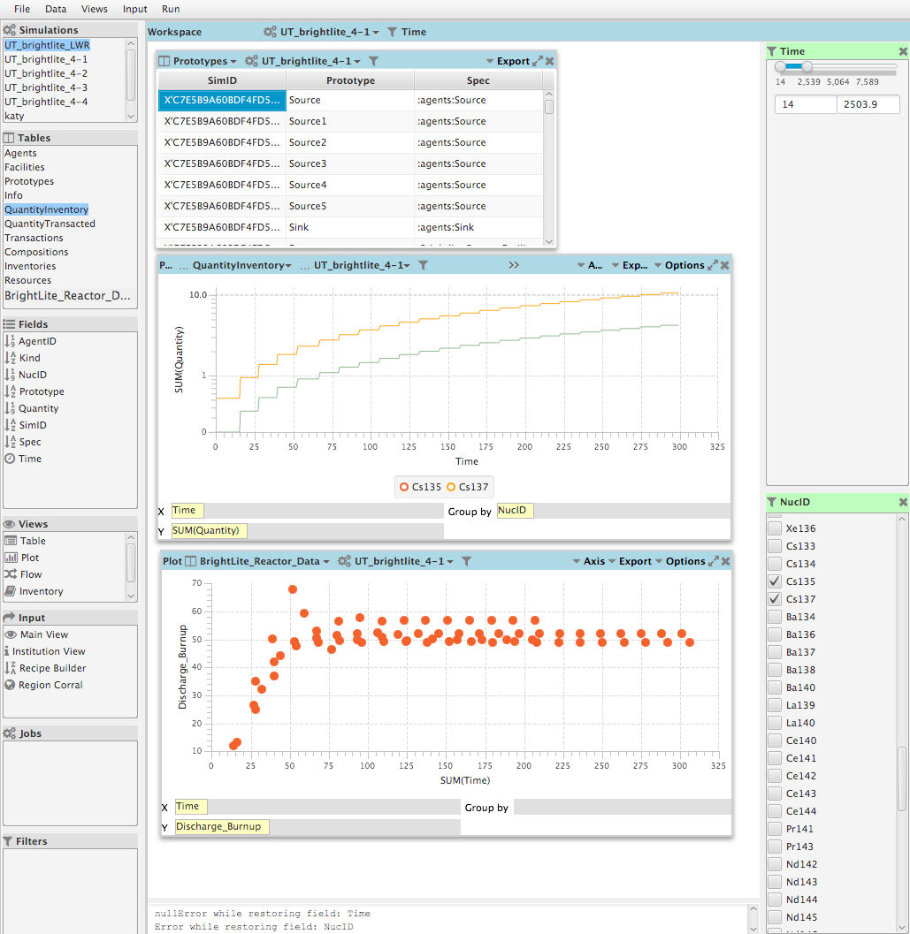
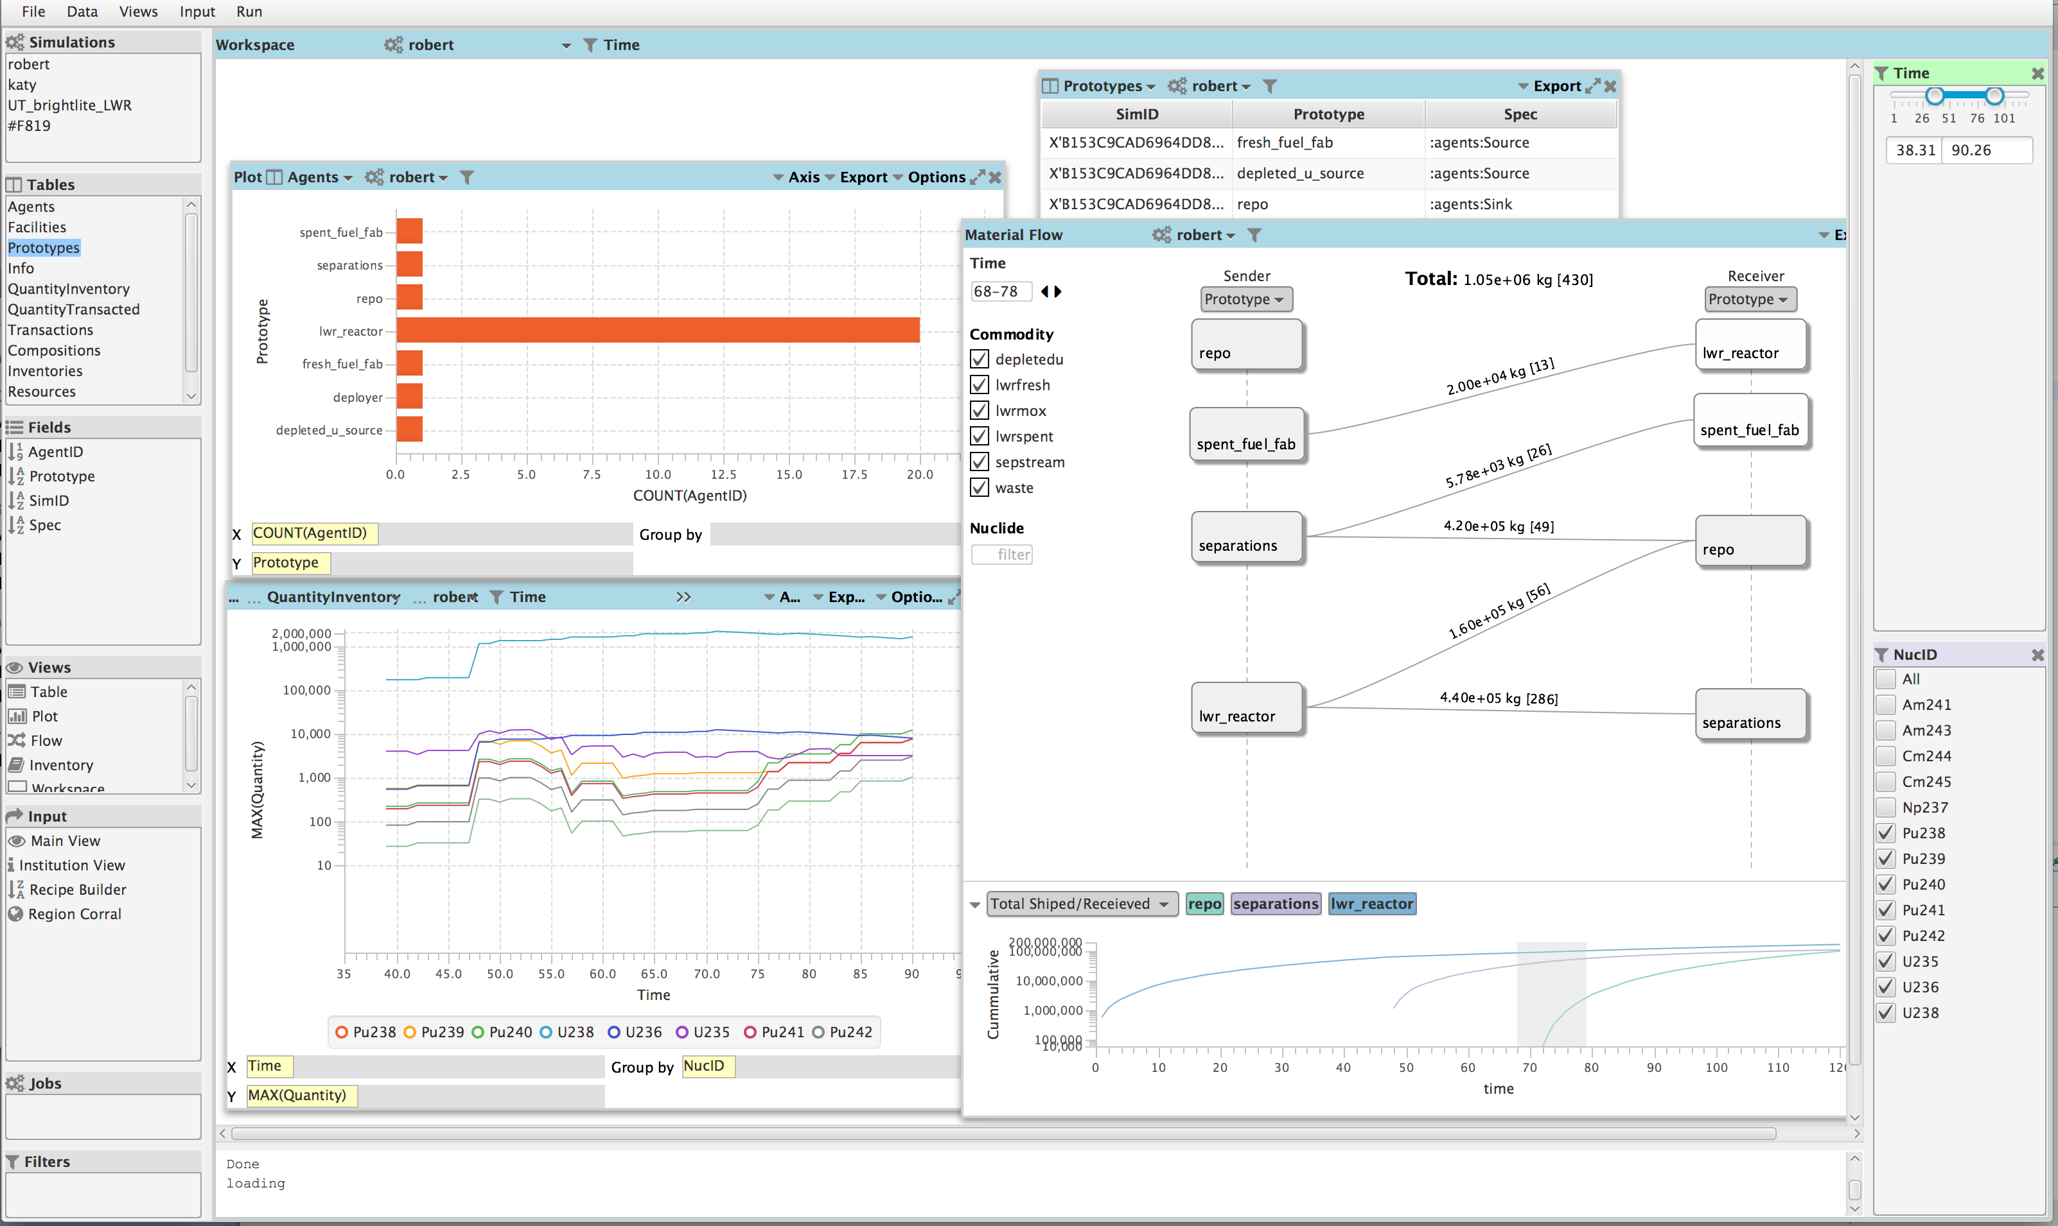
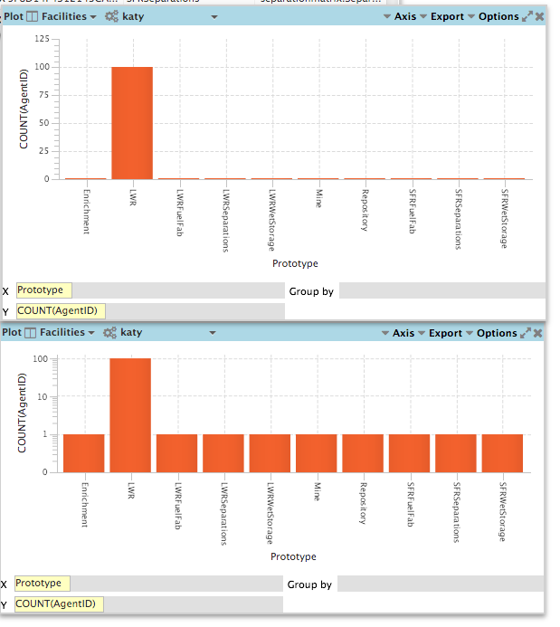
Cyclist visualization
Local and global filtering
Coordinated multiple views
Automatic charts

Slide 5
Cyclus.js
Cyclist
A Java-based desktop application
rename, upgrade, expand

Slide 6
Cyclus.js
Streamlining the analysis workflow
Distributed services and capabilities
Extendable scripted analytics
Web-based state-of-the-art visualizations

Slide 7
Cyclus.js distributed services
Cyclus management services
Data storage services
Post-processing services
Deploy your own
or use ERGS public services

Slide 8
Cyclus.js analytics
Server side computation
Jupyter based back-end
Scripting capabilities
Open architecture: Python, SQL, R, Matplotlib, Widgets
Data representation as first-class objects
e.g. time series, material flow, composition
Simplify data manipulation and visualization
Extensible fuel cycle metrics library

Slide 9
Cyclus.js web-based visual analytics
HTML/JavaScript/d3
Views: tables, advanced plots, graphs, geo-spatial, notebook (scripting),
Jupyter widgets, SVG, printing, save and share, create your own
Perspectives (topic oriented views)
Material flow: transactions, …
Energy: demand, capacity, production, …
Economics: cost, schedule, transition, …
Political: stockpiles, …

Slide 10
Cyclus.js discussion session
tomorrow 4-5pm
Tell us what
… questions are you trying to answer?
… your pain points are?
… kind of analysis do you do?
… visualizations you use, need or wish you had?
Your input, your tool

