Slide 1
Cross Section Versus Recipes for Fuel Cycle Transition Analysis
Technical Workshop on Fuel Cycle Simulation
July 19 – 21 2017, Columbia, SC
Josh Peterson-Droogh and Eva Davidson (ORNL)
Robbie Gregg (NNL)

Slide 2
Overview of cross sections and recipes
All fuel cycle tools need to represent transmutation (and decay) of materials in reactors
This is the most complex part of the fuel cycle model, therefore getting it “right” is vital to the accuracy of the model
Two methods for calculating reactor inventories includes:
pre-calculated recipes
cross sections
Recipes are tabulated sets of discharge compositions for a given fuel irradiation history
Recipes work well for modeling fuel cycles:
with fixed input and output compositions
already at equilibrium when compositions do not vary significantly

Slide 3
Overview of cross sections
With cross sections the output streams in the reactor models are dynamic and change based on input stream and reactor parameters
Cross sections can be interpolated based on reactor-, cycle-, and scenario-specific production and destruction routes
Interpolation can capture the effects of changes in the neutron flux spectrum and associated magnitude of isotopic concentrations
Utilization of cross sections allow for adding additional functions such as:
Fissile equivalence material adjustments (e.g., taking account of changing fissile material such as in Pu multiple recycle)
radioactive decay
Cross sections work well for:
dynamic input and output compositions (e.g., in transition, startup of reactors)
complex fuel cycles transitions when compositions do vary significantly
sensitivity/parametric studies
fuel cycle metric calculations

Slide 4
Assumption for one example that demonstrates the value of using cross sections
0% growth
Existing fleet of 100 LWRs retire at 5 GWe/y from 2030-2049
No recycling of LWR UNF
First SFRs deployed in 2030 on LEU fuel only, with driver RU and TRU recycled back into the SFR drivers, after 5 passes
The equilibrium support ratio is ~84/16 SFR/PWR-MOX
Deploy SFRs the first 16+ years, then only PWRs (on LEU fuel for two stages of the SFR and then on MOX fuel thereafter)
Only recycling TRU from SFR blankets in the PWRs. All of the TRU from PWR MOX fuel is recycled into the SFR driver, along with TRU from the SFR driver.
The core changes at Pass 5 by removing all of the radial blankets, many of the inner blankets and replace them with reflector assemblies.
The cycle length for these SFR LEU cores is 1.37 CY.
Acronyms: LWR (Light Water Reactor), LEU (Low Enriched Uranium), UNF (Used Nuclear Fuel), SFR (Sodium Fast Reactor), RU (Recycled Uranium), TRU (Transuranic), MOX (mix oxide fuel), CY (calendar year)
Notes:
5 stages for SFR + 1 at Equilibrium, 4 cycles before discharge for IB and Driver, 9 cycle before discharge for OB, 3 cycle of irradiation before discharge in LEU and MOX

Slide 5
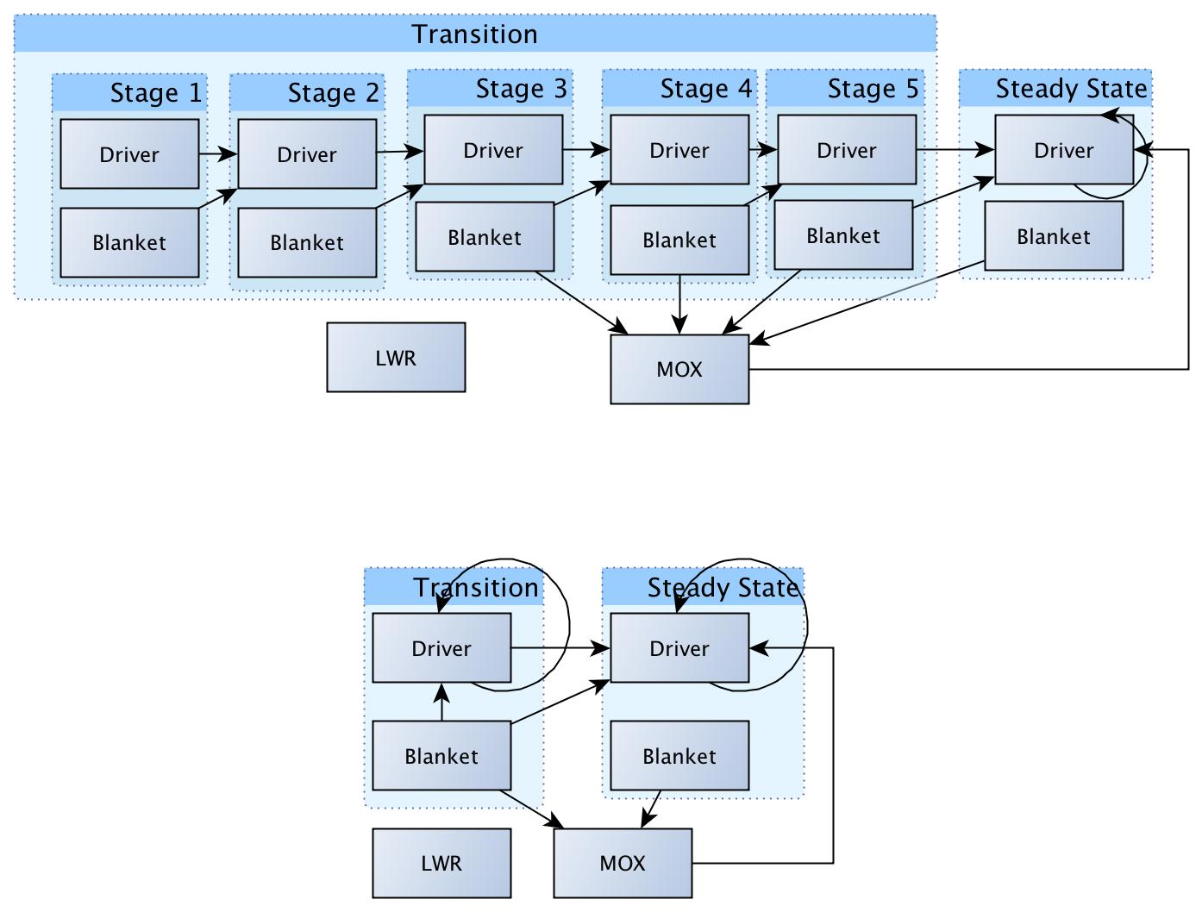
Modeling LEU SFR Transition with Recipes (animation)

Slide 6
Multiple recipes are needed for LEU SFR transition
For a LEU fuel cycle transition study, a recipe is needed for each reactor type (SFR, LWR, and MOX)
For the SFR, separate recipes are needed for the driver, inner blanket, and outer blanket
For this LEU fuel cycle transition study there were 5 stages modeled, and for each stage only recipes for the last cycle was used due to the computational complexity of modeling cycle-by-cycle dependency of recipes
This required 6 driver, 6 blanket, 1 UOX, and 1 MOX recipes for a total of 14 recipes
Explicit modeling (cycle-by-cycle) would require even more recipes if higher fidelity was needed:
LEU SFR fuel cycle-by-cycle transition phase could require over 100 recipes
In addition, more recipes would be needed to account for the buildup of TRU during “equilibrium” after core reconfiguration following the 5th stage
Changing any one of the parameters below would require a new set of recipes, and therefore, the reactor physics calculations to be re-run:
Five different batches required before reaching equilibrium
5 years cooling, 1 year manufacturing, 1 year recycling
Cycle length for SFR LEU cores set to 1.37 calendar year
Notes:
5 stages for SFR + 1 at Equilibrium, 4 cycles before discharge for IB and Driver, 9 cycle before discharge for OB, 3 cycle of irradiation before discharge in LEU and MOX

Slide 7
Modeling LEU SFR Transition with Cross Sections (animation)

Slide 8
Small number of cross sections are needed for LEU SFR transition
Only 7 cross section sets were needed for explicit modeling (cycle-by-cycle dependency) LEU SFR transition
With cross sections, all of the previously mentioned parameters and many more can be changed without the need for generating new cross sections
Cross sections allow for additional calculations within the code such as:
radioactive decay (2200+ radionuclides)
fissile equivalence coefficients to adjust material flow
fuel cycle metrics on the fly (rather than outside of the model)

Slide 9
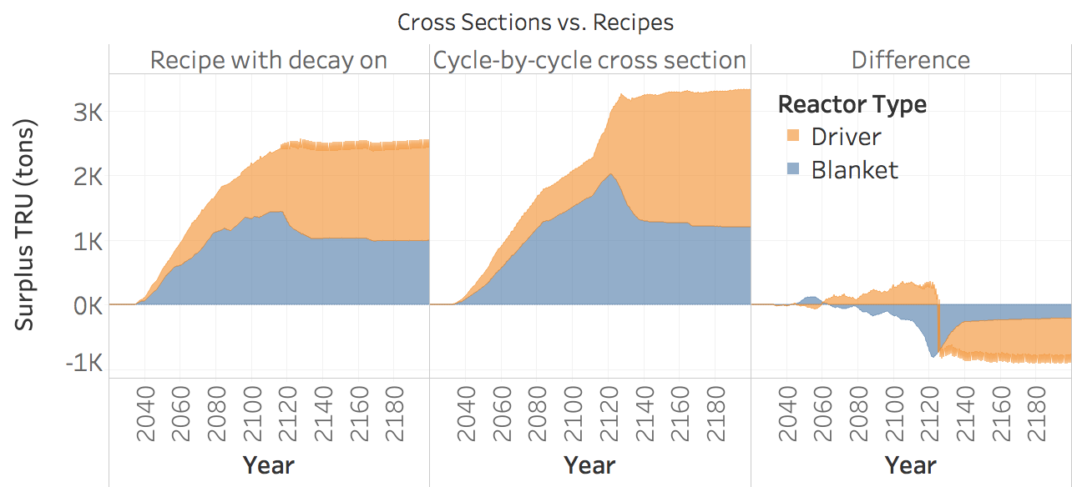
Detailed LEU SFR cycle-by-cycle transition analysis
The following steps were used to demonstrate difference when analyzing LEU SFR on a cycle-by-cycle basis:
Step 1: Generate cross sections for ORION using one group cross section and energy spectrum provided by ANL
Step 2: Cross checked that the cross sections produced similar results as those when recipes were used
Step 3: Changed the model to include:
cycle by cycle discharge material flow calculations
automated effective fissile mass material flow adjustments
decay turned on

Slide 10
Summary of the advantages of using cross sections
Provides more flexibility to model changes in more dynamic systems such as complex scenarios involving the multi-reuse and isotopic changes that occur during the transition and on the approach to equilibrium
In LEU SFR transition analysis the cycle-by-cycle approach would require over 100 recipes and would not take into consideration effective fissile mass coefficient corrections at “equilibrium”
Any change in the specified parameters would require regenerating the recipes
Enable a more accurate representation of the inventories to be produced, and comparison with the simpler recipes to determine when/if recipes break down
Enables an easier/faster parametric study to be completed as recipes do not have to be regenerated for all of the additional variants
Allows decay to be taken into account
Enables key metrics (heat, radiotoxicity etc.) to be calculated on the fly

Slide 11
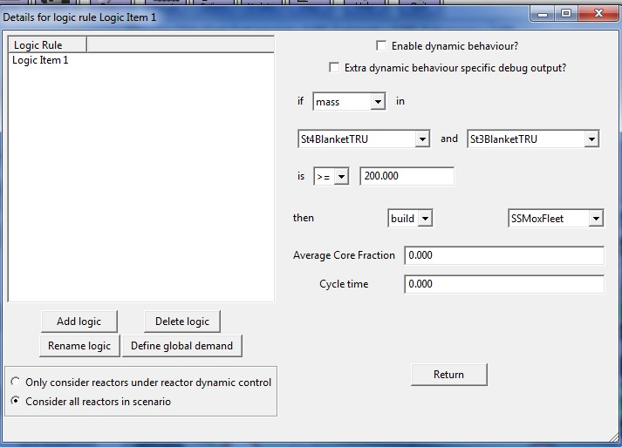
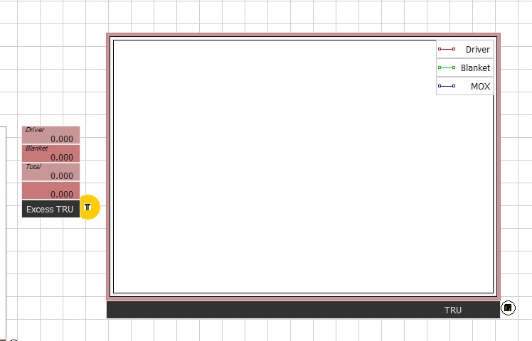
New features in ORION that can help model transition
Additional features in ORION that can help model transition include:
Live streaming of the results during runtime
Ability to use cross sections directly from reactor physics calculations e.g. MC² or ORIGEN
ORIGEN now coupled into ORION cross sections within the code
Advanced dynamic reactor control
ORIGEN V&V Libraries
abb8x8-1
agr
atrium10x10-9
atrium9x9-9
bw15x15
candu19
candu28
candu37
ce14x14
ce16x16
ge10x10-8
ge7x7-0
ge8x8-1
ge8x8-2
ge9x9-2
irt2m3tube36enrich
irt2m3tube
irt2m4tube36enrich
irt2m4tube
irt3m6tube36enrich
irt3m6tube90enrich
irt3m8tube36enrich
irt3m8tube90enrich
irt4m6tube
irt4m8tube
magnox
mox_abb8x8-1
mox_atrium10x10-9
mox_atrium9x9-9
mox_bw15x15
mox_ce14x14
mox_ce16x16
mox_ge10x10-8
mox_ge7x7-0
mox_ge8x8-1
mox_ge8x8-2
mox_ge9x9-2
mox_s14x14
mox_s18x18
mox_svea100-0
mox_svea64-1
mox_svea96-0
mox_w14x14
mox_w15x15
mox_w17x17
mox_w17x17_ofa
rbmk1000
s14x14
s18x18
svea100-0
svea64-1
svea96-0
vver1000
vver440_3.82
vver440_4.25
vver440_4.38
vver440
w14x14
w15x15
w17x17
w17x17_ofa

