Slide 1
Protecting Application and Service Principal Permissions in Azure AD
Eric Hall

Slide 2
Agenda
Introduction
What are workload identities?
Permissions and consent
Attack patterns, defenses, and mitigations
Managing apps in your tenant

Slide 3
Introduction

Slide 4
Attack History
Illicit Consent Grants
Attacker registers an app that looks legit
Induces consent through phishing or code injection
Solorigate
Attackers added credentials to existing applications
Attackers added service principals to privileged roles (Tenant Admin)
Attackers used access to query Mail APIs
Sources:
Detect and Remediate Illicit Consent Grants - Office 365 | Microsoft Docs
Solorigate AzureAd IOCs (microsoft.com)
Notes:
https://docs.microsoft.com/en-us/microsoft-365/security/office-365-security/detect-and-remediate-illicit-consent-grants?view=o365-worldwide
https://techcommunity.microsoft.com/t5/azure-active-directory-identity/understanding-quot-solorigate-quot-s-identity-iocs-for-identity/ba-p/2007610

Slide 5
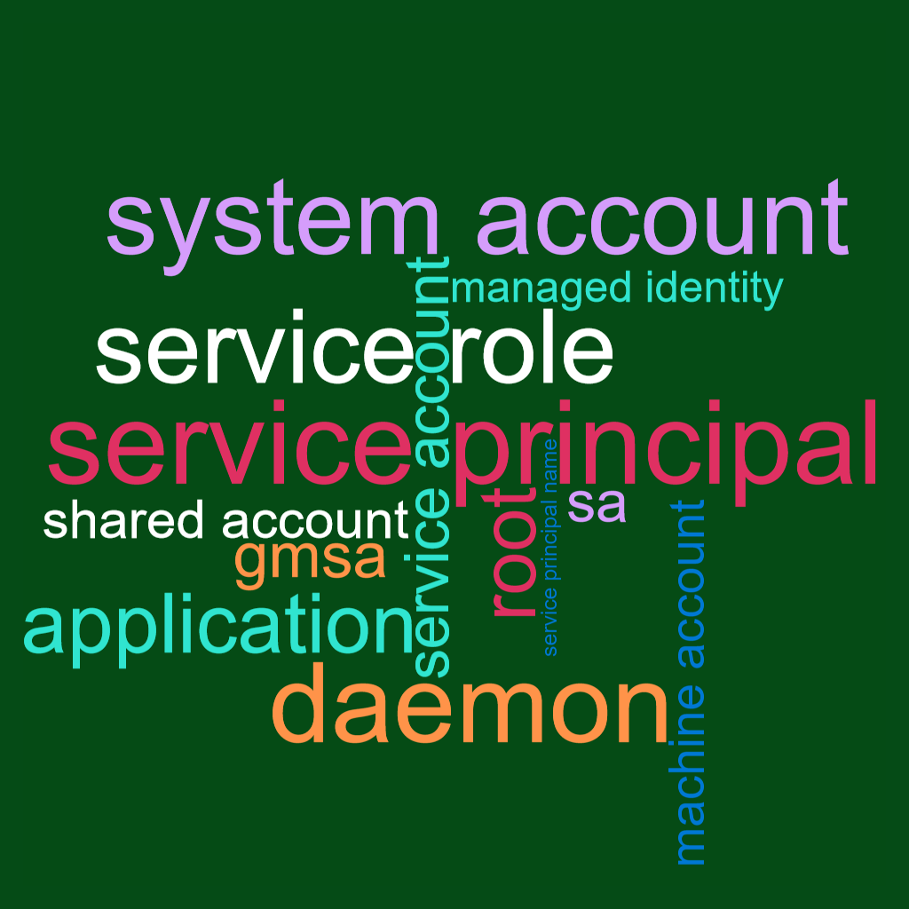
What are workload identities?
Notes:
https://docs.microsoft.com/en-us/azure/active-directory/develop/workload-identities-overview

Slide 6
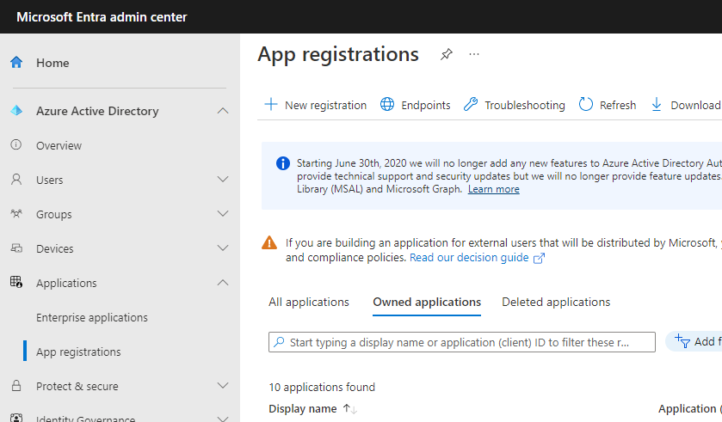
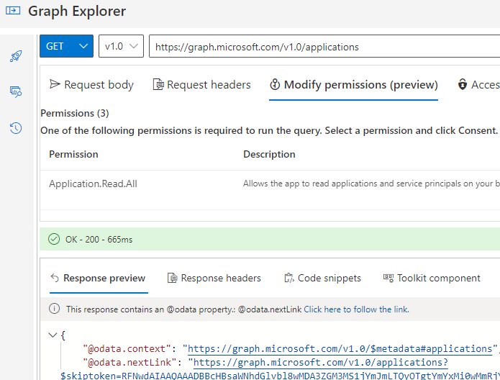
Applications
Applications are a template for the service principal
Assign credentials (certificates or passwords)
Define API permissions
Expose APIs to other apps
App registrations blade in the Azure Portal or Entra admin center
Microsoft Graph /applications endpoint

Slide 7
Application Manifest
manifest.json
{
"id": "54bab7ee-f595-4aeb-8afd-44a62f95ebc8",
"appId": "ae70771d-7c3b-4e28-9439-d2d75af24472",
"informationalUrls": {
"termsOfService": null,
"support": null,
"privacy": null,
"marketing": null
},
"name": "BlueTeamDemo",
"passwordCredentials": [
{
"customKeyIdentifier": null,
"endDate": "2023-02-26T05:43:17.494Z",
"keyId": "9817f1d8-918f-4d26-a245-9009852d0340",
"startDate": "2022-08-26T04:43:17.494Z",
"value": null,
"replyUrlsWithType": [
{
"url": "https://blueteamcon.contoso.com",
"type": "Web"
}
],
"requiredResourceAccess": [
{
"resourceAppId": "00000003-0000-0000-c000-0000000
"resourceAccess": [
{
"id": "e1fe6dd8-ba31-4d61-89e7-88639da4683d
"type": "Scope"
}
]
}

Slide 8
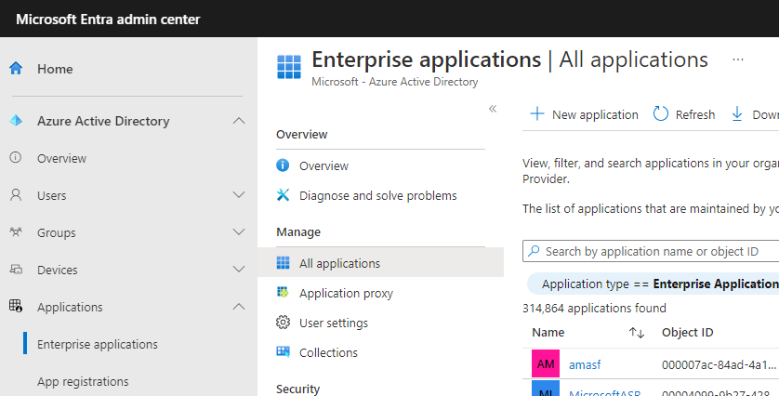
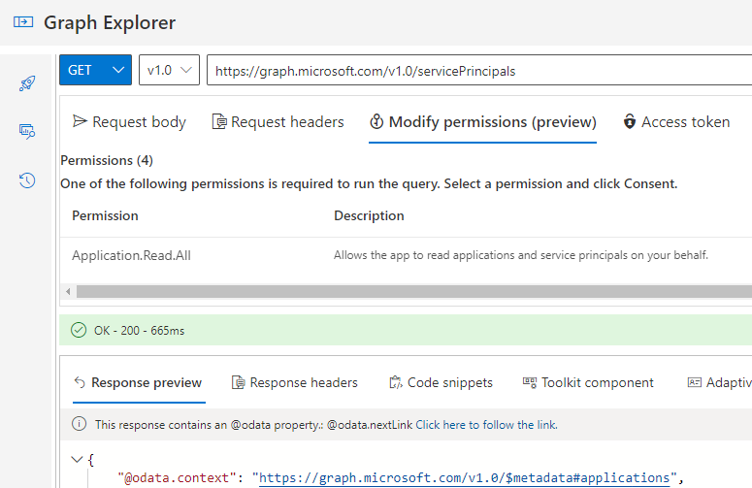
Service Principals
Service Principals are securable objects in the directory
Instance of an application
Use credentials from the app registration to acquire sign-in tokens
Assignable to Azure AD or resource roles (Owner, Contributor, etc.) and groups
Can be granted permissions to access APIs
Enterprise Applications blade in the Azure Portal
Microsoft Graph /servicePrincipals endpoint

Slide 9
Permissions and consent

Slide 10
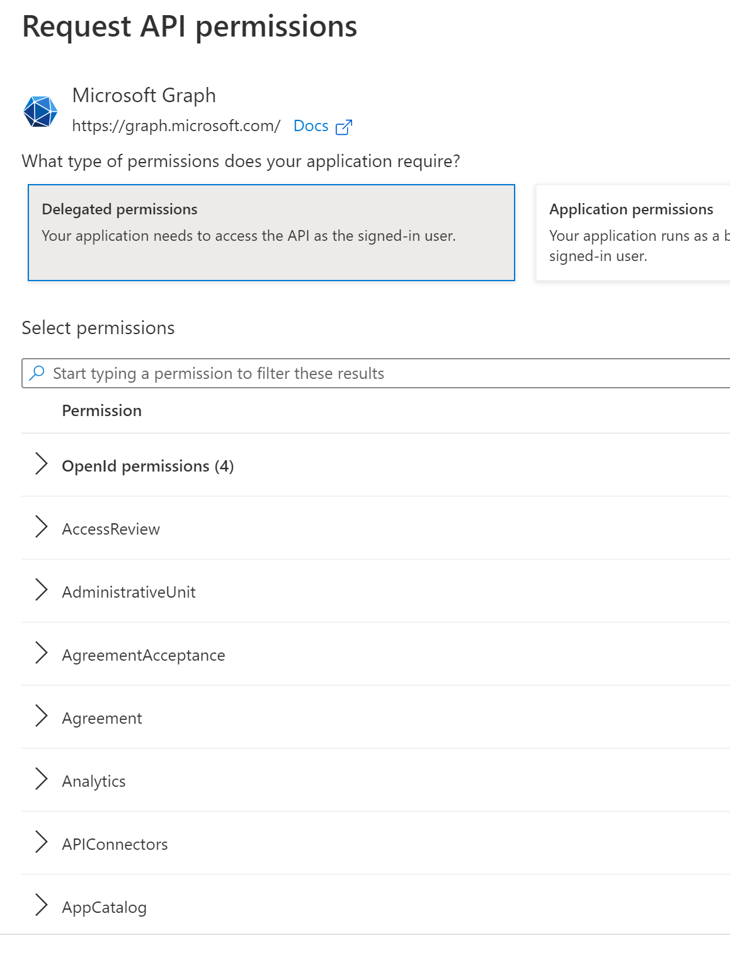
Permissions
Applications consume permissions to gain resource access
Delegated permissions function on behalf of a user
Application permissions function without a user
We’re focusing on Microsoft Graph (first-party) permissions today

Slide 11
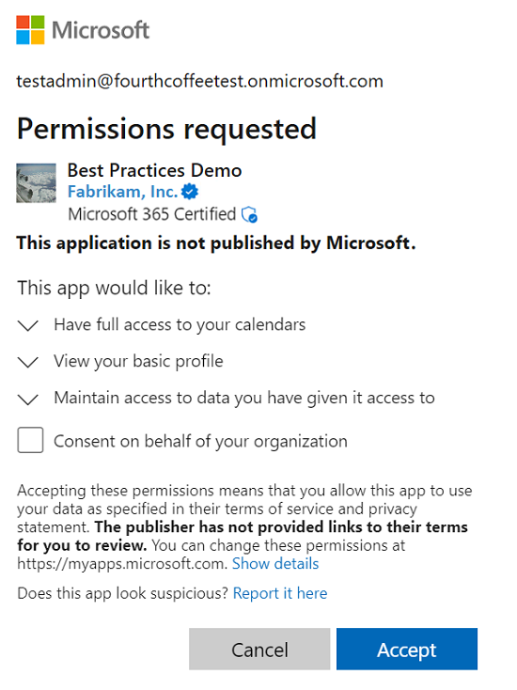
Consent
Applications must receive approval to use permissions
User consent
Allowed by default for low-risk delegated permissions
Recommend disabling user consent
Admin consent
Required for higher-risk delegated permissions (on behalf of users)
Required for all application permissions
Applies tenant-wide

Slide 12
Delegated permissions
Allow an app to act on behalf of a user
Constrained access
Scope of the permission
User’s access
Mail.Read
Read user’s mail
Only in the signed-in user’s mailbox
Mail.Send.Shared
Send mail as the signed-in user
Send mail as a shared mailbox the user has permissions to
Files.ReadWrite.All
Read or write any OneDrive or SharePoint file the user can access
Only access to files the user can access
Can’t send mail or read shared mailboxes
Can’t read mail

Slide 13
Application permissions
Allow an app to act without a user present
Allows broad access across the tenant
Mail.Read
Read mail in any mailbox
Mail.Send
Send mail as any mailbox
Files.ReadWrite.All
Read or write any OneDrive or SharePoint file
Can’t read mail
Can’t send mail

Slide 14
Evaluating Permission Risk
Compromise the tenant
Enable impersonation
Expose employee or customer personal data
Disclose confidential data
Understand permission scope and impact
Some Microsoft Graph permissions are equivalent to Global Admin
SaaS-provider permissions could grant full access to their application
Delegated permissions are usually less risky than application
Constrained by privileges of the signed-in user
But what if a global admin signs in?

Slide 15
Example risks for Microsoft Graph permissions
Permission | Category | How
RoleManagement.ReadWrite.Directory | Compromise Tenant | Add members to global admin role
Policy.ReadWrite.ConditionalAccess | Compromise Tenant | Remove conditional access protections (e.g. MFA requirement for sign-in)
Mail.Send | Impersonation | Send mail pretending to be from IT or a company executive
Group.Read.All | Information Disclosure | Read all content in modern Groups and Teams, including conversations
Sites.Read.All | Information Disclosure | Read all content and files in SharePoint sites
User.Read.All | Privacy | Read directory attributes for all users in the tenant
Directory.Read.All | Privacy | Read directory attributes of all users and membership of all groups in the tenant

Slide 16
Attack patterns, defenses, and mitigations

Slide 17

Scenario: Application Owner Compromise
1
Threat actor steals corporate credentials of application owner
2
Threat actor modifies configuration of application to exploit its permissions
ACTIONS ON OBJECTIVE
Privilege
escalation
Threat actor uses the application permissions to expand access in the tenant
Credential compromise
3
Defenses and Mitigations
Treat application owners like privileged administrators
Separate admin account from information worker account
Use a privileged access workstations (PAW)
Enforce phish-resistant multi-factor auth (MFA) like smartcards or FIDO2 tokens
Block Azure B2B guests and other untrusted users from app ownership
Limit the number of owners
Monitor audit logs for application changes

Slide 18
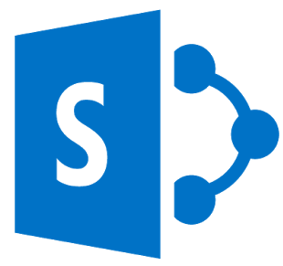

Scenario: Compromise Application/Service Principal Credentials
Threat actor finds exposed credentials
Threat actor gains read access to organization (assume breach)
2
1
ACTIONS ON OBJECTIVE
3
Threat actor authenticates as application using the stolen or found credential
User error /
Neglect
Spoofing
Credential compromise
Defenses and Mitigations
Limit password credential usage
Application authentication methods API in preview
Monitor logs for credential changes and new sign-in locations
Scan for credentials in source repos and file shares
Store credentials securely (Azure Key Vault)
Notes:
Azure AD application authentication methods API: https://docs.microsoft.com/en-us/graph/api/resources/applicationauthenticationmethodpolicy?view=graph-rest-beta

Slide 19


Scenario: Compromise Running Applications
Threat actor exploits web app vulnerabilities
Threat actor modifies web app code
2
1
Web app
attack
Malware /
Malicious code
2
Threat actor deploys malicious code
ACTIONS ON OBJECTIVE
Threat actor gains access to deployment pipeline
Threat actor uses app permissions to access and exfiltrate data
3
1
Data
exfiltration
Malware /
Malicious code
Supply chain attack
Defenses and Mitigations
Secure cloud resources
Microsoft Defender for Cloud (Azure configuration is secure)
Entra Permissions Management (Least privilege access for multi-cloud)
Enforce alternate accounts, MFA, PAW for cloud admins
Secure deployment pipelines
Separate committers and approvers (code review)
Require MFA to deploy to production
Restrict access to pipelines and internal repos
Secure code
Threat model and mitigate
Static code analysis (CodeQL)
Web App Firewalls and dynamic AppSec testing

Slide 20


Scenario: Dangling URLs
Developer removes a site without updating the app registration
4
Threat actor phishes employees with legitimate looking site
1
Developer registers app with multiple Reply URLs
2
Threat actor harvests credentials for further access and data exfiltration
ContosoV2.azurewebsites.com
5
User error /
Neglect
Contoso.azurewebsites.com
Contoso-test.azurewebsites.com
Contoso-dev.azurewebsites.com
ContosoV2.azurewebsites.com
Watering hole /
Strategic web compromise
Phishing
Stolen access token
Threat actor registers a new site with the forgotten URL
ACTIONS ON OBJECTIVE
3
Defenses and Mitigations
Compare application Redirect URIs with owned domains
Separate production and non-production applications
Implement Continuous Access Evaluation (CAE) in your apps
Notes:
https://docs.microsoft.com/en-us/azure/active-directory/develop/app-resilience-continuous-access-evaluation?tabs=dotnet

Slide 21
Managing Apps in your Tenant

Slide 22
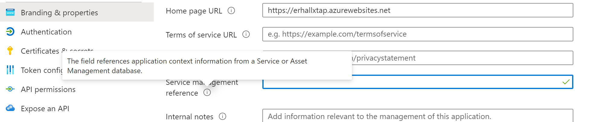
Application Inventory
Associate applications with your asset inventory or service database
Keep track of what apps are supposed to do
Regularly pull data from Azure AD

Slide 23
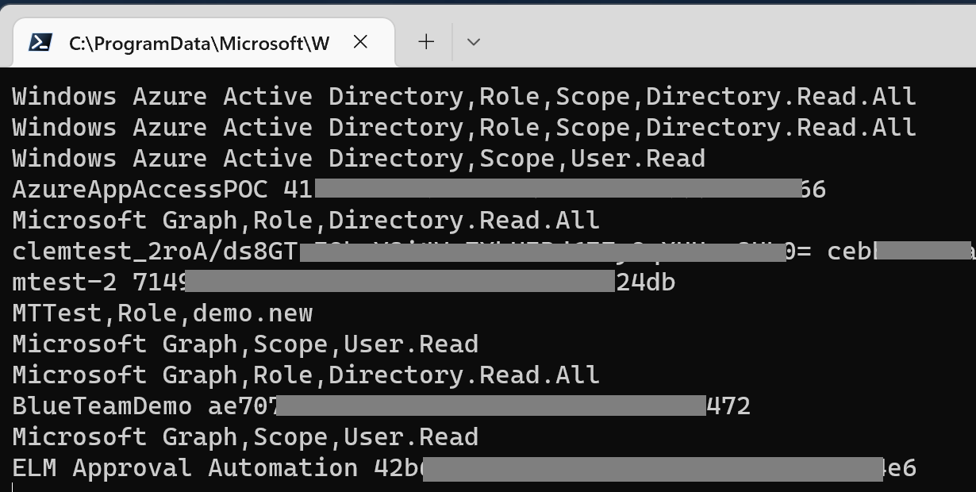
Get-Applications.ps1
Microsoft Graph PowerShell module
$AppList = Get-MgApplication -All
foreach ($App in $AppList) {
$App.DisplayName, $App.AppId -join " "
foreach ($Resource in $App.RequiredResourceAccess) {
$ResourceSP = Get-MgServicePrincipal `
-Filter "appid eq '$($Resource.ResourceAppId)'"
[Array] $Permissions = foreach ($Permission in $Resource.ResourceAccess) {
if ($Permission.Type -eq 'Role') {
$PermissionValue = $ResourceSP.AppRoles |
Where-Object -Property Id -eq $Permission.Id |
Select-Object -ExpandProperty Value
}
else if ($Permission.Type -eq 'Scope') {
$PermissionValue = $ResourceSP.Oauth2PermissionScopes |
Where-Object -Property Id -eq $Permission.Id |
Select-Object -ExpandProperty Value
}
$ResourceSP.DisplayName, $Permission.Type, $PermissionValue -join " "
}
}
}

Slide 24
Get-RedirectURIs.ps1
Microsoft Graph PowerShell module
$AppList = Get-MgApplication -All
foreach ($App in $AppList) {
$App.DisplayName, $App.AppId -join " "
foreach ($Address in (
$App.Web.RedirectUris +
$App.Spa.RedirectUris +
$App.PublicClient.RedirectUris)
) {
([uri]$Address).Authority
}
}

Slide 25
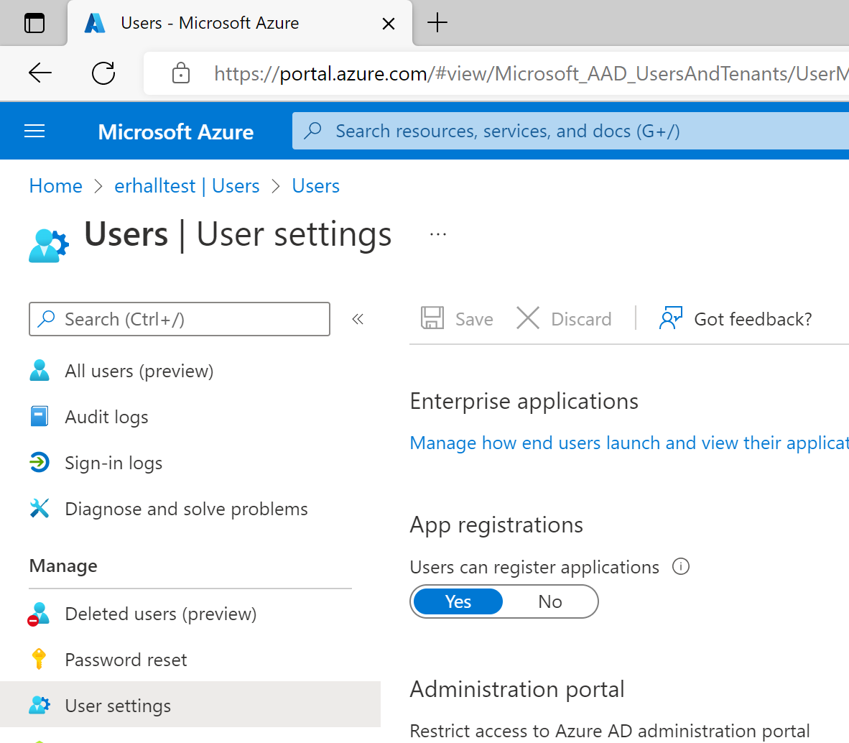
Restricting app registration
All users in the tenant can register apps by default
If your developer population is small consider turning this off
Once turned off, only global admins or application admins can register apps
1
3
2

Slide 26
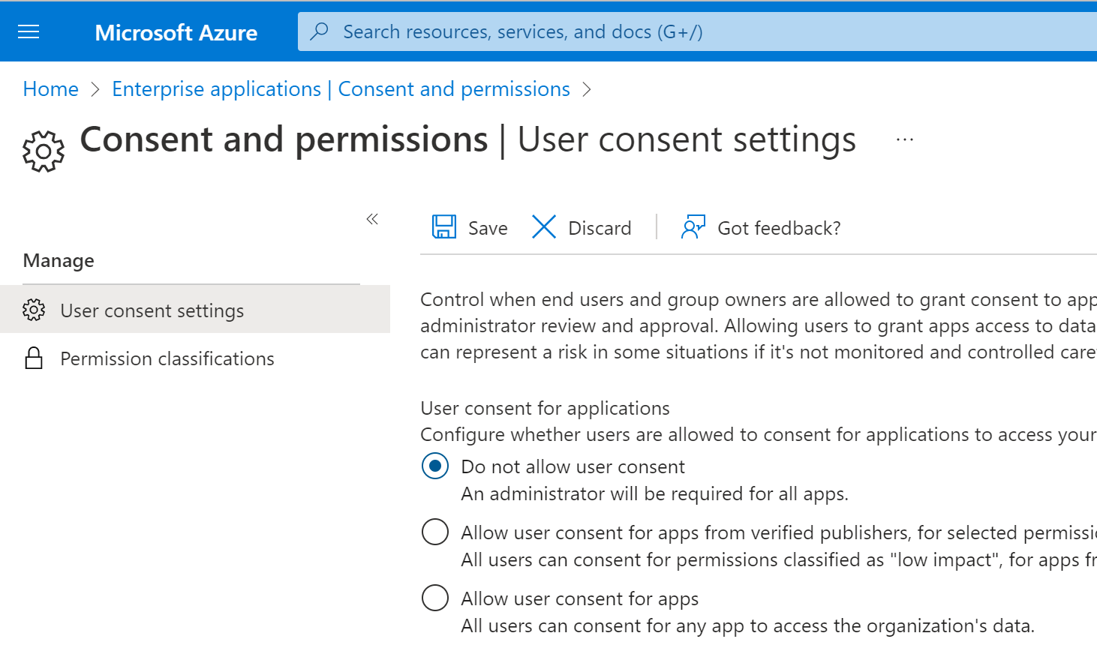
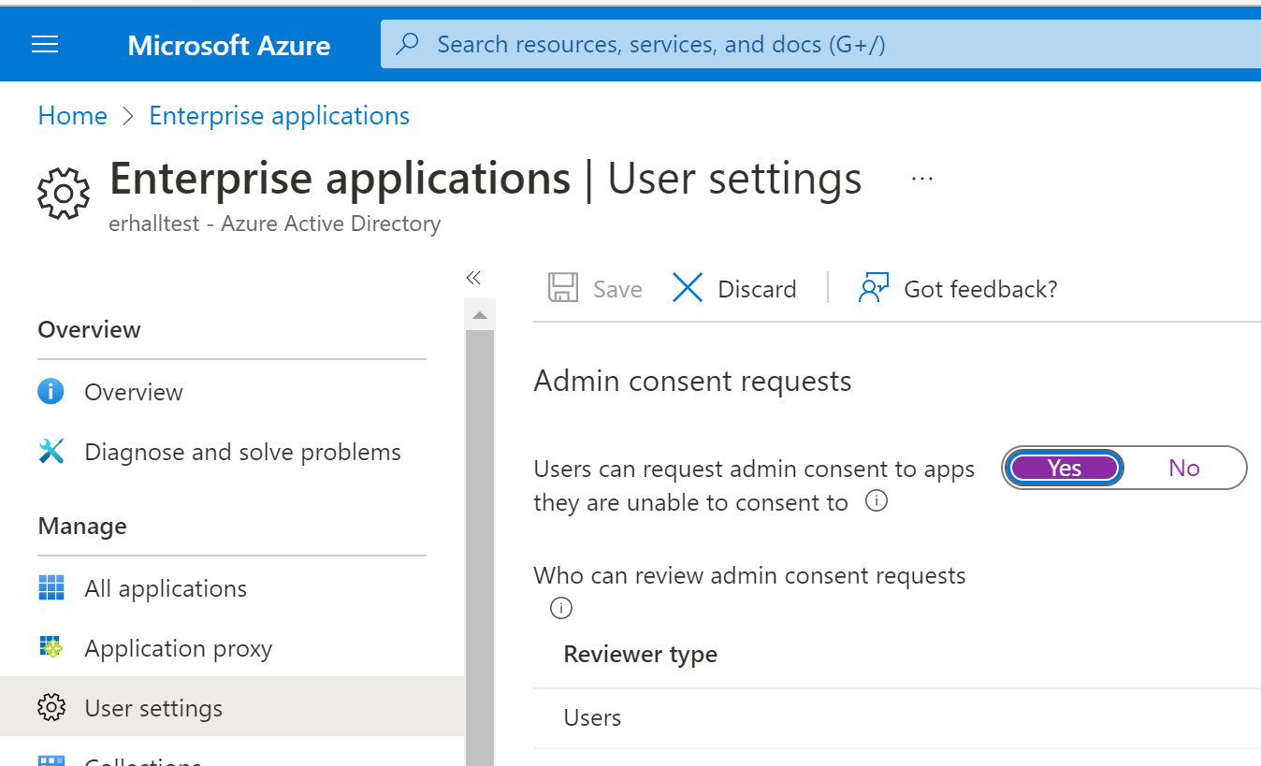
Consent management
Turn off user consent!
Use Admin consent workflow to manage requests
Advanced option: Use app consent policies to customize consent for sets of users and apps
Notes:
https://docs.microsoft.com/en-us/azure/active-directory/manage-apps/manage-app-consent-policies

Slide 27
Evaluating consent requests
Make sure apps follow your SDLC and governance processes
Evaluate requests commiserate with risk - threat models and code reviews for high-risk apps
Are API endpoints consistent with requested permissions?
No need for ReadWrite permission if the app only reads
How does the app handle authentication to APIs?
No credentials in code!
Is the app’s behavior consistent with its description?
A group management app probably shouldn’t call APIs to read mail
How does the app handle users’ authentication tokens?
Refresh tokens are long-lived and allow impersonation – they must be stored securely

Slide 28


Summary
Review your applications
Restrict their permissions
Protect them from abuse
@erhall76
linkedin.com/in/erhallmsft

