Slide 1

CS TEAM_DAILY_CHAT_STATS_06.07.2026

Slide 2



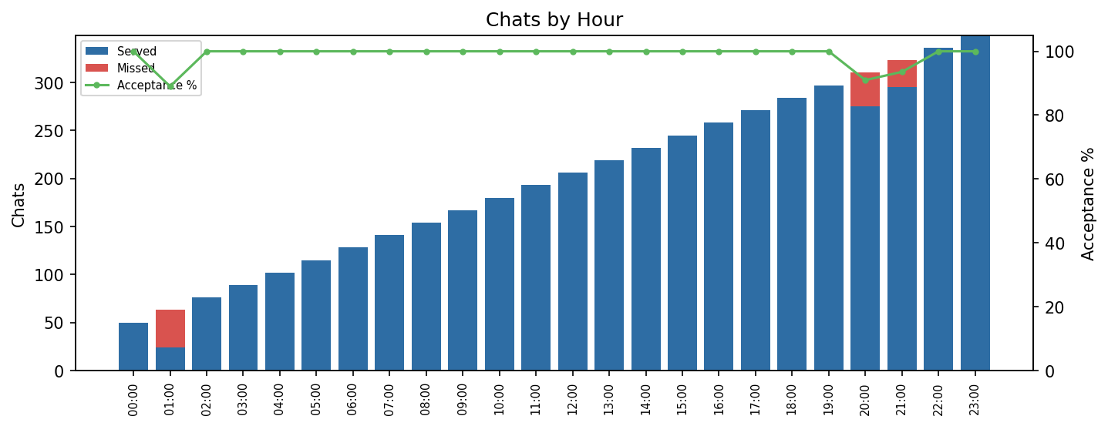

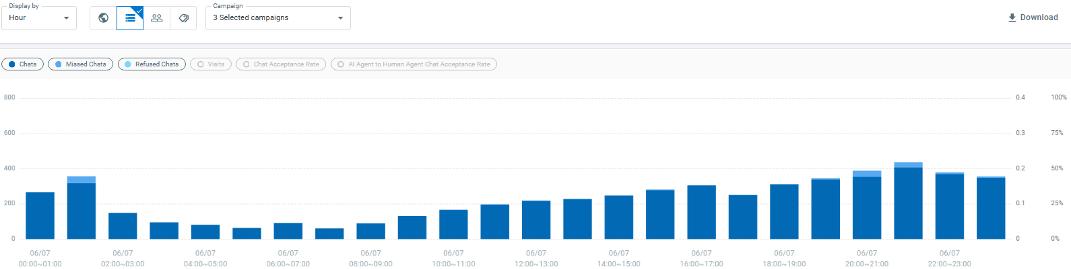
Missed Chats
Explanation;
- Total Chats: 5.486
- Total Served Chats: 5.348
- Total Missed Chats: 138
- Success: 97,48%
En yüksek missed chat sayısı 01:00–02:00 arasında görüldü (39 chat kaçtı, kabul oranı %89,01). Olayın sebebini buraya ekleyin.
Between: 01:00 – 02:00
Total chats: 356
Served chats: 317
Missed chats: 39
Success: 89,01
Available Agents: 8
Avg. Chat per agent/h: 44
Between: 20:00 – 21:00
Total chats: 388
Served chats: 353
Missed chats: 35
Success: 90,98
Available Agents:11
Avg. Chat per agent/h: 35
Between: 21:00 – 22:00
Total chats: 435
Served chats: 407
Missed chats: 28
Success: 93,56
Available Agents:12
Avg. Chat per agent/h: 36

Slide 3
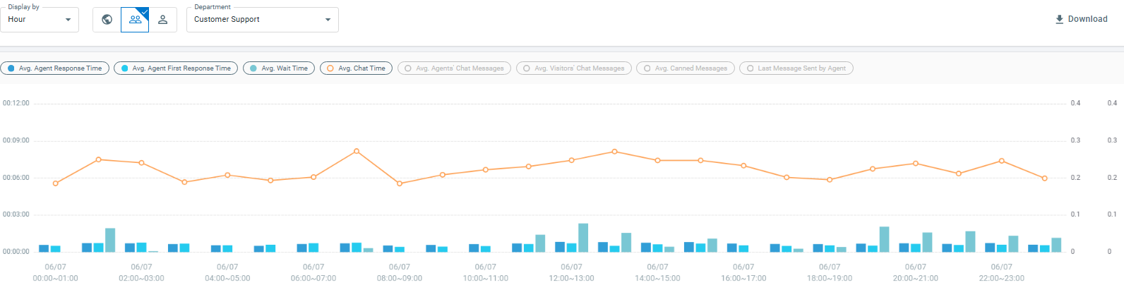
Response Time and Chat Duration
Explanation
Avg. response time: 41s
Avg. First response time: 36s
Avg. Wait Time: 1m 32s
Avg. Chat Duration: 6m 45s

Slide 4


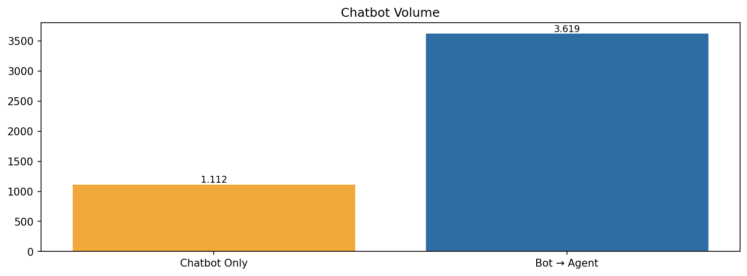
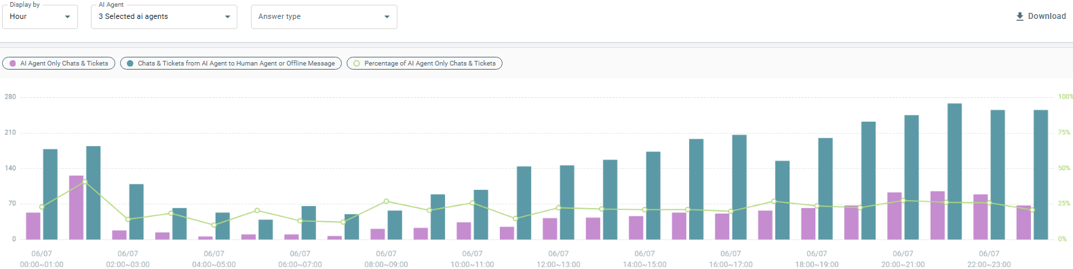
Chatbot Statistics
All chatbots;
- Chatbot only chats : 1.112
- From chatbot to agent : 3.619
- Percentage of chatbot : 23,50%
- Action usage : 21.171
- Action per chat : 5,85

Slide 5
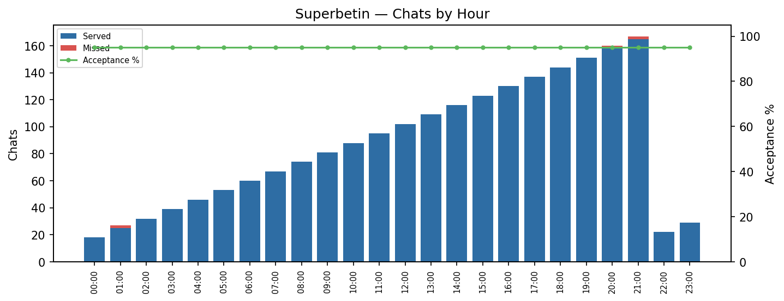
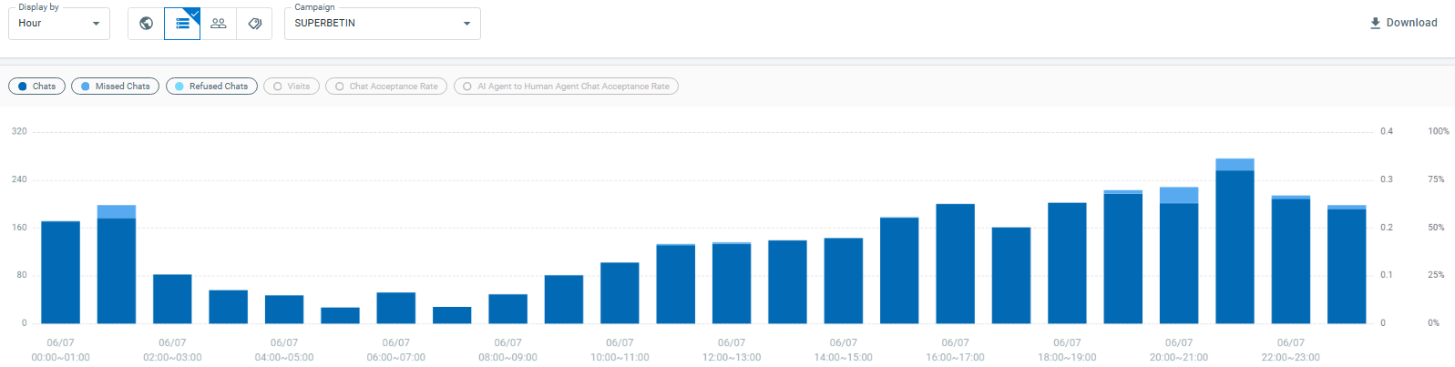
Missed Chat
Explanation;
- Total Chats: 1.356
- Total served chats: 1.356
- Total Missed chats: 0
- Succes: 100,00%
Superbetin chatbot;
- Chatbot only chats : 240
- From chatbot to agent : 889
- Percentage of chatbot : 17,70%

Slide 6
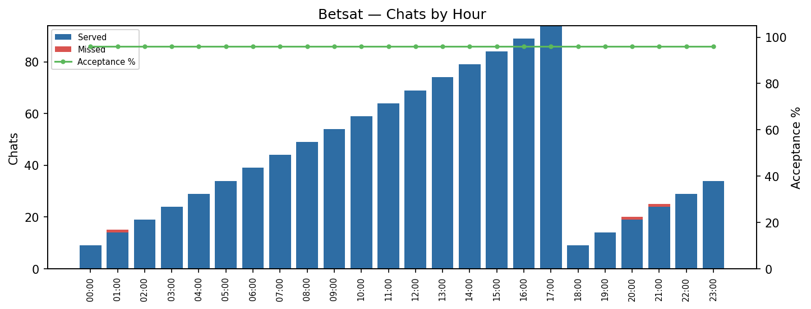
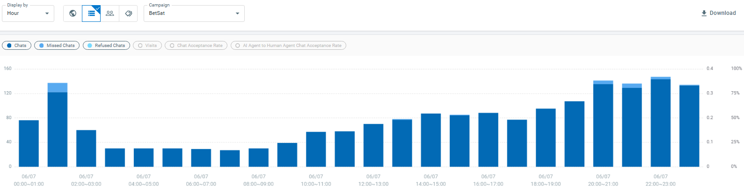
Missed Chat
Explanation;
- Total Chats: 804
- Total served chats: 802
- Total Missed chats: 2
- Succes: 99,75%
Betsat chatbot;
- Chatbot only chats : 141
- From chatbot to agent : 600
- Percentage of chatbot: 17,54%

Slide 7
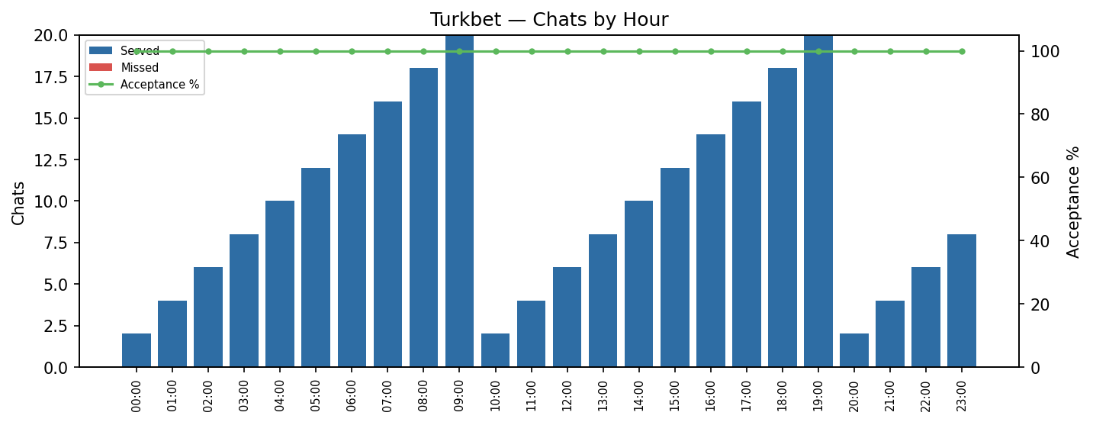
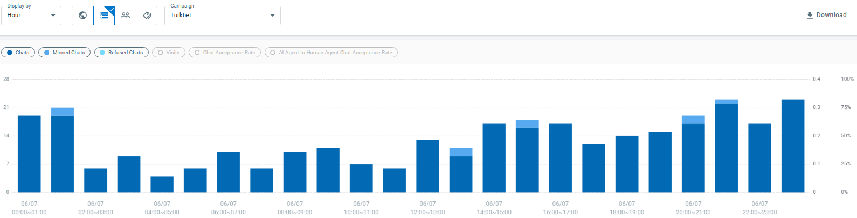
Missed Chat
Explanation;
- Total Chats: 132
- Total served chats: 132
- Total Missed chats: 0
- Succes: 100,00%
Turkbet chatbot;
- Chatbot only chats : 30
- From chatbot to agent : 87
- Percentage of chatbot : 22,73%

Slide 8
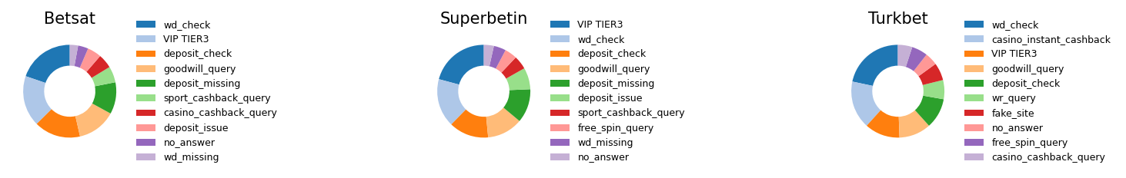
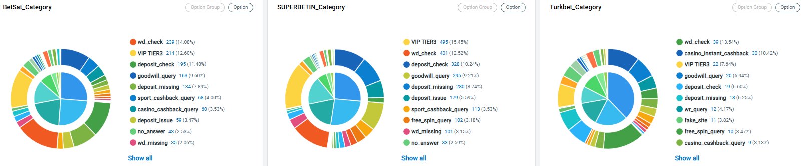
Top 10 Tags
- Top 10 Chat Tags
VIP TIER3 | 731
wd_check | 679
deposit_check | 542
goodwill_query | 478
deposit_missing | 432
deposit_issue | 242
sport_cashback_query | 184
wd_missing | 144
casino_cashback_query | 141
free_spin_query | 140

