Slide 1
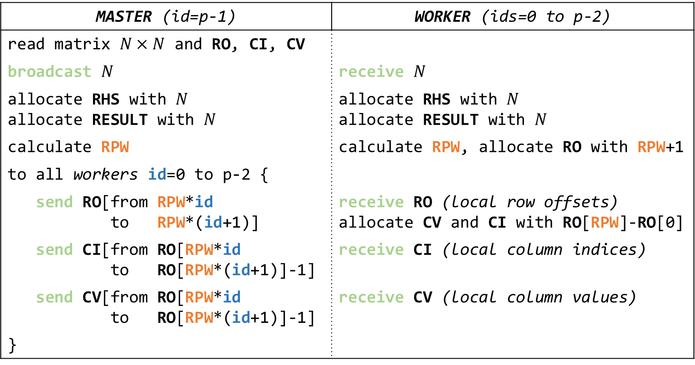
MASTER (id=p-1) | WORKER (ids=0 to p-2)
read matrix $N×N$ and RO, CI, CV
broadcast $N$ | receive $N$
allocate RHS with $N$ allocate RESULT with $N$ | allocate RHS with $N$ allocate RESULT with $N$
calculate RPW | calculate RPW, allocate RO with RPW+1
to all workers id=0 to p-2 {
send RO[from RPW*id to RPW*(id+1)] | receive RO (local row offsets) allocate CV and CI with RO[RPW]-RO[0]
send CI[from RO[RPW*id to RO[RPW*(id+1)]-1] | receive CI (local column indices)
send CV[from RO[RPW*id to RO[RPW*(id+1)]-1] | receive CV (local column values)
}

