Slide 1
SmartCart
Customer Segmentation System
Turning purchase behavior into actionable customer personas
K-MEANS + AGGLOMERATIVE CLUSTERING · PCA · 2,240 CUSTOMERS

Slide 2
Project Overview
Customer behavior is one of the most valuable assets an e-commerce business has. Treating every customer the same way leads to inefficient marketing and lower engagement — unsupervised machine learning instead uncovers natural groupings in how people shop, spend, and engage.
2,240
Customers analyzed
This project builds an end-to-end segmentation system: from raw transactional data, to validated clusters, to business-ready customer personas — benchmarking multiple algorithms rather than committing to just one.
22
Raw features
4
Customer segments
SmartCart Customer Segmentation
2

Slide 3
Objectives
1
2
3
Analyze purchasing behavior
Discover hidden segments
Compare clustering algorithms
Understand how customers differ in spend, channel, and frequency
Uncover natural groupings without pre-labeled categories
Benchmark K-Means against Agglomerative clustering
4
5
6
Evaluate with quantitative rigor
Generate business personas
Recommend marketing actions
Silhouette, Davies-Bouldin, Calinski-Harabasz, ARI
Translate clusters into names a marketer can act on
Pair each persona with a concrete next step
SmartCart Customer Segmentation
3

Slide 4
The Dataset
2,240 customers · 22 raw features · 2,236 retained after outlier removal
Demographics
Spending Behavior
Age, income, education, and household composition (kids, partner status)
Spend across 6 product categories — wine, fruit, meat, fish, sweets, gold
Purchase Channels
Engagement & Campaigns
Web, catalog, and store purchases, plus deal-driven purchases
Site visits, days since last purchase, campaign responses, complaints
SmartCart Customer Segmentation
4

Slide 5
Methodology
1
2
3
4
5
6
Data Prep
EDA
Feature Engineering
PCA
Clustering
Evaluation &
Personas
Each stage builds on validated output from the last — dimensionality reduction and cluster count were chosen with evidence, not defaults.
SmartCart Customer Segmentation
5

Slide 6
Dimensionality Reduction
Principal Component Analysis (PCA) compresses 18 scaled features into a visualizable space.
44.95%
variance retained using just 3 components
3 components keep the clusters visualizable in 3D for stakeholders. Later slides check this trade-off directly against clustering on the full feature space.
SmartCart Customer Segmentation
6

Slide 7
Choosing the Number of Clusters
Elbow Method (WCSS) on the 3D PCA space, k = 1–10
k = 4
selected via KneeLocator (convex, decreasing)
Silhouette scores across k = 2–10 stay in the 0.37–0.41 range with no sharper peak, so the elbow's k = 4 is used going forward and confirmed independently in the next steps.
SmartCart Customer Segmentation
7

Slide 8
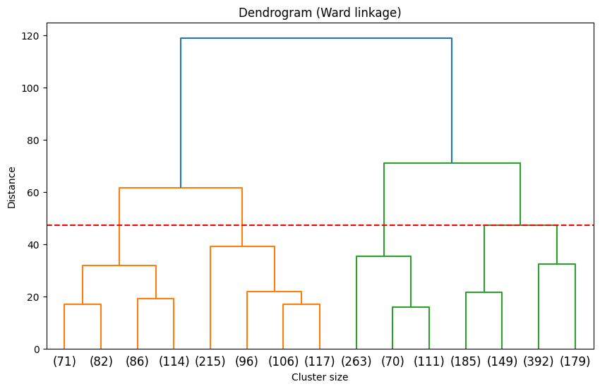
Validating the Cluster Count
Ward-linkage dendrogram for Agglomerative Clustering
Why this matters
The elbow method picked k = 4 for K-Means. Agglomerative clustering deserves its own evidence — a dendrogram lets us read the cluster count directly from the merge structure, independent of K-Means entirely.
The dashed cut confirms 4 is a natural break — the same count the elbow method suggested, reached independently.
SmartCart Customer Segmentation
8

Slide 9
Model Comparison & Decision
Both models evaluated on the same 3D PCA space, k = 4
Metric | K-Means | Agglomerative
Silhouette Score (higher better) | 0.3984 | 0.3793
Davies-Bouldin (lower better) | 1.0497 | 1.0683
Calinski-Harabasz (higher better) | 1387.6 | 1301.8
Decision
K-Means scores marginally higher on all three metrics. We still use Agglomerative for the segmentation ahead: the gap is modest, the dendrogram gives a deterministic, stakeholder-explainable reason for k = 4, and it doesn't depend on centroid initialization.
Adjusted Rand Index: 0.8687 — the two models agree on ~87% of customer assignments.
If squeezing out the last bit of separation mattered more than interpretability here, K-Means would be the pick instead.
SmartCart Customer Segmentation
9

Slide 10
Four Customer Segments
Profiled on original (unscaled) feature values for business interpretability
Premium Independent Spenders
Affluent Multi-Channel Couples
353 customers
534 customers
$71K
$1190
32%
$73K
$1237
16.7%
Income
Spend
Response
Income
Spend
Response
Budget-Conscious Single Parents
Value Family Shoppers
444 customers
905 customers
$37K
$166
14.2%
$40K
$222
7.6%
Income
Spend
Response
Income
Spend
Response
SmartCart Customer Segmentation
10

Slide 11
Key Insight: Who Actually Responds?
Campaign response rate by segment
4.2x
higher response from Premium Independent Spenders than Value Family Shoppers
Segments split mainly by income and household structure, not spend alone. The two highest-income segments spend similarly (~$1,200), but the one living alone (no kids) responds twice as often as the partnered one — and four times as often as the lowest-income segments.
SmartCart Customer Segmentation
11

Slide 12
Business Recommendations
Premium Independent Spenders
Prioritize for premium launches and full-price campaigns — the clear best ROI segment.
Affluent Multi-Channel Couples
Target with family and bundle offers through catalog and store — their preferred channels.
Budget-Conscious Single Parents
Convert high web traffic with deal-driven messaging; price and convenience win here.
Value Family Shoppers
Lowest responder — cut campaign frequency and lead with coupons over premium pushes.
SmartCart Customer Segmentation
12

Slide 13
Tech Stack
Data Engineering
Visual Analytics
Machine Learning
Python
Matplotlib
Scikit-learn
Pandas
Seaborn
PCA
NumPy
Jupyter Notebook
K-Means
SciPy
Agglomerative Clustering
KneeLocator
SmartCart Customer Segmentation
13

Slide 14
Conclusion & Future Work
This project turned raw transactional data into four validated, business-ready customer personas — using multiple algorithms, quantitative evaluation, and a dendrogram-backed decision, not a single default pipeline.
Successfully transformed 2,240 rows of raw data into 4 distinct, actionable customer segments using PCA and clustering — empowering marketing teams to increase engagement, optimize resource allocation, and drive revenue.

