Slide 1
DSI Capstone
Eric Hepp

Slide 2
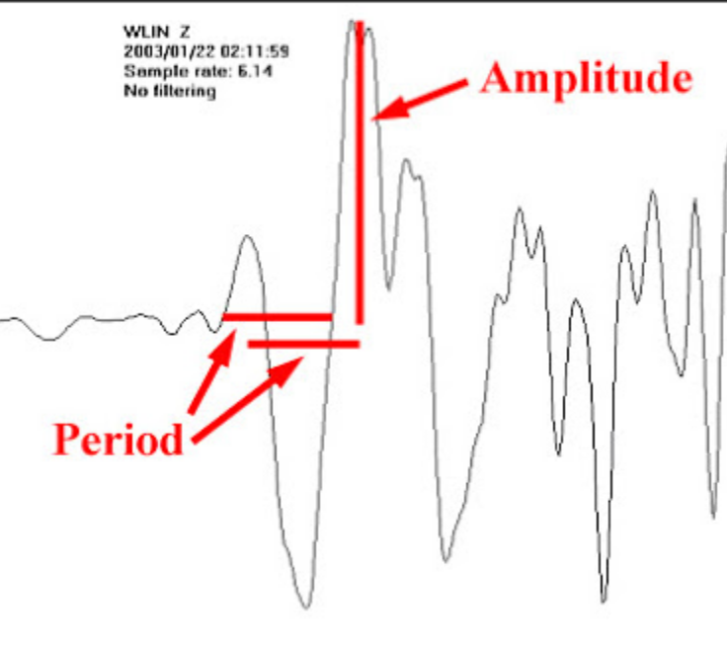
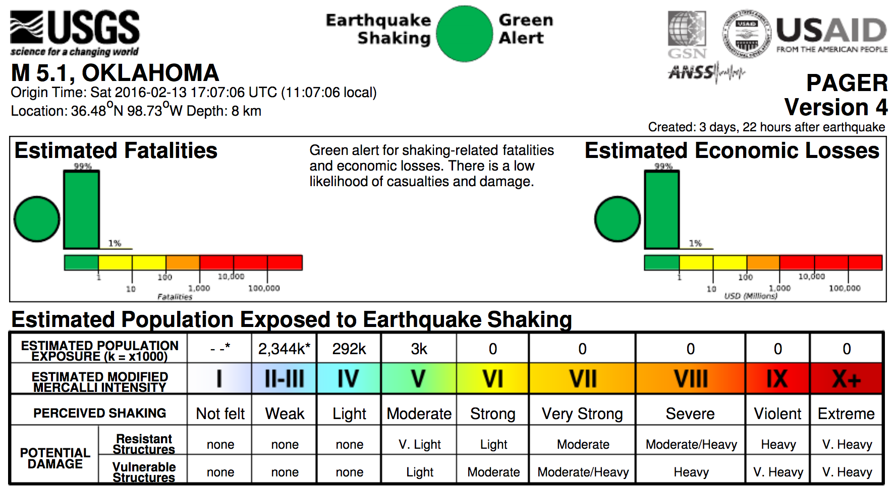

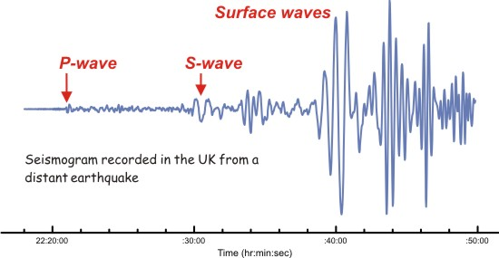
3: Intensity is more subjective, and is determined by observer reports augmented by surface velocity recorders
1: Magnitude is computed from the period, amplitude and distance
2: Distance is found from by measuring time between arrivals of P, S and Raleigh/Love waves

Slide 3
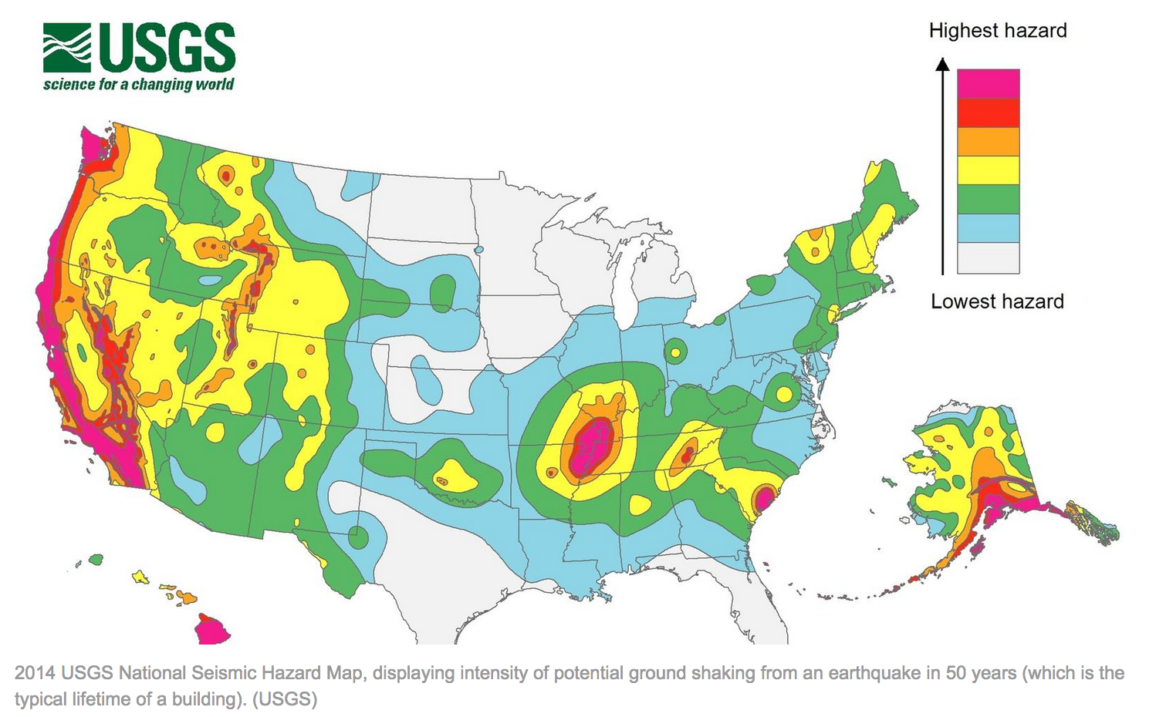
USGS Earthquake Hazard Map

Slide 4
Problem Statement
Exploration of earthquake magnitude / intensity relationships
Intensity measures impact of earthquakes on surface features and structures
How is citizen reported intensity related expert assessment and surface velocity measurements?
How does intensity relate to crustal thickness?
Are there areas experiencing intensity above what is predicted by current E/W models?
Intensity
Distance
Magnitude
Material Properties
Regional Geology

Slide 5
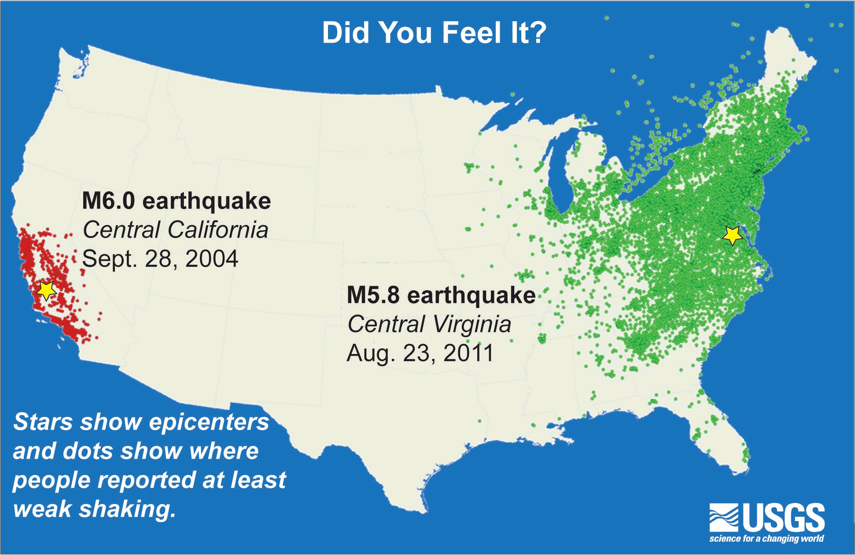
USGS Differences in Intensity between earthquakes of similar magnitude

Slide 6
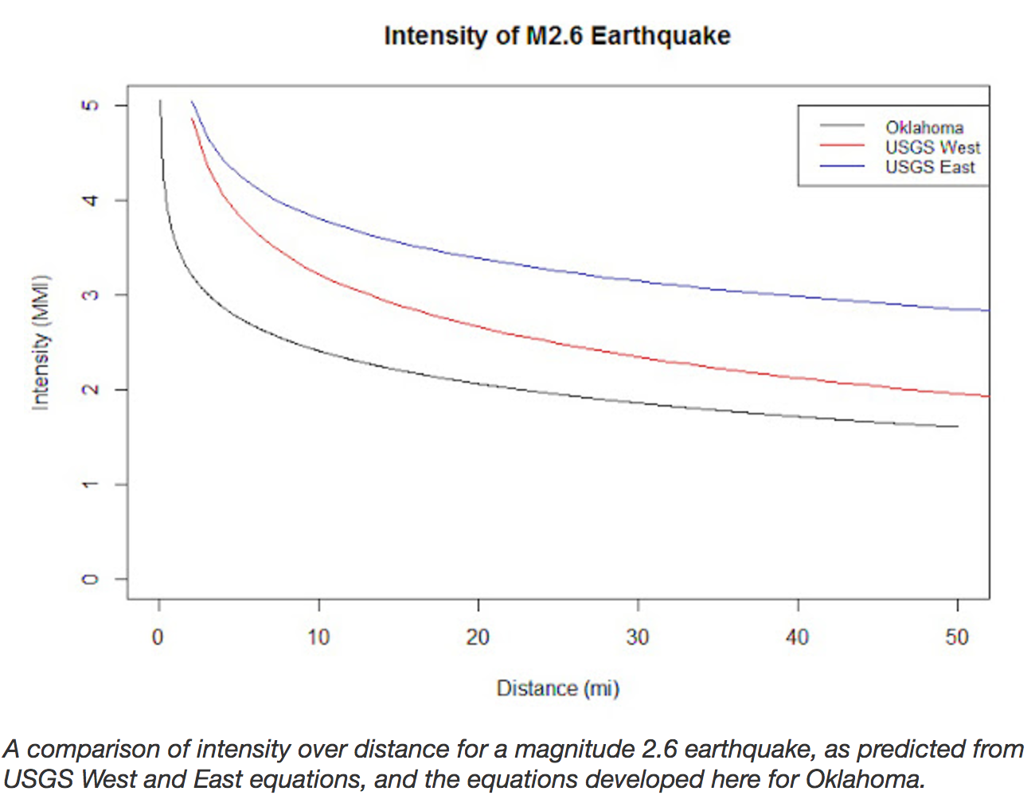
Relationship of Intensity and Magnitude
USGS Western US equation: I = 1.01M - 0.00054D - 1.72logD + 1.15
USGS Eastern US equation: I = 1.29M - 0.00051*D - 2.16logD + 1.60
Crowd sourced data based OK eqn: I = 0.93M - 1.15logD + 1.14
Schroyer, Matthew (2016). Scraping crowd-sourced shake reports to produce a cumulative shake map for Oklahoma earthquakes, Mental Munition Factory. Retrieved from: http://www.mentalmunition.com/2016/02/scraping-crowd-sourced-shake-reports-to.html

Slide 7
Problem Statement
Exploration of Earthquake / Tsunami relationships
Tsunamis are unpredictable and have the potential for catastrophic damage and loss of life.
Factors governing tsunami severity:
EQ Magnitude: energy released
Fault Type: direction of ocean floor motion
Location: distance of shoreline from event
Ocean Depth: deep water increases speed
Coastal Slope: shallow slope drives energy further inland
Height
Timing
Severity
Change
Can the height of Tsunami at coastal impact be predicted?
Can we better predict which earthquakes will produce damaging tsunamis?
Is the frequency or severity of Tsunamis changing over time?
Can the effect of sea level change be anticipated?
Notes:
Can the height of Tsunami at coastal impact be predicted?
Can we better predict which earthquakes will produce damaging tsunamis?
Is the frequency or severity of Tsunamis changing over time?
Can the effect of sea level change be anticipated?

Slide 8
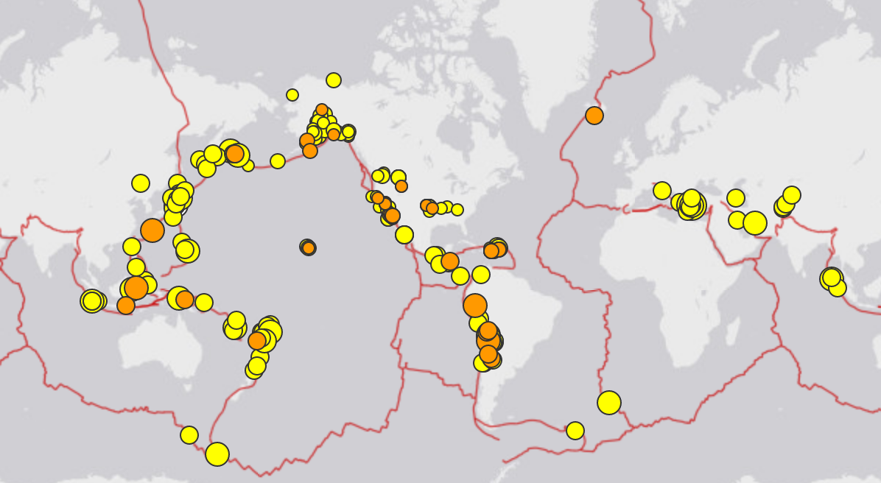
Earthquake Catalog
Event record for every recorded quake WW
This sample Is those in last 7 days with magnitude > 2.5
Includes time, magnitude, latitude, longitude,
Calculation method, error estimates.
Each quake has unique ID number, which matches intensity data, but does not match tsunami ID. Must match on date, lat. & long.

Slide 9
Potential audience
Exploration of earthquake / tsunami relationships
Exploration of earthquake magnitude / intensity relationships
Everyone living in costal areas, esp. Indian Ocean and Pacific Rim
Government agencies in at risk coastal areas
Geophysical & Oceanographic Communities
Everyone living in seismically active regions
Insurance Agencies
damage risk assessments
Government Agencies
construction public safety
Seismic Researchers

Slide 10
Goals
Exploration of earthquake / tsunami relationships
Exploration of earthquake magnitude / intensity relationships
Develop a model which predicts tsunami height
Evaluate accuracy of tsunami warnings
Determine if tsunami frequency or severity is changing
Assess additional risk from anticipated sea level changes
Assess correctness of citizen provided intensity data
Estimate accuracy of USGS magnitude/intensity equations
Model more specific formulas for regions of seismic interest
Determine influence of crustal thickness

Slide 11
Learning Goals
Exploration of earthquake / tsunami relationships
Exploration of earthquake magnitude / intensity relationships
Data Search
Web Scraping
JSON
Exploratory
Data
Analysis
Real Time Data Collection
Modeling and Prediction
Geographic Maps and Plots
Combining Disparate Datasets

Slide 12
Success Metrics
Exploration of earthquake / tsunami relationships
Exploration of earthquake magnitude / intensity relationships
A successful model predicting tsunami height
Guidelines for more refined risk assessments in initial warnings
Clear statement on changes in tsunami frequency or severity
Experience in explaining reasons for unsuccessful project with super cool maps and graphs
Regional equations more accurately relating M & I
M/I/D equatio related to crustal thickness or other response
Clear statement validity and accuracy of citizen reported data
Experience in explaining reasons for unsuccessful project with super cool maps and graphs

Slide 13
Data Sources
Exploration of earthquake / tsunami relationships
Exploration of earthquake magnitude / intensity relationships
Earthquake catalog
API Information
Tsunami catalog, Center for tsunami research
Travel time data
Bathymetry & shoreline change data
Earthquake catalog and additional site info
Intensity data from traditional means
Intensity from CII, citizen reported
Wald, David J. (2011). USGS “Did You Feel It?” Internet-based macroseismic intensity maps. ANNALS OF GEOPHYSICS, 54.6
Oklahoma Example: Matthew Schroyer paper
Crowdsourced Geographic Information use in Govt.
Sent note to USGS help link

