Slide 1
JobHopper
Turning a pile of job postings into a picture of what to learn — and a way to practise it.
THE LAUGHING BOTS
Rose Duarte · Elijah Hewlett · Angel Patino · Terrell Whiting
Final project presentation
A full-stack web application: HTML, Bootstrap and Sass on the front end; FastAPI, SQLAlchemy and SQLite behind it.
JobHopper · The Laughing Bots
1
Notes:
[0:00 - 0:15] SPEAKER 1
Hi, we're the Laughing Bots - Rose, Elijah, Angel and Terrell. This is JobHopper:
it reads real job postings, shows you which skills those postings are actually
asking for, and lets you quiz yourself on any of them.

Slide 2
APPLICATION GOAL
The information is public. Reading it is the problem.
Somebody trying to move up in tech opens a job
board and finds forty postings for the same title -
each one a different wall of requirements.
What we set out to build
JobHopper's goal is to analyze job postings for a target
role, identify the most in-demand skills in the job market
for that role, and present those findings to the user
through a word cloud visual. Additionally, JobHopper aims
to help people build those skills through interactive Q&A
games.
The useful signal is which tools keep coming up. That
signal is real, it is public, and it is completely buried.
Reading forty postings by hand is the thing nobody
actually does, so people guess at what to learn next.
And every skill in that picture is clickable - click it and you are in a timed quiz on that exact skill.
JobHopper · The Laughing Bots
2
Notes:
[0:15 - 1:00] SPEAKER 1
The problem isn't that this information is secret - job postings are public.
It's volume. Search one title and you get forty postings, each with its own wall
of requirements. The signal is which tools keep repeating, and nobody reads
forty postings to find it. So people guess at what to learn next.
So our goal was this: analyse the job postings for a target role, identify the
most in-demand skills, and show them as a word cloud - then help people actually
build those skills through interactive Q&A games.
That second half is what we care about. Every skill in the picture is clickable.
Click Python, and you're in a timed quiz on Python. It doesn't just tell you
what to learn - it gives you somewhere to start.

Slide 3
FUNCTIONAL REQUIREMENTS · 1 OF 2
Accounts, and building the word cloud
User registration and login
Word cloud creation
The system shall allow users to register an account using a
username and password input, with the option to include name
and email.
The system shall validate that the user's credentials are correct
before allowing them to sign in.
The system shall allow the user to see their most recent game
keyword and score after the user logs in.
The system shall allow the user to see their three most recent
job title searches after the user logs in.
The system shall allow the user to input job search parameters
including job title, location, and minimum salary.
The system shall allow the user to select word cloud
configurations such as shape and number of words.
The system shall generate a word cloud where the size of each
word is based on the frequency of tool and skill keywords
extracted from online job postings.
JobHopper · The Laughing Bots
3
Notes:
[1:00 - 1:50] SPEAKER 2
These are our functional requirements, written the way we specified them. I
won't read them all - two things to point at.
In registration and login, it's the last pair: showing you your most recent game
score, and your three most recent searches. Those are the requirements that
forced everything to be stored against a real account rather than sitting in the
browser.
And in word cloud creation, it's the last line. The size of each word is based
on how often that skill appears across the postings we pulled. Size equals
frequency - a count, not an opinion. That one sentence is the whole product.

Slide 4
FUNCTIONAL REQUIREMENTS · 2 OF 2
Scraping the postings, and the Q&A game
Job scraping
The system shall calculate the frequency of tool and skill keywords extracted from online job postings.
The system shall display an error in the event that there is not enough job information for the word cloud.
Q&A game
The system shall allow the user to click on any word in the word cloud.
The system shall redirect the user to the respective Q&A game dashboard after the user clicks on a word from the word cloud.
The system shall select Q&A game questions that are related to the skill or tool keyword and the difficulty that the user selected.
The system shall keep a timer for the user's quiz completion based on the selected difficulty.
The system shall display the score to the user.
JobHopper · The Laughing Bots
4
Notes:
[1:50 - 2:40] SPEAKER 2
Job scraping is two requirements. Count how often each keyword appears - and
display an error when there isn't enough job information to build a cloud. A
thin, misleading picture is worse than saying we can't build one, so we made
that a requirement rather than an edge case.
The Q&A game block is the exact path you'll see in the demo: click any word, get
sent to that word's game, get questions matching the keyword and difficulty you
chose, on a timer, with your score at the end.
One thing that isn't on the slide - every answer is locked in on the server
before you're told whether it was right, so the running score and the final
score can never disagree.

Slide 5
NON-FUNCTIONAL REQUIREMENTS
How well it has to do it
Not features - but the app is wrong without them.
Word cloud speed
Game responsiveness
Input safety
The system should generate and display
the skill word cloud within 10 seconds of
the user submitting valid search criteria.
The system should redirect the user to
the Q&A game within 10 seconds, and
calculate their score within 7 seconds of
finishing.
The system should validate and sanitize
all user input to prevent injection. Every
query goes through the ORM,
parameterised - never built by string.
Credential security
Score integrity
Reliability
Passwords are bcrypt-hashed, never
stored or returned. Tokens expire in 24
hours, and a failed login gives one
generic message either way.
The server decides every score, never
the browser, and a finished quiz cannot
be replayed.
250 automated tests - 222 backend, 28
front end - and nothing merges until
both suites pass.
JobHopper · The Laughing Bots
5
Notes:
[2:40 - 3:30] SPEAKER 2
Non-functional requirements - not features, but the app is wrong without them.
The top row is what we committed to in our spec: the cloud back within ten
seconds, the game open within ten and scored within seven, and all user input
validated and sanitised against injection. We get that last one structurally -
every query goes through the ORM, parameterised, never built by string.
The bottom row we held ourselves to as we built. Passwords bcrypt-hashed and
never returned, and a failed login gives the same generic message whether the
account exists or not. The server decides every score, never the browser. And
250 tests, with nothing merging until both suites pass.

Slide 6
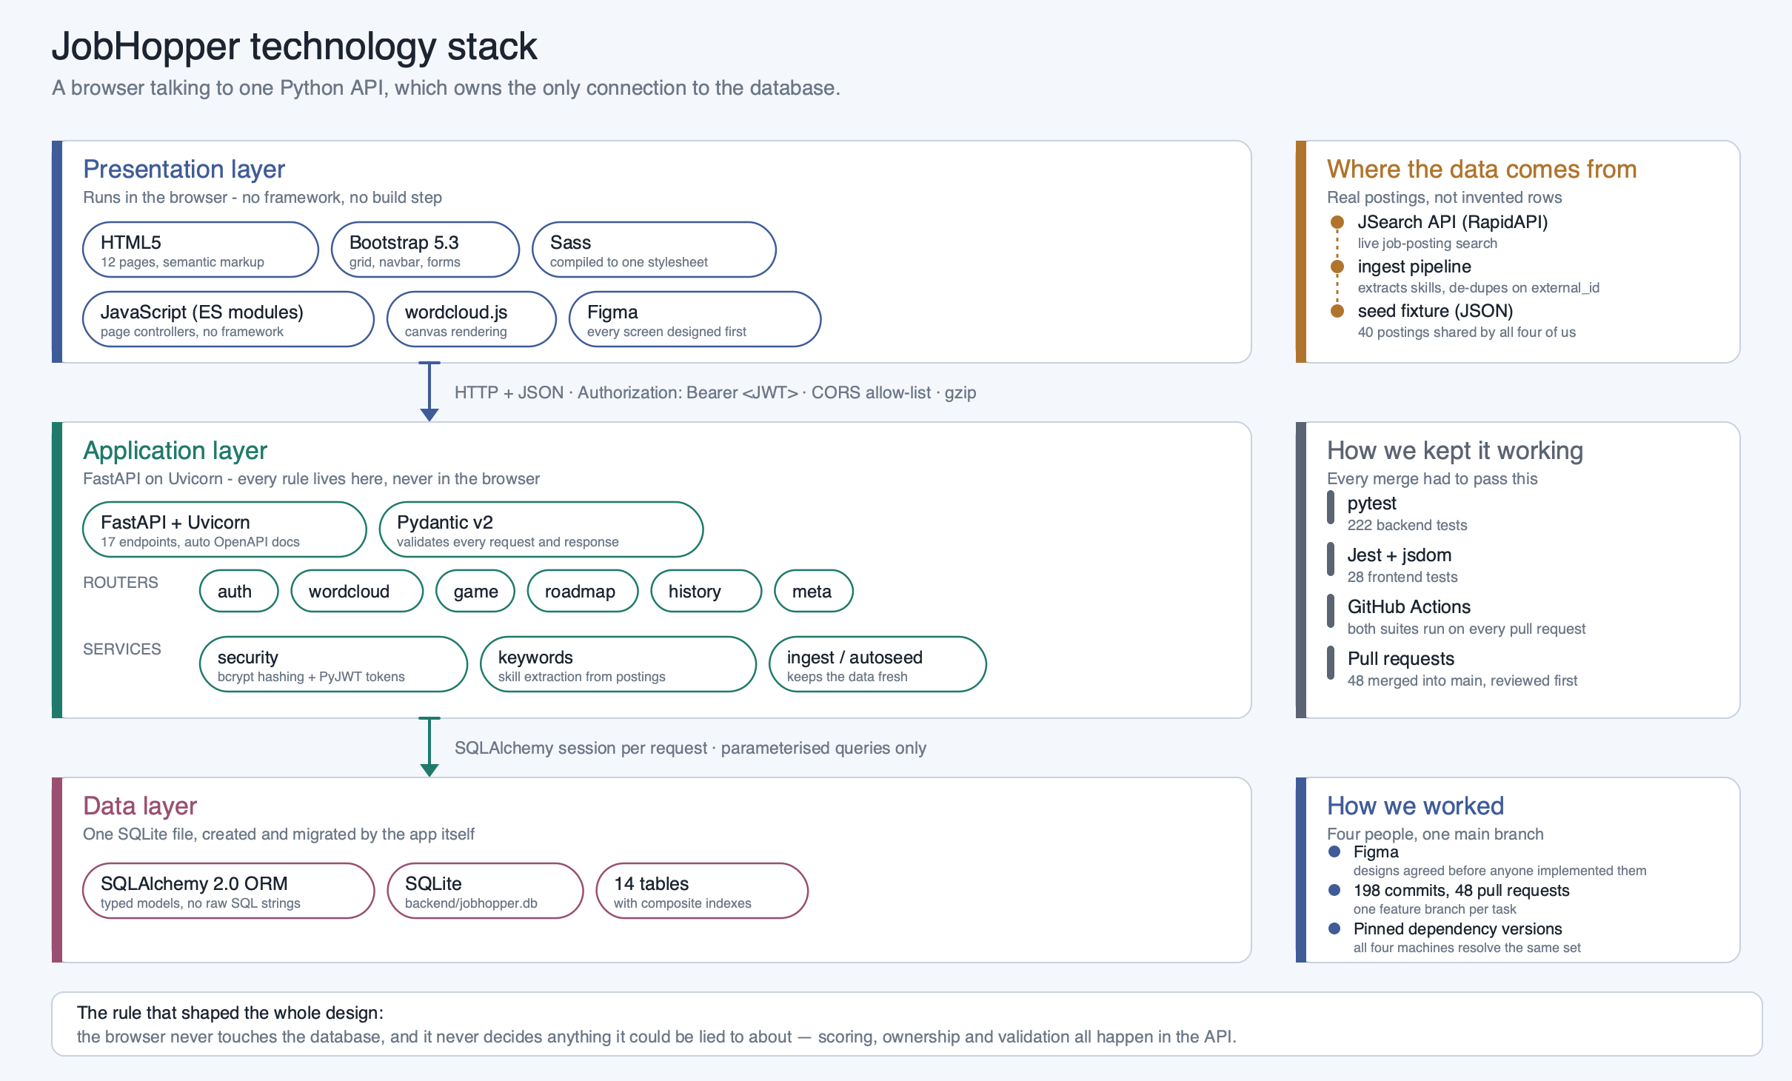
JobHopper · The Laughing Bots
6
Notes:
[3:45 - 4:40] SPEAKER 3
The whole system on one page.
Top: the browser. Twelve HTML pages, Bootstrap, Sass, plain JavaScript modules -
no framework, no build step. It talks to exactly one thing, our API, and
anything tied to an account carries a signed token.
The middle band is where every rule lives: FastAPI, seventeen endpoints, Pydantic
validating every request and response, and underneath it the services - hashing
and tokens, skill extraction, and the ingest that keeps our data current. Note
on the right that our postings are real, pulled from a live job-search API.
The bottom is one SQLite file, reached only through SQLAlchemy.
That line along the bottom is the rule that shaped everything: the browser never
touches the database, and never decides anything it could be lied to about.

Slide 7
WHY THIS STACK
Chosen for a four-person team on a semester timeline
Python + FastAPI
SQLite + SQLAlchemy
Python is the strongest shared language on this team. FastAPI
gave us request and response validation for free and generated
live API docs - so the front end could build against a written
contract instead of waiting for the backend to finish.
SQLite is a single file: no database server to install, so four
laptops and the CI runner all run an identical database with zero
setup. SQLAlchemy keeps every query parameterised -
injection-safe by construction - and moving to PostgreSQL later is
one connection string.
Figma, Bootstrap and Sass
GitHub Actions + pytest + Jest
Figma let us agree on every screen before anyone implemented
it, and kept us coordinated once we started. Bootstrap's
components sped up the build and gave us a responsive grid on
day one. Sass let us generate custom CSS quickly, from one
shared palette across twelve pages.
The cheapest way to stop four people breaking each other's
work. Both suites run on every pull request, so a regression is
caught by the robot rather than by whoever pulls next.
JobHopper · The Laughing Bots
7
Notes:
[4:40 - 5:35] SPEAKER 3
Why these choices.
Python and FastAPI: Python is the strongest shared language on this team, and
FastAPI gave us validation for free plus live API docs - so the front end could
build against a written contract instead of waiting for the backend.
SQLite: one file, no server to install, so four laptops and the CI runner run an
identical database with zero setup - which removed a whole category of "works on
my machine". SQLAlchemy keeps every query parameterised, so we're injection-safe
by construction.
On the front end, Figma first. We designed every screen before anyone built it,
which kept four people from producing four different-looking pages. Bootstrap
gave us a responsive grid on day one, and Sass gave us one shared palette across
twelve pages.
And GitHub Actions - the cheapest way to stop four people breaking each other's
work.

Slide 8
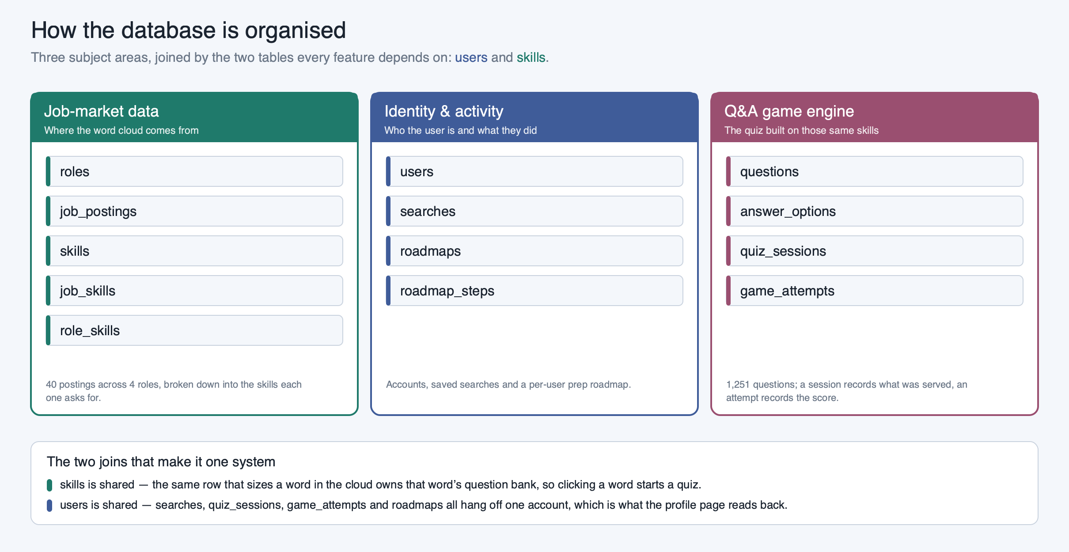
JobHopper · The Laughing Bots
8
Notes:
[5:50 - 6:30] SPEAKER 4
Before the full diagram, the shape of it. Fourteen tables in three groups.
Left: the job-market data - roles, postings, skills, and the junctions between
them. That's where a cloud comes from. Middle: identity and activity. Right: the
quiz engine.
What makes this one system rather than three is two shared tables. Skills is
shared left to right - the same row that sizes a word in the cloud owns that
word's question bank, which is why clicking a word can start a quiz. And users
ties everything on the right to one account.

Slide 9
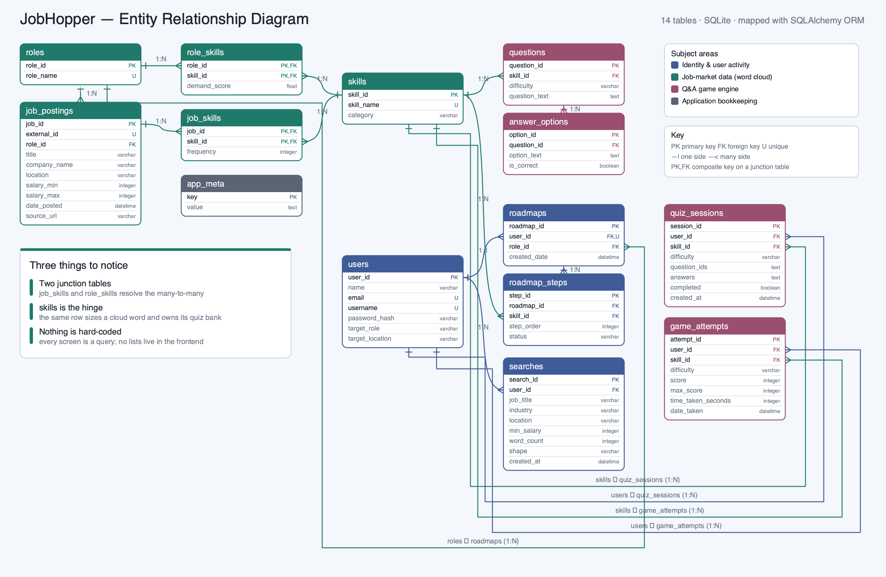
JobHopper · The Laughing Bots
9
Notes:
[6:15 - 7:35] SPEAKER 4 - Trace each table with the cursor as you name it.
Let me trace the one path that touches most of it.
Start at ROLES. One role has many JOB_POSTINGS - title, company, location, salary
range, date posted.
Now the interesting part. A posting mentions many skills, and a skill appears in
many postings. That's many-to-many, which a relational database can't store
directly - so JOB_SKILLS resolves it. Its primary key is the pair, job plus
skill, which is what guarantees one posting can only count once toward a skill.
So the word cloud is one query: the postings for this role inside the date
window, joined through job_skills, counted per skill, sorted descending. That
count is the word size.
Follow SKILLS right and it becomes the quiz. One skill has many QUESTIONS split
by difficulty, each with its ANSWER_OPTIONS - one flagged correct, and that flag
never leaves the server.
Starting a quiz creates a QUIZ_SESSION recording which questions went out and
what you picked - that is what makes live scoring trustworthy, and what stops a
finished quiz being replayed. Submitting lands the result in GAME_ATTEMPTS.
And down the middle, USERS - every search and every attempt hangs off it.

Slide 10
USER ROLES
JobHopper has two roles — and we'll show you both
What the app lets you do depends entirely on whether the request carries a valid token.
Visitor · not signed in
Registered user · signed in
Can browse the home page, the game rules, the stack page
and the creators page — and can register an account.
Cannot generate a word cloud, and has no profile, no saved
searches and no game history. The page sends them to
sign-in — and the API refuses the request as well, so the rule
holds even if you skip the page.
Everything above, plus: generate word clouds, play quizzes
with the result saved, and a profile page showing recent
searches and recent scores — each one re-runnable in a
click.
Identity comes from a signed token, checked on the server
for every single request.
Why there is no admin role
Nothing in JobHopper is administered through a screen. Postings arrive through the ingest pipeline and the question bank is loaded
from a fixture, so there was never a task an admin would log in to do. Adding an admin login would have been a role with nothing
behind it.
JobHopper · The Laughing Bots
10
Notes:
[7:55 - 8:30] SPEAKER 1 - sets up the demo
One note before the demo, because it shapes what you'll see.
JobHopper has two roles, and the difference is whether the request carries a
valid token. A visitor can read the public pages and register - nothing else. A
signed-in user gets word clouds, quizzes that save their result, and a profile.
And there's deliberately no admin role. Postings come in through the ingest
pipeline and questions load from a fixture, so there was never a job an admin
would log in to do.

Slide 11
LIVE DEMO · PART 1 OF 3
Role 1 — the visitor
Browse the public pages — home, rules, stack, creators
Try to reach a word cloud without signing in → bounced to sign-in
Register a brand-new account live — the form builds your first cloud with you
JobHopper · The Laughing Bots
11
Notes:
[8:22 - 9:22] SPEAKER 3 - LIVE DEMO, PART 1. Share your screen now.
Lines in quotes are what you say. Lines starting with > are what you do.
> Home page already open.
"This is JobHopper the way anyone arrives at it - not signed in. Rules, stack
and creators are open to everybody."
> Click Game Rules. Don't scroll far.
"Ten questions, three difficulties, each with its own clock."
> Try to open the word cloud page directly.
"Now watch what happens if I go straight for a word cloud with no account. It
sends me to sign-in - and that's not the page hiding a button. The API refuses
the request too, so there's no way around it."
> Click Sign Up. Type a 3-character username so the validation fires.
"So let's make one. Validation is inline, right where the problem is."
> Fix the username, then fill the rest. Job title and location are type-ahead
> fields - start typing and real options drop down. Keep talking while you
> type; don't narrate the typing.
"The same form takes your first search - and those suggestions are the job
titles and locations we actually have postings for."
> Submit.
If registration misbehaves: sign in with the backup account, say "we've already
got one set up", and carry on. Do not debug on camera.

Slide 12
LIVE DEMO · PART 2 OF 3
Role 2 — the registered user
Read the cloud we just generated — then build another from the profile
Click a skill → pick a difficulty → play the timed quiz
Watch the live score move as each answer locks in
Open the profile: the search and the score are both already there
JobHopper · The Laughing Bots
12
Notes:
[9:22 - 11:22] SPEAKER 3 and SPEAKER 4 - LIVE DEMO, PART 2. The main event.
Lines in quotes are what you say. Lines starting with > are what you do.
> You are on the cloud registration just built.
"Here's what that search produced. The biggest words are the ones that appeared
in the most postings for that role - that's a count, not our opinion. Anything
we have questions for is clickable."
> Click one of the biggest skills.
"So let's take that one."
> Difficulty screen. Choose EASY - three minutes, so you can finish all ten.
> The score is only saved when the quiz is submitted, and that happens on the
> tenth answer or when the clock runs out. Stopping early means an empty game
> history on the profile.
"Three difficulties, three timers. I'll take easy - three minutes."
> Answer one question correctly.
"It tells me straight away whether I got it. It can do that safely because my
answer is already locked in on the server before I'm told - so knowing it now
can't change what I picked."
> Answer the next one wrong, on purpose.
"And there's the other case. It shows me the right answer, and the clock pauses
while I'm reading it."
> Now click through questions 3 to 10 without narrating each one. About
> sixty seconds if you don't read them aloud.
"I'll speed through the rest of these."
> The Submit button is replaced by a return button. Click it.
"That's graded and saved. This is my profile - the search I ran is under recent
word clouds, and the quiz I just played is under game history, score and all.
We didn't refresh anything, and none of this is hard-coded. That's the database
answering."
> Click Search Again on the saved cloud.
"And any saved search re-runs in one click."

Slide 13
LIVE DEMO · PART 3 OF 3
It really is a database
Open the database file and list the tables — the same fourteen from the ERD
Show the rows we just created: the search and the game attempt, carrying our user_id
Show a stored password — a bcrypt hash, not the password we typed
Show the word-cloud counts matching the picture we just drew
JobHopper · The Laughing Bots
13
Notes:
[11:22 - 12:22] SPEAKER 4 - LIVE DEMO, PART 3. This is the 9-point item.
Switch to the DB Browser window already open on the second desktop. Do not open
a terminal - that reads as code.
> Show the table list in the sidebar.
"Last thing - proof this is really sitting in a database. There are our fourteen
tables, the same fourteen from the ERD. That diagram isn't what we planned; it's
what's in the file."
> DB Browser lists fifteen. The extra one is sqlite_stat1, which SQLite makes
> for its own query statistics. Say "our fourteen tables", not "fourteen
> tables", so the count on screen doesn't catch you out.
> Browse Data, searches table, scroll to the last row.
"The bottom row is the search from ninety seconds ago - role, salary, shape,
timestamp, and a user_id pointing at the account we made on camera."
> Switch to game_attempts.
"Same for the quiz. Skill, difficulty, score, seconds taken."
> Switch to users. Point at the password_hash column.
"And this is the users table. That's a bcrypt hash. We couldn't tell you that
password if we wanted to - we never stored it."
> Stop sharing, back to the deck.
"Everything you just saw came out of that one file."

Slide 14
SUMMARY
How much was achieved, and what was altered
We planned more than we shipped. Here is the honest accounting.
Achieved
Altered or cut
▸ Users can register, sign in, and stay signed in.
▸ The app parses job postings and generates a word cloud from
the user's own search parameters.
▸ The Q&A game runs on a timer with live scoring, and every
result is saved to the account.
▸ The prep roadmap ranks a role's skills by demand and tracks
progress through them.
▸ The question bank beat its target: about 15 per skill per
difficulty, which is 1,251 questions across 28 skills.
▸ 250 automated tests, run on every pull request.
▸ Users were originally going to type in any role. External API
limitations reduced that to 4 supported roles.
▸ Location became a dynamic menu, listing only places that have
enough postings to build a cloud from.
▸ Maximum salary was removed rather than shipped as a filter
that quietly did nothing.
▸ Named ranks are on the rules page, but scoring currently ends
at a normalised number.
JobHopper · The Laughing Bots
14
Notes:
[11:20 - 12:10] SPEAKER 1
The honest accounting.
On the left, what worked. Everything you just saw, plus a question bank that beat
its own target - we aimed for ten per skill per difficulty and shipped fifteen,
so more than 1,250 questions. And 250 tests on every pull request.
On the right, what changed. The top two are the same story: the external API
limited what we could reliably fetch, so typing any role became four supported
roles, and location became a menu of places that actually have postings behind
them. Both were us refusing to offer a search that comes back empty.
The rest is choosing depth over breadth - and one place where our documentation
got ahead of the app, which is on us.

Slide 15
WHERE WE'D TAKE IT NEXT
Rank the roadmap by what
you're weak at
Widen the ingest
Close the loop
Four roles was enough to prove the
idea. The pipeline isn't the limit —
the vocabulary of skills we match
against is.
Feed quiz results back into the cloud,
so the skills you keep getting wrong
become the ones it puts in front of
you.
It orders skills by market demand
today. It should also weigh what your
quiz scores say you don't know yet.
Thank you
JobHopper reads what the market is asking for, and gives you somewhere to start.
THE LAUGHING BOTS
Rose Duarte · Elijah Hewlett · Angel Patino · Terrell Whiting
JobHopper · The Laughing Bots
15
Notes:
[12:30 - 13:00] SPEAKER 1 - close
Three things next. Rank the roadmap by what you're weak at, not just by what the
market wants. Widen the ingest; the pipeline isn't the limit, the skill
vocabulary is. And the one we actually want: close the loop, so the skills you
keep getting wrong become the ones your cloud puts in front of you.
Right now the two halves of the app share a database. They should share a memory.
That's JobHopper. Thank you.
--- END. Target 13:00. Hard ceiling 15:00. ---

