Slide 1
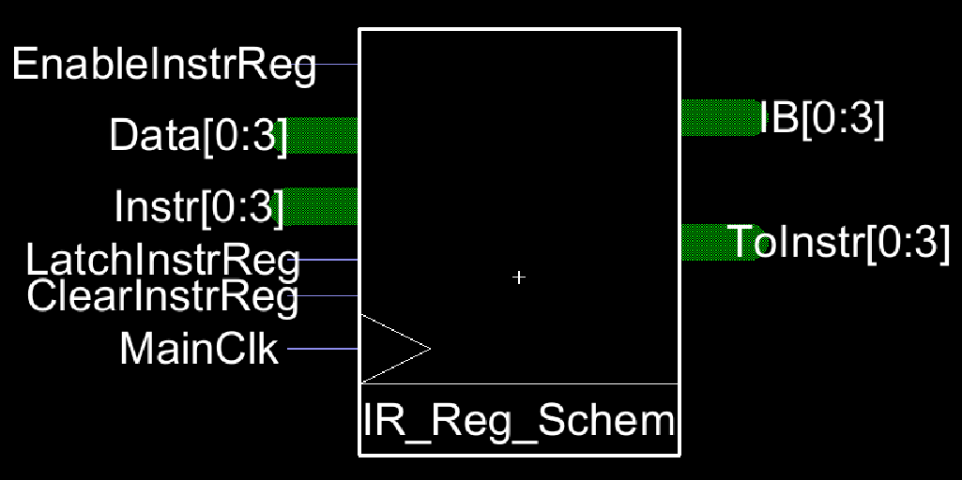
VLSI Electric: Instruction Register
Evan Hill

Slide 2
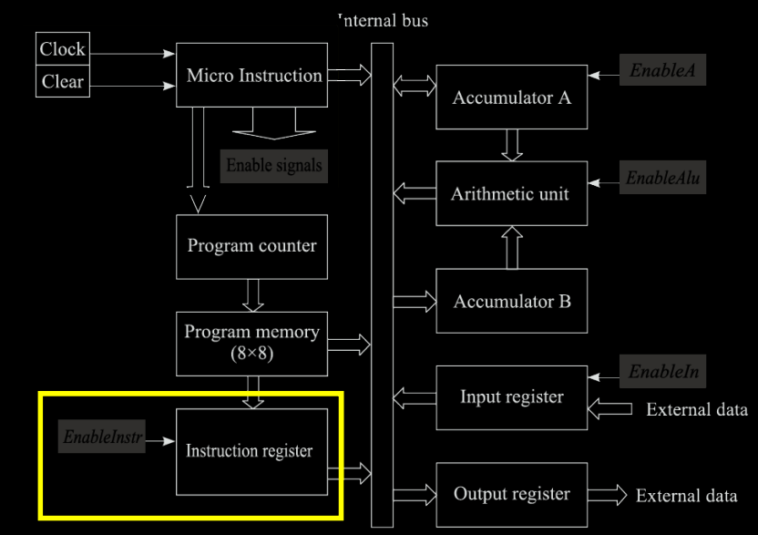
Instruction Register
Takes data from the program memory
Splits into – Data (4 bits) Instruction (4 bits)
Feeds data to Internal Bus for processing

Slide 3
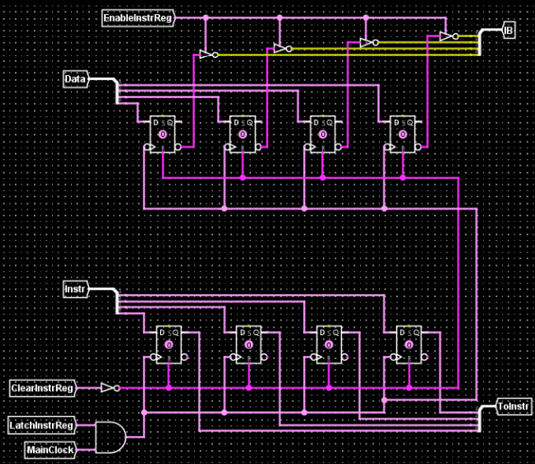

Schematic

Slide 4
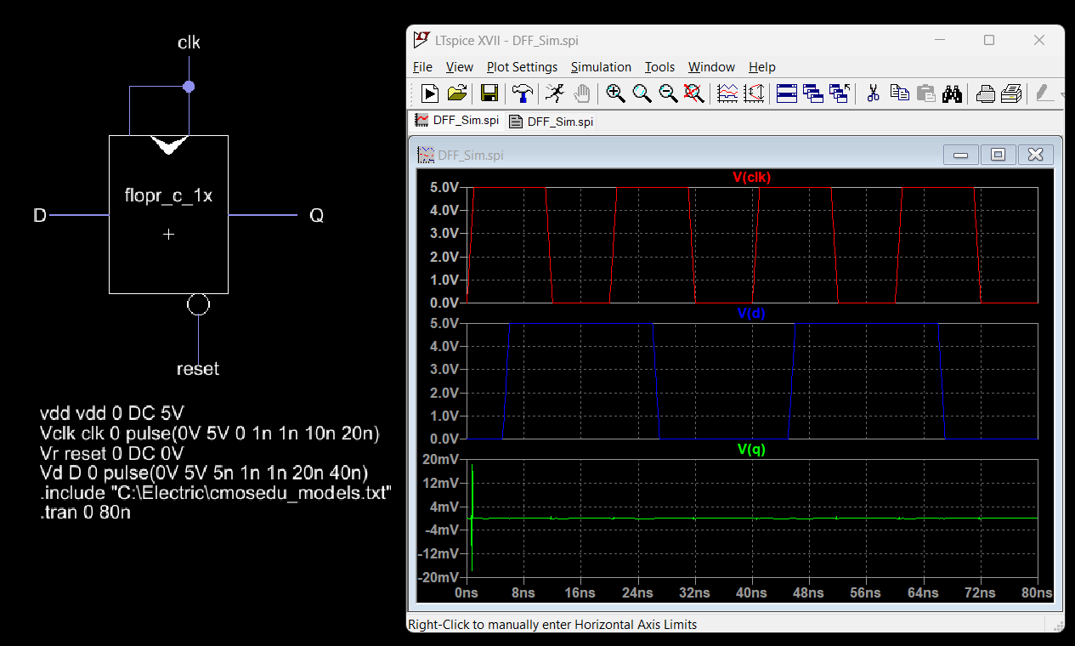
DFF

Slide 5
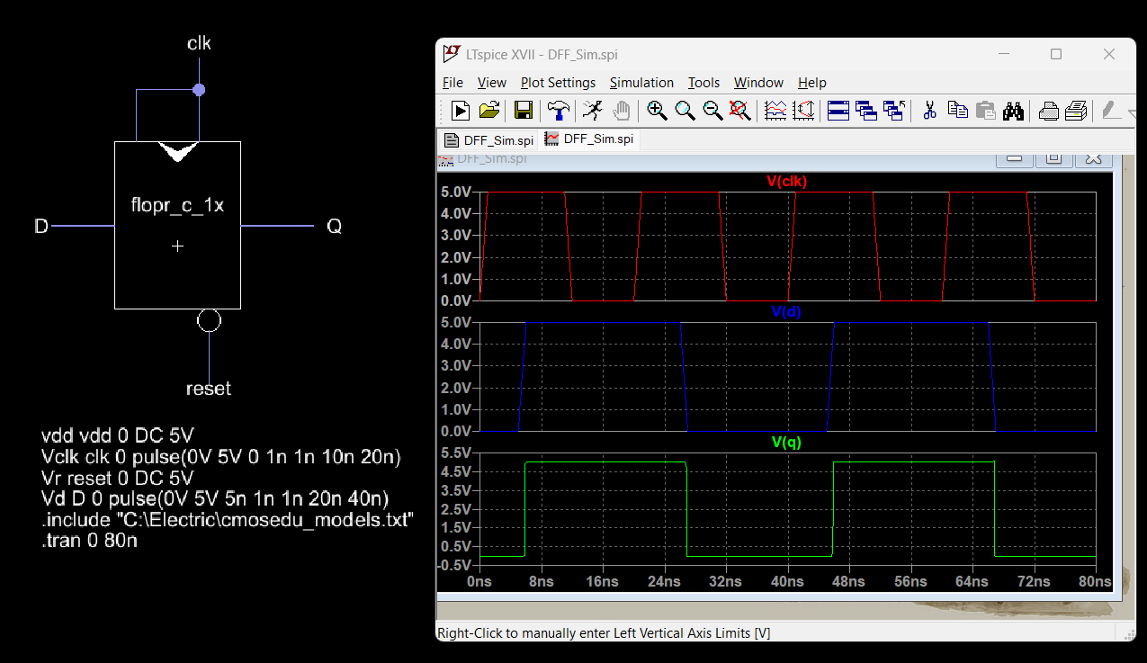

DFF

Slide 6
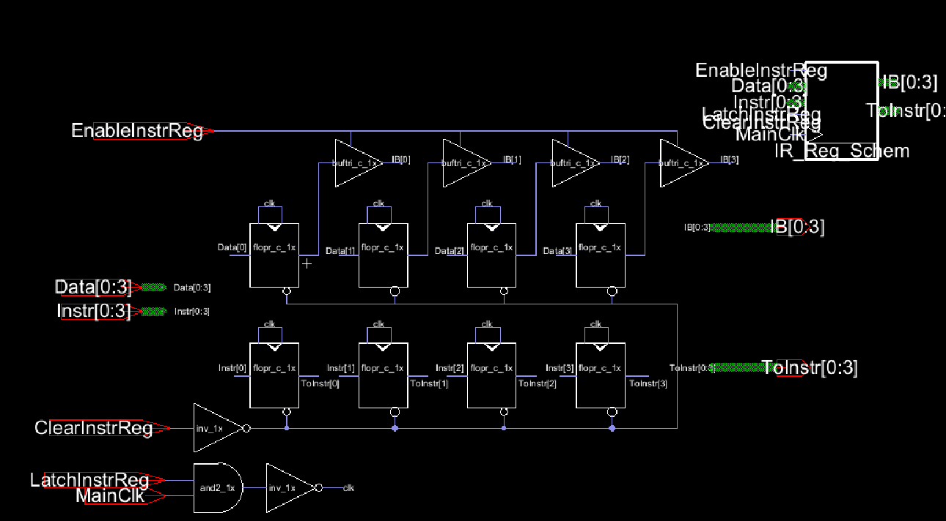
Electric VLSI

Slide 7
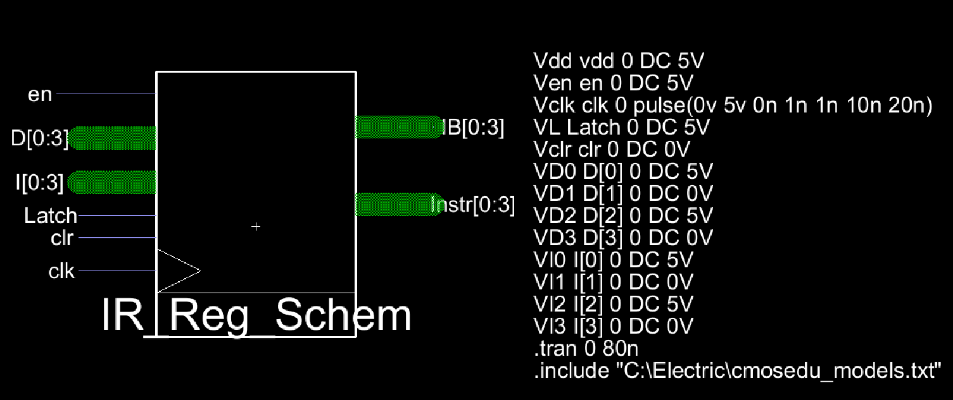
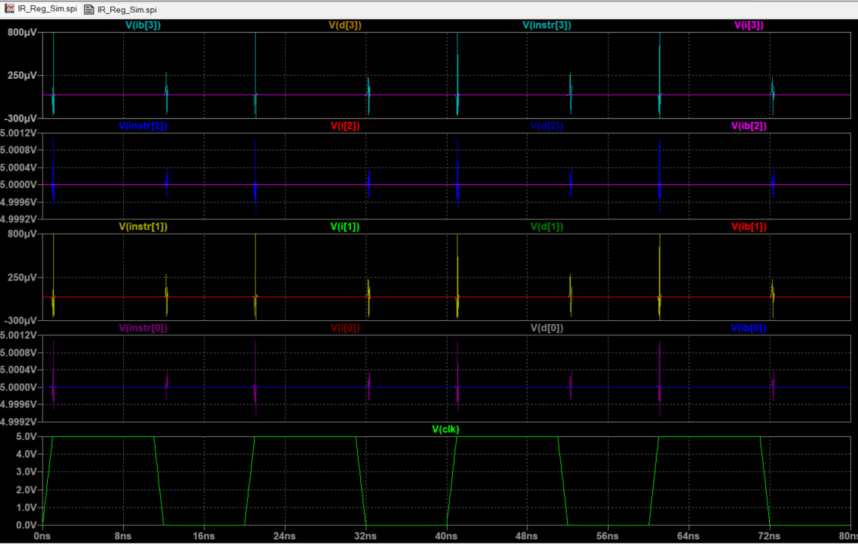

LTSpice Simulation
Input: -Data : 0101 -Instr : 0101

Slide 8
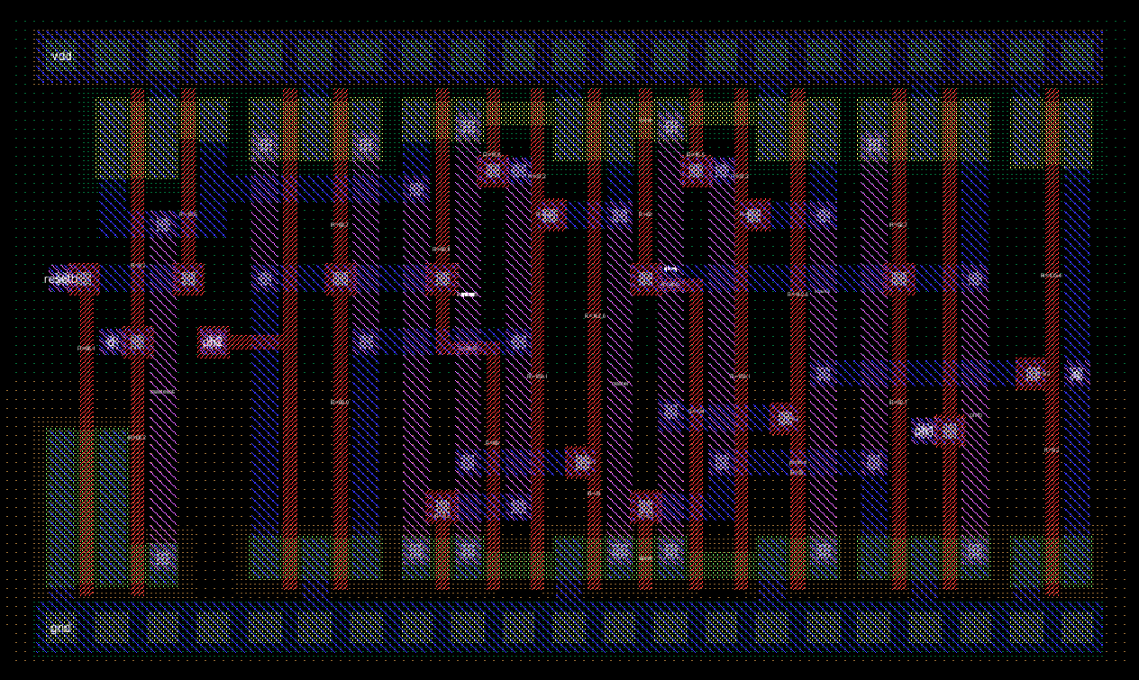
Layouts
DFF

Slide 9
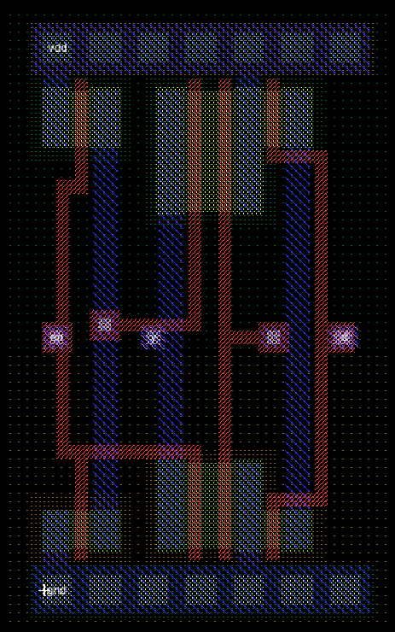
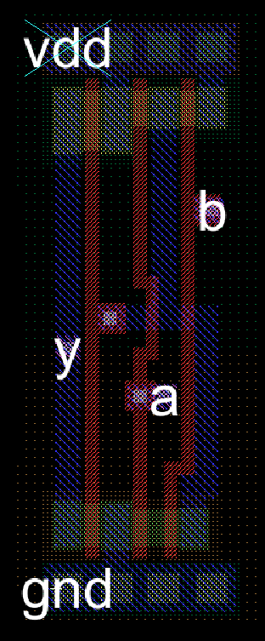

Layouts
Enabled Buffer AND2 Inverter

Slide 10
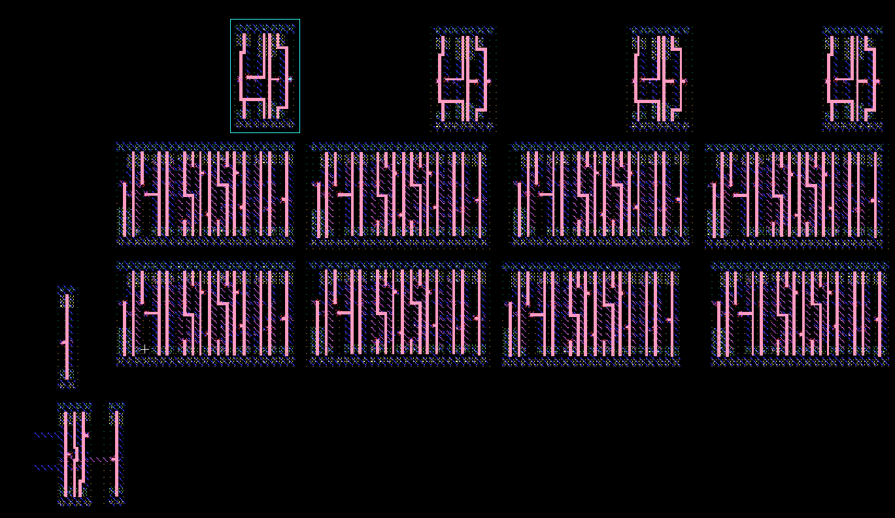
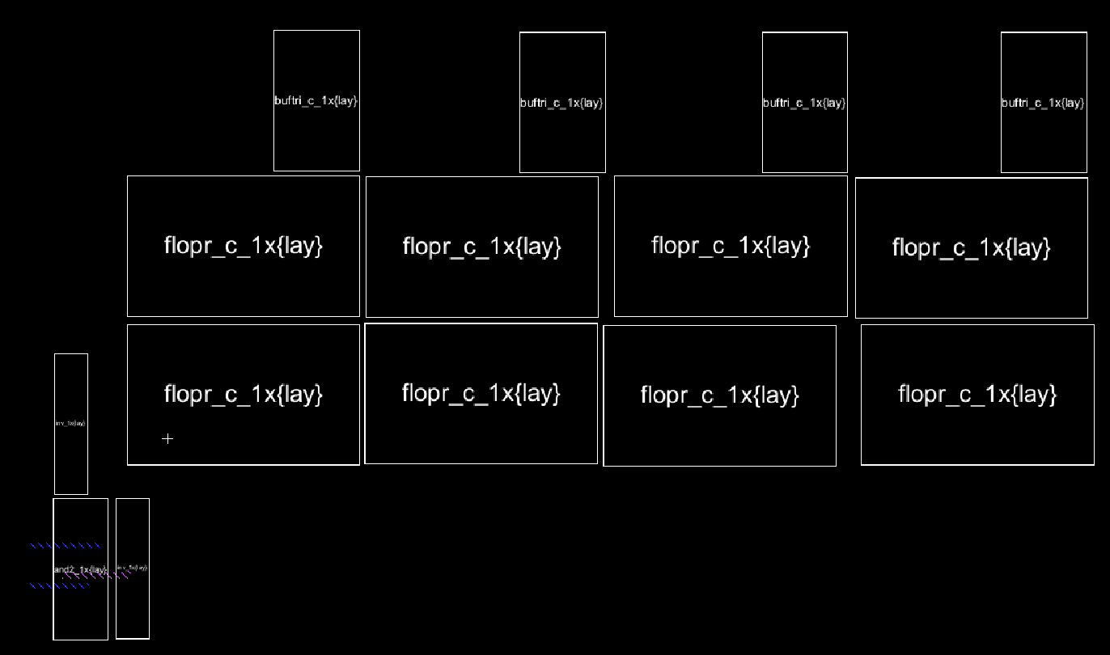
Layout (unfinished)

Slide 11
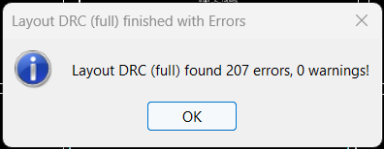
Layout (unfinished)

Slide 12
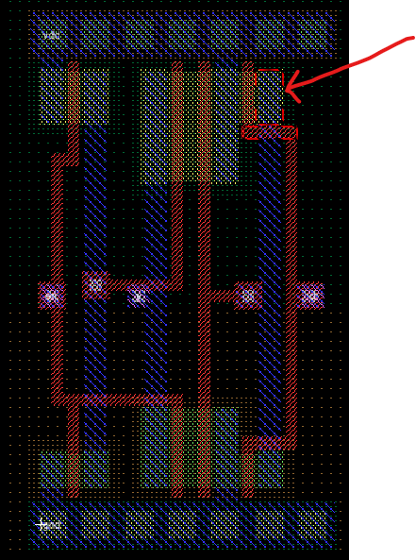
Buffer

