Slide 1
Using Machine Learning to detect Pulsars
By Elizabeth Jeanne Howard for
Data Science Project Using Python [DSA13]

Slide 2
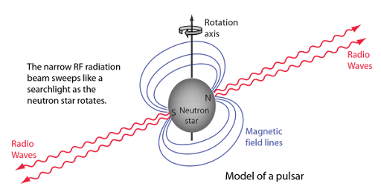
What is a Pulsar?
The primary goal of this data is to try to tell the differences between neutron stars and pulsars.
Both star types are the results of a supernova, and pulsars are a subclass of neutron star. Both star types are extremely dense (the only stellar object with a higher density is a black hole), but pulsars are highly magnetic and emit large quantities of electromagnetic radiation as well as being highly dense. They get their name from a regular, evenly spaced 'pulse' they emit. Sometimes they're called cosmic light houses because of this feature. Each pulsar has a unique 'pulse' pattern.

Slide 3
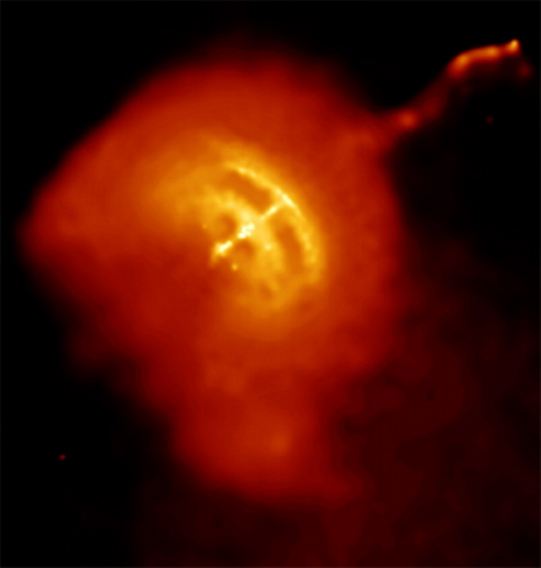
More on Pulsars
All stars in the data set are either neutrons or pulsars. If the target class is 1, it is a pulsar. Otherwise, it is actually noise, indictive of nothing. Initially I thought these were neutron stars but that was incorrect.
DM-SNR (a term seen in the columns) stands for two things: Dispersion Measure (DM) and Signal-to-Noise Ratio (SNR). DM measure the dispersion or the spread of pulsar's signals during their journey to earth. SNR measures the strength of a pulsar's signal relative to background noise. DM is calculated from the time delay of each signal when they arrived in earth, while SNR is calculated at the peak intensity of each signal. After collecting data of both DM and SNR over multiple signals, these two are plotted together to create a curve, and the data here measures the mean, standard deviation kurtosis and skewness of this curve.
Integrated Profile, another term referred to in columns is a consistent measure of the star itself, also called a pulse profile or folded pulse shape. There are specific tools observatories use to collect this data.

Slide 4
About the Data
Variable Names:
Mean of the integrated profile
Standard deviation of the integrated profile
Excess kurtosis of the integrated profile
Skewness of the integrated profile
Mean of the DM-SNR curve
Standard deviation of the DM-SNR curve
Excess kurtosis of the DM-SNR curve
Skewness of the DM-SNR curve
target_class
9 variables – All numeric
17898 rows, 1639 having a target class of 1.
None of the variables are normal.
There are many outliers.
There were no missing or duplicated values.
Data was not scaled in processing.

Slide 5

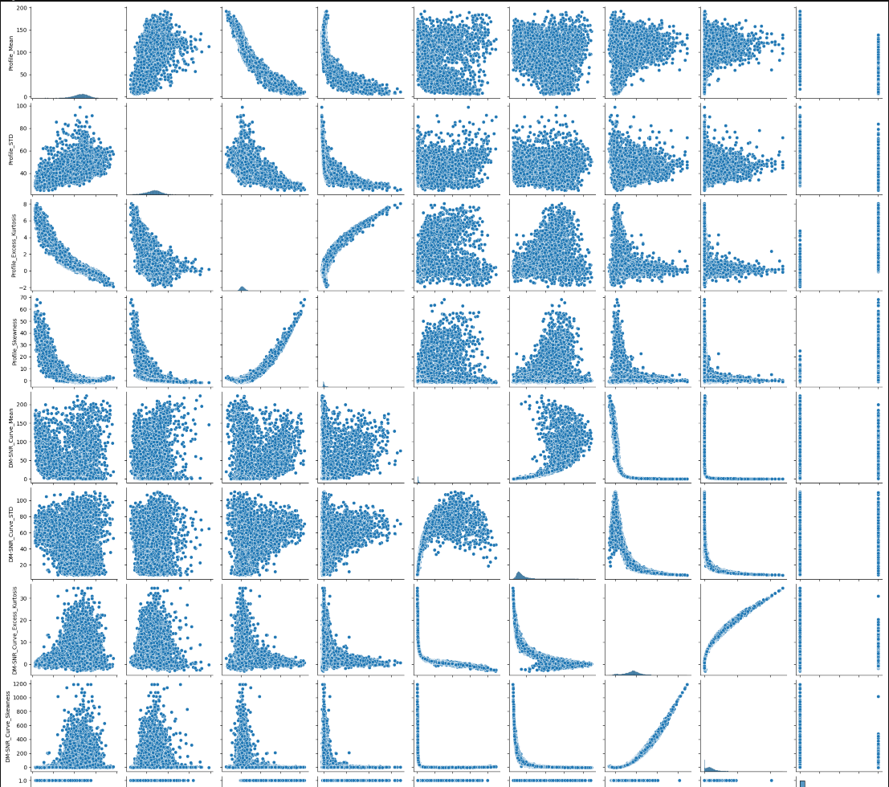
Pair plot showing values

Slide 6
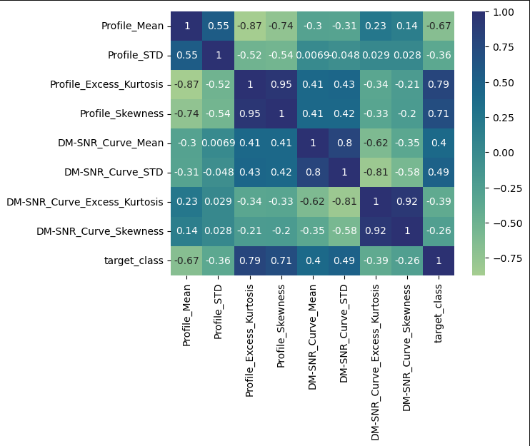
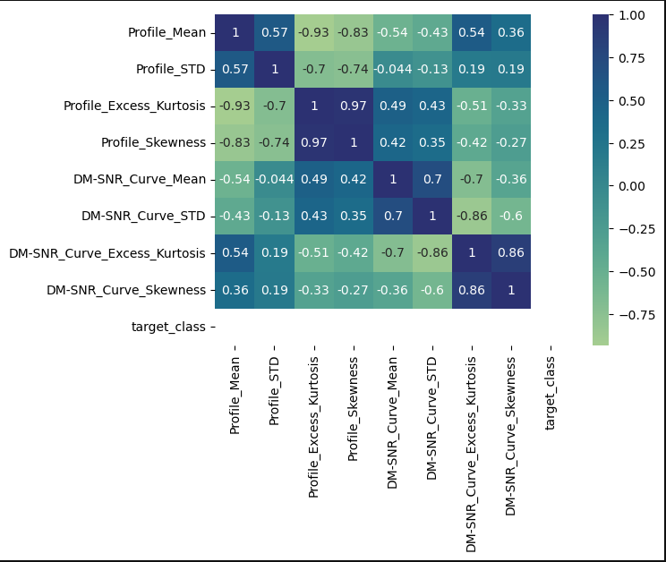
Heatmap comparison
Entire Dataset
Just Pulsars

Slide 7
What went into the model
Profile_Mean Profile_STD, Profile_Excess_Kurtosis, DM-SNR_Curve_Mean, DM-SNR_Curve_Excess_Kurtosis were the remaining variables after removing those that showed collinearity with each other.
These become x
y is ‘target_class’

Slide 8
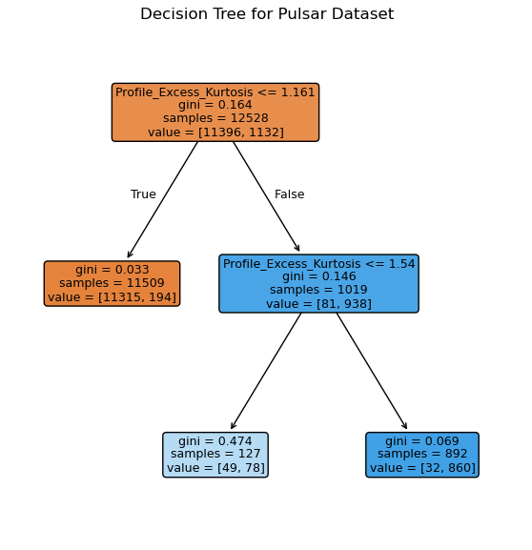
Decision Tree
The decision tree focused on the Profile_Excess_Kurtosis variable.

Slide 9
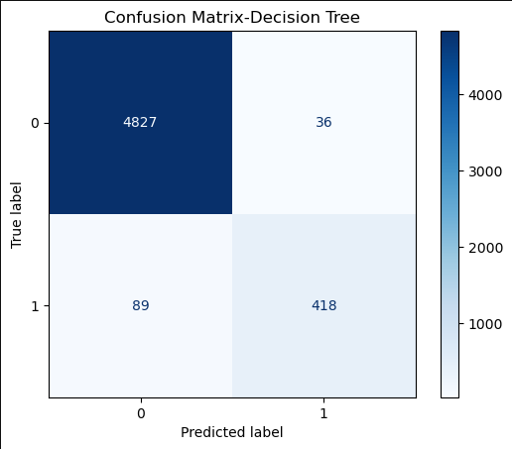
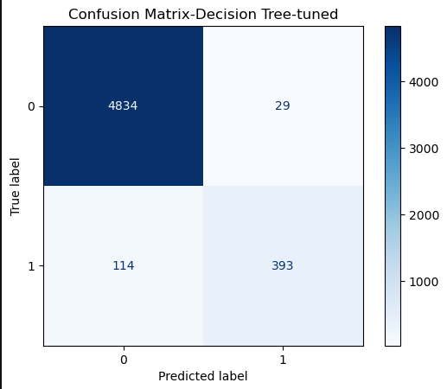
Decision Tree Results
Before Grid Search
After

Slide 10
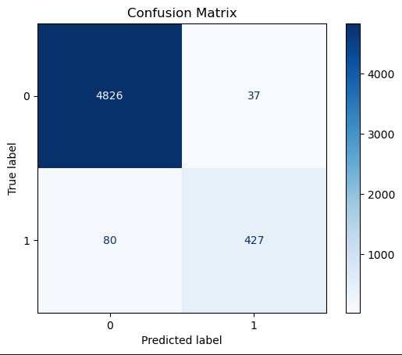
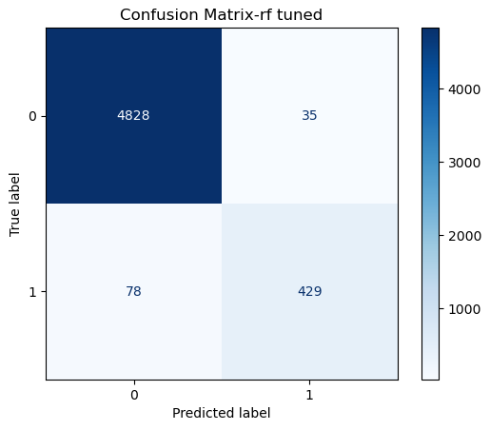
Random Forest
Before Grid Search
After using Grid Search Values

Slide 11
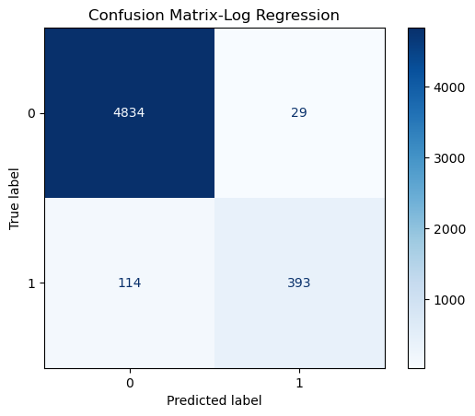
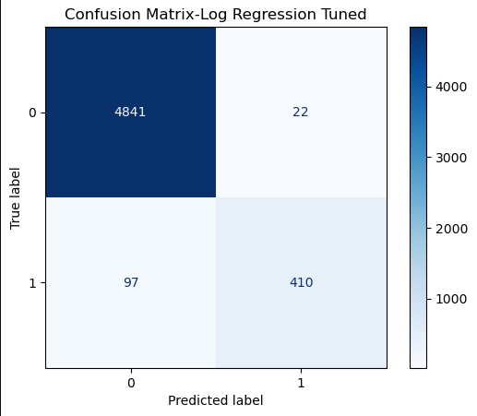
Logistic Regression
Untuned
Tuned

Slide 12
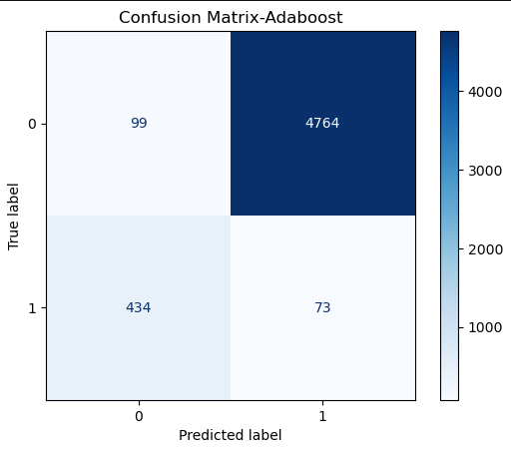
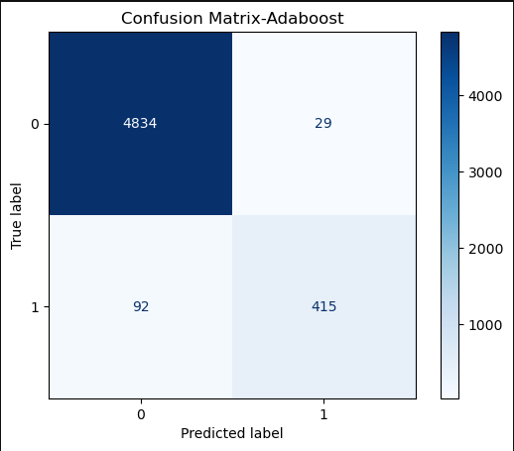
Adaboost
Untuned
Tuned

Slide 13


XGBoost
Untuned
Tuned

Slide 14


KNNeighbors
Untuned
Tuned

Slide 15
Results Overall
Classifier | Accuracy | Precision | Recall | AUC
Decision Tree | 0.9767 | 0.9207 | 0.8245 | 0.9085
Decision Tree - T | 0.9734 | 0.9312 | 0.7751 | 0.8845
Random Forest | 0.9782 | 0.8422 | 0.9203 | 0.9173
Random Forest -T | 0.9790 | 0.9246 | 0.8462 | 0.9195
Logistic Reggre | 0.9734 | 0.9313 | 0.7751 | 0.8846
Logistic Reggre - T | 0.9778 | 0.9491 | 0.8087 | 0.9021
AdaBoost | 0.0320 | 0.0151 | 0.1440 | 0.0822
AdaBoost - T | 0.9774 | 0.9347 | 0.8185 | 0.9063
XGBoost | 0.9786 | 0.9279 | 0.8383 | 0.9157
XGBoost - T | 0.9780 | 0.9201 | 0.8402 | 0.9163
KNN | 0.9715 | 0.9317 | 0.7535 | 0.8738
KNN - T | 0.9726 | 0.9245 | 0.7732 | 0.8833
Accuracy Similar in all models except Untuned Adaboost.
Tuned Random Forest has best Recall.
Tuned Logistic Regression has best Precision
Tuned Random Forest has best AUC.
Random Forest has least false negatives.

Slide 16
Conclusion
All tuned models had a decent rate of accuracy but have issues with Type II errors or false negatives.
Untuned models that were not Adaboost also did well.
Random Forest is the best option, with Logistic Regression as second.

