Slide 1




SCIENCE 4 – QUARTER 1, WEEK 3
DAY 1-5
LESSON 3: CHEMICAL PROPERTIES OF MATERIALS AND THEIR USES

Slide 2

LESSON OVERVIEW
1
Content Standard:
Chemical properties of materials determine their uses.
2
Performance Standard:
Learners use science to solve problems and understand material changes.
3
Learning Objectives:
a. Identify flammable materials and explain their properties.

Slide 3
LESSON OVERVIEW
3
Learning Objectives:
b. Recognize the importance of fire safety precautions and responsible behavior around flammable materials.
c. Define chemical reactions and their significance in material interactions.
d. Analyze the factors that influence material reactivity and predict outcomes of common reactions.

Slide 4
LESSON OVERVIEW
3
Learning Objectives:
e. Differentiate between degradable and biodegradable materials.
f. Evaluate the environmental implications of using degradable and biodegradable materials versus non-
degradable materials.

Slide 5

DAY 1
CHEMICAL PROPERTIES OF MATERIALS

Slide 6

Matter has different physical and chemical properties, and these properties
determine how it is classified, changed, and used. In the next phase of the lesson,
you will learn more about other properties of matter and how to classify these
materials according to these properties.

Slide 7
LESSON PURPOSE
Unscramble Word Game
Meaning: It is a measure of how quickly a specific material is capable of catching fire and burning.
Unscrambled word #1: LITYMABIMALF
Answer: FLAMMABILITY

Slide 8
LESSON PURPOSE
Unscramble Word Game
Meaning: These are waste products, such as packaging materials, that can be slowly broken down into simple parts by chemical reactions or physical force.
Unscrambled word #2: ABLEGRADED
Answer: DEGRADABLE

Slide 9
LESSON PURPOSE
Unscramble Word Game
Meaning: Waste materials that can be broken down into simpler, non-toxic substances by microorganisms.
Unscrambled word #3: IOBEDGABLERAD
Answer: BIODEGRADABLE

Slide 10


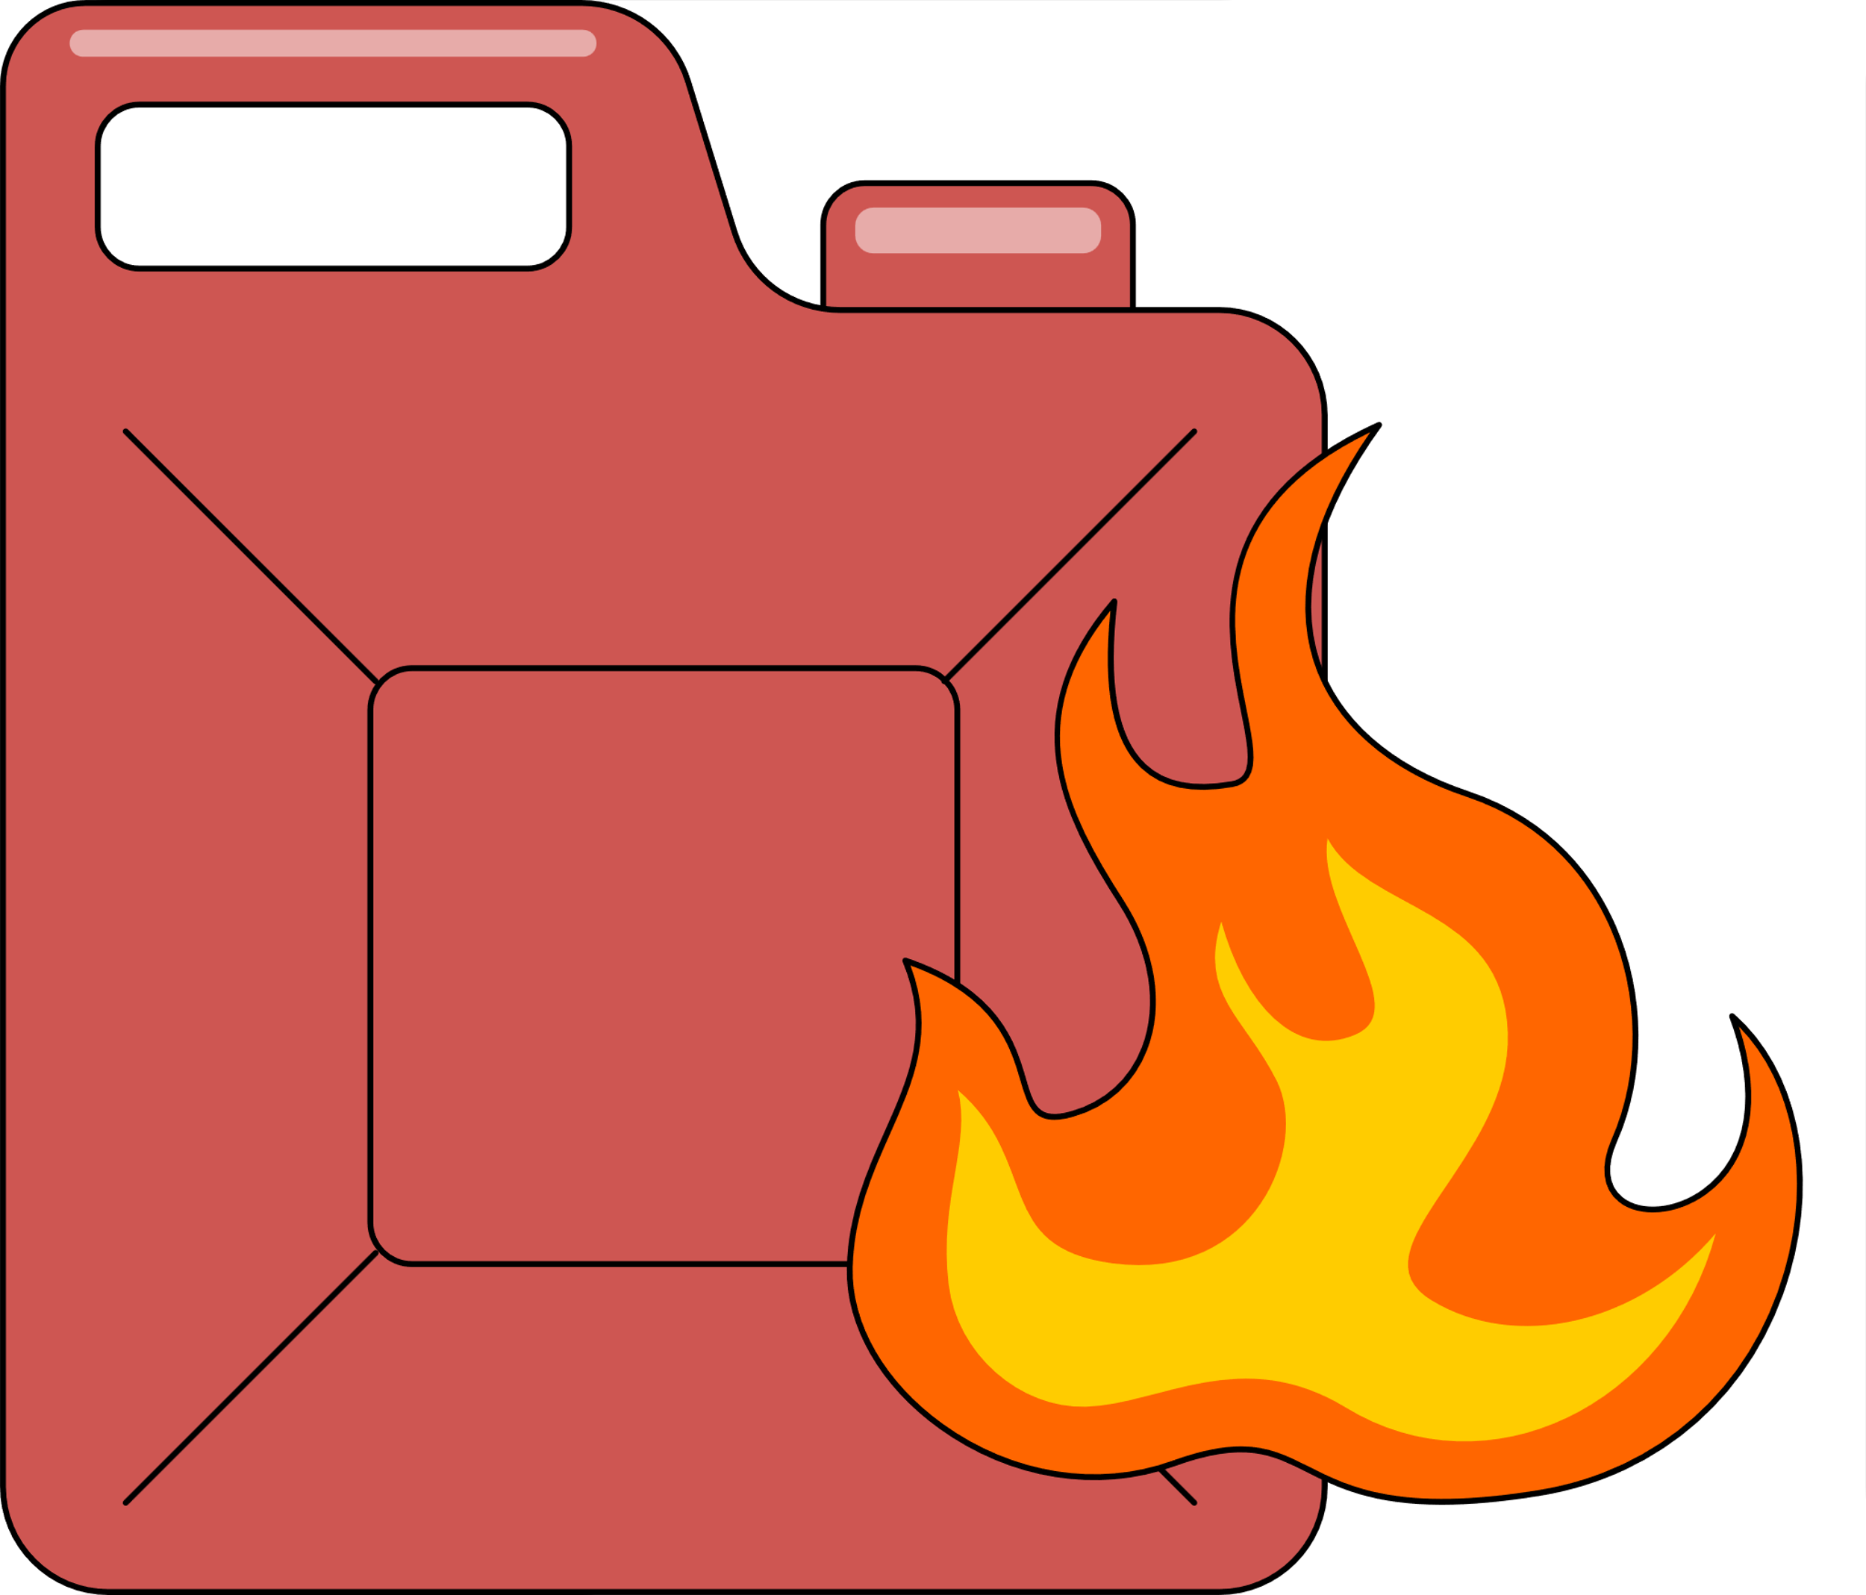
FLAMMABILITY
It is a measure of how quickly a specific material is capable of catching fire and burning.

Slide 11
WORKED EXAMPLE
Example: A piece of wood from a tree.
Wood is a natural material commonly used in construction and furniture-making. Wood is flammable and can easily catch fire when exposed to heat or flame. It burns relatively slowly, producing heat and light. Understanding the flammability of wood is crucial for fire safety in buildings and forests.

Slide 12
WORKED EXAMPLE
Example: A cotton ball.
Cotton is a natural fiber obtained from the cotton plant and is used in textiles, clothing, and medical supplies. Cotton is highly flammable and burns easily when ignited. It burns quickly and can produce a hot flame. Understanding the flammability of cotton is important for safety in clothing manufacturing, bedding materials, and medical applications.

Slide 13
WORKED EXAMPLE
Example: A metal paperclip.
A metal paperclip. Metals are solid materials characterized by their shiny appearance, conductivity, and strength. They include iron, aluminum, copper, and gold. Most metals are non-flammable and do not catch fire undernormal conditions. They have high melting points and are not easily oxidized.

Slide 14
WORKED EXAMPLE
Example: A metal paperclip.
Recognizing the non-flammability of metals is important for fire-resistantbuilding materials, electrical wiring, and industrial applications.

Slide 15
DAY 2
How Materials React with Other Materials

Slide 16
HOW MATERIALS REACT WITH EACH OTHER
When two or more materials come into contact, they may react and change in form, color, or composition. This happens because the substances combine or interact at a chemical level. Some reactions can cause heat, gas, or new substances to form. These changes are called chemical reactions.

Slide 17
WORKED EXAMPLE
Example: Rusting of iron.
Iron is a metal commonly used in construction and manufacturing. When iron comes into contact with oxygen and moisture in the air, it undergoes a chemical reaction known as oxidation. This results in the formation of iron oxide, also known as rust. Understanding the reaction between iron and oxygen is crucial for preventing corrosion in metal structures and equipment. Protective coatings and proper maintenance can help mitigate rusting.

Slide 18
WORKED EXAMPLE
Example: Foam production in a hydrogen peroxide and yeast experiment.
Hydrogen peroxide is a chemical compound often used as a disinfectant, while yeast is a microorganism used in baking and brewing. When hydrogen peroxide is mixed with yeast, the enzyme catalase in yeast catalyzes hydrogen peroxide's decomposition into water and oxygen gas. This reaction produces foam as a result of the release of oxygen gas bubbles.

Slide 19
WORKED EXAMPLE
Example: Foam production in a hydrogen peroxide and yeast experiment.
Understanding the reaction between hydrogen peroxide and yeast demonstrates the role of enzymes in catalyzing chemical reactions and is commonly used in educational experiments.

Slide 20
WORKED EXAMPLE
Example: Aluminum foil reacting with air.
Aluminum is a lightweight metal commonly used in packaging, construction, and transportation. When aluminum comes into contact with oxygen in the air, it forms a thin layer of aluminum oxide on its surface. This layer acts asa protective barrier, preventing further oxidation. Understanding the reaction between aluminum and oxygen helps prevent corrosion and volcano.

Slide 21
WORKED EXAMPLE
Example: Aluminum foil reacting with air.
Understanding the reaction between aluminum and oxygen helps prevent corrosion and maintain the integrity of aluminum-based products, such as aluminum foil and aluminum alloys used in aircraft construction.

Slide 22
WORKED EXAMPLE
Example: Weathering of limestone by acid rain.
Limestone is a sedimentary rock composed primarily of calcium carbonate. When limestone is exposed to acid rain, which contains sulfuric and nitric acids, it undergoes a chemical reaction called acid erosion. The acid reacts with the calcium carbonate in limestone, dissolving it and causing the rock to deteriorate over time. Understanding the reaction between acid rain and limestone highlights the environmental impact of air pollution on

Slide 23
WORKED EXAMPLE
Example: Weathering of limestone by acid rain.
natural rock formations, historical monuments, and building materials. The reaction between acid rain and limestone highlights the environmental impact of air pollution on natural landscapes and architectural heritage. It contributes to the degradation of limestone buildings, statues, and monuments, such as the limestone facades of historic buildings and sculptures in urban environments.

Slide 24
WORKED EXAMPLE
Example: Tarnishing of silver jewelry.
When silver comes into contact with sulfur compounds present in the air, water, or certain materials, it undergoes a chemical reaction called tarnishing. Understanding the reaction between silver and sulfur compounds helps explain the tarnishing process and guides the proper care and maintenance of silver objects and jewelry.

Slide 25
DAY 3
Degradable or Biodegradable

Slide 26
DEGRADABLE
Degradable materials are substances that can break down into smaller parts over time through chemical or physical processes such as exposure to sunlight, heat, or moisture. These materials may take a long time to decompose and may still leave harmful residues in the environment even after breaking down.

Slide 27
WORKED EXAMPLE
DEGRADABLE
Example 1: Plastic Straw
A plastic straw is a cylindrical tube made from plastic polymers, commonly used for drinking beverages. The plastic straw is degradable, meaning it can break down into smaller pieces over time when exposed to environmental factors such as sunlight, heat, and moisture. However, it does not break down into simpler substances through biological processes.

Slide 28
WORKED EXAMPLE
DEGRADABLE
Example 1: Plastic Straw
Over time, exposure to sunlight (UV radiation) and environmental stressors can cause the plastic straw to degrade physically, resulting in fragmentation into smaller plastic particles known as microplastics. These microplastics can persist in the environment for extended periods, posing risks to wildlife and ecosystems.

Slide 29
WORKED EXAMPLE
DEGRADABLE
Example 1: Plastic Straw
Understanding the degradability of plastic straws highlights the environmental challenges associated with plastic pollution and the importance of reducing single-use plastic consumption.

Slide 30
WORKED EXAMPLE
DEGRADABLE
Example 2: Polystyrene Foam (Styrofoam)
Polystyrene foam is a lightweight plastic material commonly used for packaging and food containers. Polystyrene foam is degradable, meaning it can break down into smaller pieces over time when exposed to environmental factors such as sunlight, heat, and mechanical stress. Exposure to sunlight (UV radiation) and physical abrasion can cause polystyrene foam to degradeinto smaller particles known as microplastics.

Slide 31
WORKED EXAMPLE
DEGRADABLE
Example 2: Polystyrene Foam (Styrofoam)
These microplastics can persist in the environment and pose risks to wildlife and ecosystems. Understanding the degradability of polystyrene foam highlights the environmental challenges associated with plastic pollution and the importance of reducing single-use plastic consumption.

Slide 32
WORKED EXAMPLE
DEGRADABLE
Example 3: Nylon Fishing Line
Nylon fishing line is a synthetic polymer material used for fishing and other recreational activities. Nylon fishing line is degradable, meaning it can break down into smaller pieces over time under environmental conditions. Exposure to sunlight (UV radiation) and mechanical stress can cause nylon fishing lines to degrade into smaller fragments.

Slide 33
WORKED EXAMPLE
DEGRADABLE
Example 3: Nylon Fishing Line
These fragments can persist in the environment and pose risks to aquatic life, such as entanglement and ingestion. Recognizing the degradability of nylon fishing lines underscores the importance of proper disposal practices and the use of eco-friendly alternatives to reduce environmental harm.

Slide 34
BIODEGRADABLE
Biodegradable materials are those that can naturally decompose through the action of living organisms like bacteria and fungi. They return to the environment as natural elements without causing harm, helping maintain ecological balance and reducing waste buildup.

Slide 35
WORKED EXAMPLE
BIODEGRADABLE
Example 1: Paper Towel
A paper towel is an absorbent sheet made from paper pulp, commonly used for cleaning and wiping surfaces. The paper towel is biodegradable, meaning it can be broken down by microorganisms into simpler organic compounds over time. When discarded in a compost pile or natural environment, microorganisms, such as bacteria and fungi, feed on the paper towel's cellulose fibers

Slide 36
WORKED EXAMPLE
BIODEGRADABLE
Example 1: Paper Towel
through the process of microbial decomposition. This process converts the paper towel into humus, a nutrient-rich organic material that enriches soil fertility. Biodegradable materials like paper towels can be composted, diverting organic waste from landfills and contributing to soil health and sustainable waste management practices.

Slide 37
WORKED EXAMPLE
BIODEGRADABLE
Example 2: Banana Peel
A banana peel is the outer protective covering of a banana fruit. It is biodegradable, meaning microorganisms can break down the peel into simpler organic compounds over time. When discarded in a natural environment, microbes in the soil decompose the peel through microbial degradation.

Slide 38
WORKED EXAMPLE
BIODEGRADABLE
Example 2: Banana Peel
The organic matter in the banana peel provides nutrients for soil organisms, contributing to soil health and fertility. Biodegradable materials like banana peels can be composted, returning nutrients to the soil and reducing waste sent to landfills.

Slide 39
WORKED EXAMPLE
BIODEGRADABLE
Example 3: Cotton Fabric
Cotton fabric is a natural textile material made from the fibers of the cotton plant. Cotton fabric is biodegradable, meaning it can be broken down by microorganisms into simpler organic compounds over time. When discarded in a natural environment, microbes in the soil decompose the cotton fabric through microbial degradation.

Slide 40
WORKED EXAMPLE
BIODEGRADABLE
Example 3: Cotton Fabric
The organic matter in the cotton fabric provides nutrients for soil organisms, contributing to soil health and fertility. Biodegradable materials like cotton fabric can be composted or naturally degraded, minimizing environmental impact and promoting sustainable waste management practices.

Slide 41
DAY 4
MAKING GENERALIZATIONS

Slide 42




Learners’ Takeaways

Slide 43

Outline in the concept map what they have learned in the lesson. Utilize the given concept map below:

Slide 44
You should be able to emphasize the following:

Slide 45
Flammability (Burnability): Some materials can catch fire and burn
when exposed to heat or flame. For example, wood, paper, and certain types of plastics can burn. This burning process is a chemical reaction where the material combines with oxygen in the air to produce heat and light. It's important to be cautious around flammable materials and to never play with fire.
Reactivity with Other Materials: Materials can react with each other
when they come into contact. This reaction can cause changes in the
materials involved. For instance, when iron (a metal) reacts with oxygen and moisture in the air, it forms rust. Similarly, when vinegar (an acid) is mixed with baking soda (a base), it produces bubbles of carbon dioxide gas. Understanding these reactions helps us predict how materials will behave when combined.

Slide 46
Degradability and Biodegradability: Materials can break down or
decompose over time due to various factors such as exposure to sunlight, air, water, or microorganisms like bacteria and fungi. Degradable materials eventually break down into smaller pieces, while living organisms can break down biodegradable materials into simpler substances. For example, food scraps, paper, and certain types of plastics are biodegradable, meaning they can be broken down naturally by bacteria and other organisms in the environment.

Slide 47
DAY 5
FORMATIVE ASSESSMENT

Slide 48
Direction: Read each question carefully. Identify the letter of the correct answer.

Slide 49
1. Which of the following best describes flammability?
A. The ability of a material to dissolve in water
B. The ease with which a material can catch fire and burn
C. The tendency of a material to react with oxygen in the air
D. The ability of a material to conduct electricity
2. What is an example of a flammable material?
A. Glass
B. Metal
C. Paper
D. Rock

Slide 50
3. When iron reacts with oxygen and moisture in the air, what does it form?
A. Aluminum oxide
B. Rust
C. Carbon dioxide
D. Hydrogen gas
4. Which of the following materials is biodegradable?
A. Plastic drinking straw
B. Nylon fishing line
C. Banana peel
D. Styrofoam packaging

Slide 51
5. What happens to a banana peel when it is discarded in a natural
environment?
A. It remains unchanged indefinitely
B. It decomposes into simpler organic compounds
C. It reacts with other materials to form new substances
D. It breaks down into smaller pieces over time
6. Sarah wants to dispose of her plastic water bottle. Plastic is harmful to the environment, so she wants to choose a more eco-friendly option. Which of the following materials should Sarah choose if she wants a biodegradable
option?
A. Plastic water bottle
B. Glass bottle
C. Aluminum can
D. Biodegradable paper cup

Slide 52
7. Tom is conducting an experiment in his science class. He wants to observe how different materials react with vinegar. Which of the following materials
is most likely to produce bubbles when mixed with vinegar?
A. Metal paperclip
B. Plastic drinking straw
C. Glass marble
D. Cotton ball
8. Emily is decorating her room and wants to hang up some pictures using metal nails. She is worried about the nails rusting over time. What can Emily do to prevent the nails from rusting?
A. Paint the nails with a waterproof sealant
B. Keep the room temperature low to slow down the rusting process
C. Use plastic nails instead of metal nails
D. Nothing, as rusting is inevitable for metal nails

Slide 53
9. David is helping his mom in the kitchen. She accidentally spills some lemon juice on the marble countertop. What is likely to happen to the marble over time?
A. The marble will remain unchanged
B. The marble will dissolve and disappear
C. The marble will develop stains and discoloration
D. The marble will react with the lemon juice to form a new substance
10.Anna is packing her lunch for school. She wants to use a material for her sandwich wrapper that will break down easily when discarded. Which of the following materials should Anna choose?
A. Plastic cling film
B. Aluminum foil
C. Biodegradable wax paper
D. Styrofoam container

Slide 54
ANSWERS SHOULD BE:

Slide 55
1. B
2. C
3. B
4. C
5. B
6. D
7. D
8. A
9. C
10.C

Slide 56
THANK YOU!

