Slide 1




SCIENCE 4 – QUARTER 1, WEEK 2
DAY 1-5
LESSON 2: IMPORTANCE AND IMPACT OF INVENTION ON EVERYDAY LIFE

Slide 2

LESSON OVERVIEW
1
Content Standard:
Science inventions have brought major changes to our daily lives.
2
Performance Standard:
Learners use science to solve problems and understand material changes.
3
Learning Objective:
Use information from home or the local community to identify a scientific invention and explain its impact on their everyday life..

Slide 3

DAY 1
How Inventions Help Us in Different Ways

Slide 4
At the end of the lesson, the learners will be able to:
1
Classify some of the inventions in terms of the areas of human life this has improved or helped.

Slide 5

Today, we will look into how varied inventions are and how this has helped the different areas of our lives.

Slide 6

LESSON PURPOSE
Instructions to the learners:
1. You get your bag and pull out at least 15 things you carried today. List those you have identified.
2. Group the objects into at least three groupings.

Slide 7
LESSON PURPOSE
Instructions to the learners:
3. When you are done, share it with your seatmate and make a drawing. An example would be,
4. Explain why you grouped the things you have in your bags that way. Each of you will have different ways and reasons for doing it.
This week, you will try to classify/group the different inventions into what area of human life this will be beneficial.

Slide 8

UNLOCKING CONTENT VOCABULARY: WHAT’S THE WORD
1. It is the movement of people and goods from place to place.

Slide 9

UNLOCKING CONTENT VOCABULARY: WHAT’S THE WORD
1. It is the movement of people and goods from place to place.
TRANSPORTATION

Slide 10
UNLOCKING CONTENT VOCABULARY: WHAT’S THE WORD
2. It is the gathering of information about the world and oneself.

Slide 11

UNLOCKING CONTENT VOCABULARY: WHAT’S THE WORD
2. It is the gathering of information about the world and oneself.
EDUCATION

Slide 12
UNLOCKING CONTENT VOCABULARY: WHAT’S THE WORD
3. It is a state of complete physical, mental, and social well-being, not
merely the absence of disease or infirmity.”

Slide 13

UNLOCKING CONTENT VOCABULARY: WHAT’S THE WORD
3. It is a state of complete physical, mental, and social well-being, not
merely the absence of disease or infirmity.”
HEALTH

Slide 14
UNLOCKING CONTENT VOCABULARY: WHAT’S THE WORD
4. It includes both growing and harvesting crops and raising animals or
livestock.

Slide 15
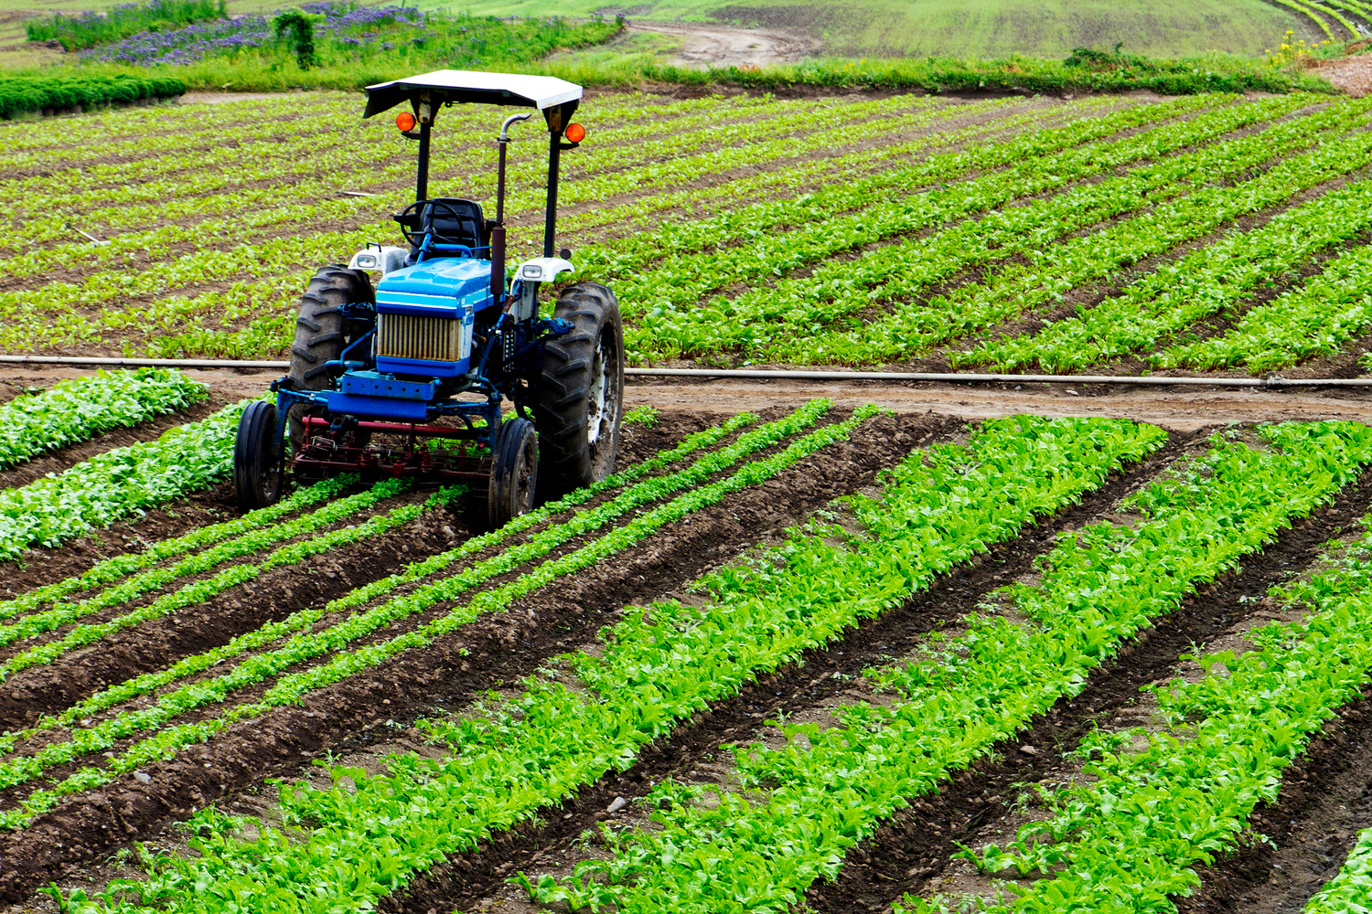
UNLOCKING CONTENT VOCABULARY: WHAT’S THE WORD
4. It includes both growing and harvesting crops and raising animals or
livestock.
AGRICULTURE

Slide 16
UNLOCKING CONTENT VOCABULARY: WHAT’S THE WORD
5. It is when people exchange various forms of meaning, such as ideas
and information, through a common system of symbols.

Slide 17

UNLOCKING CONTENT VOCABULARY: WHAT’S THE WORD
5. It is when people exchange various forms of meaning, such as ideas
and information, through a common system of symbols.
COMMUNICATION

Slide 18
UNLOCKING CONTENT VOCABULARY: WHAT’S THE WORD
6. It is a form of activity that holds the attention and interest of an
audience or gives pleasure and delight.

Slide 19

UNLOCKING CONTENT VOCABULARY: WHAT’S THE WORD
6. It is a form of activity that holds the attention and interest of an
audience or gives pleasure and delight.
ENTERTAINMENT

Slide 20
UNLOCKING CONTENT VOCABULARY: WHAT’S THE WORD
7. It refers to a family or group of people living together.

Slide 21

UNLOCKING CONTENT VOCABULARY: WHAT’S THE WORD
7. It refers to a family or group of people living together.
HOUSEHOLD

Slide 22
DAY 2
How Inventions Help Us in Different Ways

Slide 23
Health
Erythromycin
Electric mosquito repellant
3 in 1 Fire truck called Patriot
Inventions in health help protect people from diseases and save lives. They make it easier to treat illnesses and maintain good hygiene.
INVENTIONS UNDER EACH CATEGORY

Slide 24
Transportation
Plane
Steamboat
Jeepney
These inventions make travel faster and more convenient. They allow people and goods to move from one place to another easily.
INVENTIONS UNDER EACH CATEGORY

Slide 25
Education
Ballpen
Paper
Blackboard
Educational inventions help students learn better and faster. They allow teachers to explain lessons clearly and share information easily.
INVENTIONS UNDER EACH CATEGORY

Slide 26
Agriculture
Plow
Tractor
Irrigation Systems
These inventions help farmers grow and harvest crops efficiently. They improve food production and help reduce manual labor.
INVENTIONS UNDER EACH CATEGORY

Slide 27
Household
Refrigerator
Light Bulb
Vazbuilt Modular Housing
Electronic Door Opener
Household inventions make home life easier, cleaner, and more comfortable. They help with cooking, cleaning, and keeping food safe.
INVENTIONS UNDER EACH CATEGORY

Slide 28
Communication/Entertainment
Laptop
Projector
Television
Phonograph
Communication and entertainment inventions help people share ideas and stay connected, learn new things, and enjoy music or shows that keep life fun and relaxing.
INVENTIONS UNDER EACH CATEGORY

Slide 29
DAY 3
How Inventions Help Us in Different Ways

Slide 30
LESSON ACTIVITY
Instructions to the learners:
1. You will work on the same category you were assigned to report yesterday.
2. You are given 10 minutes to discuss among yourselves how the inventions have helped the people. You may research about it using your cellphone.
3. You can use the template found in the Worksheet for Activity 3 this week.

Slide 31
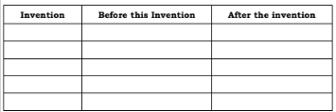
LESSON ACTIVITY
Instructions to the learners:
BENEFITS FROM THE INVENTION

Slide 32
LESSON ACTIVITY
REPORTING TO THE CLASS
After the group has worked on the assigned tasks, they will choose one member to report their answers to the whole class.
This will continue until all have shared their answers.

Slide 33
DAY 4
ACCIDENTAL INVENTIONS AND THEIR BENEFITS

Slide 34


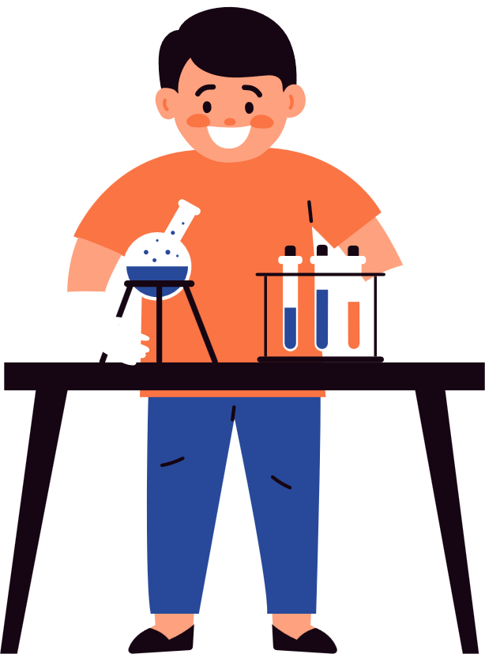
Matches - make it easy to start a fire.
FIFTEEN ACCIDENTAL INVENTIONS
Teflon - used to make non-stick pans
Potato Chips - provide a tasty and crispy snack.
Ice Cream Cones - let people eat ice cream easily
Coca-Cola - became a popular refreshing drink .

Slide 35
Post-it Notes - help people remember things.
FIFTEEN ACCIDENTAL INVENTIONS
Safety Glass - prevents serious injury.
Vulcanized Rubber - used to make strong and flexible tires.
Plastic - a lightweight and durable material.
Antidepressants - help people with mental health problems

Slide 36
Implantable Pacemaker - keeps heartbeat steady and regular.
FIFTEEN ACCIDENTAL INVENTIONS
Antibiotics - fight harmful bacteria and save lives.
X-rays - allow doctors to see inside the body.
Superglue - used to quickly fix broken objects.
Microwave Oven - heats and cooks food faster and easier.

Slide 37




Learners’ Takeaways

Slide 38
Share at least 3 of the 15 accidental inventions with your family members.
Take note of their reactions to your sharing.
________________________________________________________________________________________________________________________

Slide 39
Reflection on Learning

Slide 40
1. If you are to invent something, which issue or problem will you try to address?
________________________________________________________________________________________________________________________

Slide 41
DAY 5
FORMATIVE ASSESSMENT

Slide 42
Multiple Choice: Choose the letter of the correct answer from the given options and write your choice in CAPITAL letters. Answers will be written on a piece of paper and submitted to your teacher.

Slide 43
1. Which of the following inventions has greatly changed the way people communicate with each other?
a. laptop
b. television
c. cell phone
d. projector
2. Which of the following contributed to the improvement of health?
a. electronic mosquito repellant
b. electronic door opener
c. jeepney
d. steamboat

Slide 44
3. Identify from the list below, which DOES NOT belong.
a. patis
b. video phone
c. soyalac
d. banana ketchup
4. The following are examples of inventions in agriculture EXCEPT one, which
is it?
a. soyalac
b. banana ketchup
c. tractor
d. jeepney

Slide 45
5. Which of the following refers to the exchange of various forms of meaning, such as ideas and information, through a common system of symbols?
a. Health
b. Agriculture
c. Education
d. Communication
6. Which of the following refers to complete physical, mental, and social well-being, not merely the absence of disease or infirmity?
a. Health
b. Agriculture
c. Education
d. Communication

Slide 46
7. Identify from the list below, which DOES NOT belong.
a. refrigerator
b. stove
c. projector
d. burglar alarm
8. Identify from the list below, which DOES NOT belong.
a. Alexander Graham Bell
b. Agapito Flores
c. Gregorio Zara
d. Daniel Dingel

Slide 47
9. Which of the following will you use to help you in your studies?
a. laptop
b. projector
c. television
d. video phone
10. Who is known as the “Father of Video teleconferencing”?
a. Alexander Graham Bell
b. Agapito Flores
c. Gregorio Zara
d. Daniel Dingel

Slide 48
ANSWERS SHOULD BE:

Slide 49
1. D
2. A
3. B
4. D
5. D
6. A
7. C
8. A
9. A
10.C

Slide 50
THANK YOU!

