Slide 1
Multiple Language Implementations of Azure Functions in F#
Presented by Eriawan Kusumawardhono

Slide 2

About Me
A polyglot developer, focusing on functional programming
A Microsoft MVP on Visual F# (past 4 years) and Visual Studio Technology today
An author of F# High Performance book, published by Packt
Blog: http://fsharpmonologue.blogspot.com
MVP Profile: https://mvp.microsoft.com/en-us/PublicProfile/4040024

Slide 3
Intro to Azure Functions

Slide 4
Azure Functions overview
It was initially released as RTW in early November 2016
Based on Azure Functions portal, Azure function is: “An event-based serverless compute experience to accelerate your development. It can scale based on demand and you pay only for the resources you consume.”
It is actually a lighter version of Azure Webjobs, but without any needs of computing power that requires a machine (VM) instance, and it’s also calculated as usage of executions. This is why it’s called “serverless”
The official Azure Functions URL: https://azure.microsoft.com/en-us/services/functions/

Slide 5
Comparison to AWS Lambda as serverless app service
Azure Functions
AWS Lambda
Azure functions offer consumptions based and capped usage based (limited usage based on initial cap). It is calculated with transparent executions.
Azure Functions can be fully integrated into Visual Studio Team Services and TFS on premise as part of CI/CD process
GitHub integration is available
Support various programming languages such as C#, F#,Javascript,PHP, Powershell, Python
Versioning is done as part of the function, but it cannot differentiate as WebAPI version
Amazon Lambda is calculated as microsecond execution but it has complex metering on CPU
There is no apparent integration to any source control and version control
Support various programming languages: C#, Java, Javascript. Support for Python is still buggy
GitHub integration is still experimental
Versioning complies to any common WebAPI versioning

Slide 6
Implementations of Azure Functions

Slide 7
Ways to start develop Azure Functions
Directly code in Azure Functions’ Azure portal
Using Visual Studio with Azure SDK and Azure App tooling preview
Using Azure Functions CLI

Slide 8
Quick demo of Azure Functions in Azure portal

Slide 9
Multiple language support to implement Azure Functions
Azure Functions supports multiple language implementations, from C#, VB, F#, Powershell to other non-Microsoft’s such as PHP, Python

Slide 10
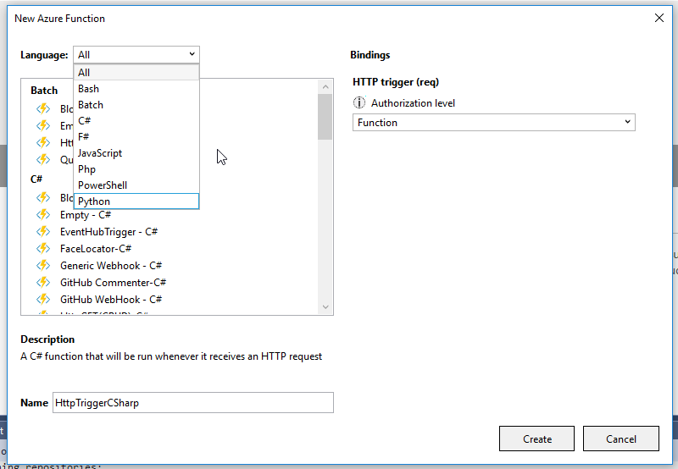
From within Visual Studio 2015 Update 3..

Slide 11
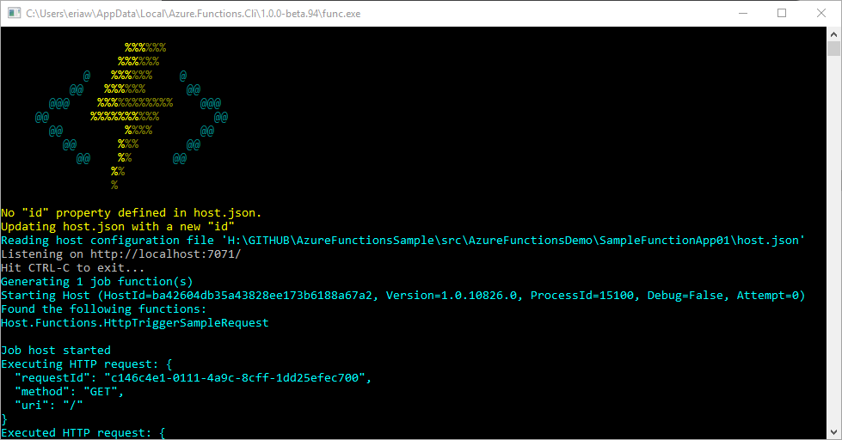

Slide 12
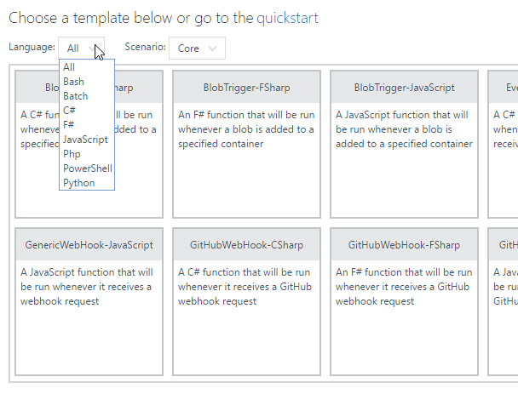
..to always updated language supports in Azure portal

Slide 13
Azure Functions Demo

Slide 14
Where to go about Azure Functions
Azure functions website: https://azure.microsoft.com/en-us/services/functions/
Azure functions documentation: https://docs.microsoft.com/en-us/azure/azure-functions/
Azure App Service team blog: https://blogs.msdn.microsoft.com/appserviceteam/

Slide 15
Q & A

Slide 16
End

