Slide 1
Best practices of .NET Core 3.0 CI/CD using Azure DevOps
By Eriawan Kusumawardhono

Slide 2

About me (Eriawan Kusumawardhono)
Based on Jakarta, Indonesia
Living with my wife, roaming around Jakarta and occasionally Singapore
Developer mentor and developer community servant 😊
Microsoft MVP since 2012. Initially Visual F# MVP (2012-2014), then Visual Studio MVP (2015), and now Developer Technologies (2016-now)
Currently works for Allegro Development

Slide 3
Where to reach me
Email: eriawan@live.com
Twitter: @erikuma
Blog: https://fsharpmonologue.blogspot.com
Slack: azure-devops-id.slack.com
LinkedIn: https://www.linkedin.com/in/eriawan-kusumawardhono/

Slide 4
Main topic
Build and test locally, with or without Visual Studio
Prepare and implement CI/CD build on Azure DevOps
DOs and DONTs on having CI (particularly on Azure DevOps)

Slide 5
Build and test locally

Slide 6
About .NET Core 3.0
The starting version of .NET Core that has Windows Forms and WPF
Based on .NET Standard 2.1
The tooling perspective is different from .NET Core 2.x and previous versions
Pay attention to actual SDK version first, instead of runtime version because of the tooling versioning “train” released with the SDK version

Slide 8
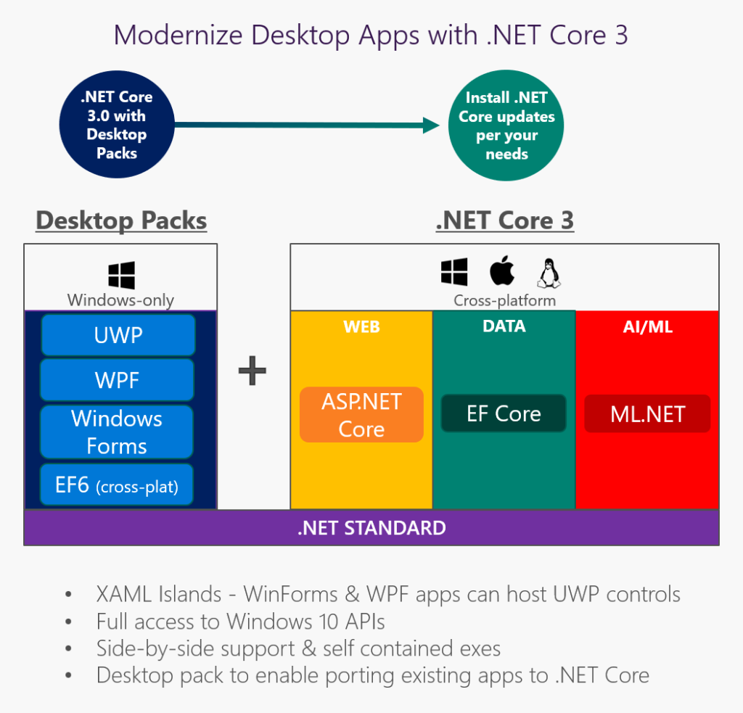
.NET Core 3.0 technology stack (from https://devblogs.microsoft.com/dotnet/net-core-3-and-support-for-windows-desktop-applications/)

Slide 9
Toolings perspective
There is a hard link between MSBuild version (hence Visual Studio update version), .NET Core SDK version, language compiler version and the nuget client version used. This is a tooling version link that is available since .NET Core 2.0
Current documentation on MS Docs only mention VS version, .NET Core SDK, and starting language compiler version
Do not use binding redirect, because binding redirect is valid only for .NET Framework project and assembly resolution.
By default, .NET Core 2.0 or later will use latest version available as assembly resolution when compiled. This is different from .NET Framework 4.0 or later, that use stricter model.

Slide 10
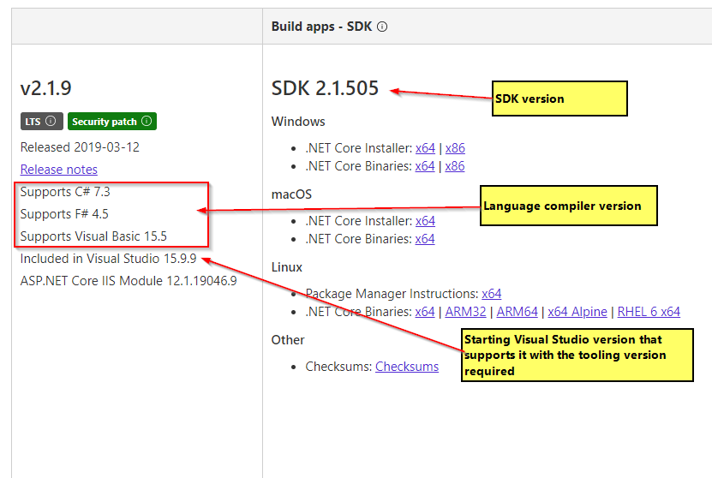
Tooling version train example

Slide 11
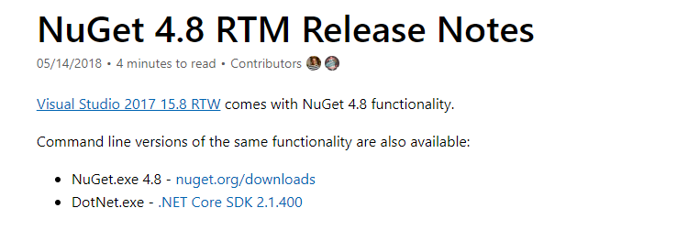
The implicit tooling requirement of nuget

Slide 12
Importance of ensuring successful build locally
Having whole build to quickly check at command prompt before creating PR and going through CI will ensure catching up build warnings and error early, not trapped within Visual Studio.
Good practice of knowing MSBuild necessary compile parameters to in sync with CI build.
The better way is scripted. For example: MS usually has scripted “build.cmd” (or “build.sh” on Linux) to compile their .NET Core FX codebase that functions equally when having CI

Slide 13
Ensuring successful local build
Define the .NET Core SDK version in global.json in the codebase folder. Usually, this means the root of the repo. Do not define the global.json in the project folder, as this will apply the SDK version for that folder only.
The .NET Core SDK version specified should dictate the version used in CI later. At least, it should be used as guidance that it is used by codebase successfully, and it is to avoid confusion when the codebase is compiled on different machine with different SDK installed.
If you want to target multiple version of .NET Core, then it is not recommended to use global.json to drive SDK version used to build
Do the build on command prompt first, not just on Visual Studio. This will ensure successful CI build.
Before build, use separate dotnet restore (or nuget restore) if we use other third party nuget
Pay attention on the version compatibility of the third party nuget used. For example: avoid third party libraries that use explicit .NET Standard before 1.6. Check the dependencies before using it, and then check against the version used by .NET Core 2.1. See https://apisof.net to check further

Slide 14
Additional guideline for nuget package developer
Declare dependency explicitly
Enforce minimum nuget toolkit version to be at least 4.8 to be able to publish nuget package to nuget.org. See also: https://docs.microsoft.com/en-us/nuget/install-nuget-client-tools#cli-tools
Enforce the minimum nuget toolkit can be set in the nuspec. Consult the nuspec doc at: https://docs.microsoft.com/en-us/nuget/reference/nuspec#general-form-and-schema
Always pay attention on how you will version your nuget

Slide 15
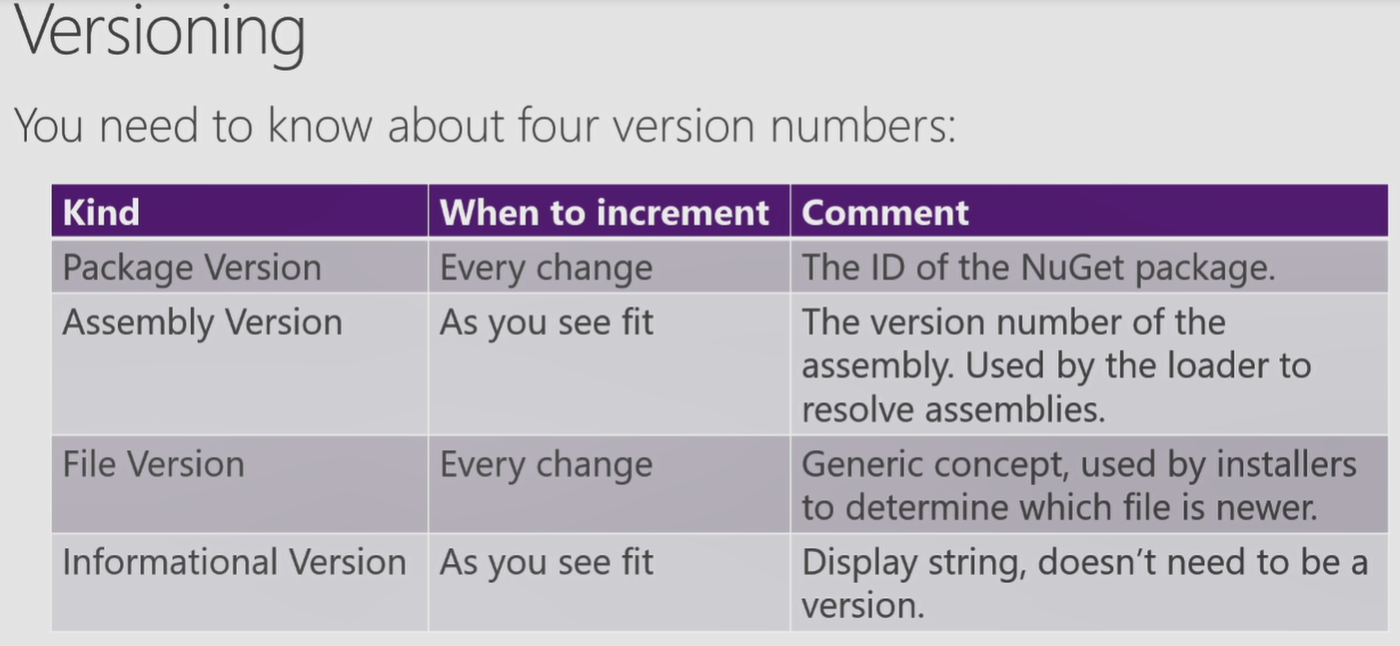
Quick guide on versioning your project/libraries and package as well (from Immo’s dotnetconf 2018 video)

Slide 16
Further notes and reference for .NET Core SDK and runtime version specific
If you want to focus on runtime specific environment, use specific runtime version by adding this XML element inside your csproj: <RuntimeFrameworkVersion>. For example: <RuntimeFrameworkVersion>3.0.0</RuntimeFrameworkVersion>
Do not mix the wrong SDK version in global.json with the runtime if you want to have both. For example: if the SDK use 3.0.100, then the runtime should only use the .NET Core runtime of version that is related or equal with the SDK release or previous but with the same 3.0.x version, such as 3.0.0 or 3.0.1 is still valid or compatible.
Refer to this official docs for use cases scenario: https://docs.microsoft.com/en-us/dotnet/core/versions/selection

Slide 17
Demo on build locally

Slide 18
Prepare and implement CI/CD on Azure DevOps

Slide 19
Guidelines on implementing .NET Core 2.x CI on Azure DevOps
Use YAML whenever possible. Pros: greater control on what’s going on. Cons: learning curve of migrating from build designer habit.
Use Visual Studio related agent. On Azure DevOps Pipeline, there are three agent that focus on having Visual Studio installation: VS2015, VS2017 on Windows 2016, and VS2019 on Windows 2019 (currently in Preview). We must focus on VS2017 and later instead, for .NET Core 2.x.
Create CI first (with unit test support whenever possible) before creating CD, and ensure that the CI environment meets your development environment and configurations

Slide 20
Notes on Azure DevOps YAML
Main focus is to be used in Azure Pipelines build (as CI)
Support multiple jobs in one YAML file, and each job can use different agent. It is strongly recommended to have multiple job if we are going to have support for different OS/platform, such as VS 2017 on Windows and Linux to ensure and check that we won’t break the build before doing deployment.
Having multiple jobs in one YAML can be used to effectively use the default free build hours if we need to do other things especially if we want to have environment checks before doing the actual build.

Slide 21
DOs and DON’Ts of Azure DevOps Pipelines

Slide 22
DO these in Azure DevOps Pipelines
Always check for the agent installed SDK specification and its runtime
Watch for any changes in the state of installed SDK, especially .NET Core SDK.
For more detail, check the actual version of the installed SDK by looking at the repo of Azure Pipeline agent image on GitHub: https://github.com/Microsoft/azure-pipelines-image-generation
Always check for installed VS 2017 version on the agent, at least on the installed MSBuild
Watch for agent deprecations

Slide 23
Optional DOs for Azure DevOps
If you use Azure Repo and Git, opt in to use GVFS (Git Virtual File System) to leverage optimized git flows for repo with many files (more than 1M files) and many branches (more than 1K branches) that has total cloned size of more than 1GB. See

Slide 24
DON’T do for Azure Pipelines
DO NOT depends heavily on .NET Core that is not supported anymore.
DO NOT use MSBUILD task to build solution without restoring nuget first. When you have to use MSBUILD task on Pipeline builds, use separate nuget task to restore the package first. But for “pure” .NET Core projects in a solution, it is better to use dotnet build to build your solution.
DO NOT assume that you can always build successfully to have nice cross platform on both Windows and Linux when you have dependency on third party libraries. Always examine the dependencies of the third party libraries first.
DO NOT depends heavily for cached image containers

Slide 25
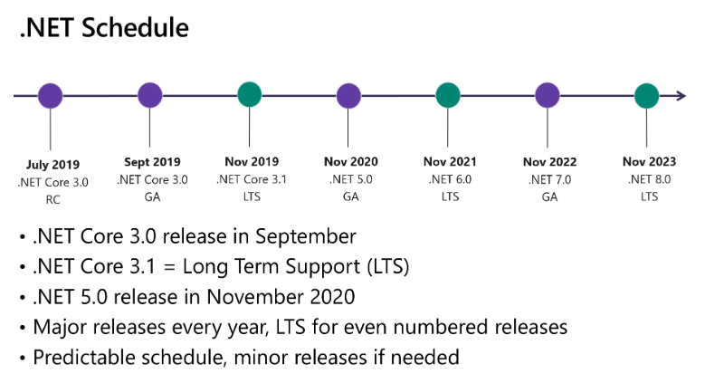
.NET Core after 3.0 and future
https://devblogs.microsoft.com/dotnet/introducing-net-5/

Slide 26
Q & A

