Slide 1
What’s new in C# 12
Presented by Eriawan Kusumawardhono

Slide 2

About me (Eriawan)
MS MVP since 2012, focusing on Developer Technologies (F#/C#/VB, .NET Core, Azure DevOps, opensource)
LinkedIn: https://www.linkedin.com/in/eriawan-kusumawardhono/
Github: eriawan
Active member and committee member of .NET Foundation’s OSS Project onboarding committee. Please ask me for support for OSS .NET project di GitHub

Slide 3
Topics
Overview of .NET 8.0
What’s new in C# 12
Q & A

Slide 4
Overview of .NET 8.0
.NET 8.0 was released on November, 2023 on .NET Conf 2023
It is an LTS release, that has support for three years since first release
The default programming languages and toolings supported always have versions usually in sync with .NET release. In .NET 8.0, C# is version 12, F# is version 8. VB is still versioned as VB 15
It is also in sync with Visual Studio releases. For example: .NET 8.0 was released at the same time with Visual Studio 2022 17.8.0 and this is the minimum version that supports .NET 8.0

Slide 5
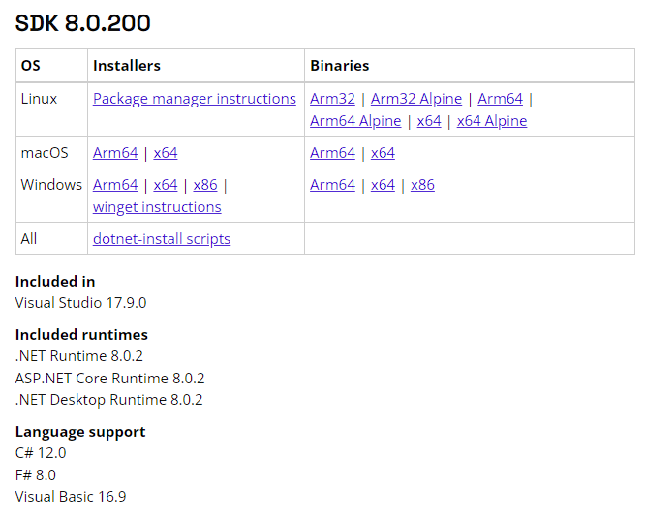
Versions in .NET SDK 8.0.200

Slide 6
What’s new in C# 12
Collection Expressions
Supports Primary constructors
The “ref” readonly parameters
Inline arrays
For more details, see also https://learn.microsoft.com/en-us/dotnet/csharp/whats-new/csharp-12

Slide 7
Interesting features for today
Collection expressions
Primary constructors

Slide 8
DEMO

Slide 9
Q &A

Slide 10
END
Download this presentation and codes is available at: https://bit.ly/eriawanspeak2024

