Slide 1
INTRODUCTION TO MEDICAL STATISTICS
LÄA110 Thesis course Autumn 2023
Adnan noor Baloch
School of Public Health and Community Medicine
The Sahlgrenska Academy
2023-08-21
Notes:
The lectures are not standalone or self-sufficient.
Based on earlier experience, I would say it will not be enough to attend the lectures, you must go through lecture slides & recommended literature.
You will also need hands on practice, try to solve the exercises in the book, and go to computer sessions

Slide 2
Structure
We statisticians are involved the following parts of the cousre.
Three introductory lectures on study design, descriptive statistics, hypothesis testing etc.
Project plan seminars
Computer exercises (book in advance)
SPSS basics
Questionnaires – designing & analysis
Statistical tests : t-test, ANOVA, some non-parametric tests
Regression analysis
Workshops (book in advance, 2 occassions) – work with your own data, project
Notes:
This is how the statistics part of the course is organized, we will have 3 introductory ……
During the three sessions, my focus will be introducing basic statistics, concepts & principle behind some commonly used statistical analysis methods in medical research. Medical research can be clinical research, laboratory research or epidemiological studies.
The most important thing during the lectures, will be the basic principles in medical statistics and some guidance

Slide 3
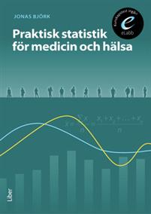
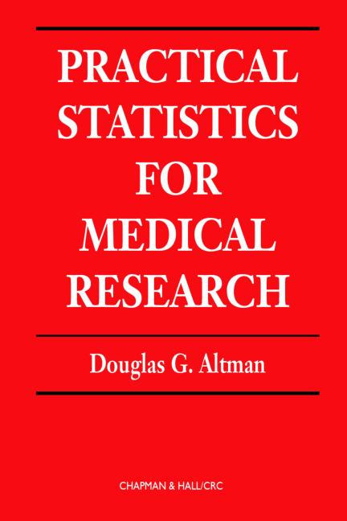

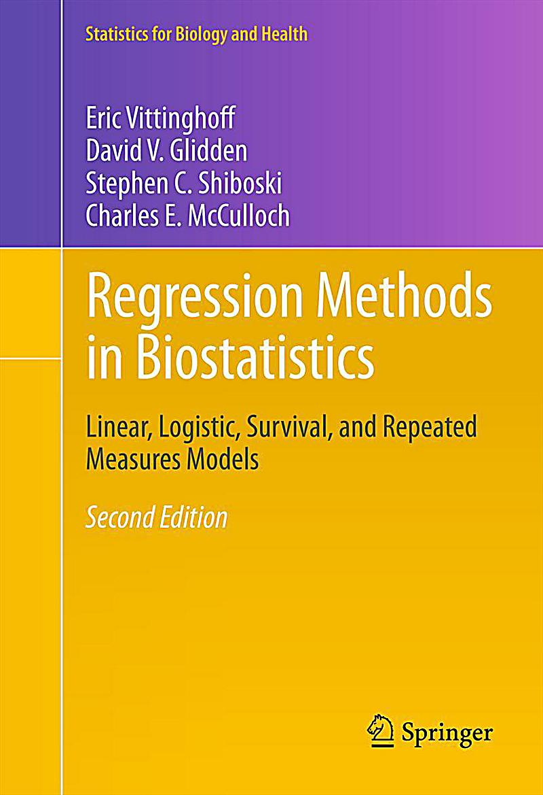
Tips on books & online resources
Praktisk statistik för medicin och hälsa (Jonas Björk)
Practical Statistics for Medical Research (Douglas G. Altman)
SPSS for Applied Sciences (E-book at GU-Library)
About regression analysis: Regression Methods in Biostatistics (Vittinghoff, Glidden, Shiboski & McCulloch, e-book at GU Library)
Online resource to learn SPSS
Online resource to learn STATA
Notes:
Search the books (3 & ) in GU-Library and navigate further to read online
In Swedish = PRAKTISK STATISTIK FÖR MEDICIN OCH HÄLSA” by Jonas Björk A good introduction to basic statistics
Vittinghoff. E.. Glidden. D.. Shiboski. S.. & McCulloch. C. (2012) is a gentle & detail introduction to Regression analysis with STATA
Regression Methods in Biostatistics (Statistics for Biology and Health). Boston. MA: Springer US.

Slide 4
Why statistics in medical research?
“Incidence of cardiovascular disease in rural and urban areas”
Rural = 91 out of 4920 = 1.85%
Urban = 64 out of 4965 = 1.29%
How do we interpret these results?
Do you think there is an association?
Notes:
Let’s look at an example from Cardiovascular disease epidemiology
A sample between 25-74 years old was analyzed. The participants were classified
Rural = community with less than 10,000 inhabitants
Town/intermediate= community with more than 10,000 inhabitants & less than 50000
Urban/City living = in a larger community, >50,000 inhabitants
The focus was on the difference between Rural and Urban areas and the incidence of CVD was
Rural = 91 out of 4920 individuals
Urban = 64 out of 4965 individuals
How do you interpret these results ? Do you think there is an association between living & incidence of CVD?
If we had 80 vs 75 incidence in Rural & Urban living, respectively. We would have thought that there is no-association, and this small difference is due to chance
Or if we had 145 vs 10 incidence in Rural & Urban living, respectively. With such large difference we would have thought that there exists an association.
But with the given situation we cannot decide using our simple intuition we have to use statistical theory to answer our research question.

Slide 5
We need statistics, we have 2 pieces of information
Place of residency (Rural vs. Urban)→ predictor variable
CVD (Yes or No)→outcome variable
Difference in proportion = 0.5% percentage points with a 95% confidence interval of (0.07% ── 1.05%)
Chi-square test (p =0.02)
 | 155 | 9 730 | 9 885
Yes
No
Total
4 829
4 901
Rural
91 (1.8%)
4 920
Urban
64 (1.3%)
4 965
Notes:
Is 0.5% Clinically relevant?
A sample between 25-74 years old was analyzed. The participants were classified
Rural = community with less than 10,000 inhabitants
Urban/City living = in a larger community, >50,000 inhabitants

Slide 6
There is an association → Difference in proportion = 0.5% (0.07%, 1.05%) and Chi-square test (p =0.02)
Is 0.5% difference clinically relevant difference?
8705 excess cases (452756 – 36572)
Yes
No
Total
Rural
45 276
2 447 909
Urban
54 744
4 246 925
Notes:
8705 excess cases (452756 – 36572)
Rural vs Urban areas Scenario-2 (Whole Sweden sample)
Yes sum
Rural = 1,8% 45 276 2 447 909 expected 36 572 (1.5%)
Urban = 1,3% 54 744 4 246 925 expected 63 449 (1.5%)
-------------------------------------------------------------
100 020(1.5%) 6 694 834
Uncorrected Chi-Sq 3315,73
P-value 0,00000

Slide 7
What is statistics?
The science that studies the methods necessary to compile, analyze and interpret data.
In research, statistical theory can be used as a help when constructing studies, collecting data and drawing conclusions.
Medical statistics deals with applications of statistics in medicine, health sciences and epidemiology.
Notes:
In research projects, we generally follow the following steps
Planning→ Design (sampling, sample size calculation) → Data collection → Analysis → Results → Interpretation → Presentation
Statistical knowledge & thinking contribute already in planning and designing phase of research projects
Statistics is very helpful already from the very beginning of research work, in deciding study designs, sample size calculations

Slide 8
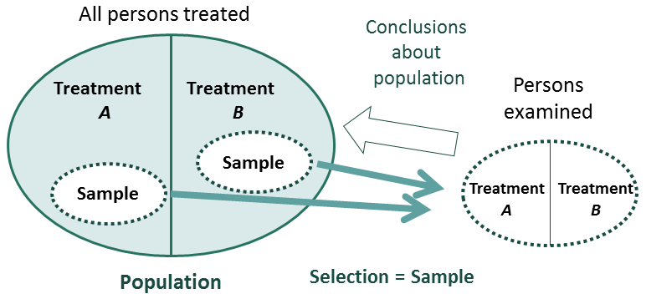
Introduction: Why use statistics?
There is a variation in the results
Practically and/or Ethically impossible to collect data from the whole population
How to deal with uncertainty in a sample?
How to use what we observe in a sample to make inferences about the population?
(Based on figure 1.2 in the JB)
Notes:
All the bold letter are statistical terms,
Statistics is useful and necessary in situations when we expect a variation in result. What does it mean to have “To have a variation in the results” ?
Knowledge in Statistics also helps us to critically analyze results from other researchers' projects.
Sample surveys are used to infer about a large population by analyzing data from a smaller part of the population.
Using samples causes some degree of statistical uncertainty! Maybe results we observe may be due to chance.
What we observe in a sample (the mean height, the improvement of a condition due to a treatment) does not automatically reflect what happens in the general population, unless the sample is well chosen (in which case is called representative of the population).

Slide 9




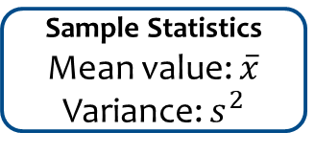
Population and sample
Mean value: μ
(e.g. average survival time)
Variance: σ²
Population Parameters
Population
Inference (“an educated guess”)
Sample data is used to draw conclusions about the population
i.e. the sample statistics is estimates of the population parameters
Sample Statistics
Mean value: $\overline{x}$
Variance: $s^{2}$
Sample
Notes:
Note that population parameters often are denoted by Greek-letter, while Latin-letters often are used for sample statistics.
A common aim of statistical analysis is to produce information or deduce about some chosen population based on sample based characteristics

Slide 10
Population and sample
Population
Sampling frame (urvalsram)
Over coverage (Övertäckning)
Under coverage (Undertäckning)
Coverage error (Ramfel)
Sample (Urval)
Sampling observation (Urvalsenhet)
Sampling methods (Urvalsmetod)
Drop out (Bortfall)
Notes:
Let’s discuss some important statistical terminolgy (definations) and see what can go wrong in sampling
Population is a set of similar units of interest for some research question or result of an experiment.
In statistical inference, a statistical sample is chosen to represent the population in a statistical analysis. Statistical inference helps us to estimate the population parameters using the appropriate sample statistics.
Sampling is the selection of a sample from the population to estimate characteristics of the whole population. We pick sampling unit (observations) from a sampling frame, which may or may not have under- or over coverage.
Which can be due to Times lags between the moment the sample frame was created and it was actually used; failure to include new births /immigration in the frame; failure to remove deaths/emigration
Under coverage = not including all units from our statistical population
Over coverage means that our sampling frame consists of elements which do not belong to our target population

Slide 11
Statistical Population
Vi want to make conclusion about the population
Newborns babies,
diagnosed with bacterial sepsis, during 2023
Notes:
We are interested in a “population”, satisfying some conditions/characteristics.
For example, patients diagnosed with some condition, Blue colored workers, Students enrolled in medical programs in Sweden
Here we have

Slide 12
Sampling units
Sampling units are observations
Here we have units from our population
and some observations outside our population
Notes:
We are interested in a “population”, satisfying some conditions/characteristics.
For example, patients diagnosed with some condition, Blue colored workers, Students enrolled in medical programs in Sweden
Here we have

Slide 13
Over and under coverage
Over coverage
under coverage
Notes:
We are interested in a “population”, satisfying some conditions/characteristics.
For example, patients diagnosed with some condition, Blue colored workers, Students enrolled in medical programs in Sweden
Here we have

Slide 14
Sampling methods
Simple random sampling
Systematic sampling
Stratified sampling
Cluster sampling
Case-control or choice-based sampling
Voluntary Sampling
Convenience sampling
Notes:
A random sample is fundamental for statistical inference.
A gold standard when drawing a sample is to be: -
Unbiased: Every subject in the population has an equal opportunity of being selected in the sample. –
Independent: choosing a subject is totally independent of the other subjects that are in the sample. Counter-example: You select people in your sample and for those that are married you include also their spouse.
Then every 2 people in a couple are dependent.
In a simple random sample (SRS) has every subject in the population has an equal opportunity of being selected to the sample. A ”Gold standard”. SRS is Obundet Slumpmässigt Urval (OSU) in Swedish.
Systematic sampling is to choose elements from a sampling fram in a systematic way. E.G. every third students, every 1oth person in the patient/population registry.
In stratified sampling is the population divided into non-overlapping subpopulations called strata and a number of subjects are then randomly selected from each strata. E.g. All girls’ names in an urn, and all boys’ name in another urn, and then a SRS from each urn.
Cluster sampling, the population is divided into already formed subgroups (clusters), a sample of such clusters is drawn. And either the whole clusters or a SRS from each clusters is selected. Cluster sampling is normally used when it is more practical to select a group of individuals instead of single individuals. This could be the case if you would like to select school children in all of the country and you need to meet them in person. 1000 children selected individually will be scattered throughout the country, but selecting 40 school classes each with 25 children would simplify your data collection.
Voluntary Sampling: Volunteers choose to complete a survey. Who are they? Are they representative of our population
Convenience sampling : the sample being drawn from that part of the population that is close to hand.

Slide 15
Drop outs
Breakoff
Unit Nonresponse
Notes:
Breakoff = start the survey but fail to complete it, resulting in survey breakoff
Unit Nonresponse = A respondent may not start the survey(not participate in clinical examination), resulting in unit nonresponse

Slide 16
Keep in mind
The conclusions are never better than the sample.
Always be clear as to what population(s) your statistic is meant to generalize to.
Don't imply that your sample generalizes to everyone if your statistic was calculated from a more specific population!
E.g., If your sample included only medical college students, you could not generalize your results to all students
Notes:
all students = students from Engineering, Humanities, Law, Natural sceinces etc.

Slide 17
Parameter, Statistic and Estimate
Population parameter is descriptive statistics (numeric summary) of some attribute of a population (e.g., the population mean)
Sample statistic (singular) is descriptive statistics summary of some attribute of a sample (e.g., the sample specific mean)
Parameter estimate are sample specific attribute (statistic) which we assume as estimates/representative for the population parameters
Notes:
numeric summary = calculated from the data

Slide 18
Variables
Characteristic of an object that can be quantified (measured) and that can vary, between or/and within object (in contrast to a constant that always have the same value)
Independent variable is measured, manipulated, or selected with the purpose to determine its relationship to the dependent variable.
The dependent (outcome) variable is often “the star of the show”. The aim of our study is usually to answer whether or not outcome variable is affected by our independent variable/s.
Notes:
Any measureable characteristic is variable

Slide 19
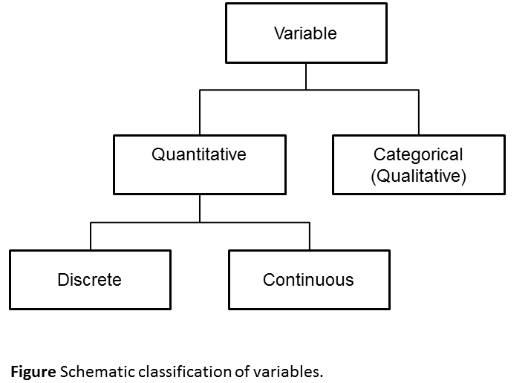
Types of variables
Notes:
Quantitative data: is based on data that can be measured.
E.g. blood pressure measurements. number of pregnancies. body weight
Continuous: possible values are infinite (Sv: obegränsat)
Discrete: there is a finite number of possible values (one can calculate the number of possible values) – For example: number of pregnancies
Qualitative/Categorical data is based on data that can be described.
E.g. quality of sleep (bad/acceptable/very good). smoking status (yes/ no)

Slide 20
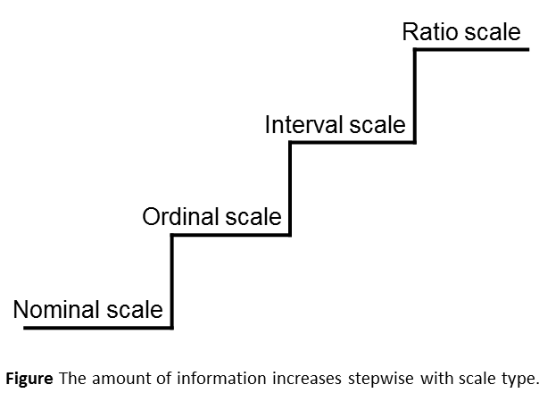
Levels of measurement
The type of scale the variables are measured on influences the choice of statistical methods for analyzing the data.
Notes:
Qualitative/Categorical data is based on data that can be described. And are on
Nominal scale: No particular order
Ordinal scale: Has a natural order
Quantitative data: is based on data that can be measured.
E.g., blood pressure measurements. number of pregnancies. body weight
Interval scale has a natural order and a defined “distance”
Ratio scale (you can take ratios and they make sense). It has a natural order and “distance” and a “Zero-value”

Slide 21
Types of scales
Categorical data
Nominal scale: Name, Gender, color, brand
Is the ”lowest” level. No particular order
Ordinal scale: Good-Better-Best, Age category
Has a natural order
Interval scale: Temperature
Has an natural order and a defined “distance” (negative, 0, positive)
Ratio scale: Weights
Has an natural order, “distance” and a “Zero-value”
Quantitative / Numerical data
Notes:
Note: The interval scale has also a zero-value as the ratio scale. And can take negative and positive values
The difference is that a variable on the interval scale can have values to the left and right of the zero-value;
Variables on a ratio scale can’t take values lower than the zero-value. Only Positives
If ratios of 2 measurements has a meaning and makes sense then Ratio scale.
Does “Zero” has a meaning? Zero kelvin (−273.15 °C) is defined as absolute zero.
https://en.wikipedia.org/wiki/Absolute_zero
What do you think about “Degree of pain”? Scale?

Slide 22
Relative & Absolute measurements
Absolute measurements (numbers with units) e.g., 100 cm or 5 kg. All quantitative variables have absolute measurements. Absolute measurements should always include the unit of measure
Relative measurements tell us the relationship between two measurements with the same unit. Ex: “youth unemployment's has decreased by 16% since last year.” Relative measurements are ratios. The most common relative measurement is %.. Can only be used for variables with ratio scale.
If possible, always report the at least one of absolute measurement compared with the relative measurement.

Slide 23

Descriptive statistics
Notes:
Any statistic is classified as being either descriptive or analytical.
Descriptive statistics gives, as it’s name reveals, a description of the data sample. This include for example graphs, mean values, median values and different measurements of variation (how far or close values are from the mean, for example).
The purpose of descriptive statistics is to summarize or describe a data set. Researchers use these statistics to describe or characterize the population or sample being studied.
To do an analysis, analytical statistics, or inferential statistics, is needed. The aim of analytical statistics is to draw conclusions about a population based on the data at hand. For example if a difference between two groups is statistically significant, i.e. if the difference is larger than could be expect to occur randomly.

Slide 24
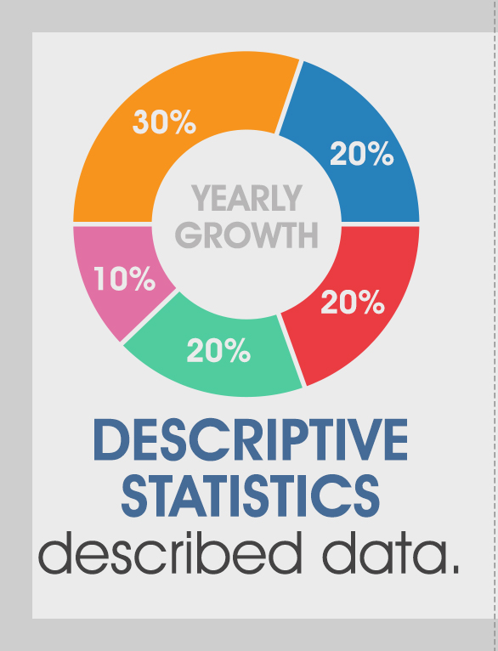
Descriptive statistics
Simple, easy to read, summaries about the sample, without losing vital information.
Together with simple graphical illustrations, they form the basis of virtually every quantitative analysis of data.
Descriptive statistics do not involve generalizing beyond the sample
Notes:
Descriptive statistics is about describing/summarizing the collected Data
It can be numerical(numbers in table) and/or graphical (histograms, box-plots, bar diagram)
NOTE: Analytical(Inferential) statistics is about drawing conclusion from the collected data

Slide 25
Descriptive statistics – categorical data
Qualitative/Categorical variables, e.g., smoking status
Bar diagram and Frequency tables with
Count (number of obs. in each category) and
Proportion (proportion of obs. in each category)
Notes:
Descriptive statistics is about describing/summarizing the collected Data
Numerical Descriptive statistics describing data by numbers in tables
Graphical Descriptive statistics describing data by diagrams. E.g. Histograms, Box plots etc.
Categorical variables
Frequency tables (frequency & proportions) and Bar diagram

Slide 26
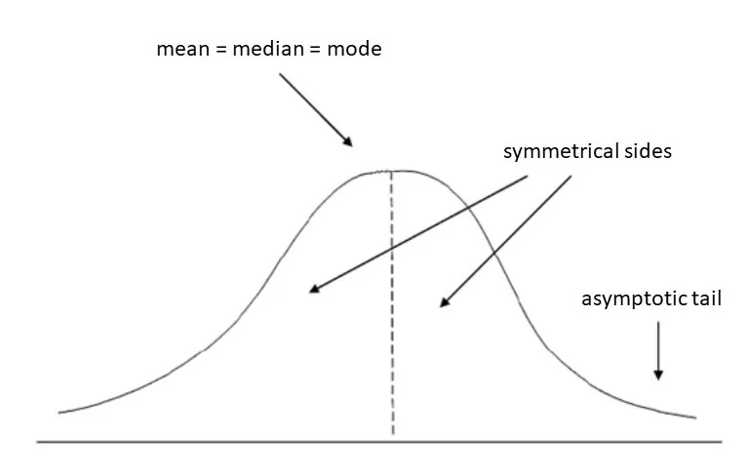
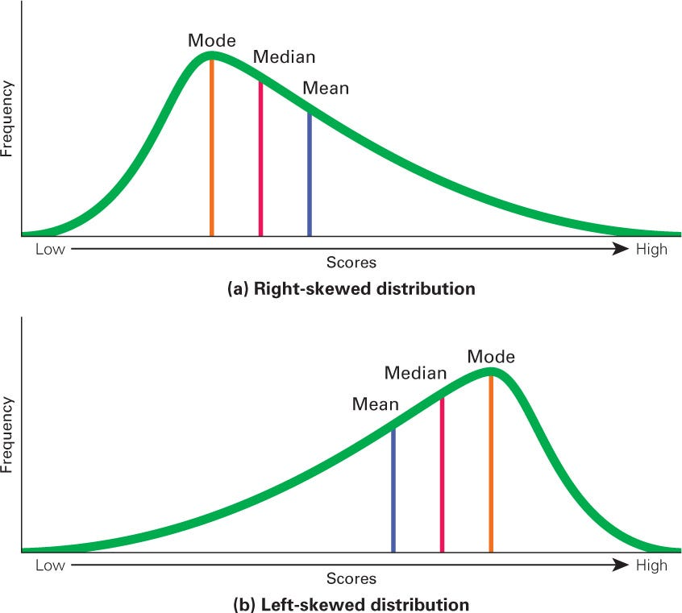
Descriptive statistics – quantitative data
Plot histogram → approximatively symmetric
Location: Enough with either mean or median
Spread: Standard deviation
Skewed distribution
Location: Median
Spread: minimum-maximum (range),
or Inter quartile range (3rd - 1st quartile)
Notes:
Descriptive statistics is about describing/summarizing the collected Data
Numerical Descriptive statistics describing data by numbers in tables
Graphical Descriptive statistics describing data by diagrams. E.g., Histograms, Box plots etc.
Continuous variables
Parametric methods
Central tendency (läge) = Mean,
Dispersion: (spridning) = How spread the values are from the “center” = Standard deviation
95% confidence intervals
Histograms to check normality of data
Non-parametric methods
Central tendency (läge) = Median
Dispersion: (spridning) = How spread the values are from the “center” = 2nd and 3rd Quartiles or Inter-quartile range
Box plots

Slide 27
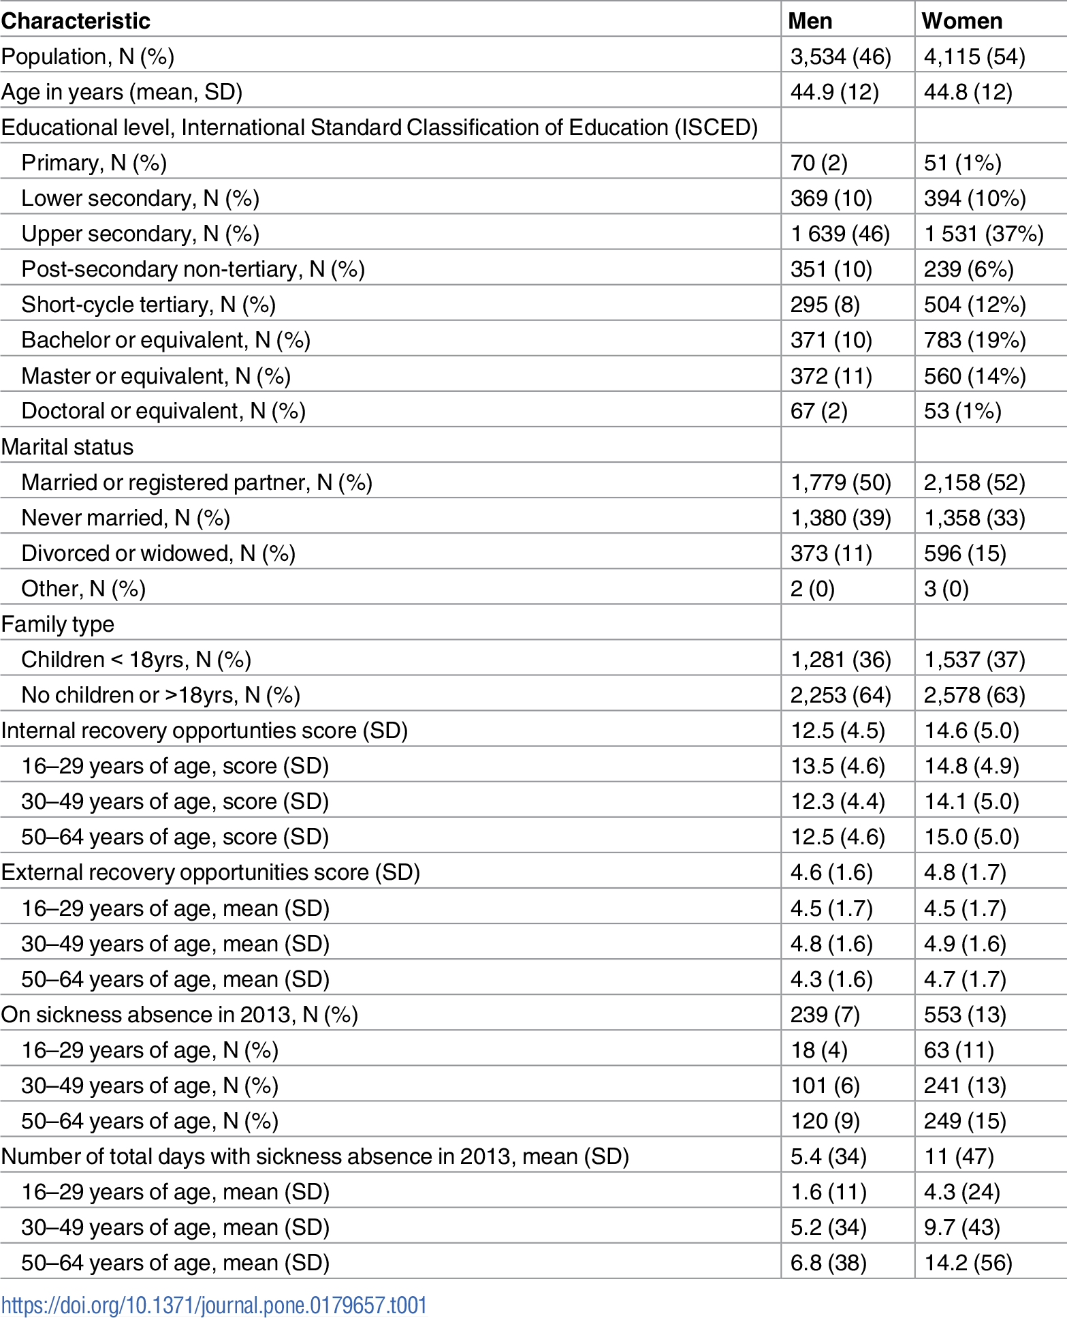
Example 1: Descriptive Statistics
Reference: The mediating role of recovery opportunities on future sickness absence from a gender- and age-sensitive perspective J. S. Boschman et al. (2017)
Notes:
Mean and standard deviation for continuous variable AGE (s
Frequency tables with frequency & proportions for each category of qualitative variable MARITAL STATUS

Slide 28
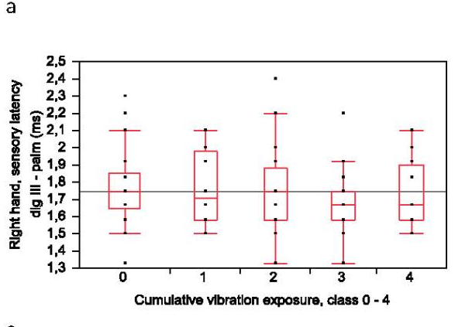
Graphical Descriptive statistics
Reference: Nerve conduction in relation to vibration exposure - a non-positive cohort study. Helena Sandén et al. (2010)
Notes:
A box plot describing Median, 1st quartile and 3rd quartile of
Sensory Nerve conduction
sensory latencies in right hand between unexposed (0) and exposed (1-4 classes with cumulative lifetime exposure ) subjects

Slide 29
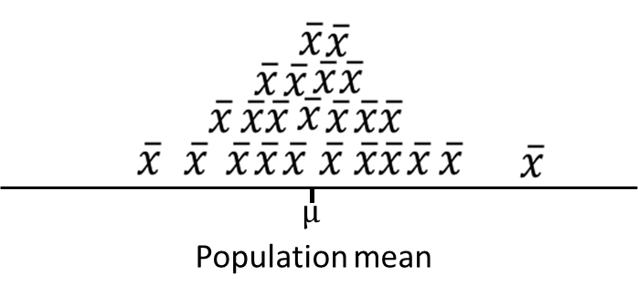
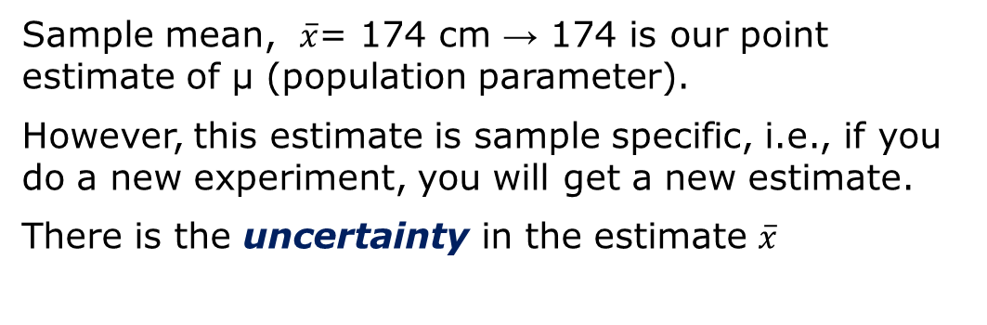
Point estimate and uncertainty
Sample mean, $\overline{x}$= 174 cm → 174 is our point estimate of μ (population parameter).
However, this estimate is sample specific, i.e., if you do a new experiment, you will get a new estimate.
There is the uncertainty in the estimate $\overline{x}$
A distinctive function of statistics is this: it enables the scientist to make a numerical evaluation of the uncertainty of his conclusion. George W. Snedecor
Notes:
THE STATISTICAL PART OF THE SCIENTIFIC METHOD
George W. Snedecor
First published: March 1950
https://doi.org/10.1111/j.1749-6632.1950.tb53972.x

Slide 30
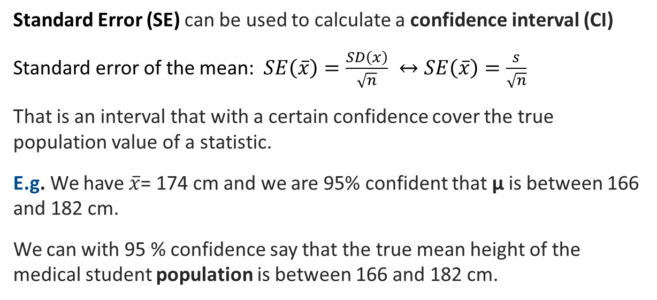
Confidence intervals (CI)
Standard Error (SE) can be used to calculate a confidence interval (CI)
Standard error of the mean: $SE\left(\overline{x}\right)=\frac{SD\left(x\right)}{\sqrt{n}} ↔SE\left(\overline{x}\right)=\frac{s}{\sqrt{n}}$
That is an interval that with a certain confidence cover the true population value of a statistic.
E.g. We have $\overline{x}$= 174 cm and we are 95% confident that μ is between 166 and 182 cm.
We can with 95 % confidence say that the true mean height of the medical student population is between 166 and 182 cm.

Slide 31
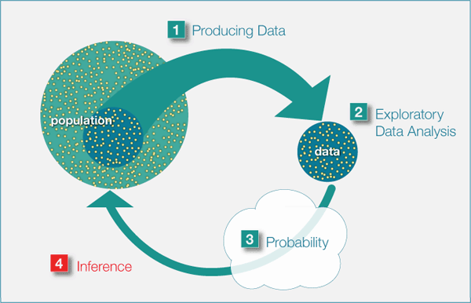
Statistical Inference : Hypothesis testing

Slide 32
Statistical inference
Statistical inference is drawing conclusion about the population-based characteristics of the sample.
There two types of statistical inferences:
Hypothesis testing (using a test/CI)
Estimation (confidence interval)
Notes:
In this lecture we will talk about Hypothesis testing.

Slide 33
Hypothesis testing
The idea is that we have a question about the population that we want to try to answer with a statistical test.
A requirement of any statistical test is to formulate a null hypothesis (H₀) and an alternative hypothesis (H₁).
Notes:
You start by sets up a null hypothesis (H₀)
You want to be able to discard / reject H_{0 ,} e.g. no effect / no difference between groups
If H₀ is rejected, only the alternative hypothesis should remains (H₁).
H₀: No effect
H₁: An effect
That is, H₀ and H₁ should be formulated so that if one is false the other must be true.

Slide 34
Hypothesis testing
Formulate
Null hypothesis (H₀): Often cautiously formulated; can never be proven; considered true until disproved
Alternative hypothesis (H_{A}): includes everything except the null hypothesis
You decide a significance level, e.g. 5%
Test the hypothesis using a statistical test, which results in a p-value
If p-value below level of significance (decided a priori) reject (H₀) else, we do not have enough evidence to reject H₀
Notes:
An hypothesis is a statement about the population that can either be true or false.
The null hypothesis (H₀):
Is considered true until disproved
Can never be proven
Often cautiously formulated
The alternative hypothesis (H₁):
Includes everything except the null hypothesis
Is in other words, rather vaguely formulated
The significance level (α) should be chosen before any analyses are done.
It specifies the highest acceptable risk for erroneously rejecting H₀ (i.e. making a type 1 error).
E.g. the significance level of a 95% CI is 0.05 (1-0.95) or 5%
We accept that 5% of our CIs won't cover the true value, hence lead us the a wrongful conclusion.

Slide 35
Parametric and non-parametric tests
The type (quantitative, qualitative) and the distribution of the outcome variable
Parametric tests: the outcome variable is, E.g., normally distributed; mean and standard deviation are parameters
You test assumptions about the parameters at population level (ex: mean)
Non-parametric tests: you don’t know (can’t assume) any distribution for the outcome variable
You test assumptions about the population independent of any distribution (ex: median or the whole distribution)
Notes:
When you have formulated your hypotheses, you might want to test them.
Choice of statistical test depends on the type of variable (quantitative, qualitative) and the distribution of the variable
Parametric tests: the variable is, for ex, normally distributed; mean and standard deviation are parameters
You test assumptions about the parameters at population level (ex: mean)
Non-parametric tests: you don’t know (can’t assume) any distribution for the variable
You test assumptions about the population independent of any distribution (ex: median)

Slide 36
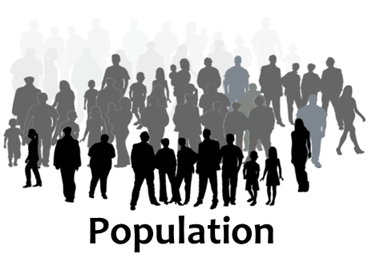

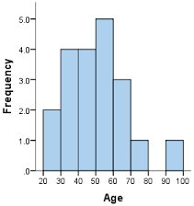
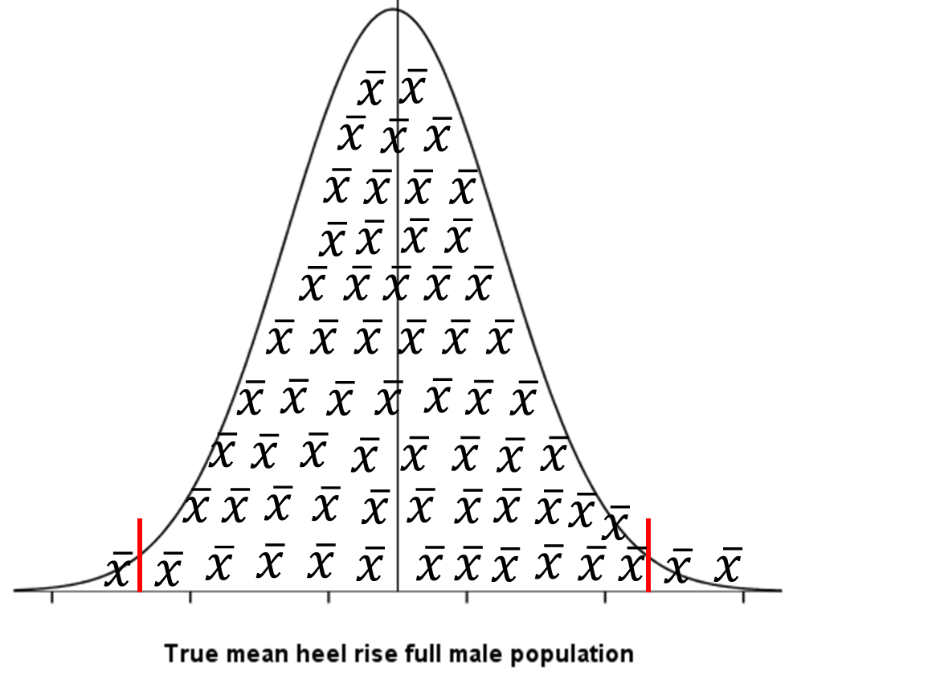
Distributions
Distribution of the population
Distribution of a sample
The only observable one.
The larger sample the closer will
the distribution of the population
Distribution of sample statistic (sampling distribution)
E.g. the sample mean has a normal distribution for a normally distributed variable or large enough sample
Notes:
A sampling distribution is the frequency distribution of the sample statistics.
The standard error of the mean is the standard deviation of sample means. It is a measure of how representative a sample mean is likely to be of the population mean.

Slide 37
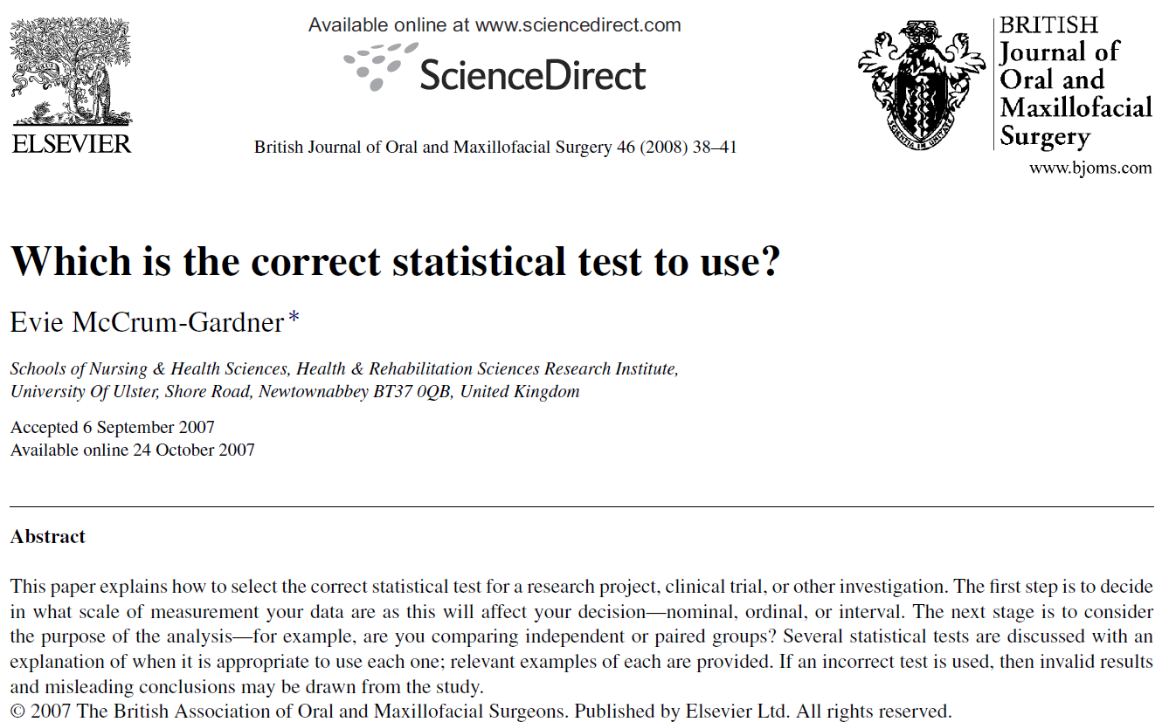
Notes:
Which is the correct statistical test to use? By Evie McCrum-Gardner
British Journal of Oral and Maxillofacial Surgery 46 (2008) 38–41

Slide 38
The Central Limit Theorem (CLT)
CLT says something like this:
The mean of a sufficiently large sample of quantitative data will be normally distributed, independent of the distribution of the sample.
This will be the truth if n tends to infinity
Also, about right for relatively small samples, if the distribution is fairly symmetric
Take advantage of this when testing and constructing confidence intervals!
Notes:
The central limit theorem says that if we repeatedly take infinitely large sample from a population, the mean values ​​of these samples will ALWAYS be normally distributed, regardless of how the original variable's distribution looks like. Since we rarely have infinitely large sample, we can be happy that this rule applies approximately long before: even for a sample of 30-50 observations, it becomes reasonable to assume normal distribution given that the variable’s distribution is not very far from the normal distribution. In the example of oxygen uptake, we had a sample of 397 individuals - it means that our statistical model is reasonable if the oxygen uptake doesn´t have a very skewed distribution. It is hard to say where exactly the line between how 'normally distributed' a sample needs to be and how large the sample size needs to be in order to apply the central limit theorem. In determining this, it is always good to draw a histogram of the data no matter how large the sample is; if nothing else, it will help you detect the existence of outliers and other errors (incorrectly entered data items, for example). If the study is very small, say n <20, it is necessary to know in advance that the variable you are interested in is normally distributed based on previous data (for example, from published studies). At a sample size of 20-50 observations, it is possible to use the normal distribution if the data is reasonably symmetrical. If the data have a skewed distribution, larger sample sizes are needed, see later examples. One may also consider transforming skewed data so that they become more symmetrical prior to analysis. This could be done by applying mathematical transformations to the data points, for example.
Centrala gränsvärdessatsen säger att om vi upprepade gånger tar oändligt stora stickprov från en population kommer medelvärdena av dessa ALLTID vara normalfördelade, oavsett hur variabelns fördelning ser ut. Eftersom vi sällan har oändligt stora stickprov så kan vi vara glada över att detta gäller approximativt långt innan – redan vid ett stickprov på 30-50 börjar det blir rimligt att anta normalfördelning förutsatt att variabelns fördelning inte är väldigt långt från normalfördelningen. I exemplet med syreupptagningsförmågan hade vi ett stickprov på 397 individer – det betyder att vår statistiska modell är rimlig om inte syreupptagningsförmåga hade en väldigt skev fördelning. Var gränsen går i balansen mellan hur ’normalfördelat’ ett stickprov behöver vara och hur stor stickprovsstorlek som behövs för att tillämpa centrala gränsvärdessatsen går inte att säga rakt av. När man skall avgöra detta är det alltid bra att rita upp ett histogram på materialet oavsett hur stort stickprov man har – om inte annat än för att det finns andra fel (felaktigt inmatade data ex) man kan upptäcka. Om undersökningen är mycket liten, n<20 så krävs det att man på förhand känner till att variabeln man är intresserad av är normalfördelad. Vid 20-50 brukar det normalt sett gå att använda normalfördelningen om data bara är någorlunda symmetrisk. Om data har en sned fördelning kan större stickprovsstorlekar behövas, se senare exempel. Man kan också överväga att transformera skeva data så att de blir mer symmetriska innan analysen.

Slide 39
Paired-samples
Typically three situations that give rise to paired observations:
Two different variables on same individual, e.g. creatinine in blood & in urine.
Measurements taken on the same individual at different time points, e.g. before & after treatment
Matched case-control studies, for every treated patient we find a non-treated person with similar observable characteristics, to assess the treatment effect
In all these cases, there will be a dependence between observations in the different groups.
Notes:
There are typically three situations in medical research that give rise to paired observations:
Comparing two different variables on the patient, e.g. comparing creatinine levels in blood and in urine.
Comparing measurements taken on the same patient , but at two different time points, e.g. before and after intake of medicine.
Matched case-control studies, in which for every treated patient, we try to find a non-treated person with similar observable characteristics against whom the effect of the treatment can be assessed.
In all these cases, there will be a dependence between observations in the different groups.

Slide 40
Two independent samples
With independent groups, the way to calculate the t-test and the confidence intervals is slightly different.
Similar assumptions:
Normally distributed groups or
Large enough sample sizes
Same standard deviation in the two groups
(There is an alternative t-test for different standard deviations)

Slide 41



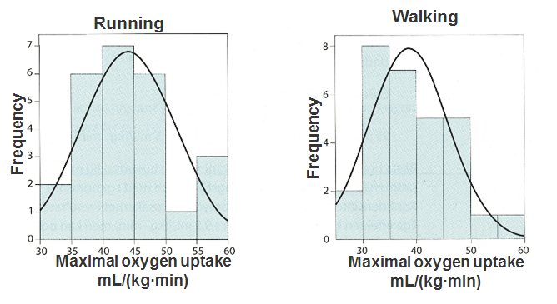
Exempel: VO2 max
Compare the maximal oxygen uptake (VO₂ max) for people with running or walking as their main form of exercise
Figure Maximal oxygen uptake for n₁=25 persons with running as primary source of exercise and for n₂= 29 persons with walking as there primary source of exercise
Notes:
maximal oxygen uptake (VO2 max) is a quantitative (continous) variable.
Draw a histogram. Are histograms aproximately symmetric?

Slide 42
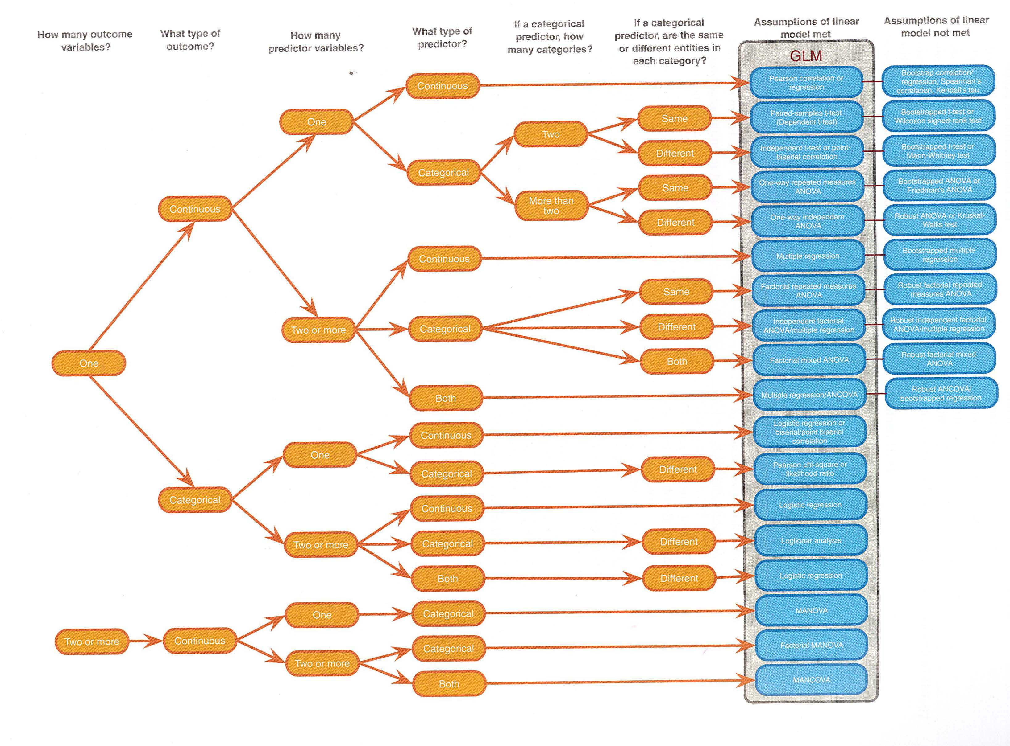
Discovering Statistics Using IBM SPSS Statistics by Andy Field 5th Edition ISBN-13:978-1-5264-1952-1
Notes:
This is a guide to choose which statistical test to use to answer an specific research question.
Discovering Statistics Using IBM SPSS Statistics
5th Edition page: 1072
ISBN-13:978-1-5264-1952-1
How to select the correct statistical test for a research project. clinical trial. or other investigation. The first step is to decide in what scale of measurement your data are as this will affect your decision—nominal. ordinal. or interval.
The next stage is to consider the purpose of the analysis—for example. are you comparing independent or paired groups?
If an incorrect test is used. then invalid results and misleading conclusions may be drawn from the study.
Scale of measurements; Parametric Assumption; Paired or un-paired data;

Slide 43
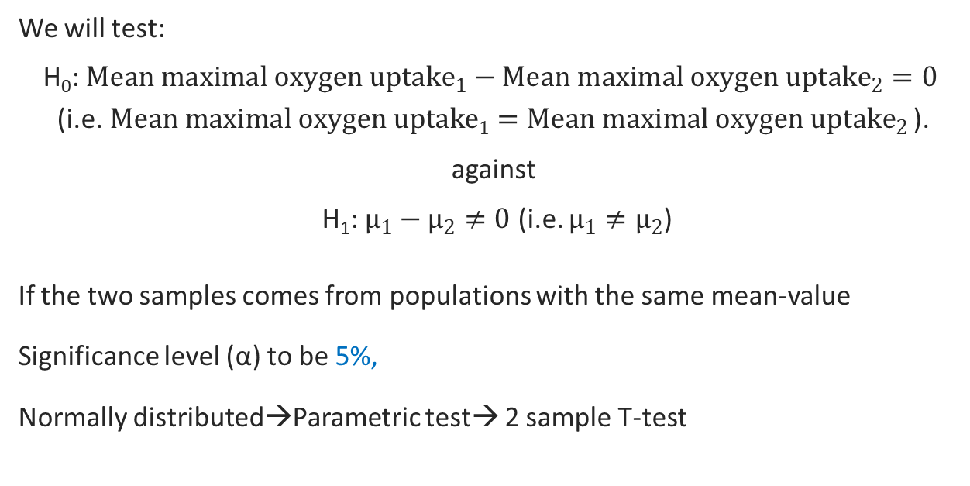
Exempel: VO2 max
We will test:
H₀: ${Mean maximal oxygen uptake}_{1}−{Mean maximal oxygen uptake}_{2}=0$ (i.e.$Mean maximal oxygen uptake1={Mean maximal oxygen uptake}_{2}$ ).
against
H₁: $µ_{1}−µ_{2}≠0$ (i.e. $µ_{1}≠µ_{2}$)
If the two samples comes from populations with the same mean-value
Significance level (α) to be 5%,
Normally distributed→Parametric test→ 2 sample T-test

Slide 44
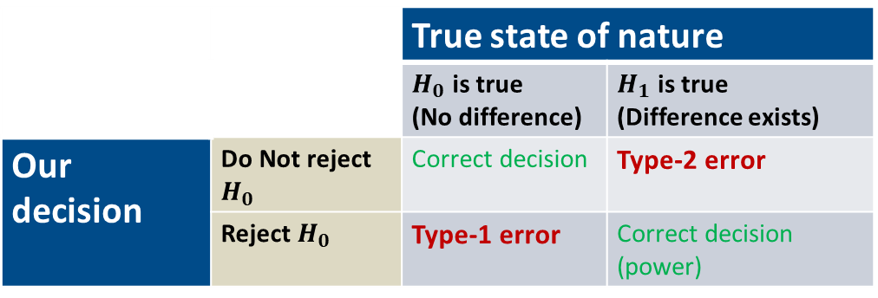
Type of errors associated with hypothesis testing
 |  | True state of nature
 |  | $H_{0}$ is true (No difference) | $H_{1}$ is true (Difference exists)
Our decision | Do Not reject $H_{0}$ | Correct decision | Type-2 error
 | Reject $H_{0}$ | Type-1 error | Correct decision (power)
Type 1 Error: The probability (α) to reject H₀ when H₀ is true. “False Positive”
Type 2 Error: The probability (β) to not reject H₀ when H₀ is false. “False Negative”
The Power of a test (1- β) is the probability to reject H₀ when H₀ is false.
Notes:
Reject the null hypothesis Potential Type I error: rejection of true H₀
We believe there is an effect of treatment, when in reality there is not.
Fail to reject the null hypothesis Potential Type II error: not rejection of false H₀
We believe there is no effect of treatment, when in reality there is.
Power = Probability of rejecting H₀ when it is false and is equal to (1-β).
We have higher tolerance for Type-2 error, as in this case we conclude there does not exist differences in therapy/operation etc. even in reality there do exist differences
A simple consequence will be not implementing the therapy.
On the other hand we have a lower threshold for Type-1 error, Why?

Slide 45
Some common simple tests
Selection of test
Quantitative outcome
Ordinal outcome
Binary
outcome
Comparison
of Variance
Comparison
of Means
Comparison
of Medians
Comparison of Frequency
Two or more independent groups
One group
Two or more independent groups
Paired Data
One group
Two or more independent groups
Paired Data
Two or more independent groups
Paired Data
Levene's test
One-sample
t-test
(7.2 in book)
Independent two-sample t-test,
ANOVA
(8.2-8.3 in book)
Paired sample t-test
(8.1 in book)
Sign test
(10.2 in book)
Mann-Whitney,
Kuskal-Wallis
(10.4-10.5 in book)
Sign test,
(10.3 in book)
Chi-square test,
Fisher's exact test
(12.3 in the book)
McNemar's exact test
(12.4 in the book)
Figure Flowchart with examples on which statistical tests to use for different kind of data.
Notes:
Adopted from Figure 8.1 and figure 10.2 from “PRAKTISK STATISTIK FÖR MEDICIN OCH HÄLSA” av Jonas Björk

Slide 46
Things to consider when choosing statistical test
All statistical tests have assumptions.
Properties/statements that are assumed to be true and that YOU need to check.
There almost always assumptions about:
Type of variables
Dependencies between observations.
Paired (dependent) data
Independent data
Eg., Mann-Whitney U test – Independent groups
Notes:
The non-parametric tests also have assumptions.
E.g. Mann-Whitney U test is for two independent groups
Chi-square test can only be used for categorical data

Slide 47
Null hypothesis and the P-value
P-values evaluate how well the sample data support the null hypothesis.
Hence, no null hypothesis, no p-value.
It can be seen as the answer to the question:
How well do my data support the null hypothesis?
If we do not know the null hypothesis, the answer is of little use to us.

Slide 48
The interpretation of p-values
Technically, the p-value is the probability to draw an equally or even more extreme sample than the one we have, assuming that the null hypothesis is true.
In other words, probability of observing the observed or larger differences, if null hypothesis was true.
Notes:
A test of the null hypothesis will result in a p-value.
Definition for p-value for testing a hypothesis about 𝛍:
The probability of observing the value of $\overline{x}$ that we did observe, or an even more extreme value, given that H₀ is true.
The p-value (p) is a measure of the strength of evidence in the observed data against H₀
The p is a probability → 0 < p < 1
The basic idea is that if p is lower that the significance level than you reject the null hypothesis
The p-value is then called significant

Slide 49
The interpretation of p-values
The p-value doesn’t say anything about the probability that a hypothesis is true, neither does it measure support for the alternative hypothesis.
Notes:
A test of the null hypothesis will result in a p-value.
Definition for p-value for testing an hypothesis about 𝛍:
The probability of observing the value of $\overline{x}$ that we did observe, or an even more extreme value, given that H₀ is true.
The p-value (p) is a measure of the strength of evidence in the observed data against H₀
The p is a probability → 0 < p < 1
The basic idea is that if p is lower that the significance level than you reject the null hypothesis
The p-value is then called significant

Slide 50
Keep in mind…
All statistical tests have assumptions.
Properties/statements that are assumed to be true and that YOU need to check.
A p-value (or CI) is valid (correct) if and only if the assumptions are true.
If the assumptions doesn't hold, there is a risk that the p-value is nonsense

Slide 51
If p-value ≥ 𝛂 ?
A p-value is larger than the significance level means that the results are not statistically significant.
So, a non-significant test of mean-values means that there are no difference between the groups?
No, it is not what we are saying!
It just means that we can’t see a statistically significant difference. It might just be that we have to low power to detect it...
Notes:
The significance level (α) should be chosen before any analyses are done.
It specifies the highest acceptable risk for erroneously rejecting H₀ (i.e., making a type 1 error).
E.g., the significance level of a 95% CI is 0.05 (1 - 0.95) or 5%
We accept that 5% of our CIs won't cover the true value, hence lead us a wrongful conclusion.

Slide 52
Group size problems
Groups are too small :
H₀ is not rejected even if a relevant difference/effect was obtained.
The results cannot be used to state that there is no difference.
Groups are too large :
Waste of resources.
The study might show differences that have no practical meaning, not clinically significant.
Risk of lower data quality due to large organization.

Slide 53
Statistical power - the other way around
You have a hypothesis – there is a difference in blood pressure between overweight and non-overweight. But what requires to confirm this hypothesis?
What you do not want is to end up with a costly, for the patients risky, time-consuming study which failed to find a true difference.
Notes:
BP = Blood pressure

Slide 54
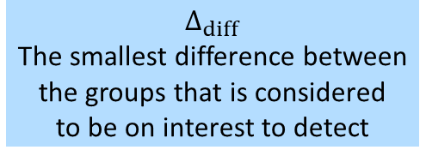

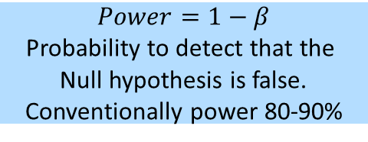
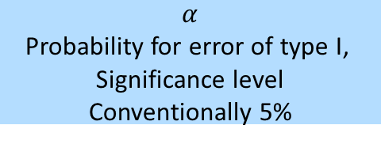
Obtaining the needed sample size (for comparing means)
$$Δ_{diff}$$
The smallest difference between
the groups that is considered
to be on interest to detect
Required
group sizes,
Equal or
Un-equal
$$α$$
Probability for error of type I,
Significance level
Conventionally 5%
$$Power=1−β$$
Probability to detect that the
Null hypothesis is false.
Conventionally power 80-90%
$$σ$$
Variability, e.g. standard deviation

Slide 55
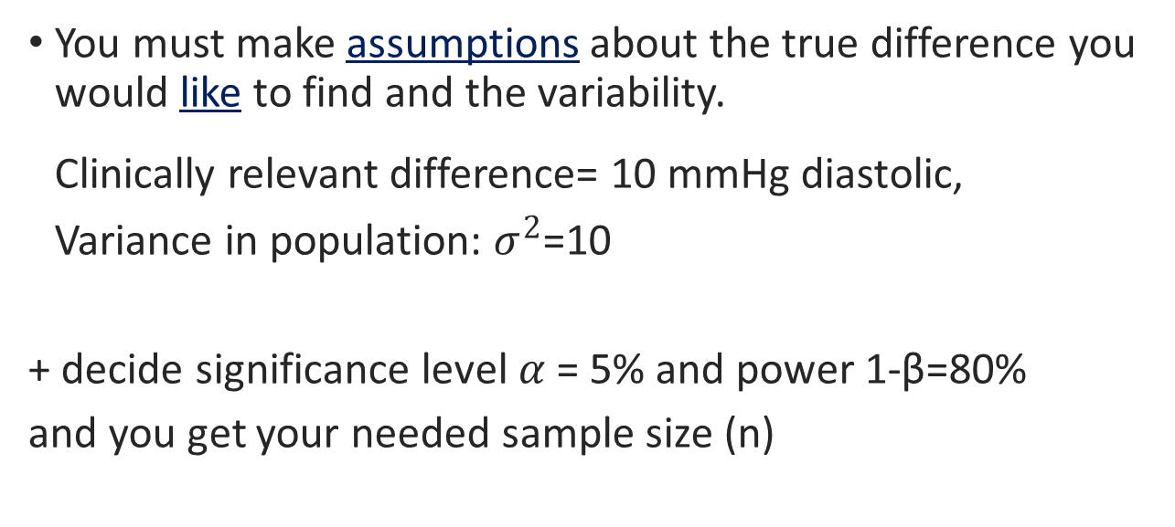
What is the minimum sample size for testing subgroup differences then?
You must make assumptions about the true difference you would like to find and the variability.
Clinically relevant difference= 10 mmHg diastolic,
Variance in population: $σ^{2}$=10
+ decide significance level $α$ = 5% and power 1-β=80%
and you get your needed sample size (n)
Notes:
Sample: normalviktiga unga vuxna, grupp 1 normalviktiga som barn, grupp 2 överviktiga
Vi vet inte skillnad, men vill kunna testa en hypotes och vi vill kunna upptäcka ovanstående skillnad

Slide 56
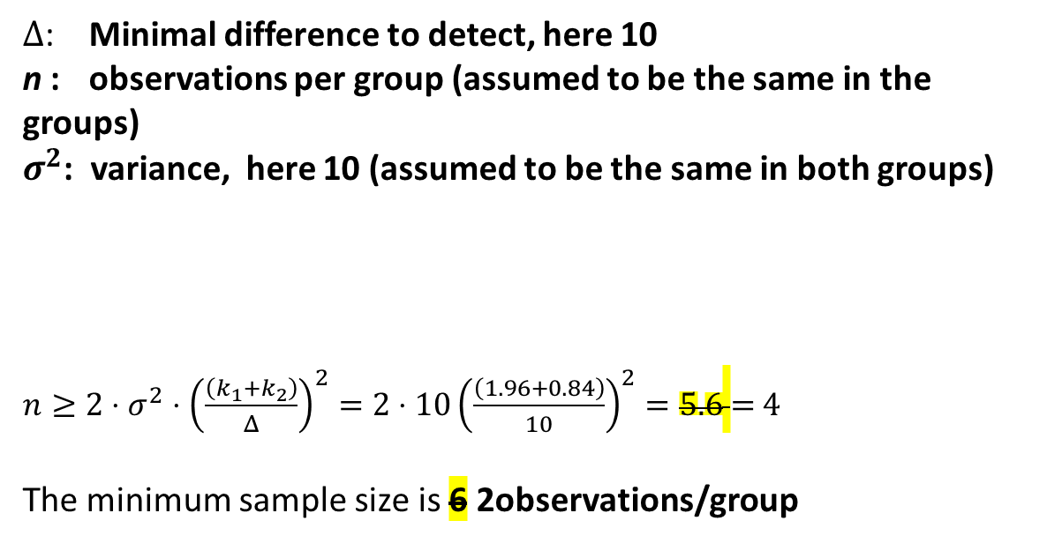
$Δ$: Minimal difference to detect, here 10
n : observations per group (assumed to be the same in the groups)
$σ^{2}$: variance, here 10 (assumed to be the same in both groups)
$n≥2⋅{σ^{2}⋅\left(\frac{\left(k_{1}+k_{2}\right)}{Δ}\right)}^{2}=2⋅{10\left(\frac{\left(1.96+0.84\right)}{10}\right)}^{2}=5.6$ = 4
The minimum sample size is 6 2observations/group
Significance level | 0.1 % | 1 % | 5 %
k₁ | 3.29 | 2.58 | 1.96
Power | 80 % | 90 % | 95 % | 99 %
k₂ | 0.84 | 1.28 | 1.96 | 2.33

Slide 57
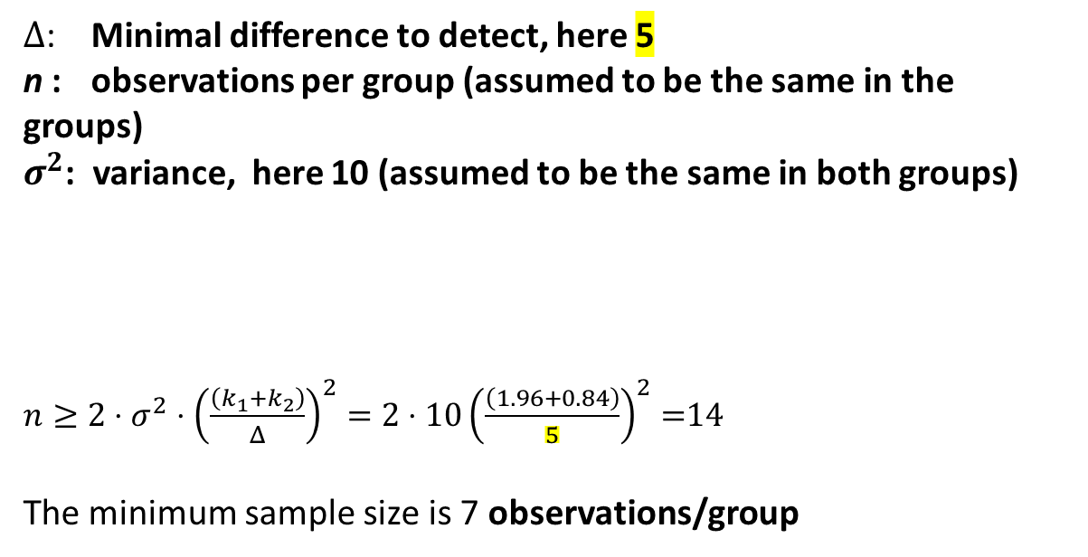
$Δ$: Minimal difference to detect, here 5
n : observations per group (assumed to be the same in the groups)
$σ^{2}$: variance, here 10 (assumed to be the same in both groups)
$n≥2⋅{σ^{2}⋅\left(\frac{\left(k_{1}+k_{2}\right)}{Δ}\right)}^{2}=2⋅{10\left(\frac{\left(1.96+0.84\right)}{5}\right)}^{2}=$14
The minimum sample size is 7 observations/group
Significance level | 0.1 % | 1 % | 5 %
k₁ | 3.29 | 2.58 | 1.96
Power | 80 % | 90 % | 95 % | 99 %
k₂ | 0.84 | 1.28 | 1.96 | 2.33

Slide 58
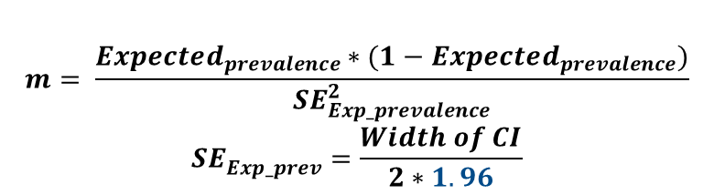
Sample size calculation for proportions/prevalence
Student Union plans to perform a telephone survey, to estimate the proportion of un-satisfied students at Sahlgrenska Academy.
How large of a sample is needed for a 95% confidence interval to have a width of 12% (or within ±6.)
$$m= \frac{Expected_{prevalence}∗(1−Expected_{prevalence})}{{SE}_{Exp_prevalence}^{2}}$$
$${SE}_{Exp_prev}^{}=\frac{Width of CI}{2∗1.96}$$
Notes:
Exercises 1. Suppose we wish to estimate the prevalence of students un-satisfied with teaching at SA. We think it will be about 25%, and we would like to estimate this to within 5%. How many subjects do we need?
With an expected prevalence of 25 % and within 6% we get
SE = (0.06*2)/1*1.96 = 0.12/3.92 = 0,031
m= 0,25*(1-0,25) / (0,031*0,031) = 200 students to answer the telephone survey

Slide 59
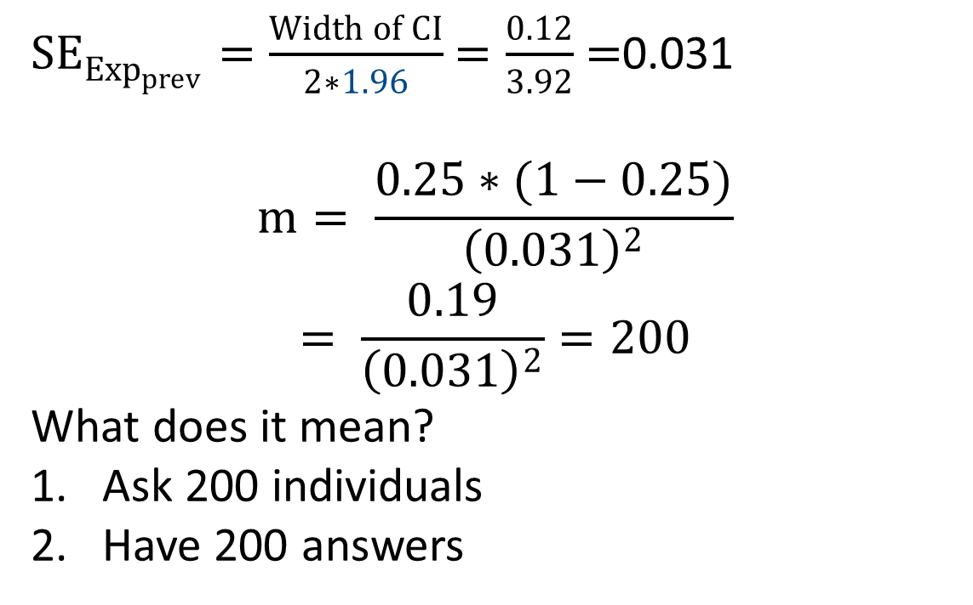
${SE}_{{Exp}_{prev}}^{}=\frac{Width of CI}{2∗1.96}$ $=\frac{0.12}{3.92}$ $=$0.031
$$m= \frac{0.25∗(1−0.25)}{{\left(0.031\right)}^{2}}$$
$$= \frac{0.19}{{\left(0.031\right)}^{2}}=200$$
What does it mean?
Ask 200 individuals
Have 200 answers
Notes:
Exercises 1. Suppose we wish to estimate the prevalence of students un-satisfied with teaching at SA. We think it will be about 25%, and we would like to estimate this to within 5%. How many subjects do we need?
With an expected prevalence of 25 % and within 6% we get
SE = (0.06*2)/1*1.96 = 0.12/3.92 = 0,031
m= 0,25*(1-0,25) / (0,031*0,031) = 200 students to answer the telephone survey

Slide 60
Return to work among cancer survivors
We are interested in a study about RTW among cancer survivors with two-sided α = 0.05 and power = 80%.
Two groups, Group-1 vs Group-2
i. Equal groups ii. Un-equal groups
How large of a sample is needed for detecting at least 20% difference in risk among groups with Grp-1 = 62% RTW
Notes:
RTW = Return to work
The margin of error is a statistic expressing the amount of random sampling error in a survey's results. The larger the margin of error, the less confidence one should have that the poll's reported results are close to the "true" figures; that is, the figures for the whole population. Margin of error is positive whenever a population is incompletely sampled and the outcome measure has positive variance (that is, it varies).

Slide 61
Example: RTW among cancer survivors
Sample size required (equal)
Index | Power |  | Total N
1 | 0.20 |  | 72
2 | 0.30 |  | 118
3 | 0.40 |  | 166
4 | 0.50 |  | 218
5 | 0.60 |  | 276
6 | 0.70 |  | 348
7 | 0.80 |  | 442
8 | 0.90 |  | 590
Sample size required (3-to-1 ratio)
Index | Power | Total N
1 | 0.20 | 108
2 | 0.30 | 172
3 | 0.40 | 236
4 | 0.50 | 304
5 | 0.60 | 384
6 | 0.70 | 476
7 | 0.80 | 600
8 | 0.90 | 792
Notes:
Sample size calculations performed in Statistical analysis software (SAS)
Optional reading:
Campbell, M., Machin, D., & Walters, S. (2010). Chapter 14. Sample size issues, Medical Statistics : A Textbook for the Health Sciences. New York: John Wiley & Sons, Incorporated. Available online at GU-library

Slide 62
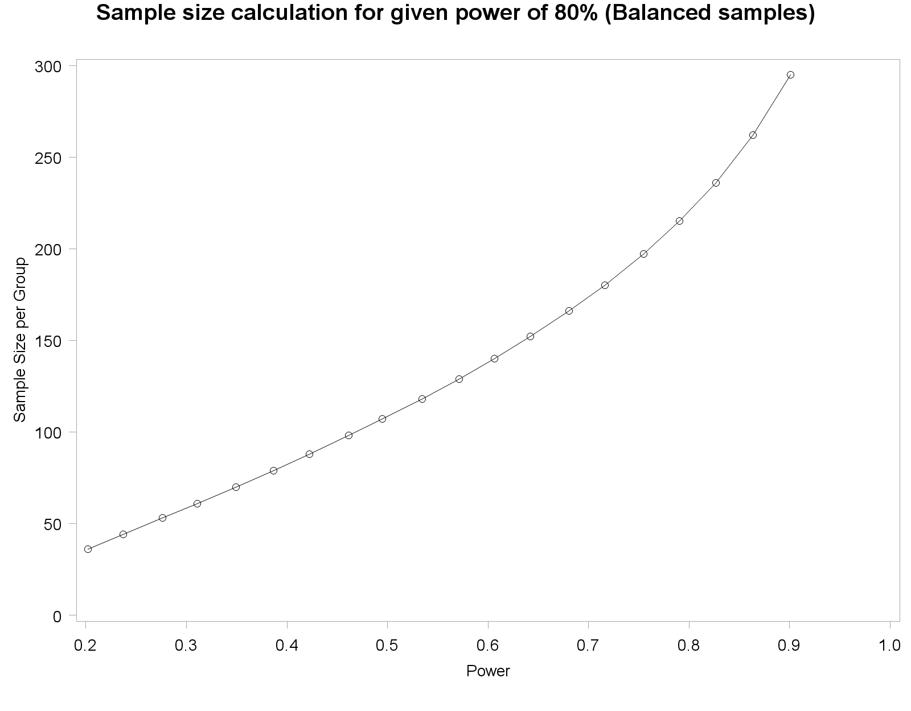
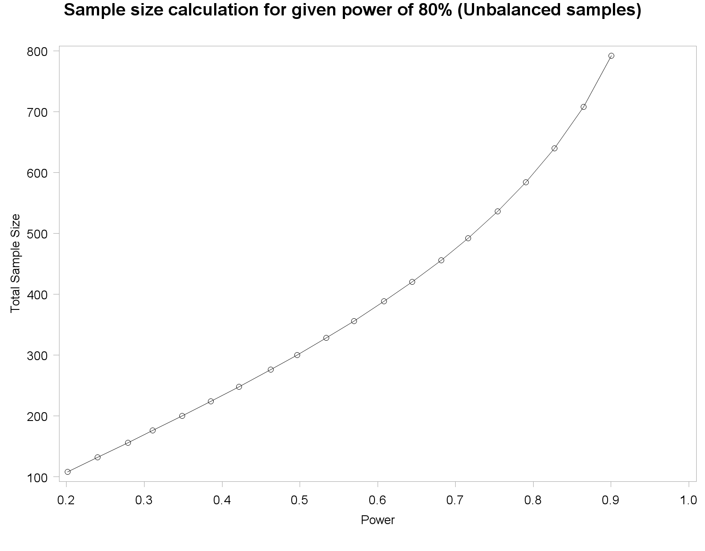
Example: RTW among cancer survivors
Notes:
Sample size calculations performed in SAS
Optional reading
Campbell, M., Machin, D., & Walters, S. (2010). Chapter 14. Sample size issues, Medical Statistics : A Textbook for the Health Sciences. New York: John Wiley & Sons, Incorporated. Available online at GU-library
Liu, G. (2005). Sample Size in Epidemiologic Studies. In Encyclopedia of Biostatistics (eds P. Armitage and T. Colton). Uploaded in same folder

Slide 63
An online epidemiology calculator
OpenEpi (http://www.openepi.com/Menu/OE_Menu.htm)
Epidemiological / statistical analysis and calculations using OpenEpi.

Slide 64
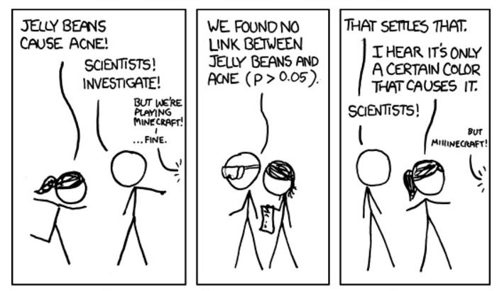
Multiple testing - doing a set of simultaneous statistical testing
xkcd.com
Notes:
Performing a set of statistical tests simultaneously

Slide 65
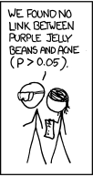
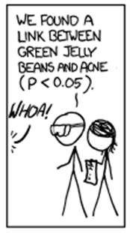
TAN JELLY
Purple JELLY
YELLOW JELLY
BROWN JELLY
TEAL JELLY
GREY JELLY
SALMON JELLY
TURQUISE JELLY
BLUE JELLY
GREEN JELLY
PINK JELLY
magenta JELLY
CYAN JELLY
BLACK JELLY
MAUVE JELLY
PEACH JELLY
lilac JELLY
xkcd.com
Notes:
17 tests were performed

Slide 66

xkcd.com

Slide 67
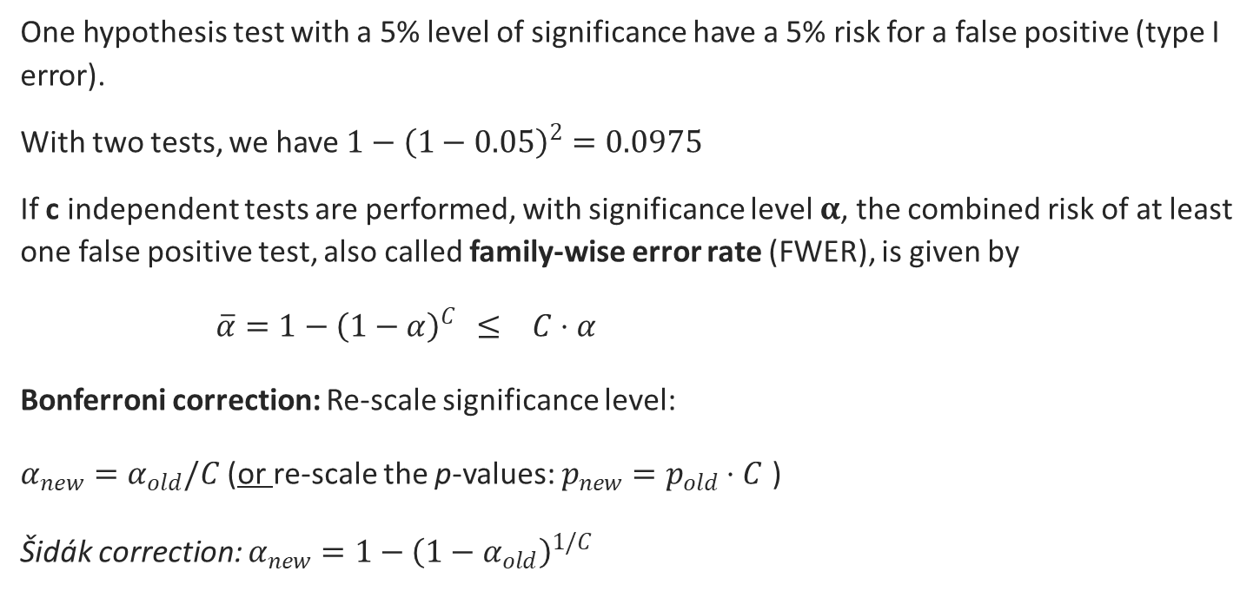
Multiple testing
One hypothesis test with a 5% level of significance have a 5% risk for a false positive (type I error).
With two tests, we have ${1−\left(1−0.05\right)}^{2}=0.0975$
If c independent tests are performed, with significance level $α$, the combined risk of at least one false positive test, also called family-wise error rate (FWER), is given by
$\overline{α}=1−{\left(1−α\right)}^{C}$ $≤ C⋅α$
Bonferroni correction: Re-scale significance level:
$α_{new}=α_{old}/C$(or re-scale the p-values: $p_{new}=p_{old}⋅C$ )
Šidák correction: $α_{new}=1−{\left(1−α_{old}\right)}^{1/C}$
Notes:
The risk of that at least one test will be significant even when H0 is true (false positive), can be calculated by 1-(1 - α )^{c}.(c =nr. of tests)
When alpha, $α=0.05 and c=1,$ then $1 – {(1−0.05) }^{1}$= 1 – 0.95 = 0.05
$For c=2$, then $1 – {(1−0.05) }^{2}$= 1 – ${0.95}^{2}$ = 1- 0.90 = 0.10
$For c=$3, then $1 – {(1−0.05) }^{3}$ = 1 – ${0.95}^{3}$ = 1- 0.86 = 0.14
$For c=$4, then $1 – {(1−0.05) }^{4}$ = 1 – ${0.95}^{4}$ = 1- 0.81 = 0.19
$For c=5$, then $1 – {(1−0.05) }^{5}$ = 1 – ${0.95}^{5}$ = 1- 0.77 = 0.23
$For c=10$, then $1 – {(1−0.05) }^{10}$= 1 – ${0.95}^{10}$=1- 0.60 = 0.40

Slide 68
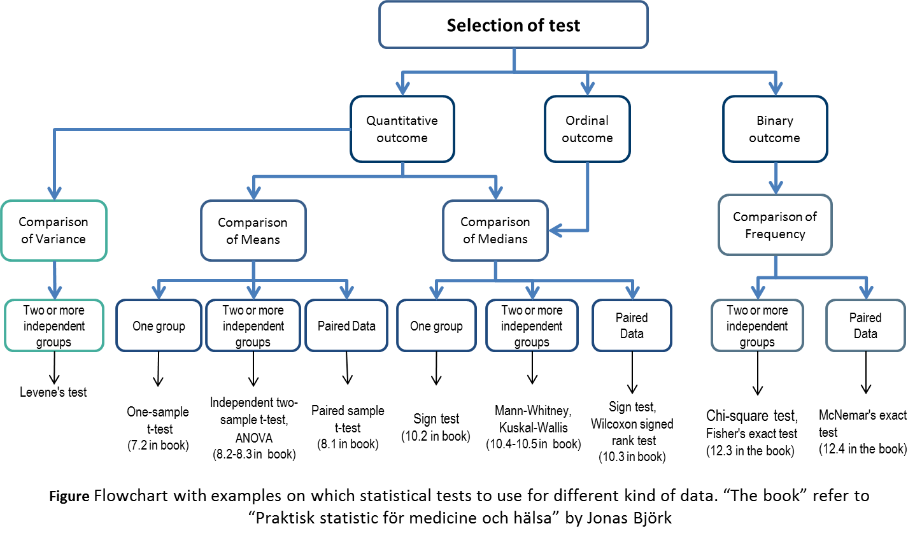
Mean value - Group comparison

Slide 69
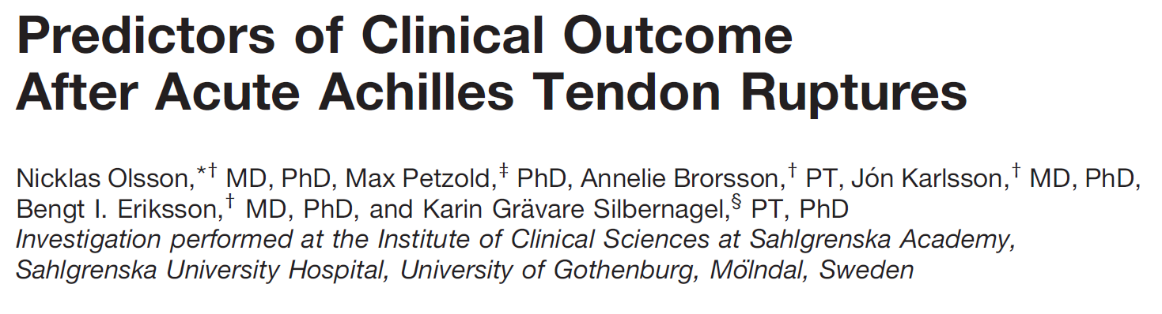
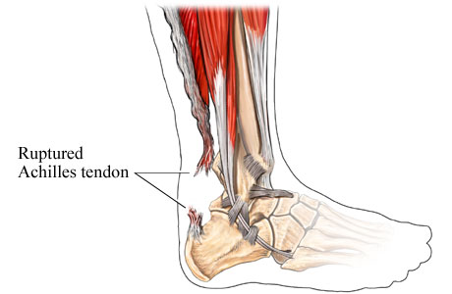
EXAMPLE: Group comparison
Aim: To investigate predictors of both symptomatic and functional outcomes after an acute Achilles tendon rupture.
Sample of 79 men and 14 women at 3, 6 and 12 months.
Outcomes: Achilles tendon Total Rupture Score (ATRS) for symptoms and maximum heel-rise height (Heel-rise) for function.
Predictors: Treatment, age, BMI, physical activity, heel-rise 6m, ATRS 3m

Slide 70
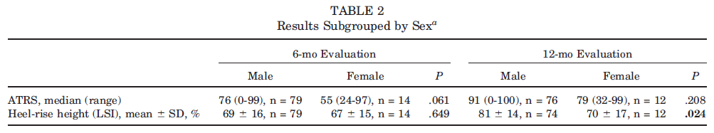
Comparing mean values between two groups
Statistical hypothesis
H₀ : No difference in mean heel-rise between males and females after 6 months
vs.
H_{A} : Difference in mean heel-rise between males and females after 6 months
Notes:
Testing, what is the p-value
First Heel-rise example

Slide 71
Comparison of Group mean values: t-test
T-tests are a family of tests for mean values.
Common assumptions:
Variable of interest is quantitative
The distribution of the sample mean is approximately normal
The variable is normally distributed, or the sample size is ”large enough”.
What is a ”large enough” sample size?
Maximum of 2 groups, 2-sample T-test
Notes:
Börja här 18/1

Slide 72
Rule of thumb from Björk’s book
< 20 obs. per group
T-test should only be used if the variable in known to be normally distributed (e.g., from previous larger studies)
Between 20 and 50 obs.
T-test can be used if data is approximately normally distributed
> 50 obs. per group
T-test can be used (with few extreme exceptions)

Slide 73
Comparing mean of several independent samples
What if we have samples from more than two groups?
We use ANOVA
Note:
Independent sample → Independent ANOVA
Paired data → Paired ANOVA

Slide 74
ANalysis Of VAriance (ANOVA)
H₀: μ₁=μ₂=…=μ_{p} vs H₁: μ_{i}≠μ_{j} for any i and j
Assumptions for ANOVA:
Response variable residuals are normally distributed
Variances of populations are equal
Responses for a given group are independent and identically distributed normal random variables
Samples are independent
Notes:
ANOVA is a parametric method

Slide 75
Result : The ANOVA table
F=15,43 → p < 0.0001
Notes:
Between groups df = number of groups – 1
Within groups df = number of observations - number of groups
Total df = number of observations - 1
F_{p, (k-1), (n-k)} = F-distribution with (k-1)(in numerator) and (n-k)(=in denominator) degrees of freedom
k = number of groups
n = total number of observations
Degree of freedom for between = number of groups -1
Degree of freedom for within = number of observation – number of groups
Degree of freedom for total = number of observation – 1

Slide 76
Non-parametric tests
What if I have a skewed distribution?
The assumptions for parametric tests are not met
What if the variable is not continuous, but is ordinal?
In all these situations use
NON-PARAMETRIC TESTS!

Slide 77
More non-parametric tests
One group/ sample: the Sign test
2 independent groups: Mann-Whitney U test
Physically active vs Physically not-active people
Intervention vs non-intervention group
Note: You don’t need to have the same number of observations in both groups!
Paired observations: Wilcoxon signed rank test
Matched case-control data
Same group before and after an event

Slide 78
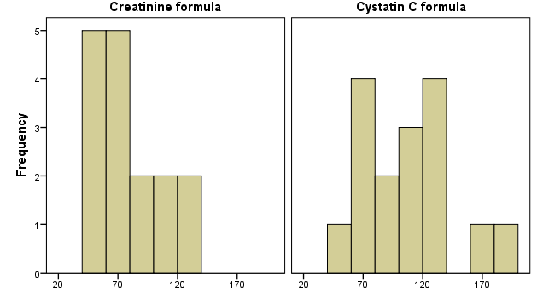
Example: Two methods for estimating renal function
The problem: A study of two methods for estimating the renal function (GFR): creatinine and cystatin C, including n=16 children.
Is there evidence that the two methods result in a different conclusion regarding GFR?
Estimated GFR
Higher values (for both creatinine and cystatin C) associate with worse renal function

Slide 79
GFR (mL/min per 1.73 m²)
 | Creatinine formula | Cystatin C formula
Mean | 78 | 106
Median | 70 | 105
Standard Deviation | 27 | 36
Min − max | 44 − 126 | 52 − 180
Distribution does NOT look symmetrical (for neither the creatinine based, nor the cystatin C based estimates)
Small sample size
=> We can’t use the parametric ‘paired t-test’
=> Need a non-parametric test!

Slide 80
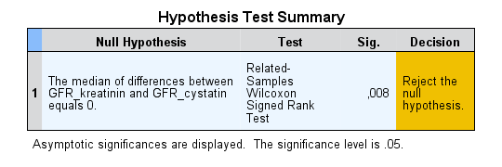
Paired data → Wilcoxon Signed Rank test
Notes:
If you obtain a large difference in the two rank sums it is a sign of positive difference or negative difference between the two methods. You need a table to find the p-value (see eLabb for the book) or, as above, use a software like SPSS.

Slide 81
Parametric vs. Non-parametric
Which information is used?
Parametric: Knowledge about distribution & observed values
Non-parametric: The ranks of the observed values
What is the risk with parametric tests?
If the assumptions are not fulfilled => erroneous conclusions
Why don’t we always use non-parametric tests?
If assumptions for parametric are fulfilled
=> parametric are more powerful to detect differences
Notes:
8.6 (p139)
Since a parametric test is based on an assumption regarding distribution, all inference might be incorrect if that assumption is incorrect.
However, if the assumption regarding distribution is correct, the parametric test will be more powerful and can detect differences more easily compared to the nonparametric tests. It also turns out that the p-value calculated based on a non-parametric test is larger than then the one that would be obtain from a parametric test. Another argument for not using routinely non-parametric procedures is that they are not as flexible as the parametric alternatives.

Slide 82
Linear relationships
Linear correlation and regression
Y: Outcome
X: Predictor
Notes:
You measure several variables on a sample of subjects.
You want to know if some (two, ..) variables are related in some way.
Does knowing one variable gives clues about the other variable (at population level)?

Slide 83
Pearson's correlation coefficient
Often denoted r or ρ (rho)
Measures the linear relationship between two quantitative variables
Has a value between -1 and 1
1 means a perfect increasing linear relationship
-1 means a perfect decreasing linear relationship
Notes:
H₀: ρ=0, i.e. correlation in the population = 0
Requires the variables to be approximately normally distributed or a large sample size
Note that hypothesis testing is always done under the assumption that H₀ is true.

Slide 84
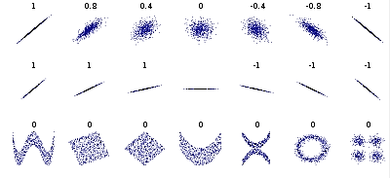
Pearson’s correlation coefficient
Reference: Wikipedia
Notes:
WHEN is it ok to use Pearson's correlation coefficient?
If you have quantitative variables. If you see some type of linear relationship/ trend . If you don’t have outliers
When not to use Pearson's correlation coefficient?
When you have
a non-linear relationship
outliers
”holes” in the data
samples from different groups

Slide 85
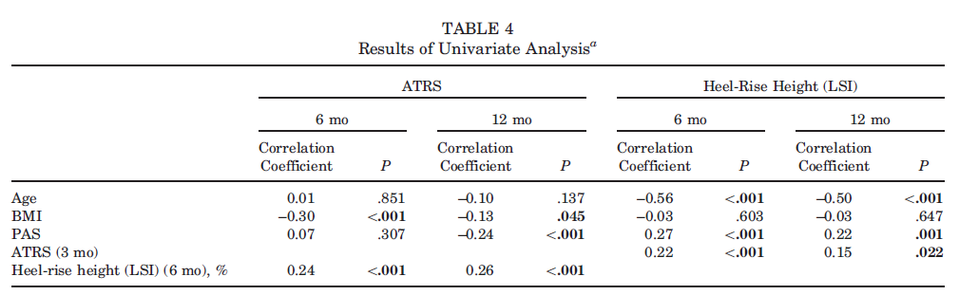
(Linear) Correlation (measured by Pearson’s correlation)

Slide 86
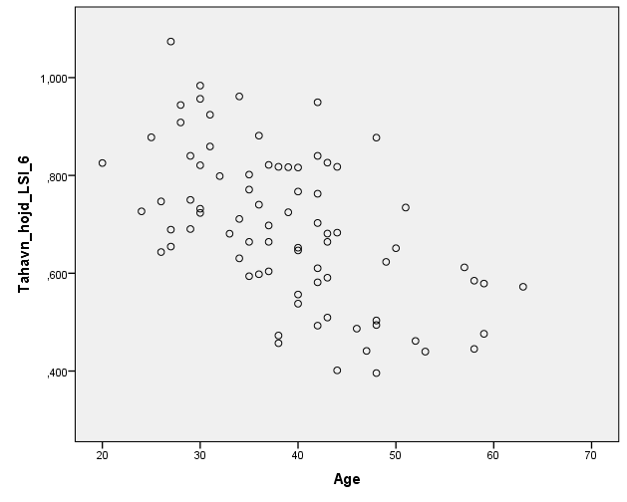
Pearson (linear) correlation = -0.56
A step up from correlation analysis is linear regression analysis.

Slide 87
Linear Regression
The idea: assume a mathematical model that reflects the reality. Based on this, we want to predict an outcome variable Y from one (or several) predictor variable X that are known.
Several types of questions can be answered by using regression:
Has the incidence of autism increased over the past 2 decades?
Does a new drug treat allergy, or on the contrary, results in more adverse events?
What is the risk of car accidents during a certain period?
…

Slide 88
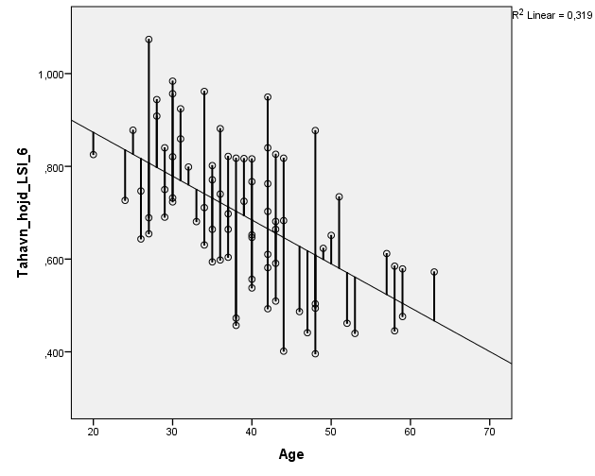
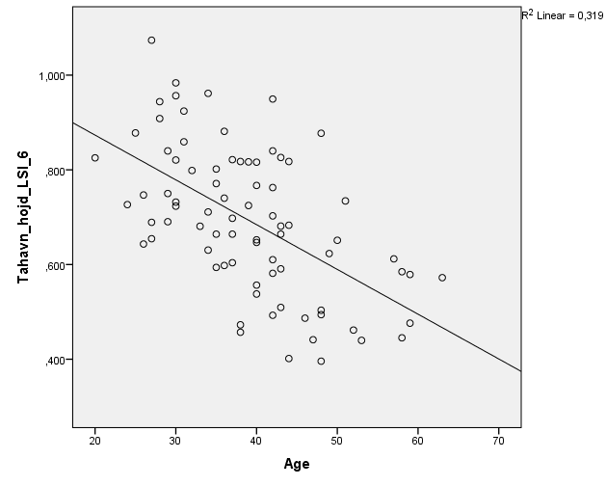
Linear regression – the ‘best’ fitted straight line
Notes:
The idea: assume a mathematical model that reflects the reality. Based on this, we want to predict a variable Y from one (or several) variable X that are known.
Several types of questions can be answered by using regression:
Has the incidence of autism increased over the past 2 decades?
Does a new drug treat allergy, or on the contrary, results in more adverse events?
What is the risk of car accidents during a certain period?
…

Slide 89
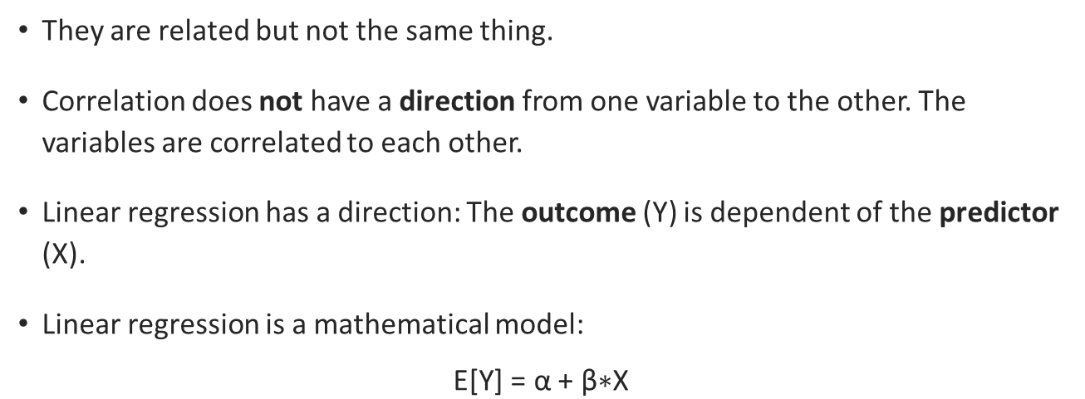
Do not confuse regression and correlation!
They are related but not the same thing.
Correlation does not have a direction from one variable to the other. The variables are correlated to each other.
Linear regression has a direction: The outcome (Y) is dependent of the predictor (X).
Linear regression is a mathematical model:
$$\text{E}\text{[}\text{Y}\text{] = }\text{α}\text{ +} \text{β}\text{∗}\text{X}$$
Notes:
Simple linear equation: Y = α + β*X
Parameters α and β
α is called the intercept (the value of Y when X = 0)
β is called the slope of the line
One unit increase in X → β units increase in Y
α and β denote the values for the population
a and b denotes the sample specific estimates of α and β

Slide 90


Linear regression output SPSS
E[Y] = α + β*X -> Heel-rise = 1.062 – 0.009*Age
General model fit?
Significances?
Confidence intervals?
Notes:
Heel-rise = 1.062 – 0.009*Age
1 unit increase in Age → 0.009 units decrease(because of negative sign) in expected Heel-rise
Expected Heel-rise is age = 0 years → 1.062
No data in that area (nobody with Age = 0), and extrapolation can give unrealistic results

Slide 91

Linear regression
Including 95% confidence bands
Notes:
The linear regression produces valid results only if some assumptions about the data are true:
The outcome variable is continuous
Linear relationship between X and Y
The residuals are independent (same way as saying that for each value of X, the Y’s are independent)
The residuals are normally distributed with mean 0 and constant deviation, for all values of X.

Slide 92
Linear Regression : Assumptions
The linear regression produces valid results only if some assumptions about the data are true:
The outcome variable is continuous
Linear relationship between X and Y
The residuals are independent (same way as saying that for each value of X, the Y’s are independent)
The residuals are normally distributed with mean 0 and constant deviation, for all values of X
Notes:
Both correlation and linear regression assumes independent observations.
Independence of observations from each other
Only one measurement per individual
Independent random sample - all individuals are equally likely to participate in the study

Slide 93
”Adjusting for other variables”
Multivariable/Multiple linear regression: linear regression with multiple predictors/risk factors.
(Not to be confused with multivariate analysis which have multiple outcome)
Modell building is complicated
Select probable explanatory variables using medical knowledge
Always plot and investigate linearity - graphics across averages can be misleading
Avoid correlated predictors (collinearity)
Build small models
More in the exercises
Notes:
Explorative
Which variables are related/associated to outcome
Adjustment
Adjusting for confounding/background variables
Outcome variables: Continuous, Binary, Time to event
Predictor/Explanatory: any combination of Continuous, Binary, categorical

Slide 94

Simpson’s Paradox
Regression line for whole data
Reference: https://trends.ufm.edu/en/article/tax-burdens-per-capita-income-simpsons-paradox/
Notes:
https://en.wikipedia.org/wiki/Simpson%27s_paradox
Scatterplot of correlation between two continuous variables X and Y , grouped by a nominal variable Z . Different colors represent different levels of Z.
Simpson's paradox
a trend appears in several different groups of data but disappears or reverses when these groups are combined.

Slide 95

Multiple Linear regression
6m: $E\left[LSI\right]\text{=}82.69\text{−}2.80\text{⋅}\text{Treatmen}{\text{t}}_{nonsurgical}\text{−}0.87\text{⋅}\text{Age}\text{+}0.23\text{⋅}BMI\text{+}2.68\text{⋅}\text{PAS}+0.19\text{⋅}\text{ATR}{\text{S}}_{\text{3}\text{m}}$
R²=0.409 → The model explains about 40.9% of the variation in LSI

Slide 96


Slide 97


What if the relations isn’t linear? Rank correlation
Example rank correlation
Pearson’s r=0.248
Spearman´s r=0.493

Slide 98
Qualitative (Categorical) outcome variables
Outcome variables which are on
Nominal scale (gender, eye color, ) no ordering
Ordinal scale (Good-Better-Best, Age categories) have a natural order
“distance between steps are not defined”
They can only take few possible values

Slide 99
Qualitative (Categorical) outcome variables
Q. When there is a lot to do. I work more intensively in order to finish what needs to be done.
Q. I skip breaks or lunch to finish what needs doing.
Q. I lower the quality of my work in order to finish what needs to be done.
Very often/always
Rather often
Sometimes
Rather seldom
Very seldom/never
Are the distance /steps between different answer alternatives equal?
Very often/always
Rather often
Sometimes
Rather seldom
Very seldom/never
Very often/always
Rather often
Sometimes
Rather seldom
Very seldom/never

Slide 100

Binary outcome variables
Two possible values, success and failure (0/1). Some of common ways to compare binary data from independent groups:
Chi2-test ($χ^{2}$-test)
The difference between independent proportions
The ratio between independent proportions
Cross-sectional studies - Prevalence ratio (PR)
Cohort/Follow-up studies - Relative risks (RR)
The ratio between independent odds in Case control studies - Odds ratio (OR)
Notes:
The risk difference (or absolute risk reduction) answers the question:
How many fewer cases can be expected if we give this specific treatment to e.g. 100 patients?
The formula for a 95% CI for the risk difference is:
$$D±k\sqrt{\frac{q_{1}\left(1−q_{1}\right)}{n_{1}}+\frac{q_{2}\left(1−q_{2}\right)}{n_{2}}}$$
where q₁ and q₂ are the proportions of disease free survivors (DFS), n₁ and n₂ the group sizes.
Relative risk (or risk ratio) is a ratio of the risk of an event (e.g. disease or relapse) occurring in two different groups. It answers the question:
How much more likely are patients to (e.g.) relapse if they get the less successful treatment?
Formula for: $RR=\frac{q_{2}}{q_{1}}$
where q₁ and q₂ is the proportions of relapses in group 1 and 2, respectively.

Slide 101
Relationship between Categorical variables
 | Sex
Semester | Females | Males | Total
Annually |  |  | 1000
Spring
Expected, 50 % = 300
Expected, 50 % = 300
600
Autumn
Expected, 50 % = 200
Expected, 50 % = 200
400
50 % females (500)
50 % males (500)
H₀: No relationship between Study semester and Sex of students admitted
H₁: There is a relationship between Study semester and Sex of students admitted
(Fisher’s exact test or Pearson’s Chi-square test of association)

Slide 102
Relationship between Categorical variables
 | Sex
Semester | Females | Males | Total
Annually |  |  | 1000
Spring
Expected, 60 % = ?
Expected, 40 % = ?
600
Autumn
Expected, 60 % = ?
Expected, 40 % = ?
400
60 % females (600)
40 % males (400)
H₀: No relationship between Study semester and Sex of students admitted
H₁: There is a relationship between Study semester and Sex of students admitted
(Fisher’s exact test or Pearson’s Chi-square test of association)

Slide 103

Chi2-tests ($χ^{2}$-test)
A very common test, and can be used for any number of rows and columns (at least 10 observations in each cell)
Fisher's exact test counts more accurately and can also be used for small samples (5 obs. in each cell).

Slide 104
Relationship between Categorical variables
Pearson’s Chi-square test compares the expected frequency against the observed frequency
If there is a LARGE descrepancy then we will get a small p-value
Hence, we will reject the Null hypothesis and conclude there exists a relationship
Else we fail to reject the Null hypothesis of ”No relationship”
Notes:
Patients diagnosed with UTI are divided in two groups
got single dose of antibiotic
got multiple doses of antibiotic

Slide 105
Relationship between Categorical variables
 | Sex
Semester | Females | Males | Total
 |  |  | 600
 |  |  | 400
Annually |  |  | 1000
Spring
Expected, 60 % = 360
Expected, 40 % = 240
Observed, 63 % = 380
Observed, 37 % = 220
Autumn
Expected, 60 % = 240
Expected, 40 % = 160
Observed, 80 % = 320
Observed, 20 % = 80
60 % females (600)
40 % males (400)
A “Large enough” difference between the Expected and Observed frequencies.
Difference in proportions (percent) = 17 percentage points with a 95% Confidence interval of (11 % ── 22 %) percentage points. In addition, each of Fisher’s exact test and Chi-square test results in a p-value <0.0000001
Notes:
A difference to be called or assumed “Large enough” is different for different scenarios. E.g., number of levels of predictor and/or outcome variable. Sample size etc.

Slide 106
Example: Urinary tract infection
Clinical trial regarding the number of antibiotic doses to treat infection
Two groups of patients:
Group 1: given only 1 dose of antibiotics
Group 2: multiple doses of antibiotics
Question: What evidence does this study give for a relationship between number of doses of antibiotics and status of urine culture at follow-up?

Slide 107
 | Status of urine culture at follow-up
Groups | Positive n (%) | Negative n (%) | Total
Single dose | E = 7 O = 8 (24 %) | E = 26 O = 25 (76%) | 33 (100%)
Multiple dose | E = 8 O = 5 (12 %) | E=32 O = 35 (88%) | 40 (100%)
Total, n(%) | 13 (18%) | 60 (82%) | 73 (100)
A “small” difference between the Expected and Observed frequencies.
Difference in proportions (percent) = 12 percentage points with a 95% confidence interval of (-6 % ── 30 %) percentage points.
In addition, Fisher’s exact test results in a p-value of 0.32. We fail to reject the Null Hypothesis and conclude “No relationship between nr. of antibiotic doses and status of urine ”
H₀: No relation between Antibiotic doses and Positive culture at follow-up
H₁: There is a relationship between nr of doses and positive culture at follow-up
Outcome is categorical, more specifically binary and the Predictor is also categorical. Hence, we can use Fisher’s exact test or Chi-square test of association.
Notes:
Patients diagnosed with UTI are divided in two groups
got single dose of antibiotic
got multiple doses of antibiotic

Slide 108
Example: Urinary tract infection
Difference in proportions (percent) = 12 percentage points with a 95% confidence interval of (-6 % ── 30 %) percentage points. In addition, Fisher’s exact test results in a p-value of 0.32. We fail to reject the Null Hypothesis and conclude “No relationship between nr. of antibiotic doses and status of urine ”
Did we have enough sample size to detect an association?
Single dose(24%) vs Multiple dose (12 %)→ Difference between groups = 12%
To detect a difference of 12% (24% vs. 12%) with 5% level of significance and 80% power requires 320 individuals (160/group)
Notes:
Patients diagnosed with UTI are divided in two groups
got single dose of antibiotic
got multiple doses of antibiotic

Slide 109
Analyzing Binary outcome variables
Investigate importance (association) of one predictor
Evaluate the importance of additional variables that may influence the observed association
Binary outcome & One quantitative/qualitative predictor → Simple Logistic Regression
Binary outcome & multiple predictors (categorical/continuous) → Multiple Logistic Regression
Notes:
Some sitautions in which Logistic regression analysis is needed
Sugegsted readings.
Simple – short
Campbell. M.. Machin. D.. & Walters. S. (2010). Section 9.6 Logistic Regression. Medical Statistics : A Textbook for the Health Sciences. New York: John Wiley & Sons
2. A gentle & detail introduction to Logistic regression with Stata
Vittinghoff. E.. Glidden. D.. Shiboski. S.. & McCulloch. C. (2012). Chapter 5. Logistic Regression. Regression Methods in Biostatistics (Statistics for Biology and Health). Boston. MA: Springer US. https://ebookcentral-proquest-com.ezproxy.ub.gu.se/lib/gu/detail.action?docID=973179

Slide 110
Adding more explanatory variables
Question: Does gender effect the association between smoking and diabetes?
Outcome, Y: Diabetes diagnose (1= Yes, 2= No)
Independent variables:
Smoker: 1= Yes (Current, 2= No (non-smoker)REFERENCE CATEGORY)
Gender (1=Male, 2= Female REFERENCE CATEGORY)
Age (years)
BMI

Slide 111
Multiple logistic regression
Parameter Estimates
Parameter | B | Std. Error | 95% Wald Confidence Interval |  | Hypothesis Test |  |  | Odds Ratio Exp(B) | 95% Wald Confidence Interval for Exp(B)
 |  |  | Lower | Upper | Wald Chi-Square | df | Sig. |  | Lower | Upper
(Intercept) | -8,213 | ,4870 | -9,168 | -7,259 | 284,486 | 1 | ,000 | ,000 | ,000 | ,001
[Smoker=Yes] | ,233 | ,1434 | -,048 | ,514 | 2,635 | 1 | ,105 | 1,262 | ,953 | 1,671
[Gender=Male] | ,122 | ,1268 | -,126 | ,371 | ,927 | 1 | ,336 | 1,130 | ,881 | 1,449
Age_y | ,054 | ,0047 | ,044 | ,063 | 128,754 | 1 | ,000 | 1,055 | 1,045 | 1,065
BMI | ,104 | ,0091 | ,086 | ,122 | 131,555 | 1 | ,000 | 1,110 | 1,090 | 1,130
The odd ratio for Smoker vs Non-smoker to have diabetes is 1.26. That is, a smokers in this sample have a 1.26 times higher odds of having diabetes. However, this is not a significant predictor as the 95% CI includes ONE and p-value is greater than 0.05 (p=0.105).
By the way… Never write p=0.000 in a report! It should be p<0.001 (p is never 0)
Notes:
More than one independent (predictor/explanatory) variable (Multi-predictor Model)
Dichotomous. ordinal. nominal. continuous …
$$\ln\left(\frac{p}{1−p}\right)=α+β_{1}x_{1}+β_{2}x_{2}+…+β_{n}x_{n}$$
Interpretation of $β_{1}$
Increase in log-odds for one unit increase in x₁ with all the other x_{i} constant (i=2,….,n)
Measures association between x₁ and log-odds adjusted for all other x_{i} (i = 2,….,n)

Slide 112

Effect measures for Binary outcome*
Risk: How probable is it to get a positive outcome given X $Risk(x)=P\left(y | x\right)$
Odds: Odds are the ratio of positive outcomes to negative outcomes. $Odds(x)=\frac{P\left(y | x\right)}{1−\text{P}\left(y | x\right)}$
Odds ratio: “How many times larger is the odds when X=t compared to when X=t-1”
$$OR(x=t vs x=t−1)=\frac{Odds(x=t)}{Odds(x=t−1)}$$
Risk ratio(Relative risk): “How many times larger is the probability for a positive outcome when X=t compared to when X=t-1”
$$RR(x=t vs x=t−1)=\frac{P(y|x=t)}{P(y|x=t−1)}$$
Risk difference: “ What is the difference in percentage point (pp) between the risk to get a positive outcome when X=t and to when X=t-1”
$$RD\left(x=t vs x=t−1\right)=P\left(y | x=t\right)−P\left(y | x=t−1\right)$$

Slide 113
effect measures – Logistic regression*
The Odds ratio (OR) used in Case control studies
The Prevalence ratio (PR) used in Cross-sectional studies
Relative risks (RR) used in Cohort/Follow-up studies
The Risk differences (RD) - used in Cohort/Follow-up
Notes:
In cross-sectional studies the calculated proportion of binary(categorical) outcome are called Prevalences and their ratios Prevalence Ratios and their differences Prevalence difference (Difference in proportion)
.
Meanwhile in Cohort(Follow-up) studies the calculated proportion of binary(categorical) outcome are called Risks and their ratios Relative Risks and their differences Risk Differences

Slide 114
Longitudinal data
Note that longitudinal studies with more than 2 measurements per individual (or unequal number of observations/individual) requires other kinds of statistical methods.
E.g. repeated measurement ANOVA or mixed models.

Slide 115
Before analysis: Organizing data
In Excel (or another program)
One variable per column
One subject (e.g., patient) per row
One number per cell
If giving presenting variable names: only in first row
No empty rows
Empty cell means missing data (0 and missing is two different things)
No comments in the data file

Slide 116
Organizing data – Incorrect
Group 1
Id | Age | Gender | Symptom
1 | 5 | Boy | Diarrhea, Vomiting, Blood in feces, Fever
2 | 10 | Boy | Diarrhea
3 | 9 | Girl | Diarrhea
4 | 3 | Girl | Vomiting, Fever
5 | 5 | Boy | Blood in feces, Fever
Group 2
Id | Age | Gender | Symptom
6 | 3 | Boy | Diarrhea, Vomiting
7 | 3 | Boy | no journal entries
8 | 9 | Boy | Diarrhea, Fever
9 | 8 | Girl | Diarrhea
10 | 8 | Girl | Diarrhea, Vomiting

Slide 117
Organizing data – Correct
Group | Id | Age | Gender, 1:boy, 2:girl | Diarrhea | Vomiting | Blood in feces | Fever
1 | 1 | 5 | 1 | 1 | 1 | 1 | 1
1 | 2 | 10 | 1 | 1 | 0 | 0 | 0
1 | 3 | 9 | 2 | 1 | 0 | 0 | 0
1 | 4 | 3 | 2 | 0 | 1 | 0 | 1
1 | 5 | 5 | 1 | 0 | 0 | 1 | 1
2 | 6 | 3 | 1 | 1 | 1 | 0 | 0
2 | 7 | 3 | 1
2 | 8 | 9 | 1 | 1 | 1 | 0 | 0
2 | 9 | 8 | 2 | 1 | 0 | 0 | 0
2 | 10 | 8 | 2 | 1 | 1 | 0 | 0

Slide 118
Remember
Before study, think about sample size
Try to state as much as possible in the protocol before beginning data collection and analysis
When having data, always plot/tabulate data
Assess the assumptions
Only include/exclude observations in a way that is scientifically ok
Format

Slide 119

The research question

Slide 120
What is a research question?
A researcher should ask a very specific question.
Broad questions are usually broken into smaller questions
A good research question can be formulated into a testable hypothesis

Slide 121
What makes a poor research question?
A question that matters to nobody (even you)
It needs to be useful one way or the other…
Hoping one emerges from routine clinical records
The records will be biased and confounded
They’ll lack information you need to answer your question reliably, because they were collected for another reason
Fishing expedition/data dredging – gathering new data
and hoping a question will emerge

Slide 122
What makes a good question?
FINER criteria
Feasible (Answerable with a robust method, and within your quite restricted time limit)
Interesting
Novel (Perhaps not the most important one for a graduate student thesis… )
Ethical
Relevant
Notes:
https://www.atsu.edu/research/pdfs/campbell_syllabus.pdf
The FINER criteria for a good research question
• Feasible: Adequate number of subjects, Adequate technical expertise, Affordable in time and money, Manageable in scope
• Interesting, Interesting to the investigator
• Novel: Confirms or refutes previous findings, Extends previous findings, Provides new findings
• Ethical
• Relevant: To scientific knowledge, To clinical and health policy, To future research directions

Slide 123
Example: Research questions
Does a difference in _________ (independent variable) explain differences in _________ (dependent variable), controlling for the effects of _________ (control variable)?
Does a difference in treatment explain differences in maximum heel-rise height, controlling for the effects of age, BMI, PAS and early (3 months) ATRS results?
Observational studies
What is the relationship between long distance commuters and eating disorders?
Experimental studies
Does the consumption of fast food lead to eating disorders?

Slide 124
Framing your research question
P Patient / Population, This is the ´Who´. How would I describe a group of patients similar to mine?
I Intervention: This is the ´What. Which main intervention, prognostic factor, or exposure am I considering?
C Comparison: With what is the intervention (or indeed population) being compared? This could be a control group
O Outcome: What outcome do you expect to see? For example, you may be interested in knowing whether an intervention has a health benefit, or whether an exposure results in mortality
S Setting: ´Where´. What is the context for the question?
P Perspective / Population: ‘Who’ . How would I describe a group of patients similar to mine?
I Intervention: ‘What’. Which main intervention, prognostic factor, or exposure am I considering?
C Comparison: With what is the intervention (or indeed population) being compared? This could be a control group.
E Evaluation: With what result? What measurement will determine the intervention’s success?
Notes:
PICO
P - Who are the patients / What’s the problem?
I - What is the intervention (or exposure)?
C – What is the control group?
O - What is the outcome?

Slide 125
Some online guidelines
equator network: Enhancing the QUAlity and Transparency Of health Research
reporting guidelines and also links to other resources relevant to research reporting http://www.equator-network.org/
Codex website: rules and guidelines for research
This website's aim is to give researchers and other interested parties access to and information on the guidelines, ethics codes and laws that regulate and place ethical demands on the research process.
http://www.codex.vr.se/en/index.shtml

Slide 126



Study designs

Slide 127

Overview of study designs
From ”Praktisk statistik för medicin och hälsa” by Jonas Björk, page 285
Notes:
The choice of a certain design depends on the research question and other conditions (ethical issues, financial, etc).
Cohort = “any designated group of individuals who are followed or traced over a period of time”
A dictionary of Epidemiology - Oxford University Press
Print ISBN-13: 9780195314496 DOI: 10.1093/acref/9780195314496.001.0001

Slide 128

Experimental studies/ trials
Identify subjects, intervene, then observe effects of intervention

Slide 129

Treatment group
Follow-up
Patients
Compare results!
Control group
Follow-up
Randomized controlled trial (RCT)

Slide 130
Randomized Controlled Trials
Advantages:
Gold standard for establishing causal conclusions (still not easy…)
Reduces influence of confounders due to randomization.
No need to adjust for confounders
Simplifies the statistical analyses
Blinding often possible
Disadvantages:
Expensive, time-consuming
Ethically problematic at times
Volunteer bias
What works in a clinical setting may not work in “real life”.

Slide 131

Cross-Over trials
Treatment A
Treatment B
Wash-out period
Collect results
Collect results
Compare results!
Treatment B
Treatment A
Wash-out period
Collect results
Collect results

Slide 132
Crossover trials
Advantages:
All participants serve as own controls
Error variance is reduced → smaller sample size needed
All participants receive treatment
Blinding can be used
Disadvantages:
All participants receive placebo/alternative treatment at some point
Washout period lengthy or might be unknown
Doesn’t work for treatments with permanent effects

Slide 133

Observational studies
Identify subjects, then observe and record characteristics

Slide 134
Observational studies
Advantages:
Ethically safe
Participants can be matched
Can establish timing and directionality of events
Disadvantages:
Controls may be difficult to identify
Exposure may be linked to a hidden confounder
Blinding is difficult
For rare disease, large sample sizes or long follow-up is necessary

Slide 135
Observational Study – Points to Consider
What is your outcome of interest?
Common or rare
Descriptive (incidence, prevalence) or analytic (association)
Time frame
Prospective or Retrospective (historical cohort)
Interested in changes over time or a single point in time?
Natural grouping of subjects
Exposed vs. unexposed
Diseased vs. non-diseased
Notes:
Different definition of Retrospective or prospective exists in litterature

Slide 136
Cross-sectional Studies
Cross-sectional data is a snapshot of the population, in which the exposure and the outcome are measured at the same time
Useful for describing variables and their distribution patterns.
Measures prevalence, not incidence, of disease
Common measures: Prevalence ratio
Often used to study conditions that are relatively frequent with long duration of expression (e.g. nonfatal, chronic conditions)
Not suitable for studying rare, highly fatal diseases or diseases with short duration of expression
Not suitable for drawing causal conclusions
Notes:
Cross-sectional studies involve point prevalence, not incidence. For very infrequent diseases they are of limited utility

Slide 137


Longitudinal studies
– Cohort studies & Case-control studies

Slide 138
Cohort studies
Prospective Cohort studies start with a group (cohort) of healthy subjects and compares those exposed with those unexposed => are those exposed more likely to get sick?
Can be either data to be collected or from historical data (registers etc.).
No randomization of exposure / treatment.
Can be confounded (by indication) since exposure not randomized.
Time: 1 month-incidence, 10 year-incidence, 5-year survival

Slide 139
Cohort studies
“Best for studying effects of risk factors on an outcome”
The result of cohort studies:
Incidence/ relative risk of incidence
“Smokers are 3 times more likely to develop cardiovascular disease compared to non-smokers.”
Survival
“Patients who got therapy X were had double chance of survival at 5-years after treatment began, compared to those patients that got therapy Y.”

Slide 140
Cohort studies
The idea: Start with a sample (cohort) of healthy subjects and follow them for a period (e.g., 5 years) in order to identify risk factors for a disease
Cohort @ baseline
Cohort @ follow-up
Exposed
Unexposed
Exposed
Unexposed
Cases
0
(Start of study)
Time
t
(End of study)
The cohort is a randomized sample or full ‘population’

Slide 141
Case-control studies
Prospective cohort studies can be often impossible to do
the time from exposure until disease can be very long
start smoking as teenager -> heart disease as an adult; treated for leukemia as a child -> affects fat-free body mass in adulthood
The disease is very rare: suppose 5/100.000. To identify “enough” cases (required for power) might need to have a cohort of 1.000.000 subjects
One alternative Case - Control study
Time is a main ingredient: how far back should I look for exposure?

Slide 142
Case-control studies
A group of cases and a group of comparable controls (not case), look back into their past; compare cases vs controls how frequently the risk factor is present
Exposed Exposed
Controls cases
Unexposed
Controls Unexposed cases
Selection of cases and controls
Cohort @time 0
Cohort @time t
Exposed
Unexposed
Exposed
Unexposed
CASES
0
(start of study)
Time
t
(end of study)
Fig 15.6 Schematic representation of a case-control study

Slide 143
Case-control studies
Case-control studies start with a group of cases and then includes a random selection of controls (no disease under the study!)
Decide the time component: look back for 20 years, 1 year, 1 month?
Map exposure for each case and control:
Cases | % exposed |  | % unexposed
Controls | % exposed | % exposed
Calculate odds ratios: compare the odds of being exposed among cases to the odds of exposure among controls

Slide 144

Last but not least…
Whatever study design is chosen, the conclusions will be valid if you picked the “right” bunnies to look at!
We want to know about these
We have only these
Random
sample
Sample
Population
Inference
(guess!)
Population mean
(average survival, ex)
$$\overline{x}$$
Sample mean

Slide 145
Repetition – in case we have time
* “PRAKTISK STATISTIK FÖR MEDICIN OCH HÄLSA”
by Jonas Björk
Notes:
Chapter 1-3 contains basic information about data, scales and presentation.
The material is vital for the understanding of statistics and might be familiar for many of you from previous courses.

Slide 146
Introduction: Why use statistics?
There is a variation in the results
Practically (and/or ethically) impossible to collect data from the whole population
How to deal with uncertainty in a sample?
How to use what we observe in a sample to make inferences about the population?
(Based on figure 1.2 in the JB)
Notes:
All the bold letter are statistical terms,
Statistics is useful and necessary in situations when we expect a variation in result. What does it mean to have “To have a variation in the results” ?
Knowledge in Statistics also helps us to critically analyze results from other researchers projects.
Sample surveys are used to infer about a large population by analyzing data from a smaller part of the population.
Using samples causes some degree of statistical uncertainty! Maybe results we observe may be due to chance.
What we observe in a sample (the mean height, the improvement of a condition due to a treatment) does not automatically reflect what happens in the general population, unless the sample is well chosen (in which case is called representative of the population).

Slide 147

Population and sample
Mean value: μ
(e.g. average survival time)
Variance: σ²
Population Parameters
Population
Inference (“an educated guess”)
Sample data is used to draw conclusions about the population
i.e. the sample statistics is estimates of the population parameters
Sample Statistics
Mean value: $\overline{x}$
Variance: $s^{2}$
Sample
Notes:
Note that population parameters often are denoted by Greek-letter, while Latin-letters often are used for sample statistics.
A common aim of statistical analysis is to produce information or deduce about some chosen population based on sample based characteristics

Slide 148
Types of variables
Notes:
Quantitative data: is based on data that can be measured.
E.g. blood pressure measurements. number of pregnancies. body weight
Continuous: possible values are infinite (Sv: obegränsat)
Discrete: there is a finite number of possible values (one can calculate the number of possible values) – All examples are counts of events For example: number of pregnancies
Qualitative/Categorical data is based on data that can be described.
E.g. quality of sleep (bad/acceptable/very good). smoking status (yes/ no)

Slide 149
Levels of measurement
The type of scale the variables are measured on influences the choice of statistical methods for analyzing the data.
Notes:
Qualitative/Categorical data is based on data that can be described. And are on
Nominal scale: No particular order
Ordinal scale: Has a natural order
Quantitative data: is based on data that can be measured.
E.g. blood pressure measurements. number of pregnancies. body weight
Interval scale: Has an natural order and a defined “distance”
Ratio scale: Has an natural order and “distance” and a “Zero-value”

Slide 150
Types of scales
Categorical data
Nominal scale: Name, Gender, color, brand
Is the ”lowest” level. No particular order
Ordinal scale: Good-Better-Best, Age category
Has a natural order
Interval scale: Temperature
Has an natural order and a defined “distance” (negative, 0, positive)
Ratio scale: Weights
Has an natural order, “distance” and a “Zero-value”
Quantitative / Numerical data
Notes:
Note: The interval scale has also a zero-value as the ratio scale. And can take negative and positive values
The difference is that a variable on the interval scale can have values to the left and right of the zero-value;
Variables on a ratio scale can’t take values lower than the zero-value. Only Positives
If ratios of 2 measurements has a meaning and makes sense then Ratio scale.
Does “Zero” has a meaning? Zero kelvin (−273.15 °C) is defined as absolute zero.
https://en.wikipedia.org/wiki/Absolute_zero
What do you think about “Degree of pain”? Scale?

Slide 151

Two types of statistics
Graphical Histogram, boxplots
1. Descriptive statistics
2. Analytical statistics
Tests: “There is a statistically significant difference.”
Numerical Tables
“Do you feel stressed in your everyday life?”
Number of persons, n (%)
Yes, often | 4128 (15)
Yes, sometimes | 12 917 (48)
No, (almost never) | 10 065 (37)
(Figure 1.1 in the book)
Notes:
Any statistic is classified as being either descriptive or analytical.
Descriptive statistics gives, as it’s name reveals, a description of the data sample. This include for example graphs, mean values, median values and different measurements of variation (how far or close values are from the mean, for example).
The purpose of descriptive statistics is to summarize or describe a data set. Researchers use these statistics to describe or characterize the population or sample being studied.
To do an analysis, analytical statistics, or inferential statistics, is needed. The aim of analytical statistics is to draw conclusions about a population based on the data at hand. For example if a difference between two groups is statistically significant, i.e. if the difference is larger than could be expect to occur randomly.

Slide 152
Descriptive statistics
A statistical distribution (ex: blood pressure values in the population) can be described by
Central tendency (läge)
Mean (the arithmetic average)
Median
Dispersion: (spridning)
how spread the values are from the “center”
Standard deviation / variance
Range
Notes:
Numerical characteristics /parameters of the population that will be estimated from the sample values.
The most common is the arthimatic mean/average = sum(x1, x2, …xn)/n
If sample size is odd then median is the middle value of the ordered observation; in samples with even numbers of observations the average of the 2 middle values gives the median. Median is robust (insensitive to outliers)

Slide 153
Hypothesis testing
We have a question about the population we want to try to answer
Steps involved:
formulate null hypothesis (H₀); an alternative hypothesis (H₁)
H₀:Often cautiously formulated; can never be proven; considered true until disproved
H₁, includes everything except the null hypothesis
test the hypothesis using a statistical test, depending on the type of variable
test results in a p- value, interpret

Slide 154
Discovering Statistics Using IBM SPSS Statistics by Andy Field 5th Edition ISBN-13:978-1-5264-1952-1
Notes:
This is a guide to choose which statistical test to use to answer an specific research question.
Discovering Statistics Using IBM SPSS Statistics
5th Edition page: 1072
ISBN-13:978-1-5264-1952-1
How to select the correct statistical test for a research project. clinical trial. or other investigation. The first step is to decide
in what scale of measurement your data are as this will affect your decision—nominal. ordinal. or interval.
The next stage is to consider the purpose of the analysis—for example. are you comparing independent or paired groups?
If an incorrect test is used. then invalid results and misleading conclusions may be drawn from the study.
Scale of measurements; Parametric Assumption; Paired or un-paired data;

Slide 155
in case we have More time Statistical inference Estimation

