Slide 1



Slide 2
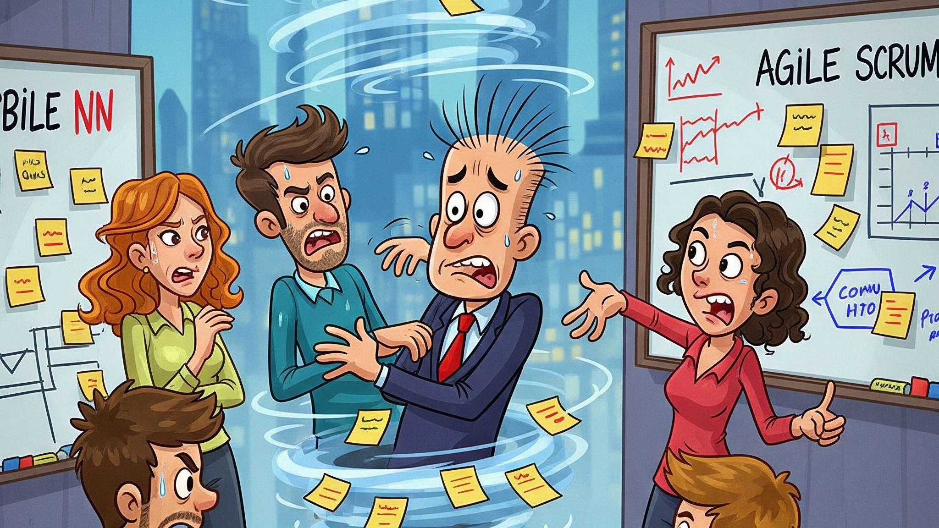

Slide 3

Unlock a whole new world of Agile efficiency
Step 1
Step 2
Step 3
Evaluate user stories following AMA guidelines
Break down work into smaller, actionable tasks
Seamlessly integrate into existing Agile processes

Slide 4
Agile transformation – no magic carpet needed
Enhanced Productivity
Immediate Returns
Improved clarity and efficiency
Teams save up to $65,000 per year. A 10,000% return
Seamless Integration
Secure
No new tools or new training required
All data remains secure in a private network

Slide 5
Let’s build the future together
Future roadmap
2025
2026
Epics/Features
Images
Knowledge
Code
Support Epic and Feature level breakdowns
Support architecture diagrams in work items
Enhance task generation with examples
Code suggestions from the code base

Slide 6
Pilot Requirements
Now Available for Pilot
Agile Process Have a well-established Agile process today
Azure DevOps Currently use Azure DevOps
Feedback Cycles Willing to learn and provide feedback

