Slide 1

Search for Cheap Flights & Airline Tickets Responsible Generative AI with Agents and Guardrails
Eric Bach
May 2024
Notes:
Today I’m excited to introduce a flight booking app, KANOE, not to be confused with another popular 5-letter flight booking app
We’ll see how we can simplify the integration challenges we face today in a responsible generative AI way
So let’s get started with a couple topics before we see how this all takes off

Slide 2
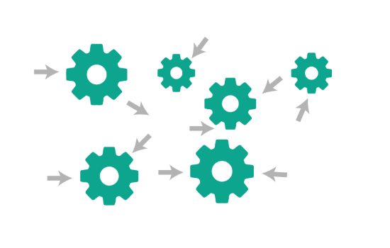

Agentic AI
Execute multistep tasks across company systems and data sources
Notes:
Delivering a feature today requires developers to integrate with multiple systems; leading to expensive development and collaboration efforts between teams
Agents, such as those offered by Amazon Bedrock, allow us to orchestrate tasks between foundation models and software applications
This means agents can make API calls without us having to write any orchestration code

Slide 3




Guardrails
Define and disallow restricted topics
(i.e. legal advice)
Filter harmful content (i.e. hate language)
Safeguards customized for application requirements and responsible AI policies
Redact of block sensitive information (i.e. personally identifiable information)
Notes:
Maintaining trust with AI involves managing how the user interacts with our app to ensure we provide safety and guide positive outcomes, from
Restricting undesirable topics such as legal advice,
Filtering harmful content, like hate language,
And redacting sensitive personally identifiable information
Guardrails for Amazon Bedrock provides the governance of safeguards to build our apps in a responsible way

Slide 4


Workflow
Membership
Travel
Loyalty
Payment
Notes:
We will see how KANOE applies Agentic AI with Guardrails to orchestrate and execute tasks safely between our systems
The Agent handles all the orchestration between each system with Guardrails in place, ensuring
A valid membership is used to search for and purchase flights, > hitting our Member and Travel systems
Allowing members to apply reward dollars to their purchase, > hitting our Loyalty system
And booking the flight using a saved credit card, hitting our Travel and Payment systems

Slide 5
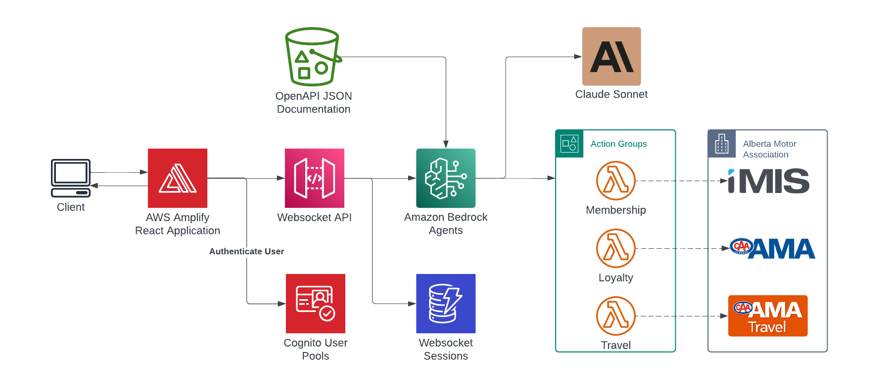
Architecture
2
1
3
Notes:
> Behind the scenes a user interacts through a conversational frontend with a Websocket
> Bedrock Agents provide the LLM with the API documentation to infer the actions available to it
> Then along with the prompt and the configured Guardrails, the Agent determines the next actions using Chain of Thought (CoT) reasoning

Slide 6


Demo
https://kanoe.ericbach.dev
For more information about Generative AI:
https://github.com/eric-bach/kanoe
https://docs.aws.amazon.com/bedrock/latest/userguide/agents.html
https://medium.com/ama-tech-blog
Tech Blog
Notes:
Of course, the potential of this technology goes beyond just a chatbot for booking flights, I just use this as an example for demonstration
While we see this in action, I ask of you to think of how best you can apply this to potential problems you may be experiencing today

