Slide 1

Travel Agent Unlocking the potential of Generative AI Agents
Eric Bach
May 2024

Slide 2

Problem
Notes:
Before we dive in, I’d like to first highlight the challenge we face today and how we can leverage Generative AI Agents to alleviate our problem
> When delivering a feature today, we often need to integrate with multiple systems (iMIS, AX, GP, just to name a few)
This effort involves huge collaboration between teams in addition to the development work required
Let’s see how Generative AI Agents can provide help with this

Slide 3
Agents for Amazon Bedrock
Retrieval Augmented Generation (RAG)
Orchestrate and execute multistep tasks
Traceable Chain of Thought (CoT) reasoning
Notes:
Agents complete actions by orchestrating interactions between foundation models, data sources, software applications, and user conversations
This means agents can automatically make API calls to take actions without us writing any orchestration code
Developers can save weeks of development effort by leveraging Generative AI Agents like the ones provided by Amazon Bedrock

Slide 4
Travel Agent
A valid membership is required to search for and purchase flights
Member can apply any available reward dollars to the purchase
Member’s saved credit card can be used to purchase flight
Member and Travel
Loyalty
Payment
Notes:
The Travel Agent application is a fictitious application meant to demonstrate how we can apply Agents and Generative AI to orchestrate and execute calls between our systems
It has 3 features
Requiring a valid membership to search for and purchase flights, hitting our Member and Travel systems
Allowing members to apply reward dollars to their purchase, hitting our Loyalty system
And using a saved credit card to purchase a flight, hitting our Payment system

Slide 5
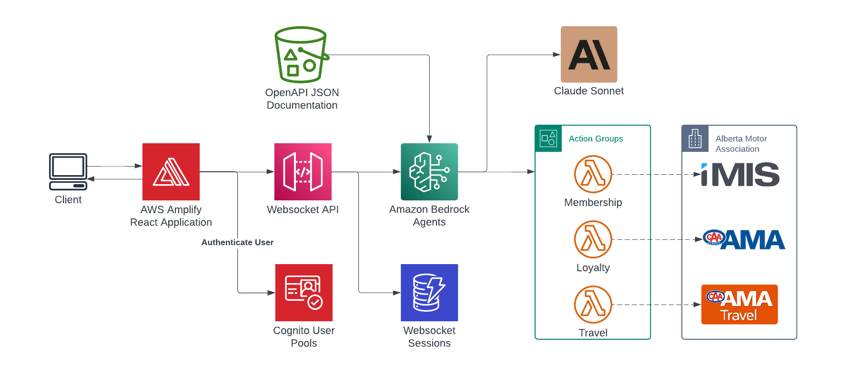
Architecture
2
3
1
4
Notes:
A user interacts with our agent through a frontend that connects through a Websocket API
Bedrock Agents read the API documentation provided in OpenAPI format from an S3 bucket to get an understanding of the API features available to it
Using the foundational model, our agent uses Chain of Thought (CoT) reasoning to determine the next action
Whether to prompt the user for additional information
Orchestrate an action through an Action Group to invoke external APIs
Or, deny the request

Slide 6






Demo
https://flights.ericbach.dev
For more information about Generative AI:
https://github.com/eric-bach/travel-agent
https://docs.aws.amazon.com/bedrock/latest/userguide/agents.html
https://medium.com/ama-tech-blog
Tech Blog
Special thanks to early access testers
WH, TH, MC, TR
Notes:
The potential for this technology goes beyond just a chatbot for booking flights, I just use this as an example for demonstration.
So while we see this in action, I ask of you to think of how you can apply this to potential problems you may be experiencing today

