Slide 1

Search for Cheap Flights & Airline Tickets Responsible Generative AI with Agents and Guardrails
Eric Bach
May 2024
Notes:
Today I’m excited to introduce a flight booking app, KANOE, not to be confused with another popular 5-letter flight booking app
We’ll see how we can simplify the integration challenges we face today in a responsible generative AI way

Slide 2
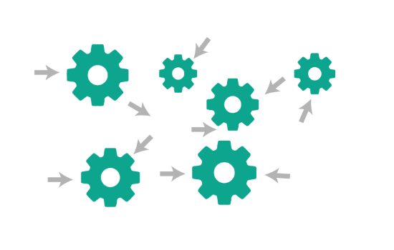

Agentic AI
Execute multistep tasks across company systems and data sources
Notes:
Delivering a feature today requires developers to integrate with multiple systems; leading to expensive development and collaboration efforts between teams
Agents, such as those offered by Amazon Bedrock, allow us to orchestrate tasks between foundation models and software applications
This means agents can make API calls without writing any orchestration code

Slide 3

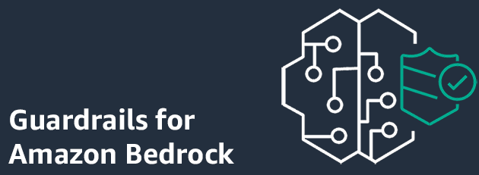


Guardrails
Define and disallow restricted topics
(i.e. legal advice)
Filter harmful content (i.e. hate language)
Safeguards customized for application requirements and responsible AI policies
Redact of block sensitive information (i.e. personally identifiable information)
Notes:
Maintaining a relevant and safe user experience means we must manage the interactions carefully, from
Restricting undesirable topics like legal advice,
Filtering harmful content, such as hate language,
To redacting sensitive personally identifiable information
Guardrails for Amazon Bedrock allows for the configuration of custom rules to detect and block such interactions

Slide 4


Workflow
Membership
Travel
Loyalty
Payment
Notes:
KANOE is a fictitious application meant to demonstrate how we can apply Agents and Guardrails to orchestrate and execute calls safely between our systems
The Agent handles all the orchestration between each system with Guardrails in place, ensuring
A valid membership is used to search for and purchase flights, > hitting our Member and Travel systems
Allowing members to apply reward dollars to their purchase, > hitting our Loyalty system
And booking the flight using a saved credit card, hitting our Travel and Payment systems

Slide 5
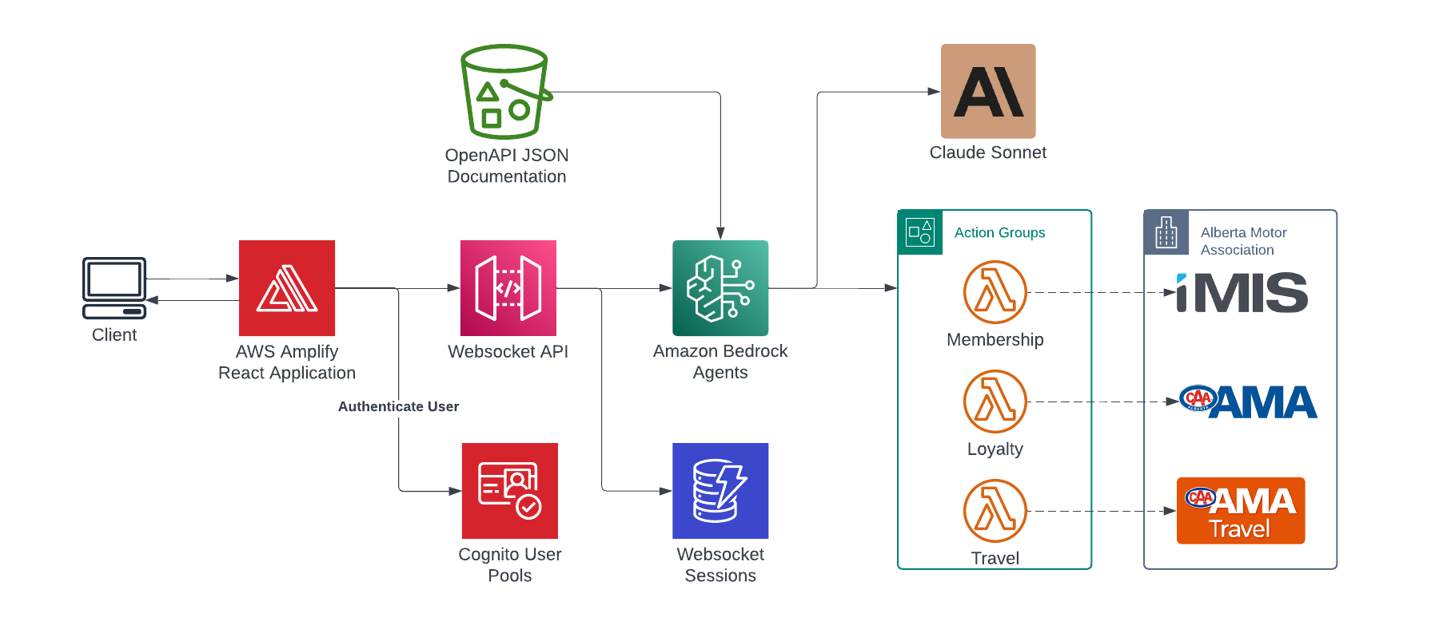
Architecture
2
3
1
4
Notes:
A user interacts with KANOE through a conversational frontend with a Websocket
Bedrock Agents read the API documentation provided in OpenAPI format to understand the API actions available to it
Then using Claude as the foundational model, the Agent determines the next actions using Chain of Thought (CoT) reasoning along with the configured Guardrails
Whether to prompt the user for additional information
Orchestrate an action through an Action Group to invoke external APIs
Or, deny the request

Slide 6






Demo
https://kanoe.ericbach.dev
For more information about Generative AI:
https://github.com/eric-bach/kanoe
https://docs.aws.amazon.com/bedrock/latest/userguide/agents.html
https://medium.com/ama-tech-blog
Tech Blog
Notes:
The potential for this technology goes beyond just a chatbot for booking flights, I just use this as an example for demonstration.
So while we see this in action, I ask of you to think of how you can apply this to potential problems you may be experiencing today

