Slide 1

Search for Cheap Flights & Airline Tickets with Generative AI Agents
Eric Bach
May 2024
Notes:
Today I’m excited to introduce KANOE, a flight booking app that uses Generative AI Agents to demonstrate how we can simplify the integration challenges we face today
It’s important to not confuse this with another popular 5-letter flight booking app with a similar name ;)

Slide 2
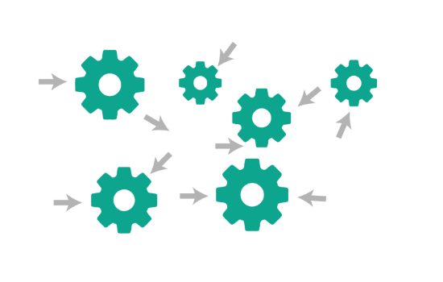
Generative AI Agents
Orchestrate and execute tasks using Chain of Thought (CoT) reasoning
Notes:
To deliver a feature, developers need to integrate with multiple systems today; leading to expensive development and collaboration efforts between teams
Agents, such as those offered by Amazon Bedrock, allow us to orchestrate tasks between foundation models, data sources, software applications, and user conversations
This means agents can make API calls without a developer writing any orchestration code

Slide 3


Workflow
Membership
Travel
Loyalty
Payment
Notes:
KANOE is a fictitious application meant to demonstrate how we can apply Agents and Generative AI to orchestrate and execute calls between our systems
The Agent handles all the orchestration between each system, ensuring
A valid membership is used to search for and purchase flights, > hitting our Member and Travel systems
Allowing members to apply reward dollars to their purchase, > hitting our Loyalty system
And booking the flight using a saved credit card, hitting our Travel and Payment systems

Slide 4
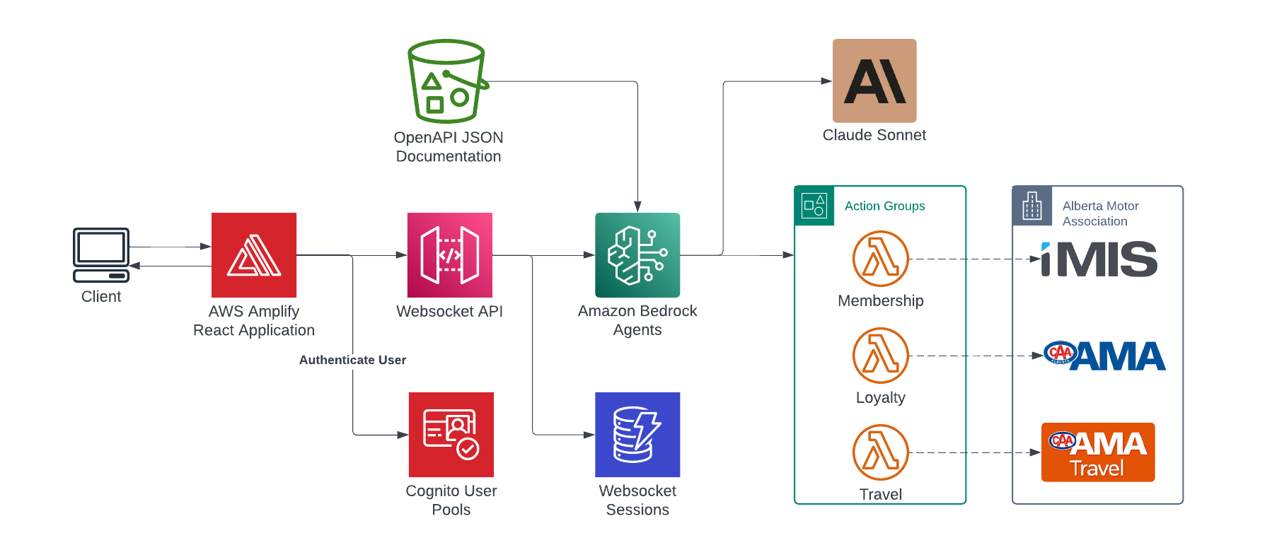
Architecture
2
3
1
4
Notes:
A user interacts with KANOE through a conversational frontend with a Websocket
Bedrock Agents read the API documentation provided in OpenAPI format to understand the API actions available to it
Then using Claude as the foundational model, the Agent determines the next actions using Chain of Thought (CoT) reasoning
Whether to prompt the user for additional information
Orchestrate an action through an Action Group to invoke external APIs
Or, deny the request

Slide 5






Demo
https://kanoe.ericbach.dev
For more information about Generative AI:
https://github.com/eric-bach/kanoe
https://docs.aws.amazon.com/bedrock/latest/userguide/agents.html
https://medium.com/ama-tech-blog
Tech Blog
Notes:
The potential for this technology goes beyond just a chatbot for booking flights, I just use this as an example for demonstration.
So while we see this in action, I ask of you to think of how you can apply this to potential problems you may be experiencing today

