Slide 1

RAGBot A fully serverless chat bot with Langchain
Eric Bach
February 2024
Notes:
Before I start, I apologize I’m unable to be there in person with you today as I haven’t been feeling too well today
However, I’m excited to introduce RAGBot, a context-aware chat bot built with Langchain to demonstrate the potential of generative AI

Slide 2




Generative AI
Knowledge learned during training
Foundation Model
Notes:
If you’re not familiar, generative AI produces original content that resembles human-generated content for many real-world tasks…like this cute puppy
> It’s powered by large sets of pre-trained data called Foundation Models (FMs) which have no knowledge outside of what it was trained with
This is why many chatbots tend to hallucinate when given a prompt beyond its knowledge

Slide 3






Retrieval Augmented Generation (RAG)
FM
Notes:
Retrieval Augmented Generation (RAG) solves this problem by augmenting the question with > context from an external knowledge base, such as a database
> The question along with this context is fed into the FM to generate a much more accurate response
The beauty of this is data within a database can always be updated, providing an easy way to evolve our responses

Slide 4
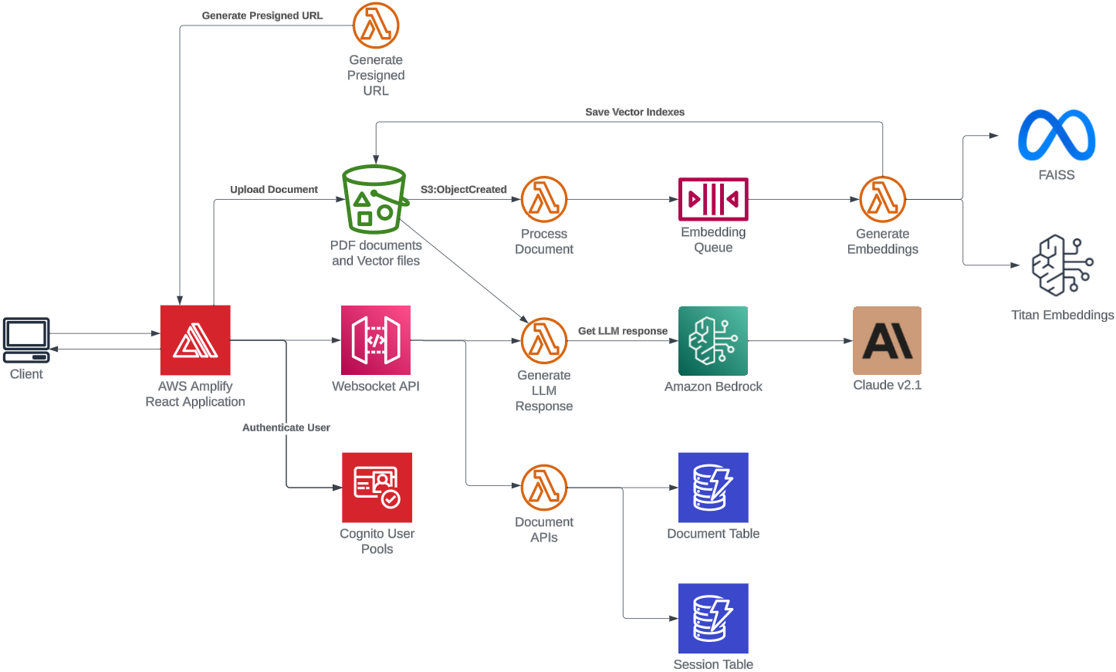



RAGBot
Notes:
For those familiar with AWS,
> A user uploads a PDF document securely to S3 using a presigned URL
> An event source mapping triggers a vector generation using Titan embeddings and FAISS algorithms
> A similarity search retrieves relevant vectors that are provided as the context to Claude to generate the response through the websocket connection

Slide 5






Demo
https://ragbot.ericbach.dev
For more information about Generative AI:
https://github.com/eric-bach/aws-bedrock-example
https://aws.amazon.com/blogs/compute/building-a-serverless-document-chat-with-aws-lambda-and-amazon-bedrock
https://medium.com/ama-tech-blog
Tech Blog
Special thanks to early access testers
WH, TH, MC, TR
Notes:
I originally was hoping to allow everyone to sign up and try this live, but the AWS bill might be a bit too much for me
If you would still like to try it out later, reach out to me after and I’ll see what I can do
For now, let’s see this in action…

