Slide 1
Introductions to Art History
An overview of diverse approaches and perspectives
by
Eric Bréchemier
February 2022

Slide 2
From Maria Montessori
To Online Learning
Maria Montessori
100 years of Bauhaus
Ways of Seeing
Learning to PLAY
Learning to See
Learning to Know
Learning Stories
Travelling Museums
How to Visit an Art Museum
Education of the senses
Preliminary course
Images of power & power of images
Toys & games
Observation & analysis
Encyclopedias & monographs
All the world’s a stage
In a box, in a truck
A Spectator is an Artist Too

Slide 3
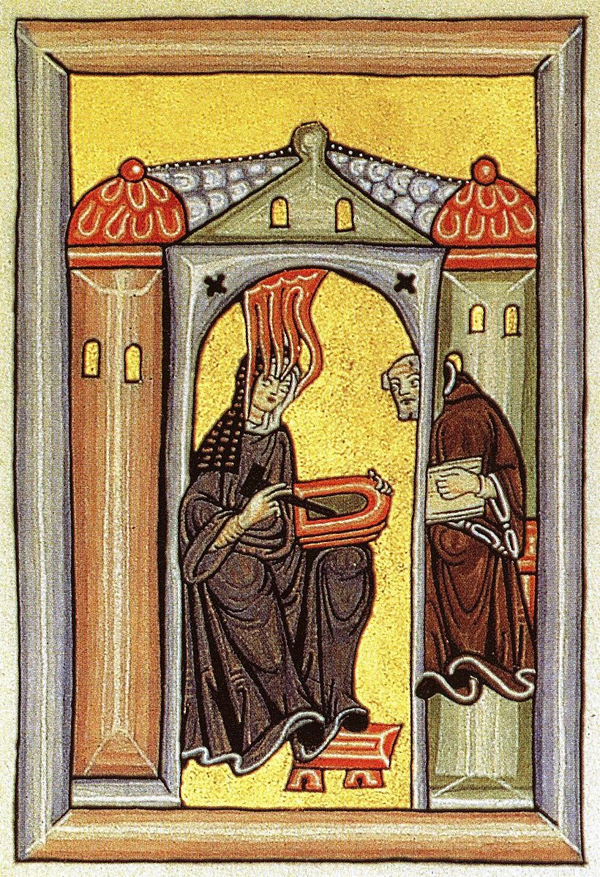
Introduction
This document presents an overview of different approaches to introduce
Art History or art histories from diverse vantage points and perspectives.
It is not meant to be exhaustive but to chart tracks for the creative exploration of this learning field with a focus on the education of children, teenagers and young adults.

Slide 4
Maria
Montessori
Education of the senses

Slide 5
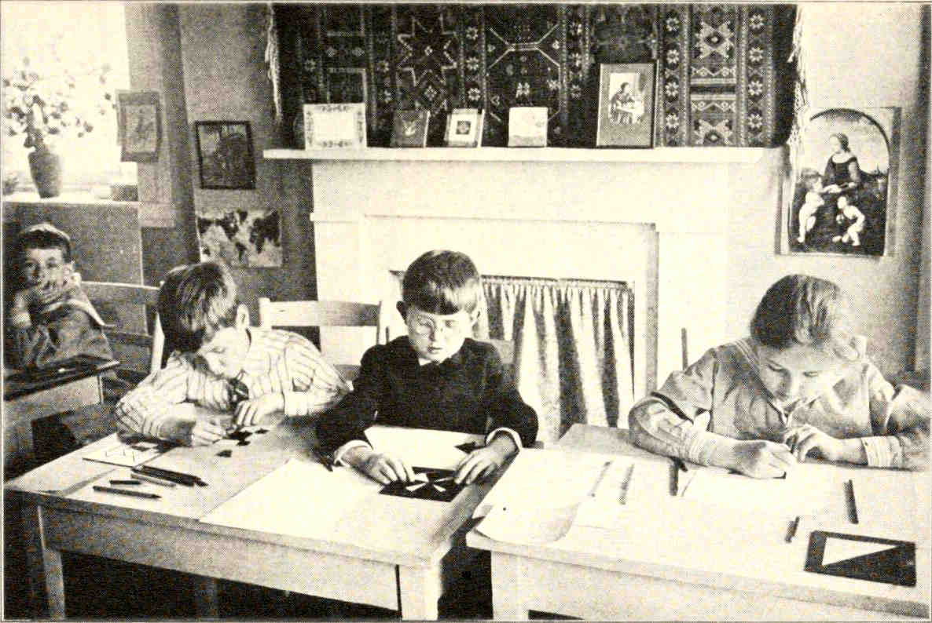
Education of the senses
The Montessori Elementary Material
Maria Montessori, 1917
Using geometric insets, reproducing decorations from a painting while listening to a story.

Slide 6
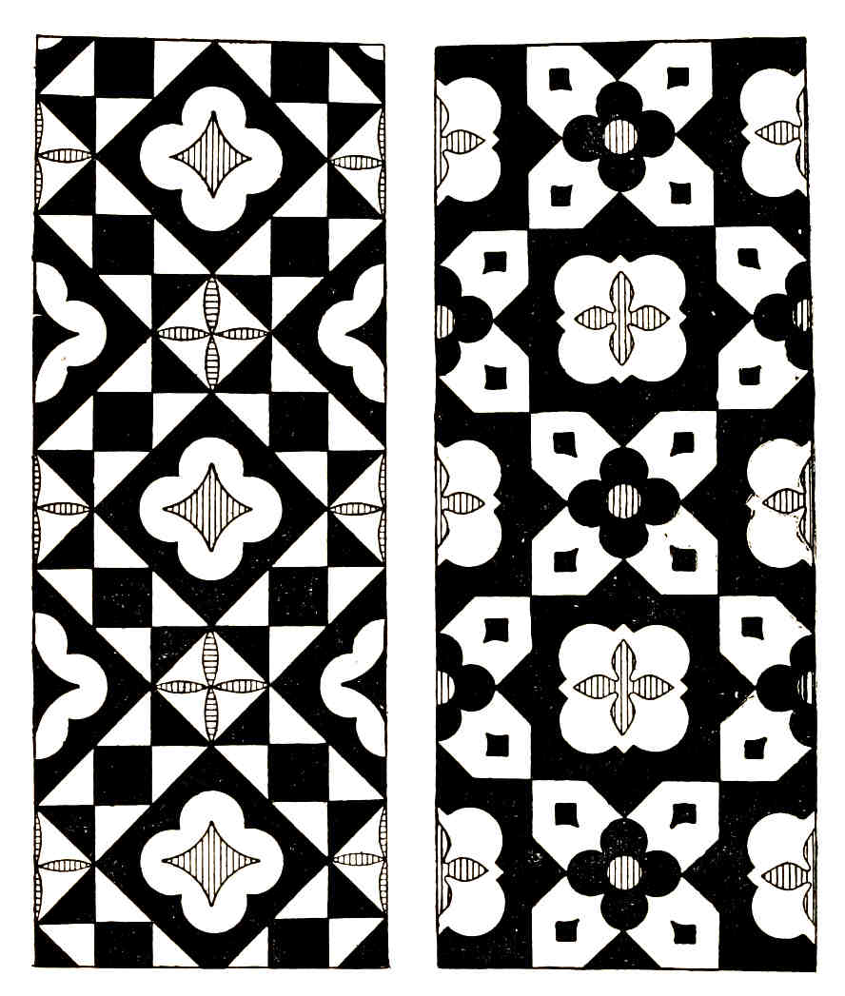
Education of the senses
The Montessori Elementary Material
Maria Montessori, 1917
Observation and copy of shapes by drawing freehand or with ruler and compasses.
Reproduction of a color shade by mixing of the 3 primaries.

Slide 7
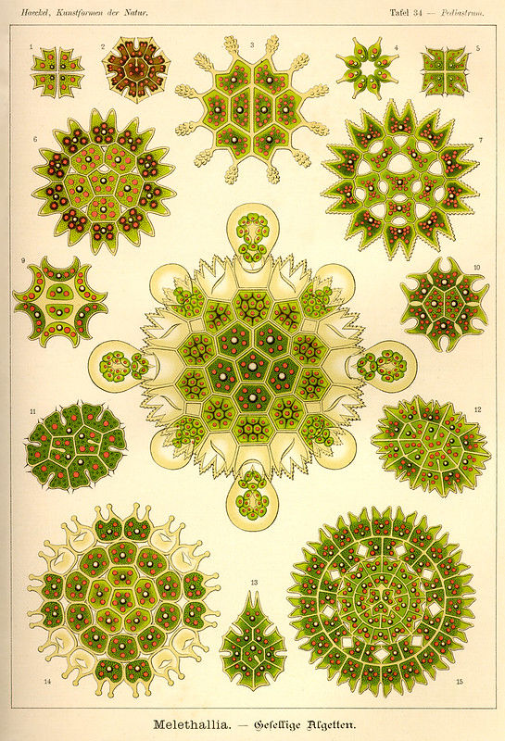
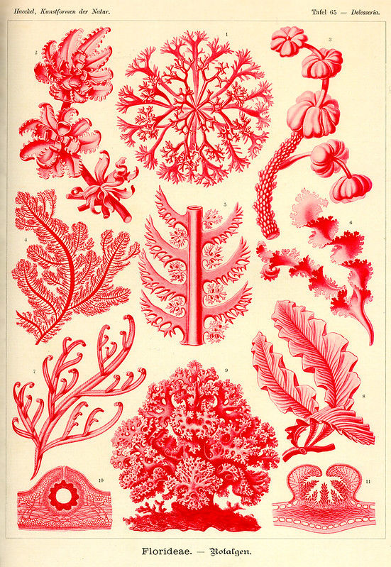
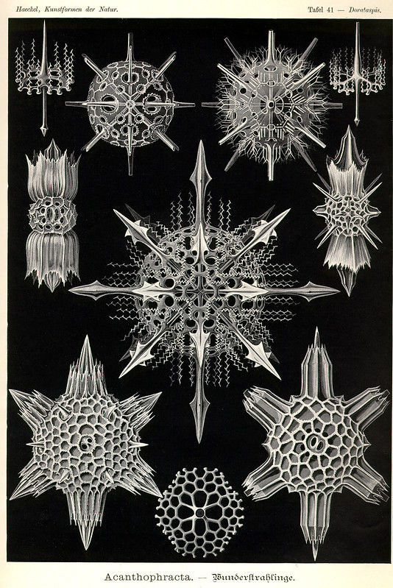
Education of the senses
Kunstformen der Natur
Ernst Haeckel, 1904
Drawing from nature, by direct observation, under the microscope, or from illustrated books.

Slide 8
100 years of Bauhaus
preliminary course

Slide 9
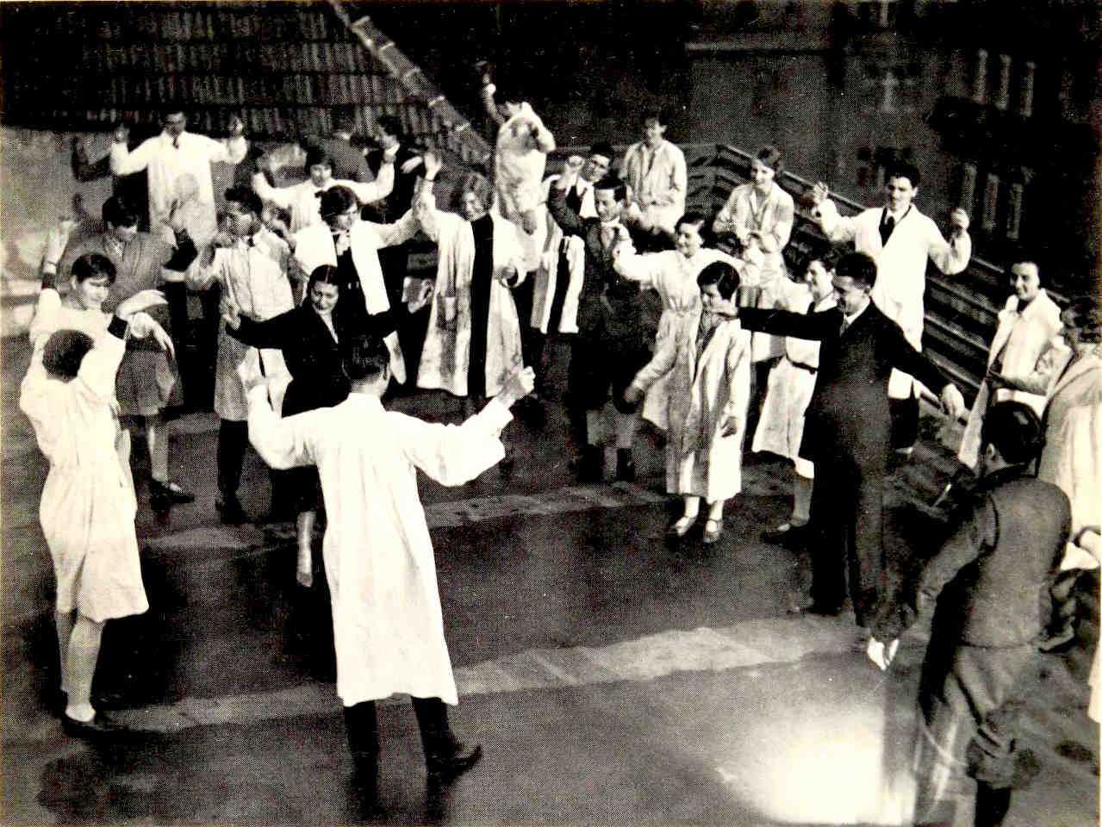
Johannes Itten
basic course from 1919 to 1923
Relaxation of the body through movements, dance, focus at rest, breathing and chanting of tones.
Warm-up activities, similar to today’s practice of yoga.

Slide 10
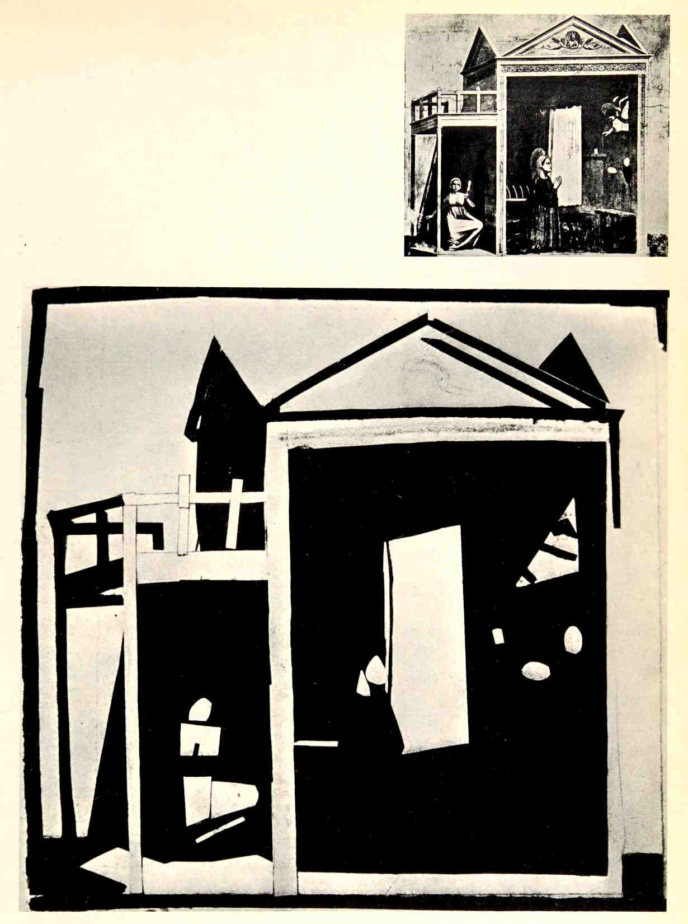
Johannes Itten
basic course from 1919 to 1923
Study of light–dark contrast
Revealing analysis of paintings copied in contrasting values.

Slide 11
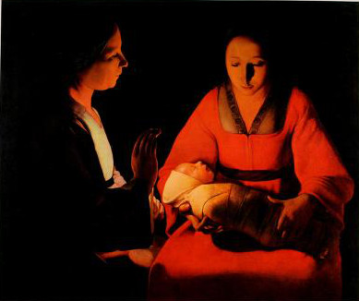
Johannes Itten
basic course from 1919 to 1923
Study of colour contrasts
• hue
• light–dark
• cold–warm
• complementary
• simultaneous
• saturation
• extension (size of areas)

Slide 12
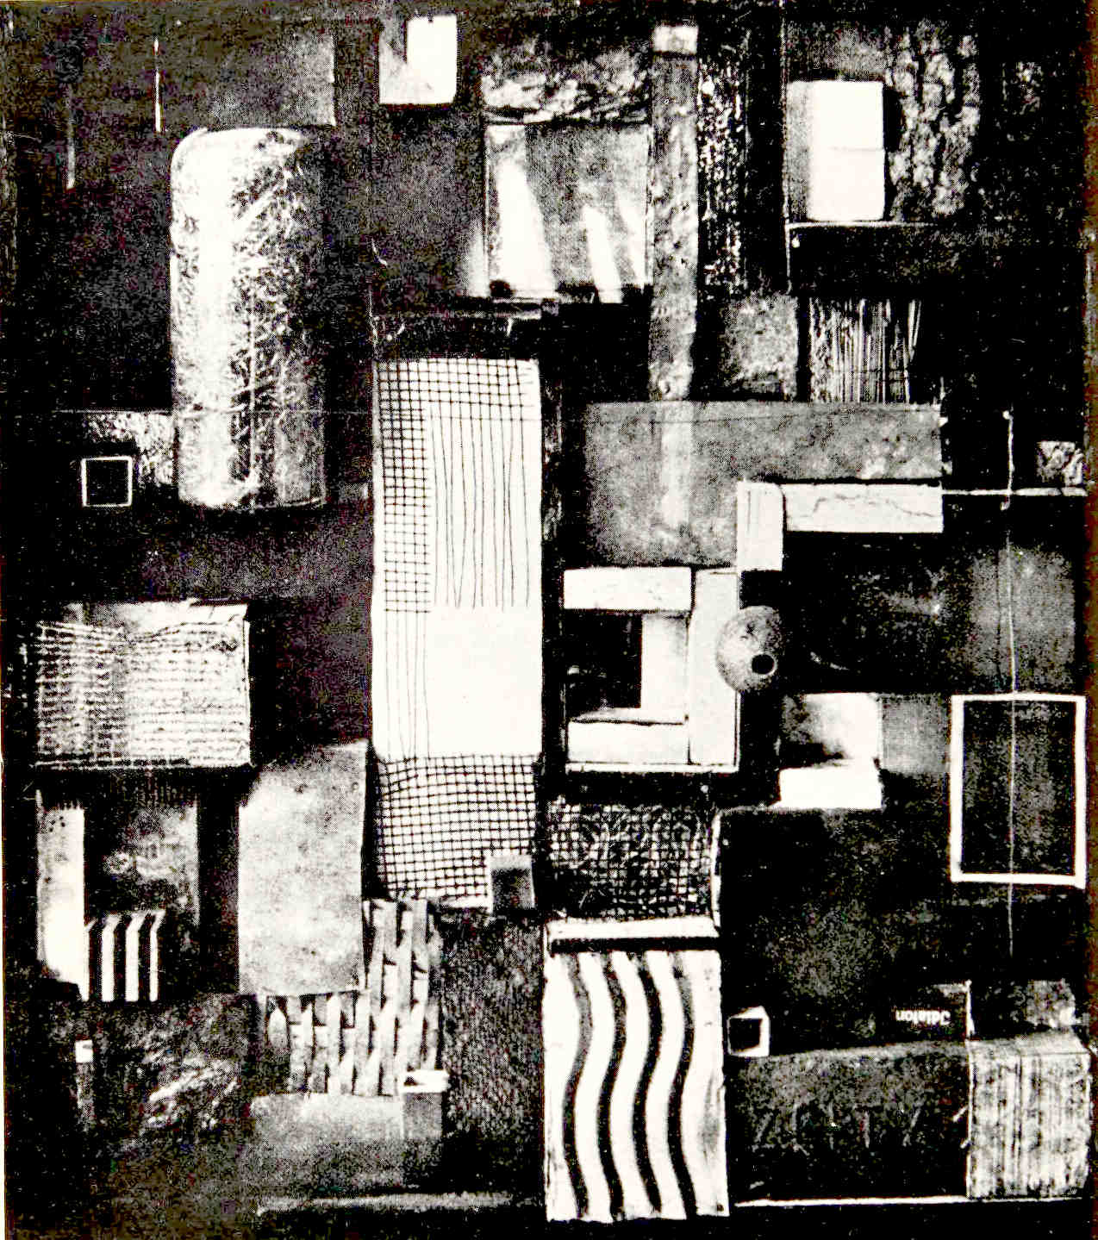
Johannes Itten
basic course from 1919 to 1923
Study of materials and textures
Creation of compositions of contrasting textures.
Education of feeling of textures from the fingertips.

Slide 13
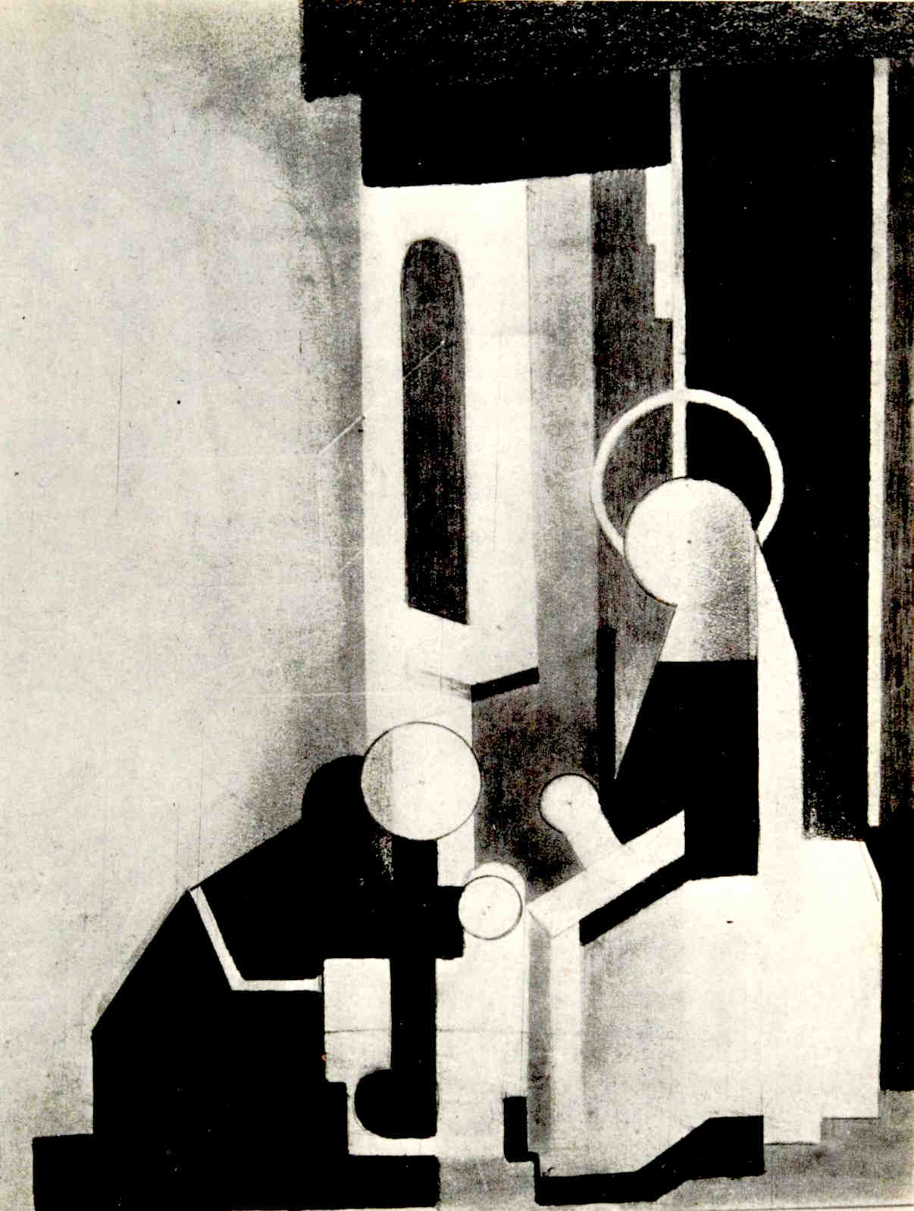
Johannes Itten
basic course from 1919 to 1923
Study of form
Experience of form, e.g. circles, through movements of the arms.
Compositions of basic shapes: circle, triangle, square.
Copy of artworks using shapes.

Slide 14
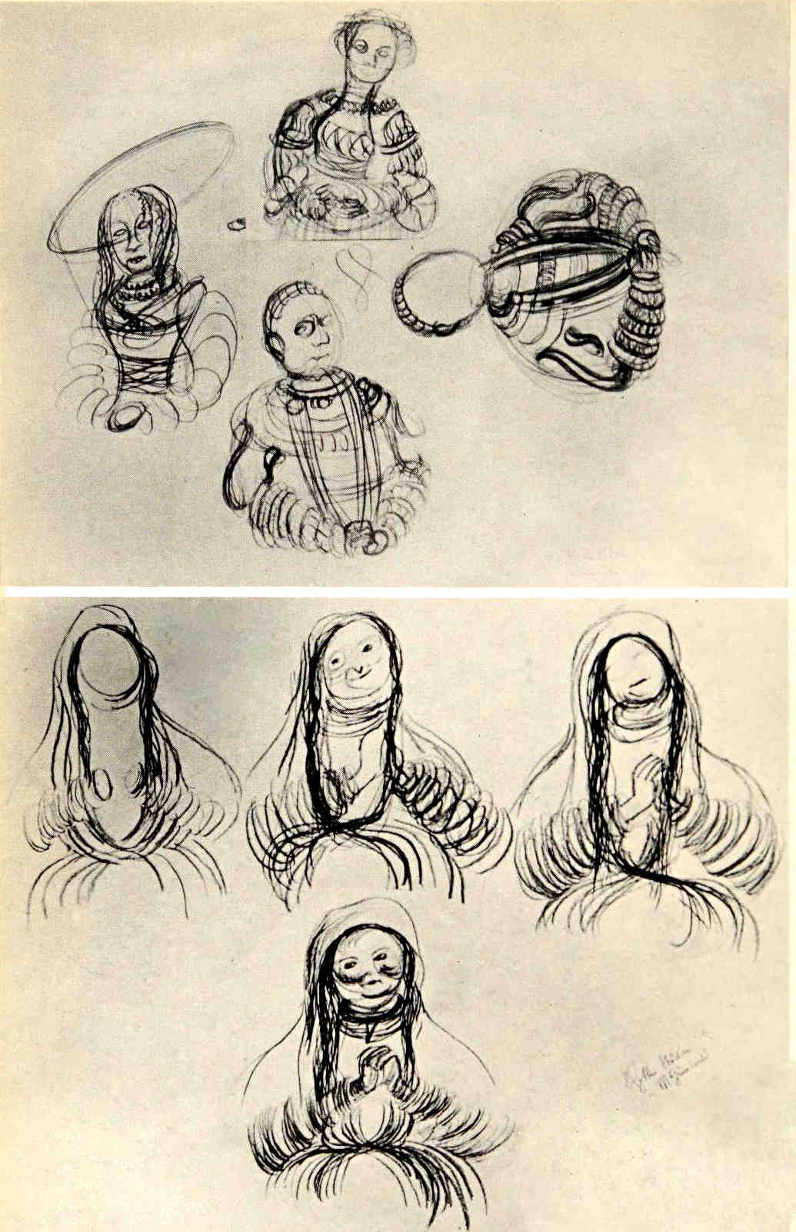
Johannes Itten
basic course from 1919 to 1923
Study of repetition & rhythm
Marching and beating hands.
Repeated drawing slower, faster.
Drawing in uninterrupted motion.
Analysis of artworks as rhythmic elements.

Slide 15
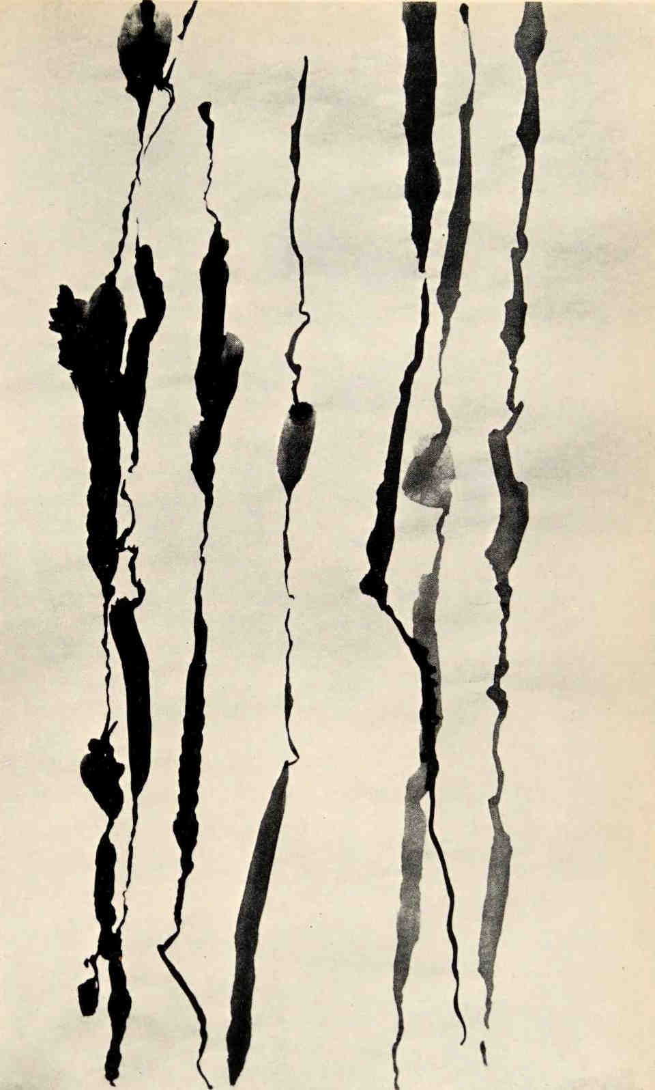
Johannes Itten
basic course from 1919 to 1923
Expressive lines & shapes
Expression of emotions through a free flowing line drawing.
Drawing of actions described as a noun + adjective:
• Roaring Tiger,
• Fighting Dogs…

Slide 16
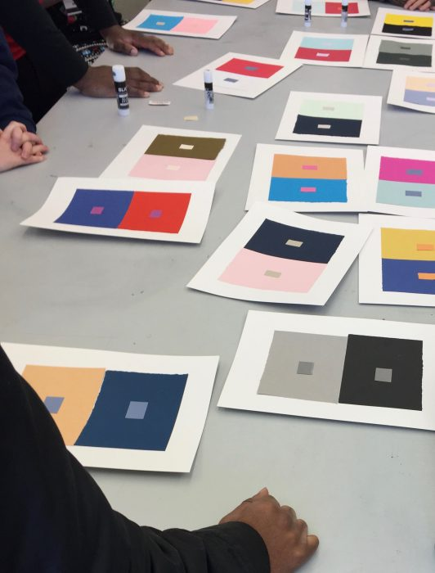
Josef Albers
assistant of Moholy-Nagy 1923–1928 then basic course teacher 1928–1933
Study of colour contrasts
Cut strips of coloured paper.
Observe how two identical strips of colour become two different colours on different backgrounds.

Slide 17
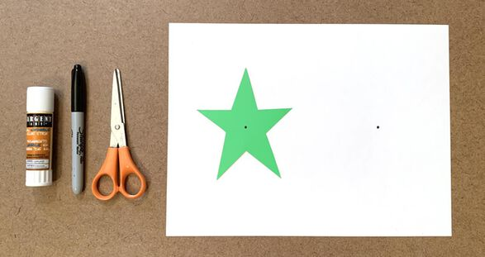
Josef Albers
assistant of Moholy-Nagy 1923–1928 then basic course teacher 1928–1933
Study of colour deception
Stare at the black dot in the middle of the coloured figure.
Focus longer than comfortable.
Then shift focus to the black dot in the middle of the white area.
A coloured after-image appears.

Slide 18
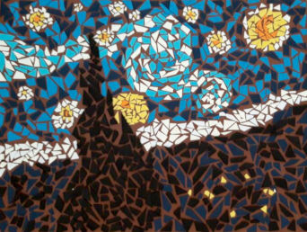
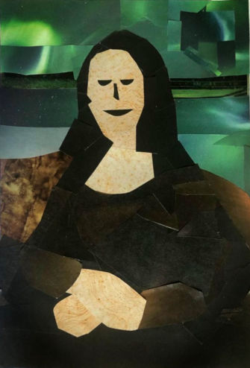
Josef Albers
assistant of Moholy-Nagy 1923–1928 then basic course teacher 1928–1933
Recreating masterworks
Collect and compose strips of paper to recreate the colour impression of masterworks.
Aim to reproduce the effects of colour juxtapositions rather than details of the composition.

Slide 19
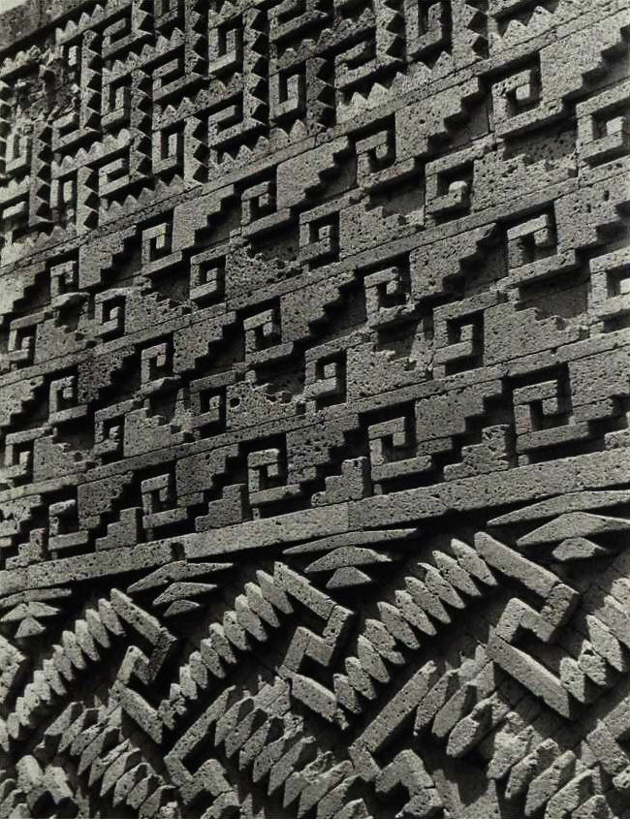
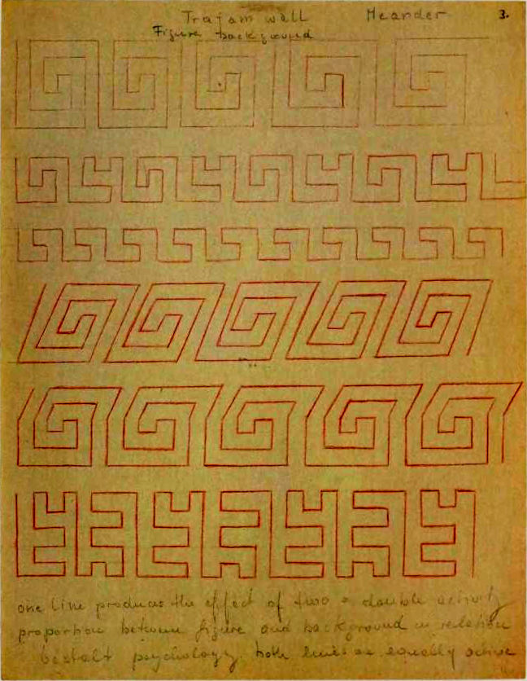
Josef Albers
Black Mountain College 1933–1949
Yale University 1950–1958
Study of figure-ground
& negative shapes
Visualize and draw Greek and pre-Columbian meanders as a single line, without lifting the pen. Observe how a different space is created on each side of the line.

Slide 20
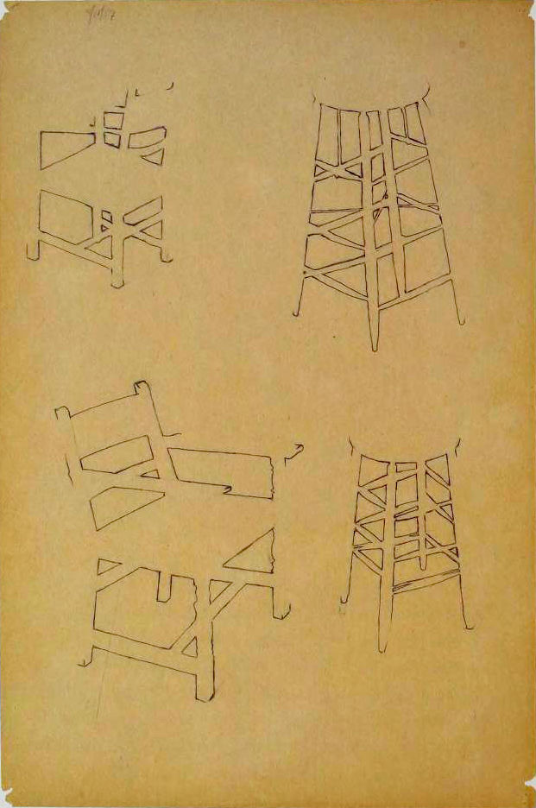
Josef Albers
Black Mountain College 1933–1949
Yale University 1950–1958
Study of figure-ground
& negative shapes
Observe and draw the space found between objects or parts of objects: chairs, plants, bottles.

Slide 21
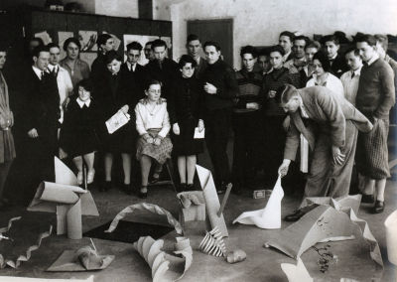
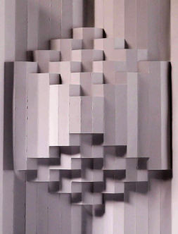
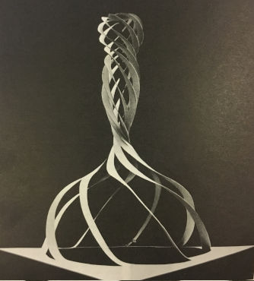
Josef Albers
Black Mountain College 1933–1949
Yale University 1950–1958
Material study of paper
Bend and cut paper using only your hands to create surprising structures. Study and reproduce the structures created by others. Explore the constraints of paper as a material, pushed to the limit.

Slide 22
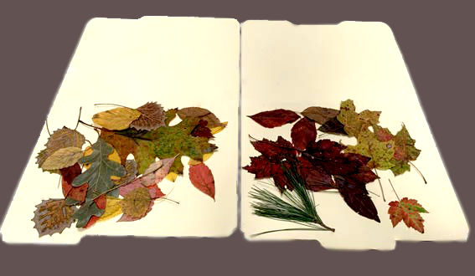
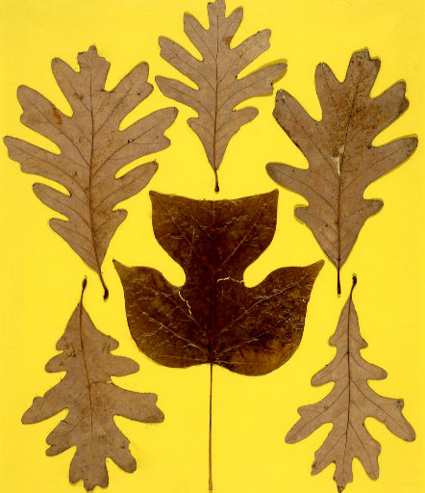
Josef Albers
Black Mountain College 1933–1949
Yale University 1950–1958
Material study of leaves
Collect autumn leaves of various sizes, shapes and colours. Dry them flat under a heavy book. Create an abstract composition which emphasizes contrasts.

Slide 23
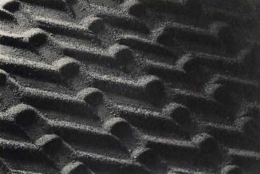
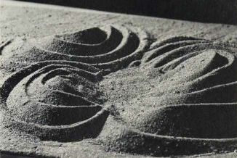
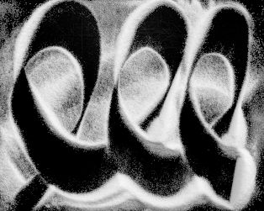
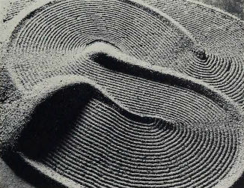
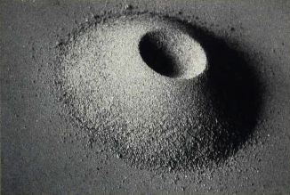
Josef Albers
Black Mountain College 1933–1949
Yale University 1950–1958
Material study of sand
Draw with white sand or salt on black paper, using your fingers.
Take pictures at different stages of the drawing until finished.

Slide 24
Ways of Seeing
Images of Power
& Power of Images

Slide 25
Camera & Painting
Episode 1 of the BBC TV Series,
John Berger & Mike Dibb, 1972
• The moving eye
• Invention of the camera
• Reproductions

Slide 26
Women & Art
Episode 2 of the BBC TV Series,
John Berger & Mike Dibb, 1972
Provident quidem necessitatibus nostrum. Est at est dicta quia corporis nostrum. Neque iste nihil nihil qui iusto ex ad. Modi voluptatum qui laborum.

Slide 27
Painting & Possessions
Episode 3 of the BBC TV Series,
John Berger & Mike Dibb, 1972
Provident quidem necessitatibus nostrum. Est at est dicta quia corporis nostrum. Neque iste nihil nihil qui iusto ex ad. Modi voluptatum qui laborum.

Slide 28
Fine Arts & Commerce
Episode 4 of the BBC TV Series,
John Berger & Mike Dibb, 1972
Provident quidem necessitatibus nostrum. Est at est dicta quia corporis nostrum. Neque iste nihil nihil qui iusto ex ad. Modi voluptatum qui laborum.

Slide 29
Ways of Seeing Book
7 essays adapted from BBC TV series, John Berger, Sven Blomberg,
Chris Fox, Michael Dibb,
Richard Hollis, 1972.
Provident quidem necessitatibus nostrum. Est at est dicta quia corporis nostrum. Neque iste nihil nihil qui iusto ex ad. Modi voluptatum qui laborum.

Slide 30
Learning
^{to} Play
Toys & games

Slide 31
Art History Courses
Provident quidem necessitatibus nostrum. Est at est dicta quia corporis nostrum. Neque iste nihil nihil qui iusto ex ad. Modi voluptatum qui laborum.

Slide 32
Learning
^{to} SEE
Observation
& Analysis

Slide 33
Art History Courses
Provident quidem necessitatibus nostrum. Est at est dicta quia corporis nostrum. Neque iste nihil nihil qui iusto ex ad. Modi voluptatum qui laborum.

Slide 34
Learning
^{to} KNOW
Encyclopedias
& Monographs

Slide 35
Art History Courses
Provident quidem necessitatibus nostrum. Est at est dicta quia corporis nostrum. Neque iste nihil nihil qui iusto ex ad. Modi voluptatum qui laborum.

Slide 36
Learning
Stories
All the world’s a stage

Slide 37
Art History Courses
Provident quidem necessitatibus nostrum. Est at est dicta quia corporis nostrum. Neque iste nihil nihil qui iusto ex ad. Modi voluptatum qui laborum.

Slide 38
Travelling
Museums
in a box, in a truck

Slide 39
Art History Courses
Provident quidem necessitatibus nostrum. Est at est dicta quia corporis nostrum. Neque iste nihil nihil qui iusto ex ad. Modi voluptatum qui laborum.

Slide 40
How to Visit an Art Museum
A Spectator is an Artist Too

Slide 41
Art History Courses
Provident quidem necessitatibus nostrum. Est at est dicta quia corporis nostrum. Neque iste nihil nihil qui iusto ex ad. Modi voluptatum qui laborum.

Slide 42
Your turn
Share ideas & comments eric@culture.graphics
Illumination from the Rupertsberger codex (circa 1151) showing Hildegard von Bingen dictating a vision to Volmar.
All pictures in this document link back to their source.

